Slide 1
Benefits down to earth
Switch to Space 2 – Topic 8: Satellites you use them everyday
Pascal Claudel, Reinhard Blasi
14 October 2020, online event

Slide 2
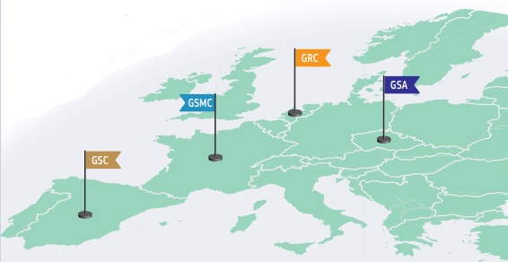




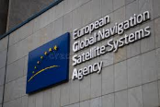
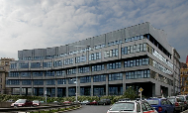
The GSA is responsible for market development and management of Galileo and EGNOS
Operational agency for the European Navigation Satellite systems
  Key player in building Europe’s independent capacity in satellite navigation
  Delivery of safe and secure satellite services 24/7
  For civil, commercial, governmental
  stakeholders
  Provide market development for EGNSS programmes
  Stimulate the development of business and companies
GSA LO
EGNOS
Our mantra:
Linking Space to user needs

Slide 3


The GSA is responsible for market development and management of Galileo and EGNOS
Operational agency for the European Navigation Satellite systems
GSA LO
EGNOS
Our mantra:
Linking Space to user needs

Slide 4
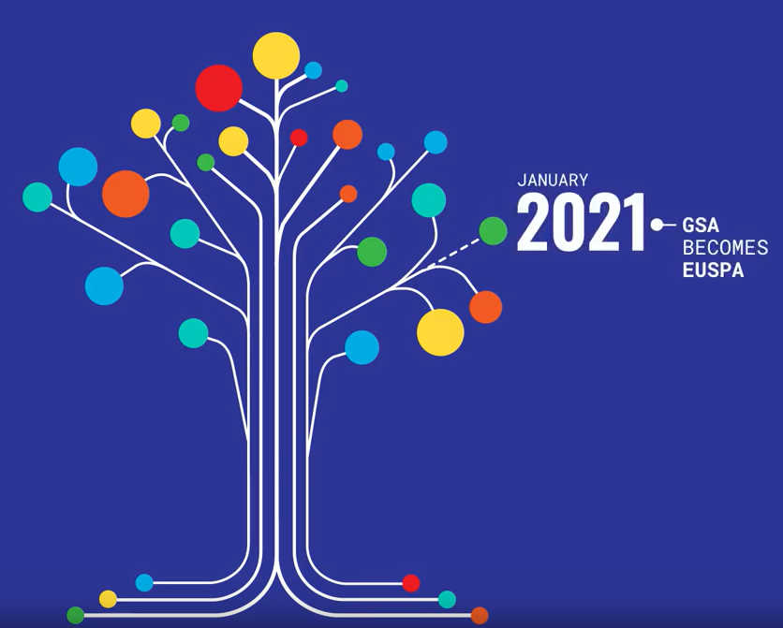

From GSA to EUSPA
1 January 2021
With the new regulation, space data is at the heart of a technological revolution
EU space activities under one umbrella:
Copernicus
Galileo
EGNOS
SSA
EU GovSatcom
Earth Observation (EO) and monitoring based on satellite and non-space data
Nr.1 world provider of space data and information
Global satellite navigation and positioning system (GNSS)
10% of the EU GDP is enabled by satellite navigation
Makes navigation signals more accurate and reliable
Operational in 350+ airports
Space Situational Aawareness monitors and protects space assets. Providing surveillance and tracking services to 129 European satellites
Secures satellite communications for EU security actors
In GSA ppt(s) I have seen so far we always presented 6-7%

Slide 5
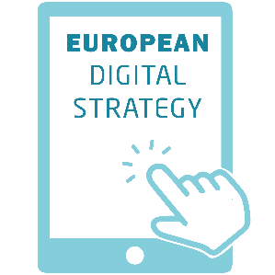

From GSA to EUSPA
1 January 2021
With the new regulation, space data is at the heart of a technological revolution
EU Space components and its joint use support the EU key priorities:
Example
Space data associated with AI, IoT, quantum computing, etc.
New markets
Huge opportunities for all MS
and their industry, SMEs and start-ups

Slide 6


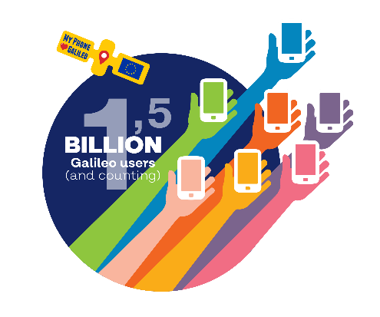
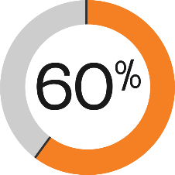
Boosting the economy
30+ EU-owned satellites in orbit for EO and GNSS
EU Investment in space
European space industry supports 250.000 + jobs
With a value added estimated at
€ 46-54 billion
Over 1.5 billion Galileo enabled devices
Copernicus data is used by 60% of the European EO companies
enabling over 10% of the income in the sector
€16
billion
€11
billion
€5
billion
2007-2013
2014-2020
2021-2027*
*Proposed budget for 2021-2027
Is it still true for a budget?

Slide 7

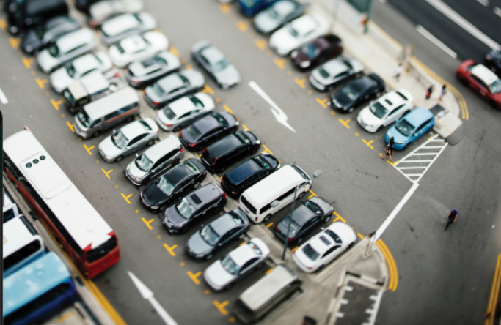



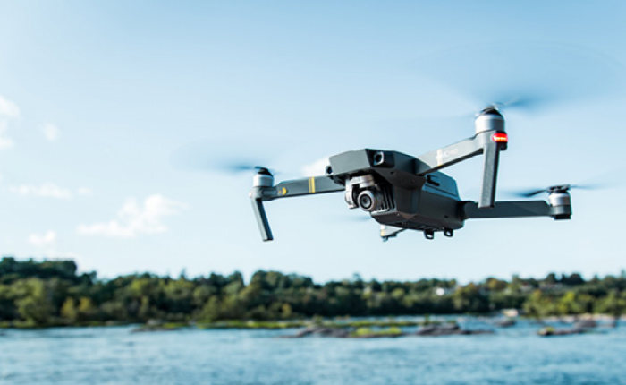
An enabler for the digital and green transition
The EU Space Programme provides critical infrastructure for the digital and green transformation
Space data is a key enabler of digital innovations such as Autonomous vehicles, smart solutions and 5G wireless telecommunication networks
Example
Galileo High Accuracy Service
<20cm positioning accuracy
Global coverage, open and free of charge
Game changer for autonomous driving and commercial drones
Copernicus
16TB data/day
Used to train Artificial Intelligence / enables big data analytics in many areas of application
AI
Credit: icons freepik

Slide 8






Some areas of EU space-based applications
The EU Space Programme is an enabler for precision agriculture and integrated farming solutions
Earth observation and satellite navigation can help farmers increase yields by more then 10% and save up to 20% on fertilizer, fuel and pesticides
EGNOS and Galileo increase precision and reliability of GNSS and is a key enabler of autonomous tractors and robots in agriculture
Response to Natural disasters
The EU Space Programme supports rescue operations during floods, fires, earthquakes and hurricanes as well as man-made disasters
Copernicus Earth Observation and Galileo positioning are crucial for urban mapping, planning and infrastructure monitoring. They enable smart mobility and waste management
Renewable Energies
EU Space programmes support the siting of renewable energy facilities assessing potential energy generation and environmental impacts
Health
Thanks to Copernicus it is possible to forecast air quality and UV radiation having impact on our health
NO²
Credit: icons freepik

Slide 9







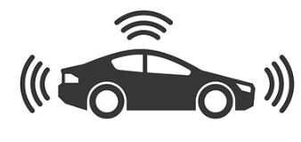



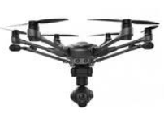



Zooming in on GNSS
Towards ubiquitous GNSS positioning
Consumer solutions
Road
Aviation
Rail
Maritime
Agriculture
Geomatics
Timing
GNSS play an important role across many markets
IoT
Augmented Reality
Autonomous Cars
Drones
Swarm Robotics
Big Data
mHealth
GNSS plays a role in all major technology trends and emerging apps

Slide 10
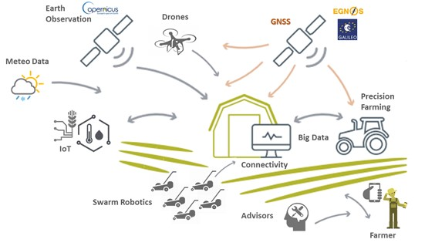

GNSS and EO are the core components in the digital farming ecosystem (Agriculture 4.0)
Example 1
GNSS and EO are examples out of many elements in the complete production system, although an eminently important one

Slide 11
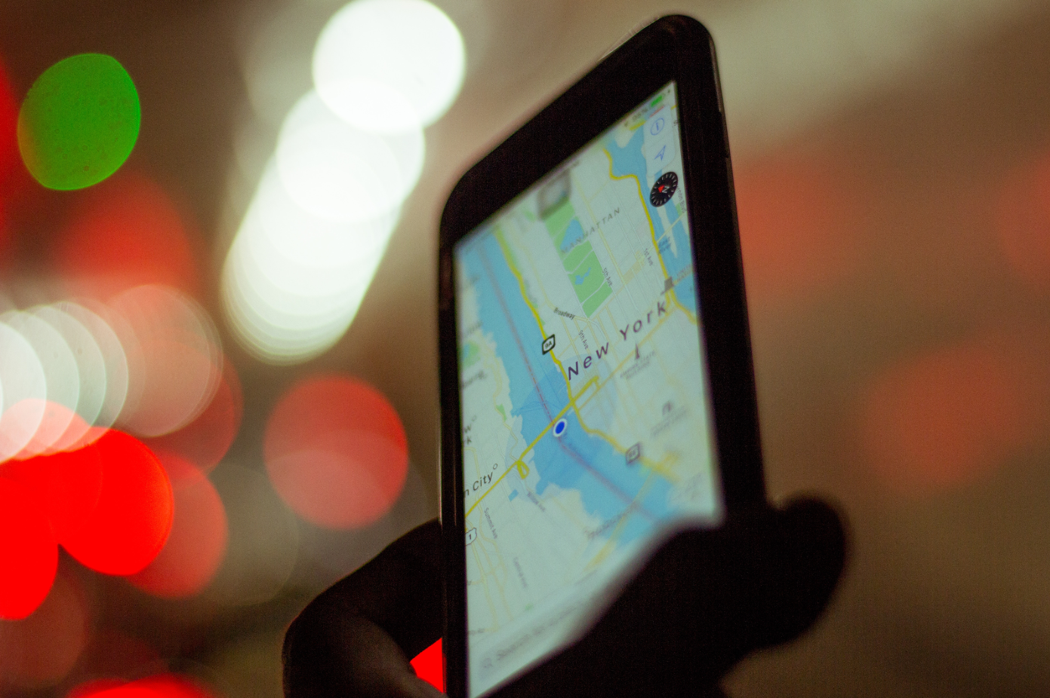
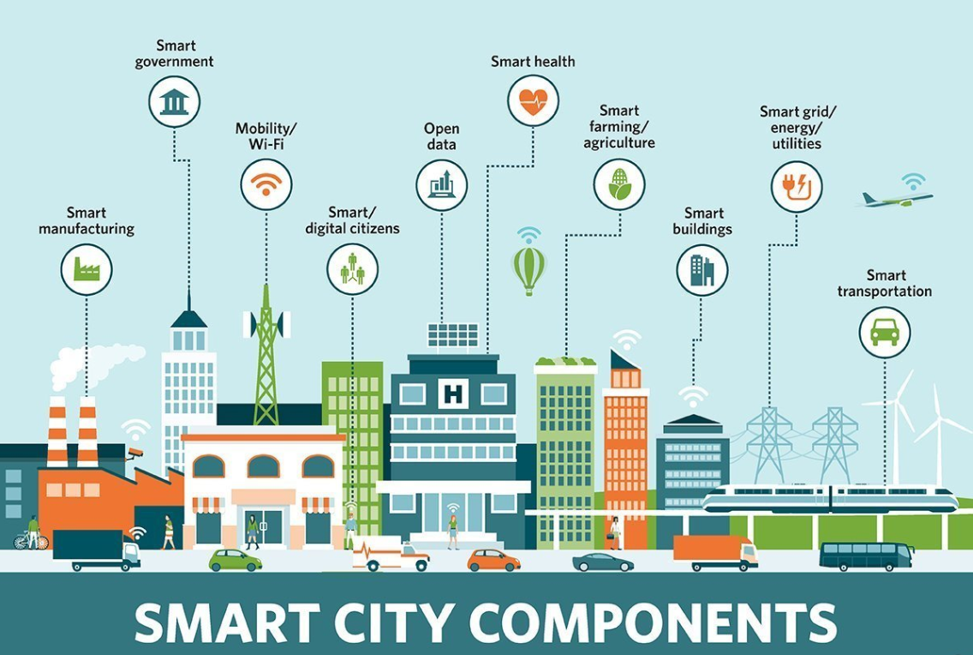

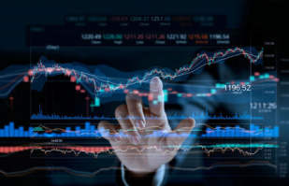
GNSS enabling ‘’Smart’’ everything
Example 2
Ubiquitous location
Ubiquitous sensing
Ubiquitous communications
GNSS in the forefront: Location (+ Navigation)
  GNSS #1 technology for location and navigation
P+N
GNSS in the background
  Sensing: In a ever changing environment, sensor data must be accurately time stamped to provide real situation awareness
  GNSS #1 technology for time stamping
T
  Communications: Digital networks need to be accurately synchronised
  GNSS #1 technology for network synchronisation
T&S
GNSS technology is everywhere in our cities
Image: https://internetofthingsagenda.techtarget.com/definition/smart-city

Slide 12












…and provide benefits to the EU citizens
Helps us
move……
Helps us
work……
Helps us
enjoy life……
TRANSPORT OF DANGEROUS GOODS
MAPPING AND SURVEYING
TRAFFIC MANAGEMENT
NAVIGATING IN THE CITY
TOURISM MADE EASY
AIRCRAFT LANDING
MARITIME NAVIGATION
PRECISION AGRICULTURE
… CATCHING POKEMONS!
SYNCHRONIZATION OF ENERGY NETWORKS
FOREST MANAGEMENT
CYCLING, HIKING, RUNNING
80,000 flight delays and 20,000 diversions avoided in Europe
15M tonnes of CO₂ saved
3.5 billion litres of fuel saved
4,500 tonnes of pesticides and 1.5mln tonnes of fertiliser saved
At least 800mln hours saved for Europe’s consumers and professionals
Nearly 50,000 annual jobs supported in the downstream
GNSS industry in Europe
Examples
Source: EGNSS CBA (London Economics)

Slide 13
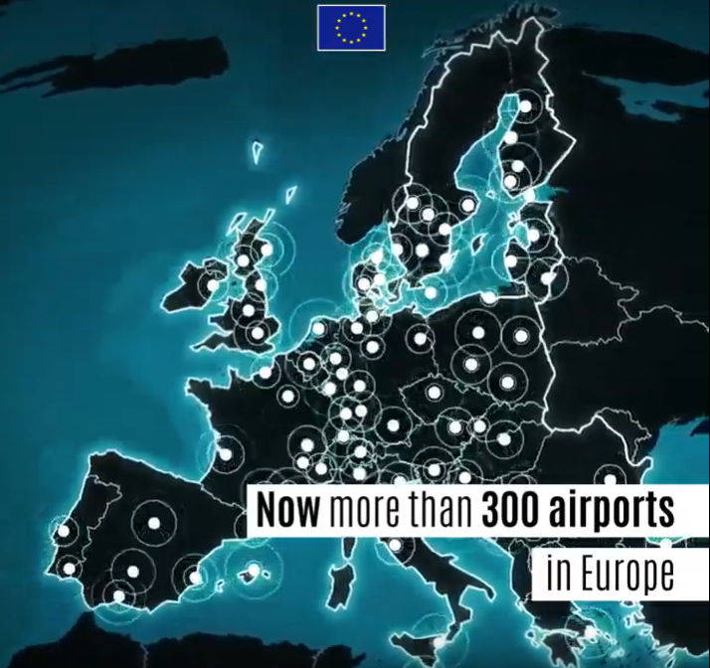
Galileo and EGNOS are widely used
More than 1.5 billion Galileo users
Around 97% of new tractors using GNSS are equipped with EGNOS, the preferred low-cost entry technology for precision farming in Europe
350+ airports in Europe are using EGNOS
All car models made after April 2018 are using Galileo-based emergency system eCall
90% of maritime receivers are EGNOS-enabled

Slide 14
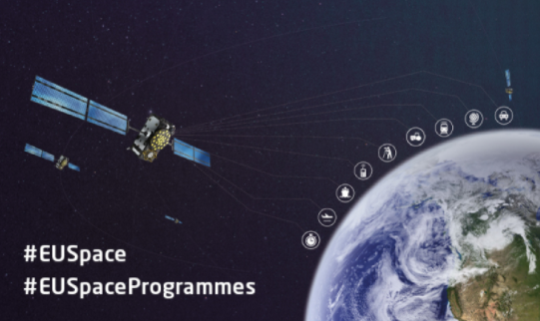
An investment in a future ready Europe
EU Space Programme provides established space technology, data and services indispensable in the lives of Europeans today.
In the future, it will address an increasing range of EU ambitions and priorities:
Competitive edge
Completion of current satellite constellation, development and launch of next-generation satellites
Research innovation
The ambitious research and innovation programme to succeed Horizon 2020
Fighting Climate Change
Monitoring biodiversity, environmental compliance and CO² emissions
(Paris Agreement)
EU as a global actor
Support disaster relief, humanitarian assistance and security operations

Slide 15
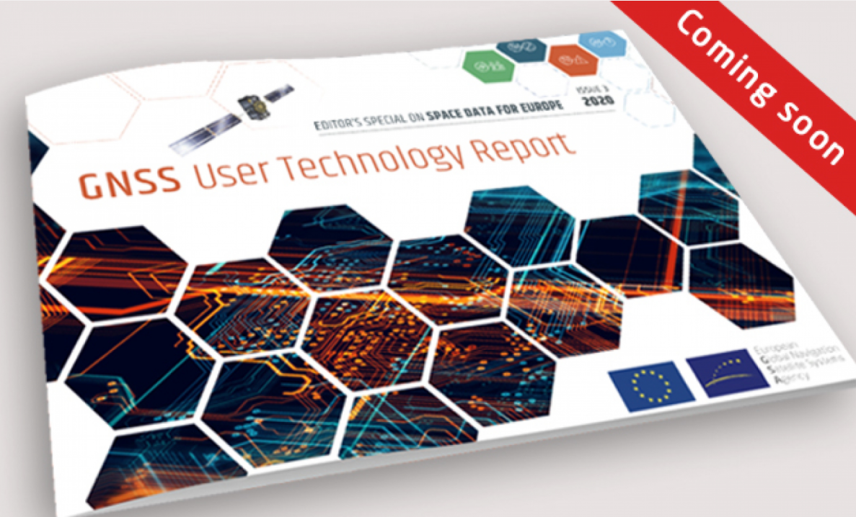
The European GNSS Agency’s (GSA) User Technology Report 2020 is on the horizon
  Present an overview of the current GNSS user technology trends and developments across four macrosegments:
  High volume devices
  Safety- and liability-critical devices
  High-accuracy devices
  Timing devices
  With over 7500 downloads the report is referenced by industry and decision-makers
To be among the first ones to download the publication register here:
https://www.gsa.europa.eu/gnss-user-technology-report-issue-3

Slide 16







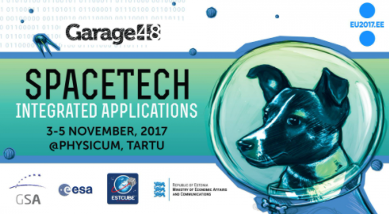

GSA – a fairly deep pool of opportunities for students young innovators, start-ups and SMEs (1/2)

Slide 17





GSA – a fairly deep pool of opportunities for students young innovators, start-ups and SMEs (2/2)
Offer Creation
Creation of new “made in Europe” products and services
H2020 Green Deal Call
Harnessing Galileo, EGNOS and Copernicus for a greener, smarter and more sustainable Europe
Indicative budget € 983 million
Just opened for submissions with a deadline on 26 January 2021

Slide 18
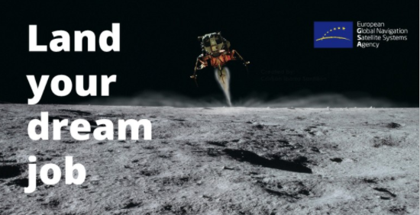

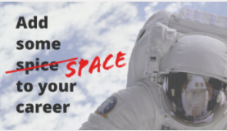
The European GNSS Agency is hiring
Join our #EUSpace team in Prague!
https://www.gsa.europa.eu/gsa/jobs-opportunities

Slide 19










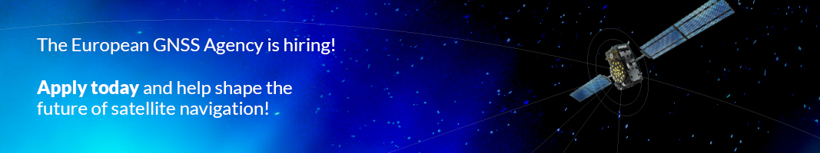
Linking space to user needs
How to get in touch:
www.GSA.europa.eu
EGNOS-portal.eu
GSC-europa.eu
G
UseGalileo.eu

