Slide 1
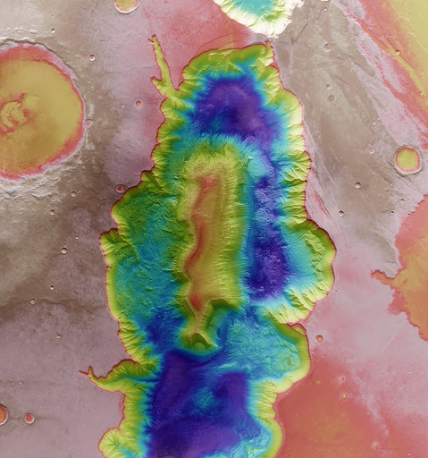
14 October 2020
Using space technologies to locate emergency calls :
Advanced Mobile Location
#switchtospace

Slide 2
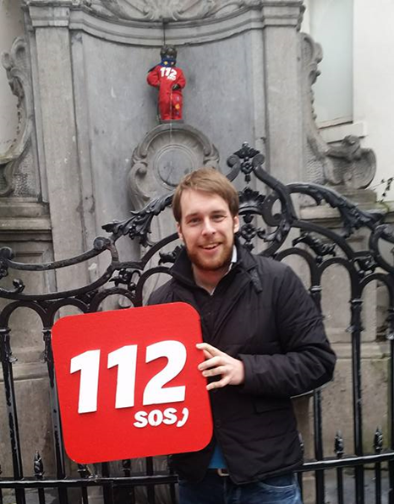
About EENA
Few words about me
EENA: European Emergency Number Association
Non-for-profit association
Mission: Improve the safety of the people
Discussion platform between public safety professionals.
Benoit Vivier, Public Affairs Manager
Studied politics & EU affairs in France, Belgium & Sweden
Joined EENA in September 2015
Following:
Legal and advocacy issues
Caller location of emergency communications
Public Warning Systems
SWITCH TO SPACE 2 • 2020

Slide 3
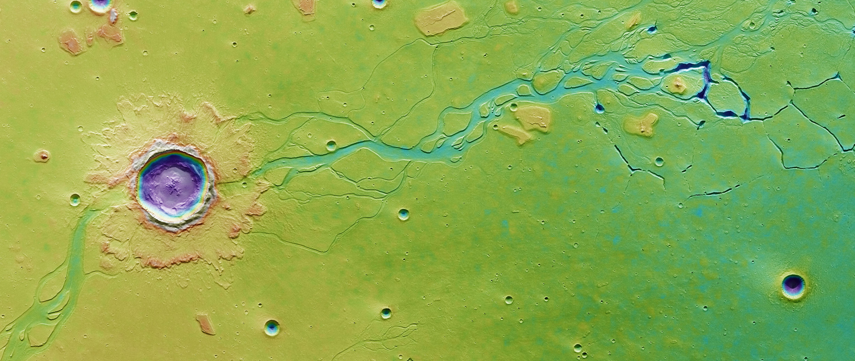
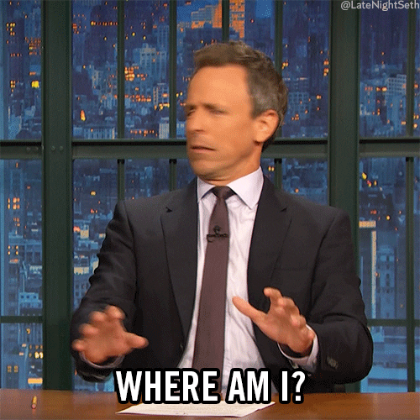
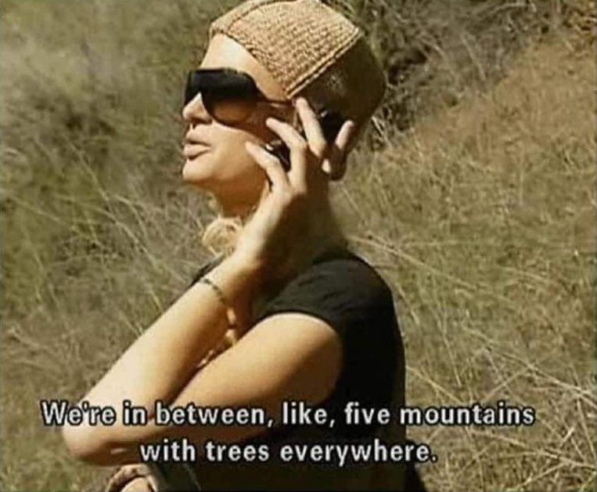
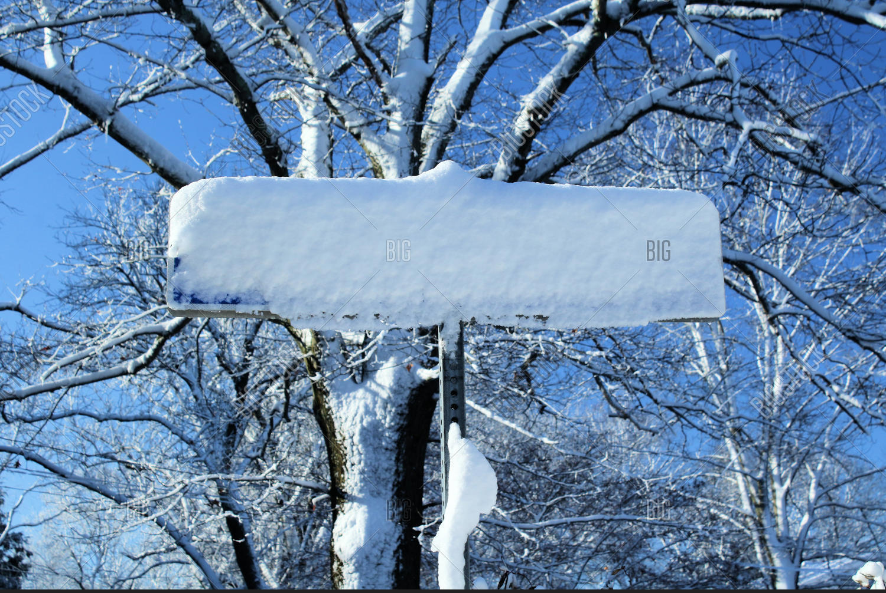
The issue of locating emergency calls
People calling emergency services are not always able to describe their exact location
Unfamiliar area
Psychological shock
Don’t know the name of the street
Remote area (countryside, mountains)
SWITCH TO SPACE 2 • 2020

Slide 4
The issue of locating emergency calls
People calling emergency services are not always able to describe their exact location
Language issues
Caller doesn’t want to give his/her location
Call dropping
Children calling
SWITCH TO SPACE 2 • 2020

Slide 5
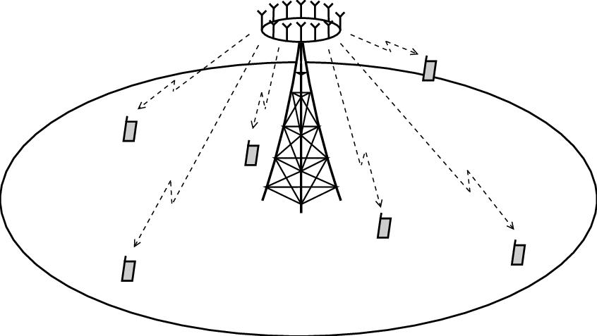
Landline phones
How emergency calls are located?
Located through the address of the subscriber
Mobile phones
Located through the near cell base station, which is particularly unprecise (2km in average)
SWITCH TO SPACE 2 • 2020

Slide 6
The issue of locating emergency calls
People calling emergency services are not always able to describe their exact location
This problem is increasing with the increased number of calls originated from mobile phones (about 70%).
In 2015, in the United Kingdom:
About 36,000 incidents per year involve searches of 30+ minutes because a mobile caller is unable to give location
SWITCH TO SPACE 2 • 2020

Slide 7
The issue of locating emergency calls
What if we could use our phone’s location data to locate emergency calls?
Meet… Advanced Mobile Location (AML)
SWITCH TO SPACE 2 • 2020

Slide 8
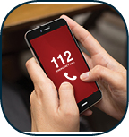
How does AML work?
AML automatically activated when an emergency call is placed
SWITCH TO SPACE 2 • 2020

Slide 9
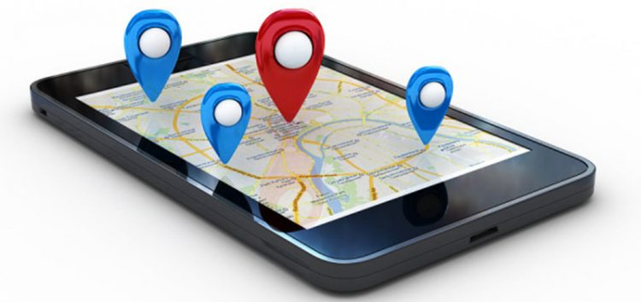
How does AML work?
Once AML is activated, the phone automatically determines the location (using GNSS, Wifi and Cell)
SWITCH TO SPACE 2 • 2020

Slide 10
How does AML work?
All is automated: no action is required from the caller
SWITCH TO SPACE 2 • 2020

Slide 11
How does it look like?
A”ML=1;lt=+55.74297;lg=-4.26880;rd=10;top=20130717175329;lc=95;pm=G;si=234302543446355;ei=356708041746734;mcc=234;mnc=30;ml=127
Header & Version
Latitude
Longitude
Radius
Time of Positioning
Level of Con-fidence
Positioning Method (GNSS)
IMSI
IMEI
MNC
Message Length
MCC
Content of an AML SMS
SWITCH TO SPACE 2 • 2020

Slide 12
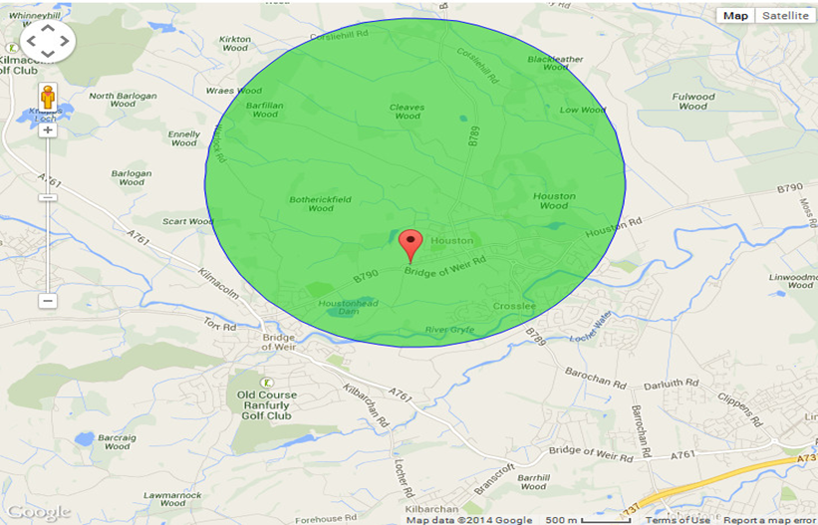
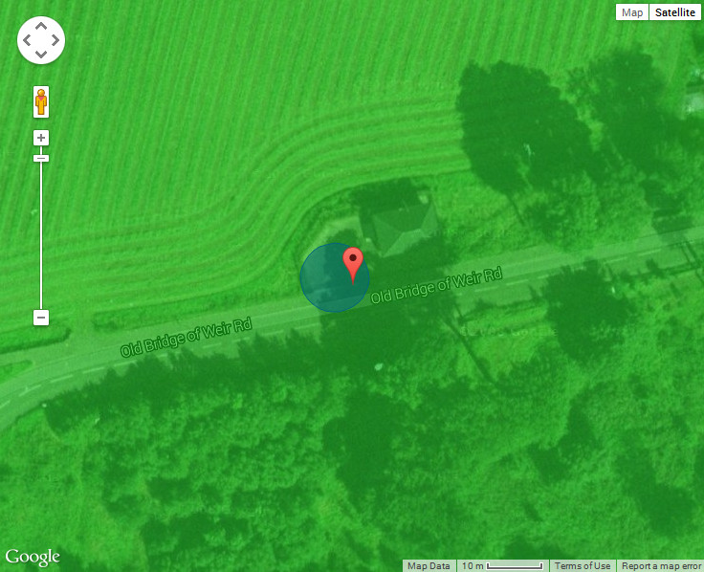
How does it look like?
In rural areas
Network-based location – location radius of 2024m.
Handset-based location – location radius of 6m. (GNSS)
SWITCH TO SPACE 2 • 2020

Slide 13
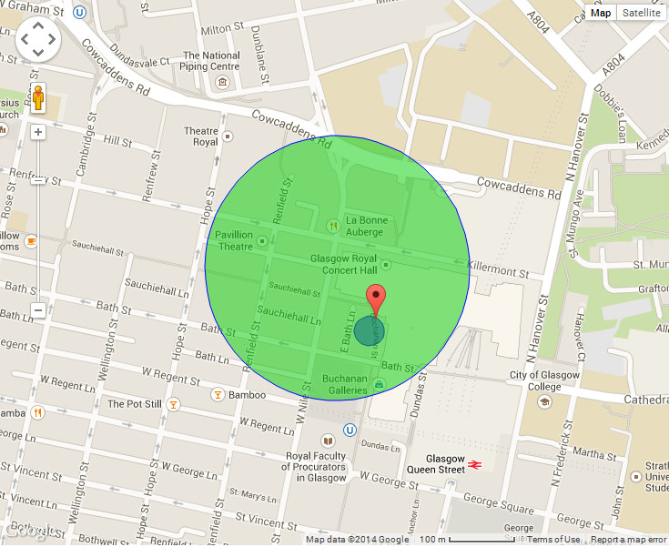
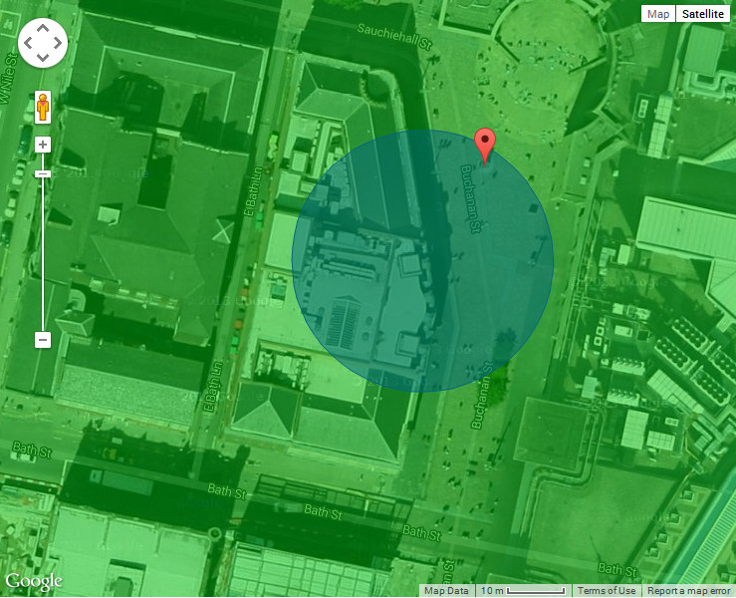
How does it look like?
In urban areas
Network-based location – location radius of 195m.
Handset-based location – location radius of 22m. (Wifi)
SWITCH TO SPACE 2 • 2020

Slide 14
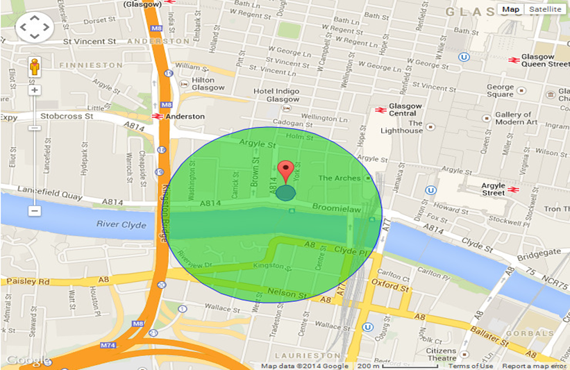
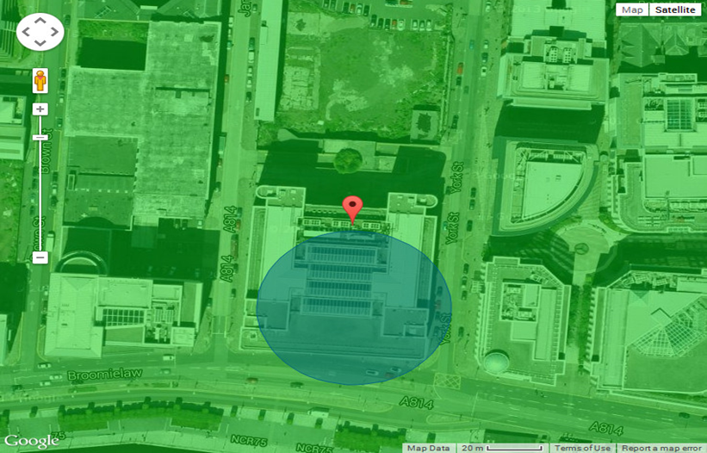
How does it look like?
In urban areas
Network-based location – location radius of 383m.
Handset-based location – location radius of 34m. (Wifi)
SWITCH TO SPACE 2 • 2020

Slide 15
Where is it activated?
SWITCH TO SPACE 2 • 2020

Slide 16
Where is it activated?
+
Mexico
New Zealand
United Arab Emirates
United States
 | AML deployed (Android + Apple)
 | AML partially deployed
 | Imminent deployment
SWITCH TO SPACE 2 • 2020

Slide 17
Lost hikers
Success stories
“A group tramping in the Bay of Plenty had become lost. One member of the group was injured and they had no food or water. They made a call to 111 from their mobile phone (which had a low battery). The call taker used the system to identify their location down to a six-metre radius. Police Search & Rescue were dispatched and the group was safely walked out of the bush a couple of hours later.”[NZ Gov]
Caller in panic
“A vehicle on fire with someone trapped. Bystander is in a panic and either does not know or cannot explain the location. Stage 1 call taker (ECAS) gives precise location to Stage 2 Fire Call taker, explaining the exact address and that the vehicle is in the grounds or carpark of a named hotel. Fire services respond immediately. Exact location is handed over in less than one minute.”[BT Ireland]
SWITCH TO SPACE 2 • 2020

Slide 18
Calls dropping
Success stories
“Bystander calls looking for fire but call drops before address is handed over. Stage 1 call taker (ECAS) gives precise location to Stage 2 Fire Call taker, explaining the exact address including house number and street. Ambulance respond immediately. The house on fire is a new one and Fire mapping records did not show it.”[BT Ireland]
Children not knowing their address
“An emergency call was received by PSAP. The caller, a 7-year old boy, reported he had found his father unconscious. He did not know his address or the telephone number of any of his relatives, and Cell-ID location information received by the emergency services had a radius of 14 km. Theoperator received a GNSS location via ELS with a radius of 6 meters. The police and ambulance services were dispatched to the location. The emergency responders provided acute medical care to the man who had likely been struck by an epileptic seizure”[112 Lithuania]
SWITCH TO SPACE 2 • 2020

Slide 19
Language issues
Success stories
“One of the best things is related to addresses that have foreign words in the names. We have a lot of those, because Finland is bilingual. For example, a caller can spell "Eekkerööntie" which can be in Finnish "Eckeröntie", "Ekeröntie" or in Swedish "Eckerövägen", "Ekerövägen". Those roads might be in different parts of Finland, so the possibility for a big mistake exists. Now the system shows the exact location and the spelling of the road in the map, so it saves a lot of time and keeps the call-taker´s focus on the call handling.”[112 Finland]
Caller with mental disabilities
“Vulnerable male with severe learning difficulty who had been robbed… call taker tried numerous times and ways to get a location, nothing forthcoming…then used lat/long and found the victim. It was later established that he had also been sexually assaulted for over a year by the suspect. Don’t know how would have been found without lat/long.”[BT UK]
SWITCH TO SPACE 2 • 2020

Slide 20
Suicidal calls
Success stories
“NZ Police received a call from a person who was having suicidal thoughts. The person let the operator know they were at a railway station, but hung up before the operator could get more information about their location. The call taker used AML to identify their location. The caller was identified as being on the train tracks, within a four-metre radius. Having this information meant the call was given high priority for a response, with Police dispatched to locate the person safely. The call taker was also able to notify train control to alert them to the issue.”[NZ Governmant]
Car accident
“Our operator told me his story about a car accident on the highway. The eyewitness called the emergency number. He was so terrified and confused that he wasn't able to provide information about location of accident. Fortunately, he knew approximate direction of the right location. AML has provide a quick response to the team rescues.”[112 Slovenia]
SWITCH TO SPACE 2 • 2020

Slide 21
Thank you for your attention
More info on: www.eena.org/aml
Email: aml@eena.org
Twitter: @BenoitVivier
SWITCH TO SPACE 2 • 2020

