Slide 1
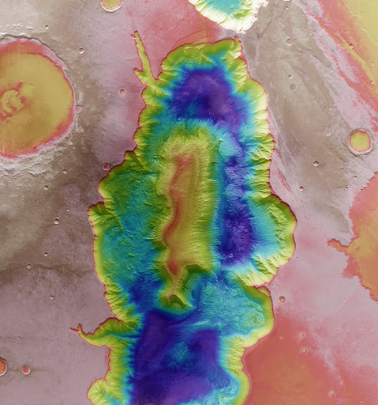
Maarten Baes
Our Universe: a 13.8 billion years old enigma
#switchtospace

Slide 3
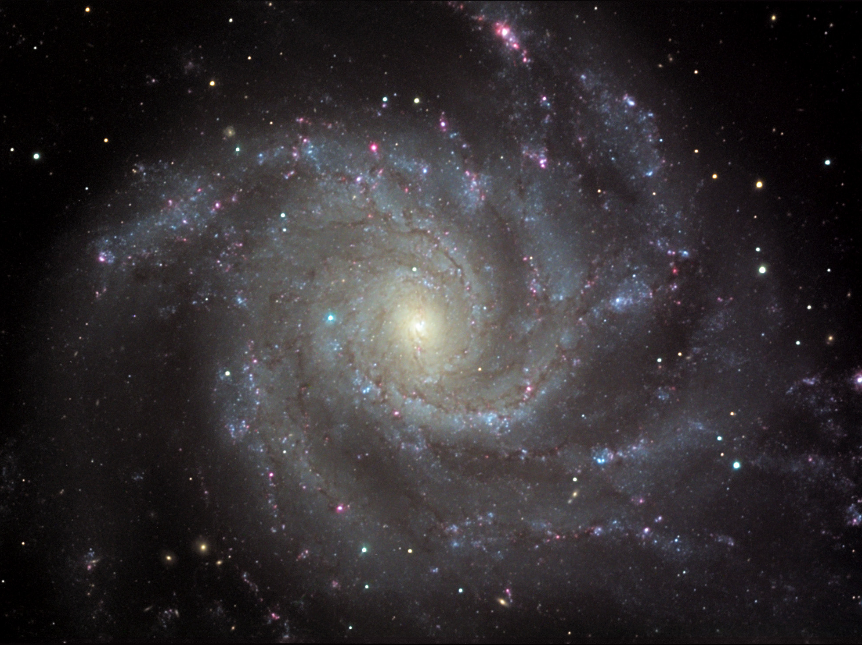

Slide 4
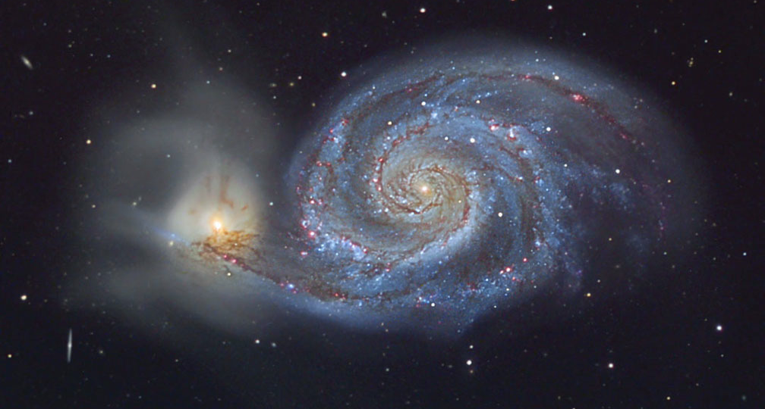

Slide 5
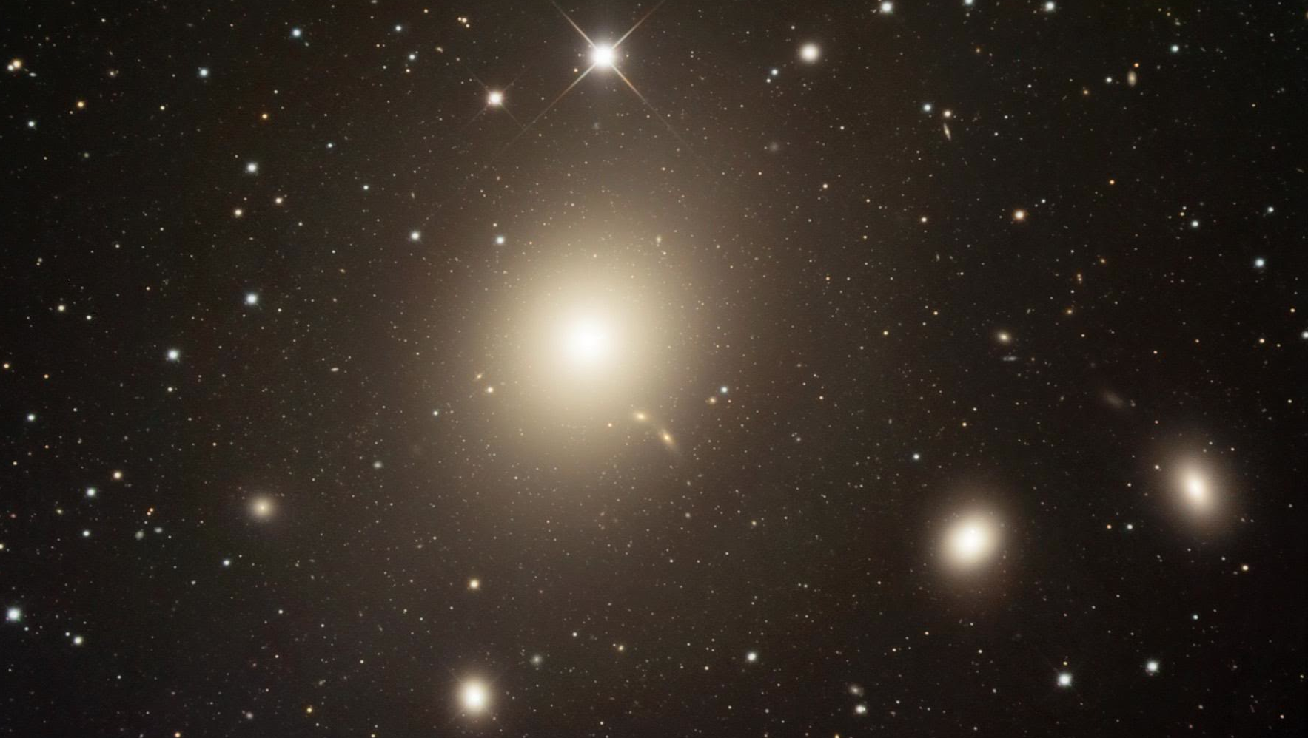

Slide 22
Maarten Baes
Our Universe: a 13.8 billion years old enigma
#switchtospace

