Slide 1
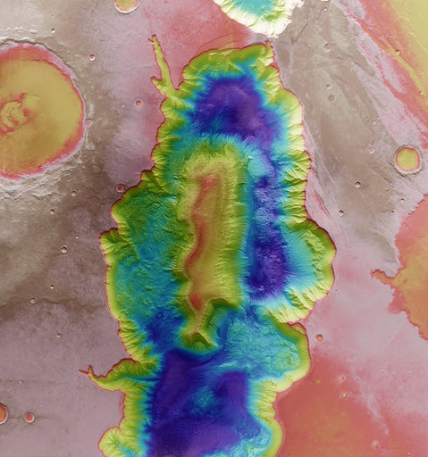



Understanding the formation and evolution of the solar system thanks to meteorites
Vinciane Debaille
#switchtospace

Slide 2
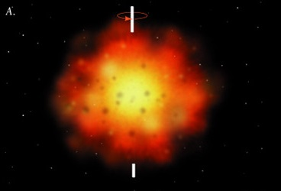
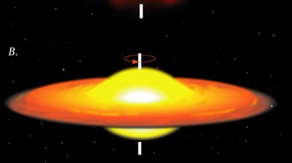
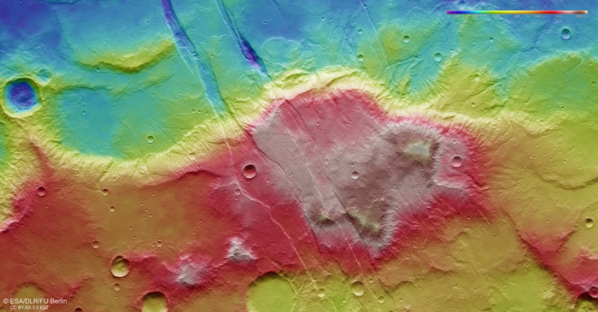
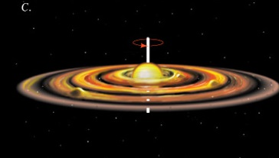
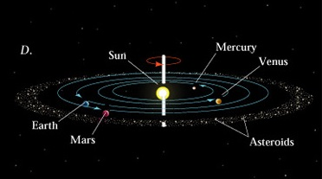
??
SWITCH TO SPACE 2 • 2020

Slide 3

SWITCH TO SPACE 2 • 2020
© Moulinsart

Slide 4
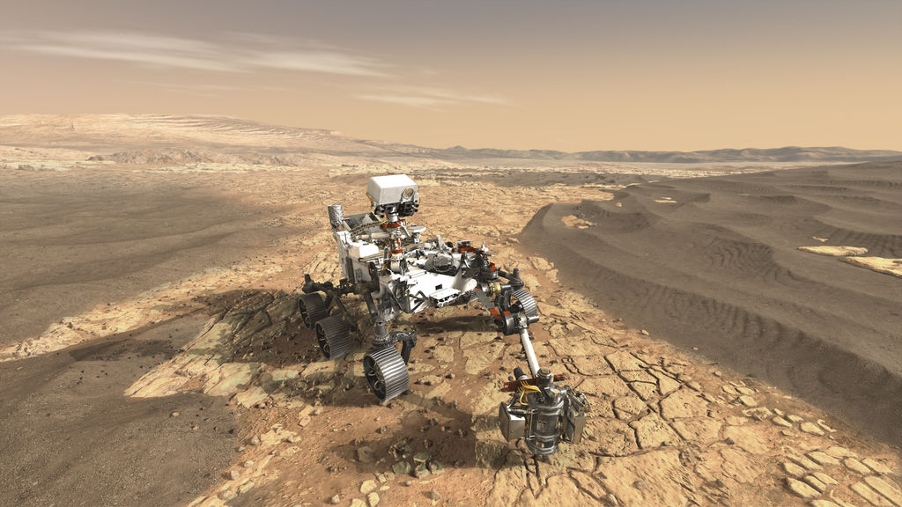
Mars 2020 Perseverance Rover
Arrival on Mars: Feb 2021
Samples coming back to Earth: ~2030
© NASA

Slide 5
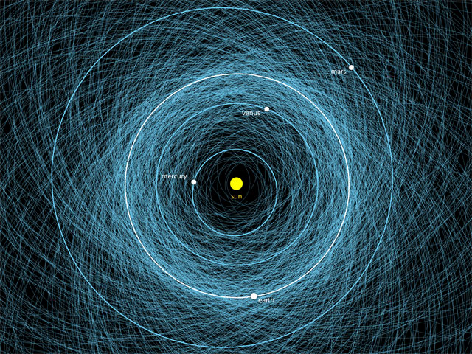
© NASA

Slide 6
Estimation of the annual flux of meteorites on Earth
Material | Estimation | Method
micrometeorites | ~40000 t | Impact on spacecraft
 | ~30000 t | Ir and¹⁸⁷Os/¹⁸⁸Os in sediments
meteorites | 4500 falls > 1 kg 13700 falls > 100 g | Photometry of fire balls
 | 1278-4906 falls > 1 kg 4855-16863 falls > 100 g | Find statistic in hot deserts
→ ~47000 tons of extraterrestrial material per year (85% as micrometeorites)

Slide 7
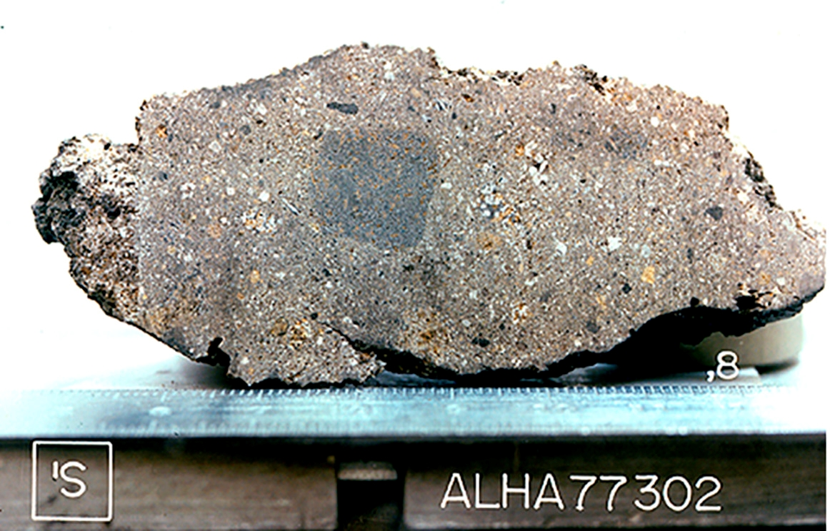
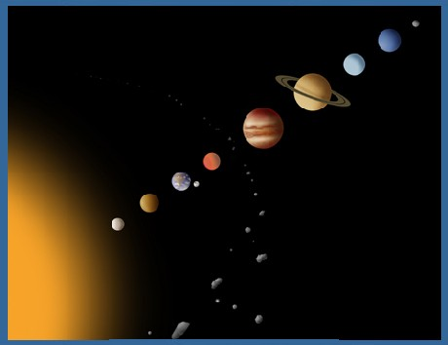
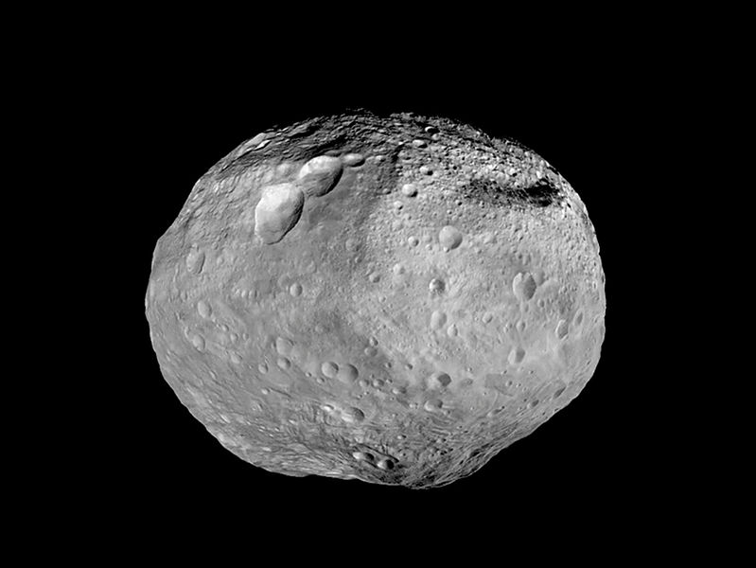
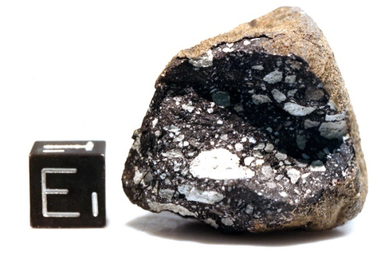
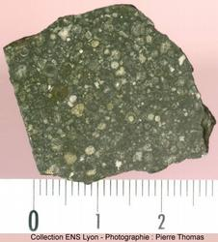
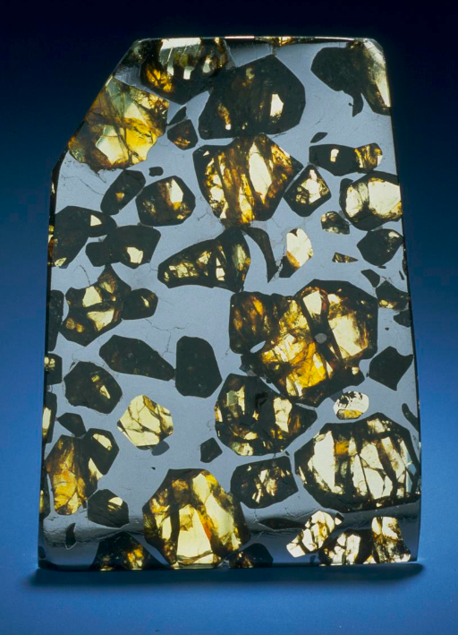
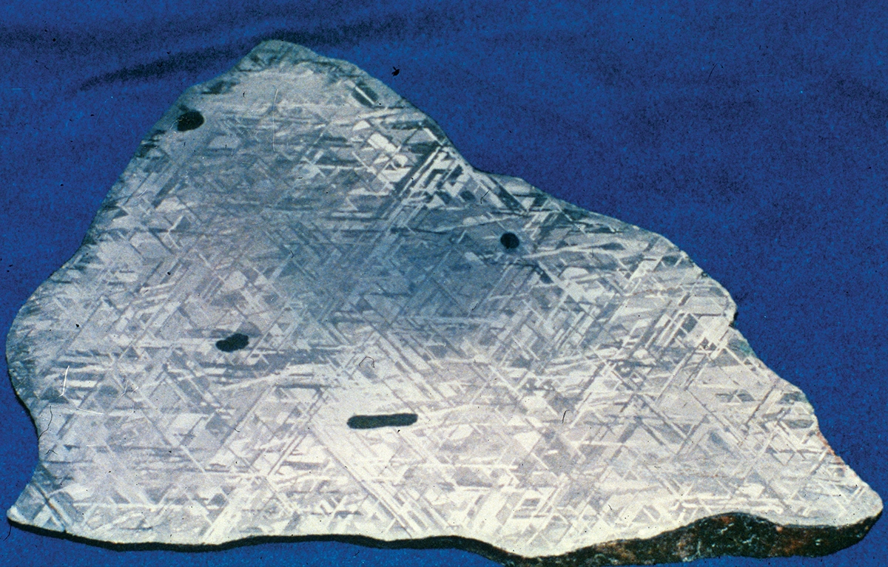
© NASA
What do we have?
© NASA
© LPI
© NASA
© NASA
© NASA
SWITCH TO SPACE 2 • 2020
© Smithsonian

Slide 8
Martian meteorites
Around ~280 martian meteorites found today for ~190 kg (but some are paired)
Observed falls: Chassigny (France, 1815), Shergotty (India, 1862), Nakhla (Egypt, 1911), Zagami (Nigeria, 1985), Tissint (Morocco, 2011)
Mars
SWITCH TO SPACE 2 • 2020
→ ~47000 tons of extraterrestrial material per year (85% as micrometeorites)

Slide 9
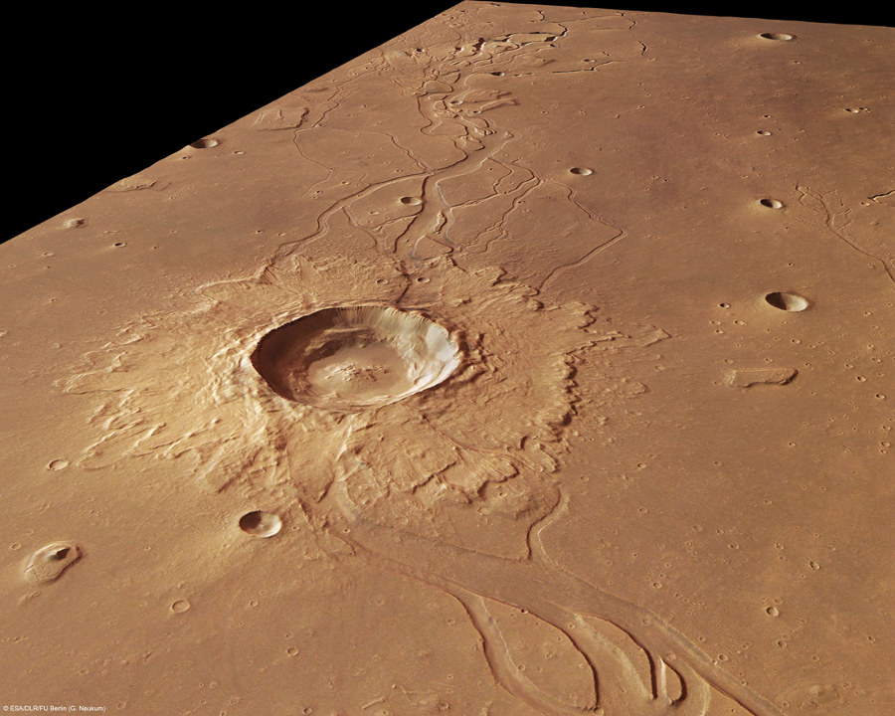
Craters at the surface of Mars
→ ~47000 tons of extraterrestrial material per year (85% as micrometeorites)

Slide 10
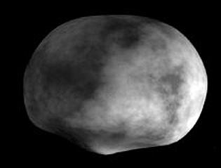
« HED » meteorites
Vesta, second largest asteroid of the asteroid belt; diameter of ~500 km
Hubble
Dawn mission (07/2011 → 09/2012)
© NASA
→ ~47000 tons of extraterrestrial material per year (85% as micrometeorites)

Slide 11

Where to find meteorites?
Observed fall (obvious, but rare)
- Random finds (least efficient)
Campaigns in hot deserts (sometimes risky)
Systematic campaigns in Antarctica (the most efficient)
SWITCH TO SPACE 2 • 2020
→ ~47000 tons of extraterrestrial material per year (85% as micrometeorites)

Slide 12
Country Number of meteorites
Algeria | 1047
Libya | 1528
North-West Africa | 11530
USA | 2779
Belgium | 5
France | 90
Antarctica | 44623
Over 66066 meteorites currently approved
SWITCH TO SPACE 2 • 2020
→ ~47000 tons of extraterrestrial material per year (85% as micrometeorites)

Slide 13
Why Antarctica is so important for finding meteorites?
- Meteorites easily found (black spots on white ice)
- Limited terrestrial alteration
- Area protected from commercial abuse by the Antarctic Treaty
- Concentration of meteorites due to glacier movements
SWITCH TO SPACE 2 • 2020
→ ~47000 tons of extraterrestrial material per year (85% as micrometeorites)

Slide 14
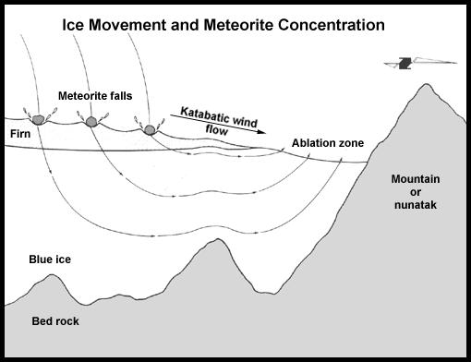
Blue Ice field
© NASA
→ ~47000 tons of extraterrestrial material per year (85% as micrometeorites)

Slide 15
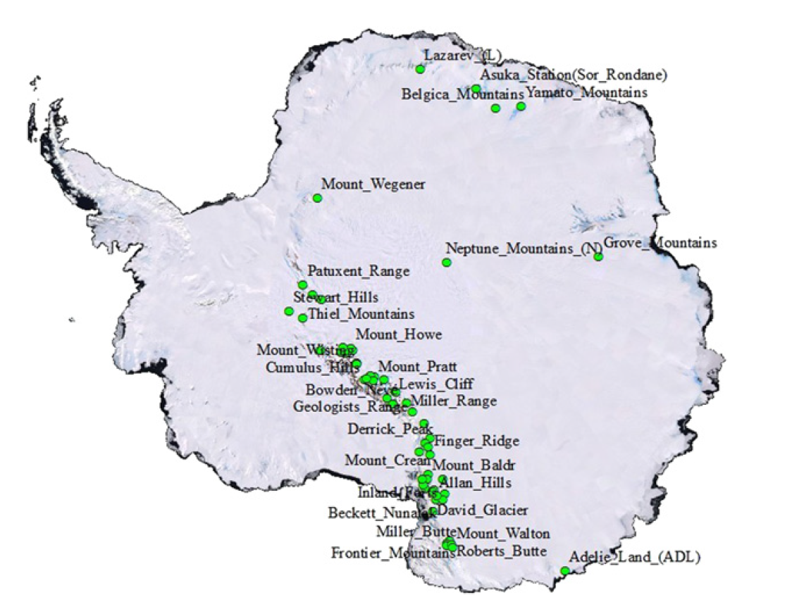
Blue Ice Fields in Antarctica
SWITCH TO SPACE 2 • 2020
Zhou et al., 2011
→ ~47000 tons of extraterrestrial material per year (85% as micrometeorites)

Slide 16
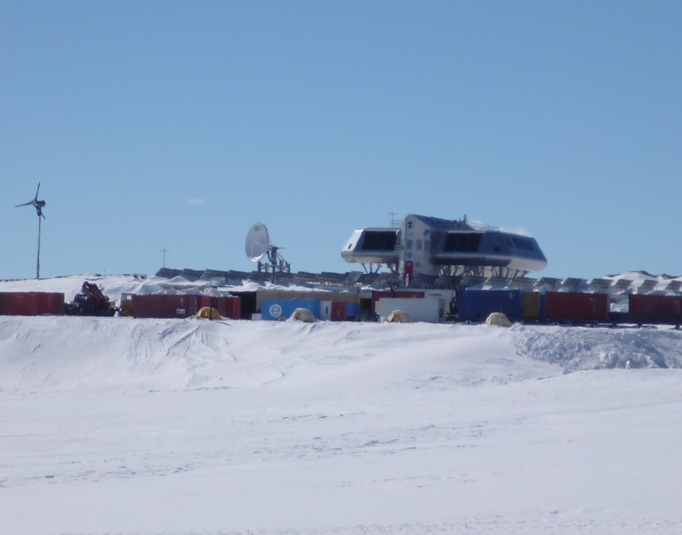
PES
First systematic collect: 1969 (Japan)
Nansen blue ice field
T_{abs}= -18.2 to -27.1°C (av. of -21.9°C)
Wind speed_{av.} = 38 km/h
T_{corr}= -36.0°C
→ ~47000 tons of extraterrestrial material per year (85% as micrometeorites)

Slide 17
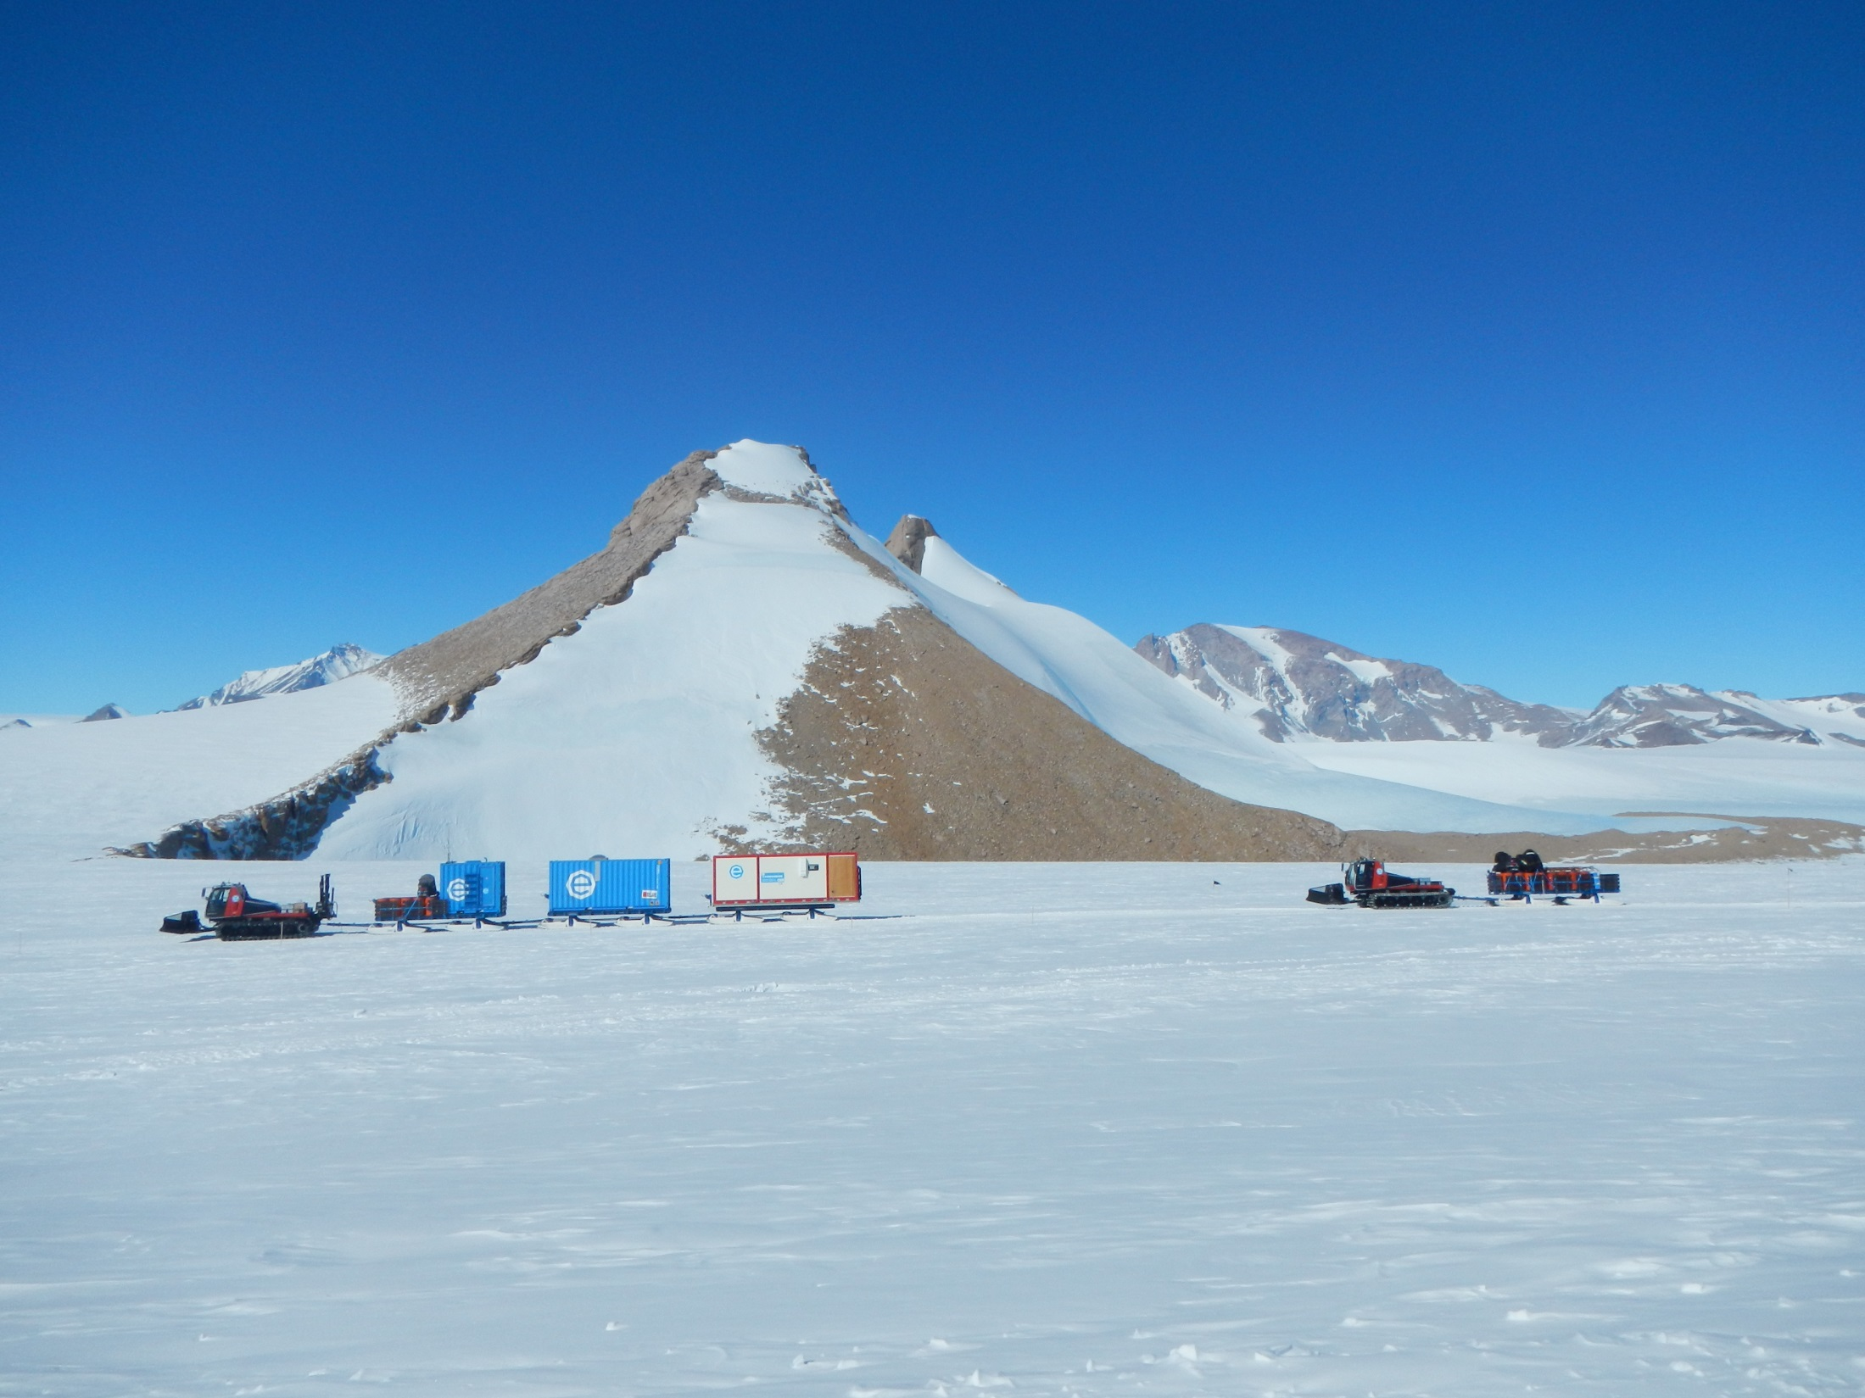
To the Nansen Ice Field
→ ~47000 tons of extraterrestrial material per year (85% as micrometeorites)

Slide 18
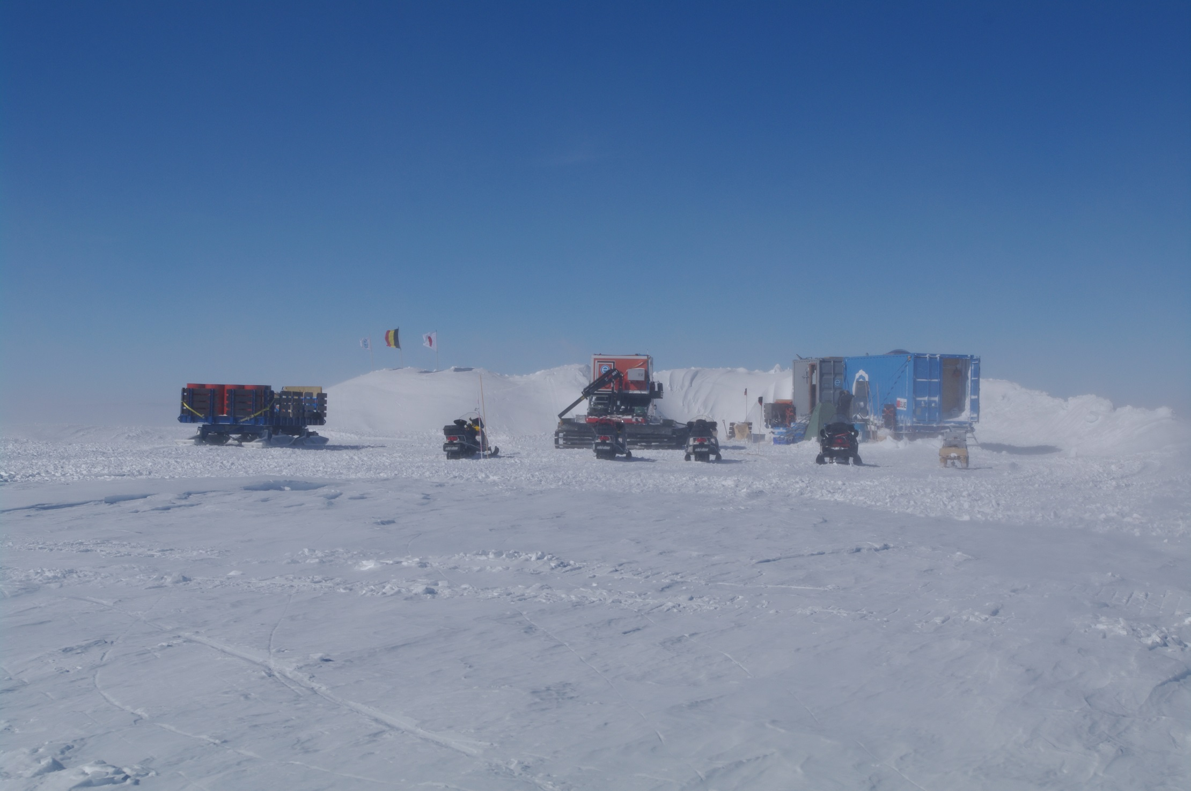
→ ~47000 tons of extraterrestrial material per year (85% as micrometeorites)

Slide 19
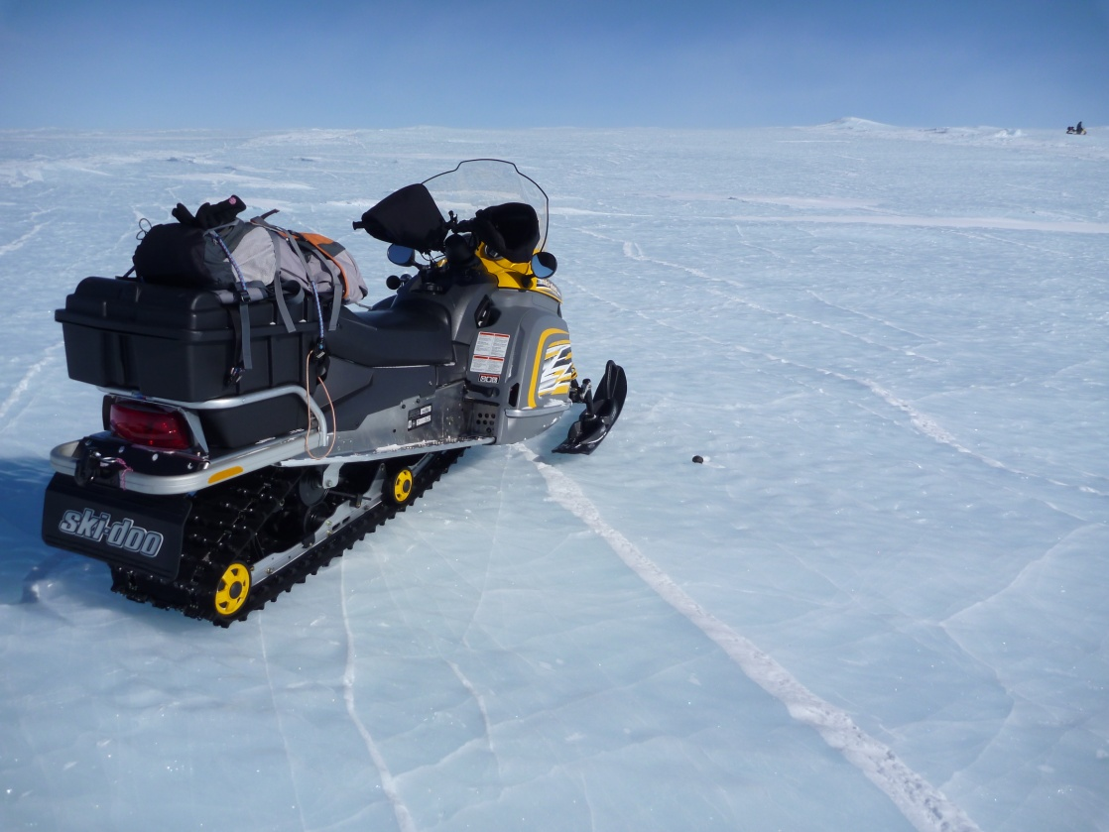
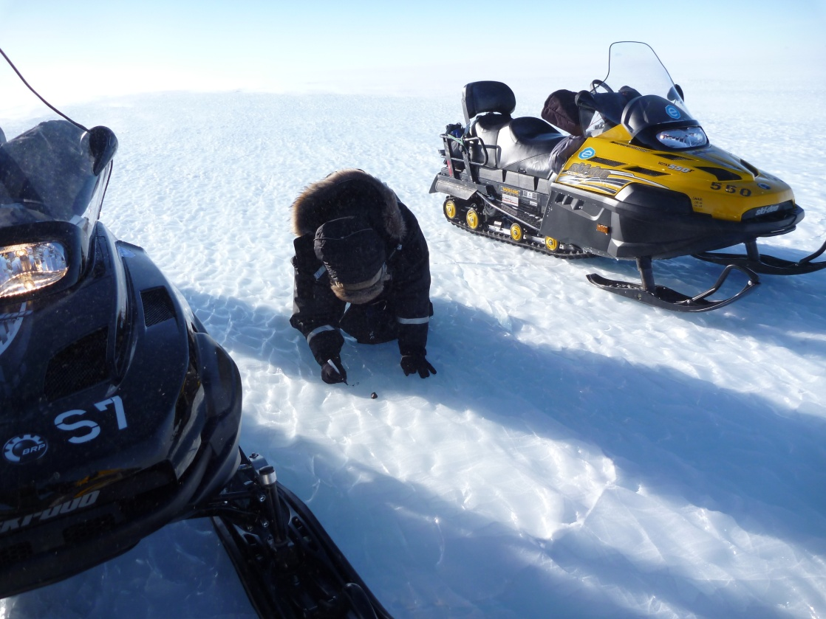
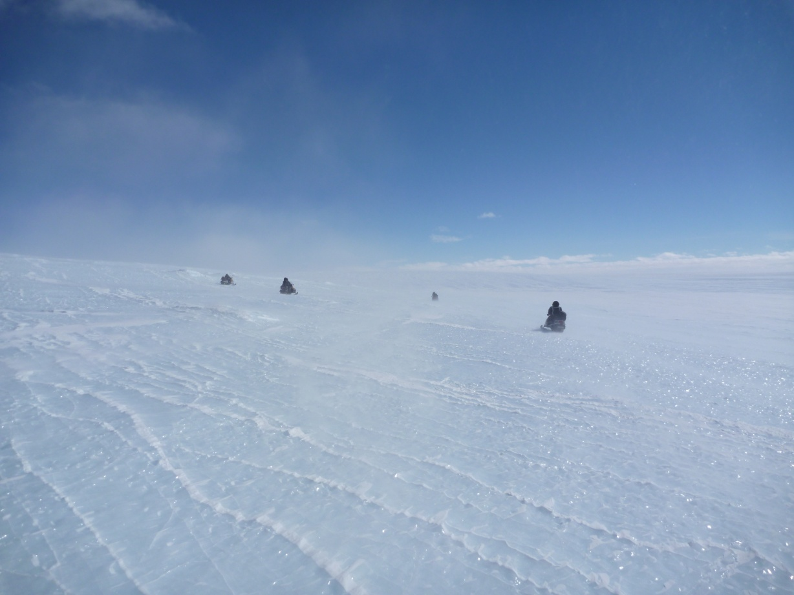
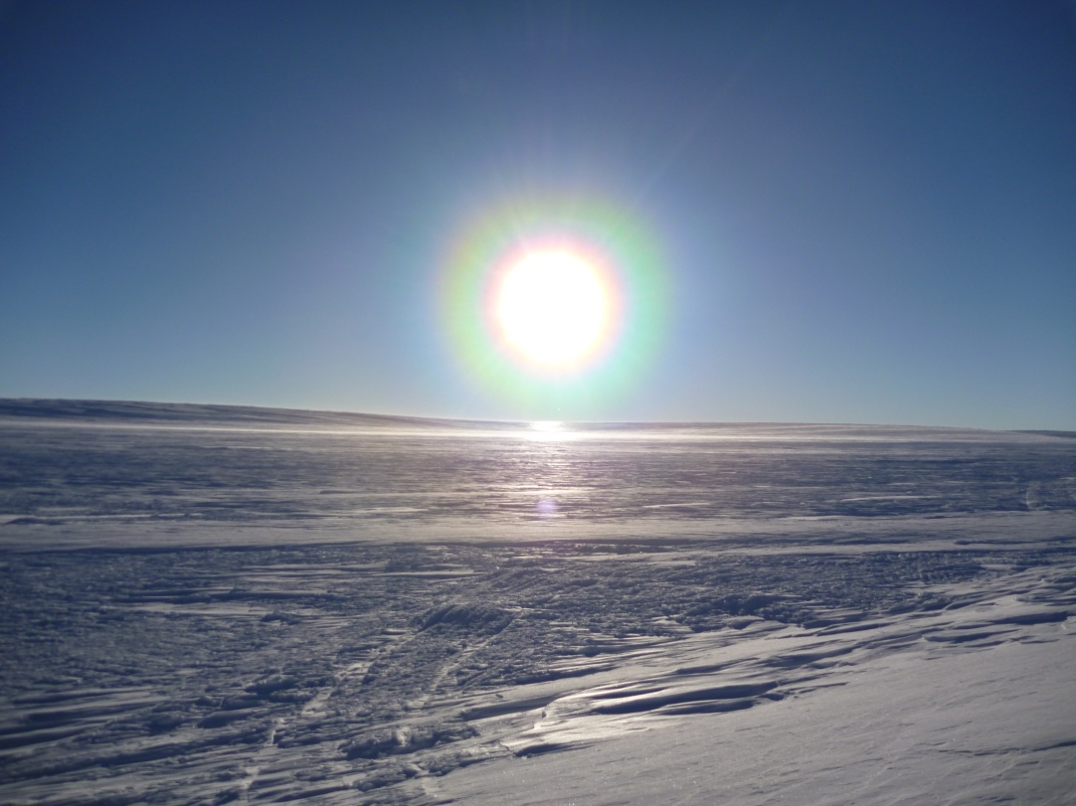
→ ~47000 tons of extraterrestrial material per year (85% as micrometeorites)

Slide 20
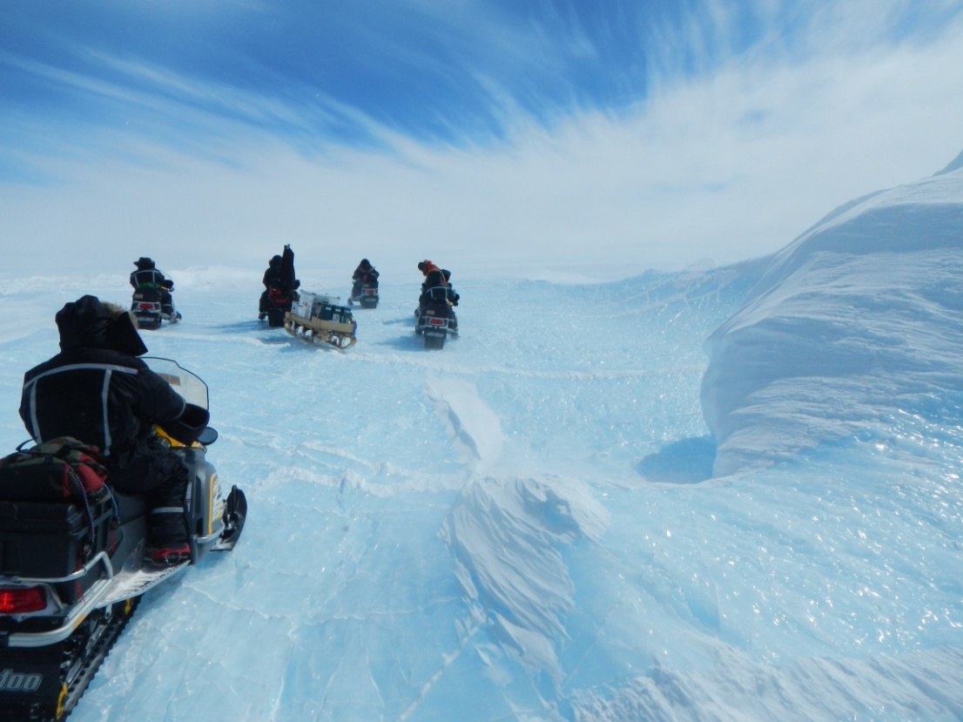
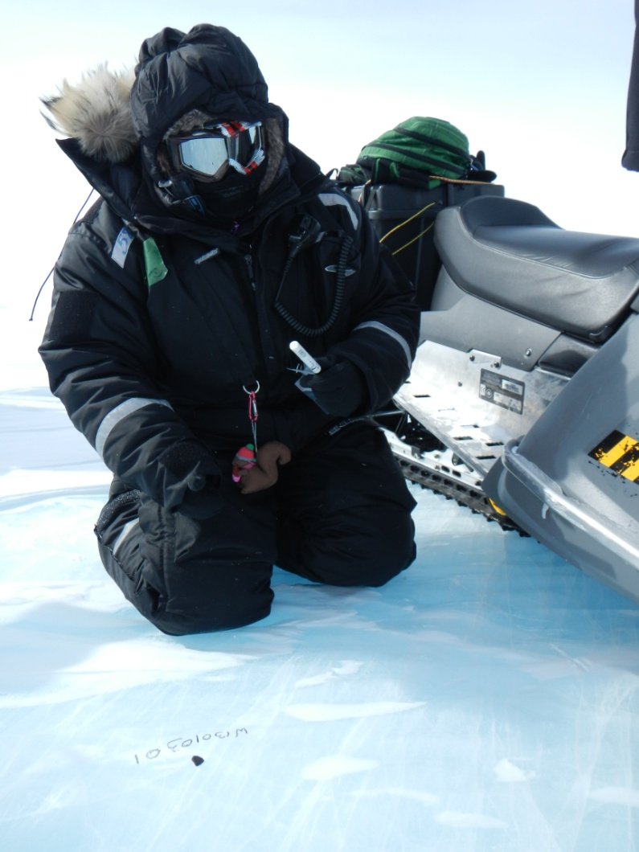
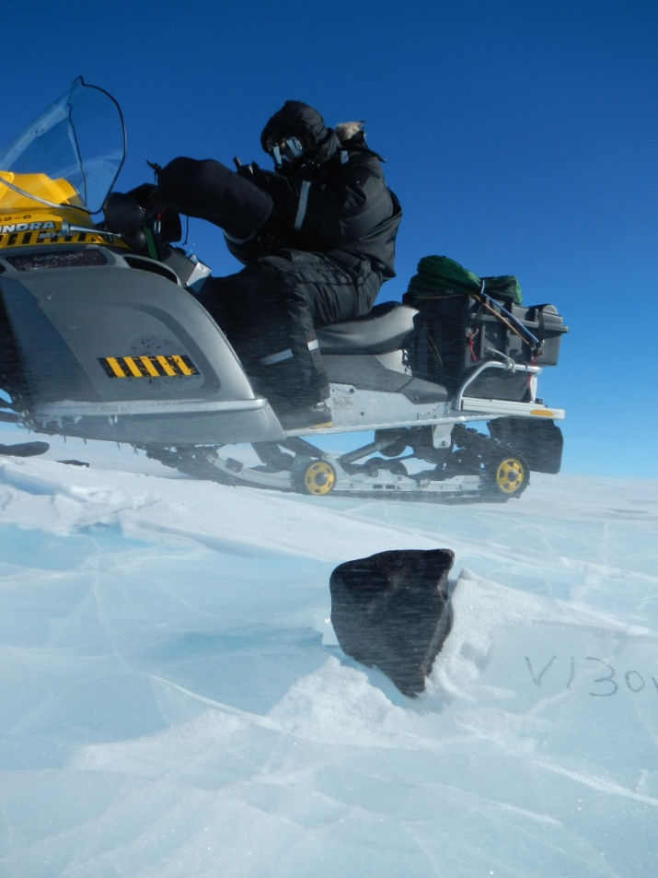
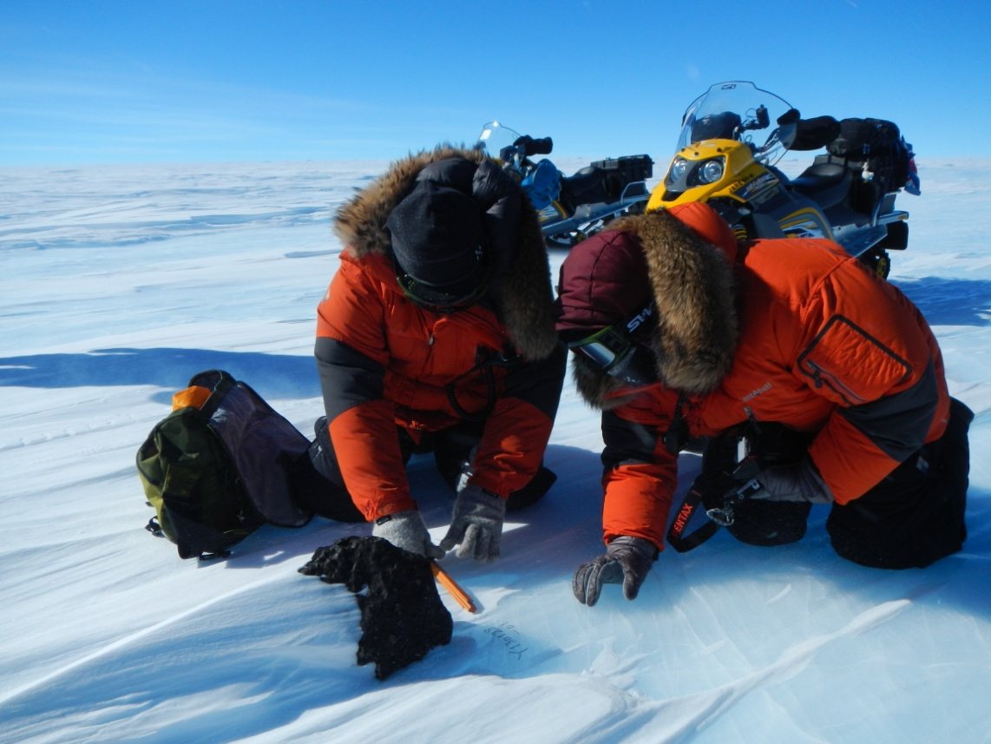
→ ~47000 tons of extraterrestrial material per year (85% as micrometeorites)

Slide 21
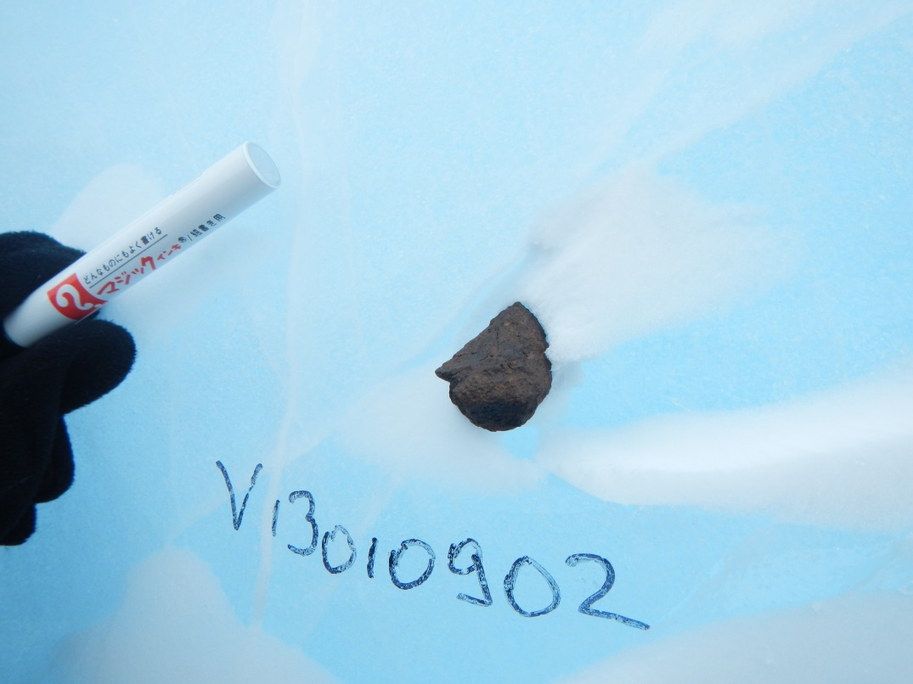
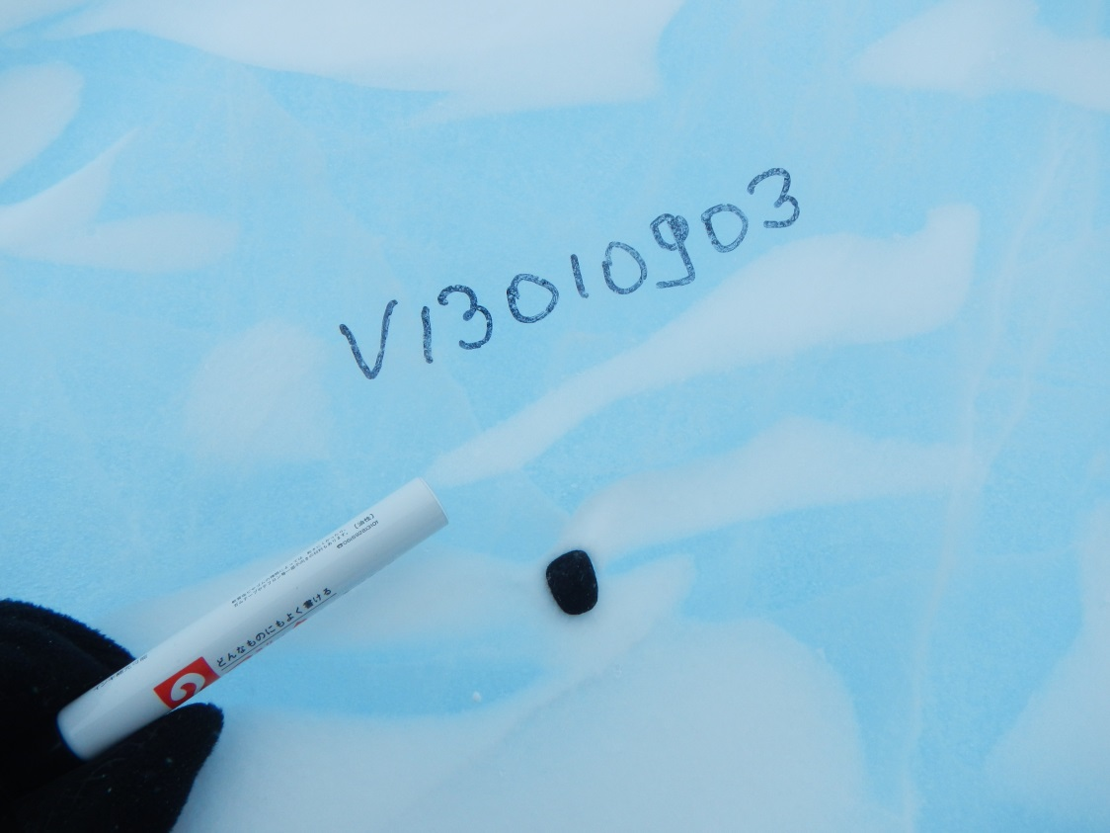
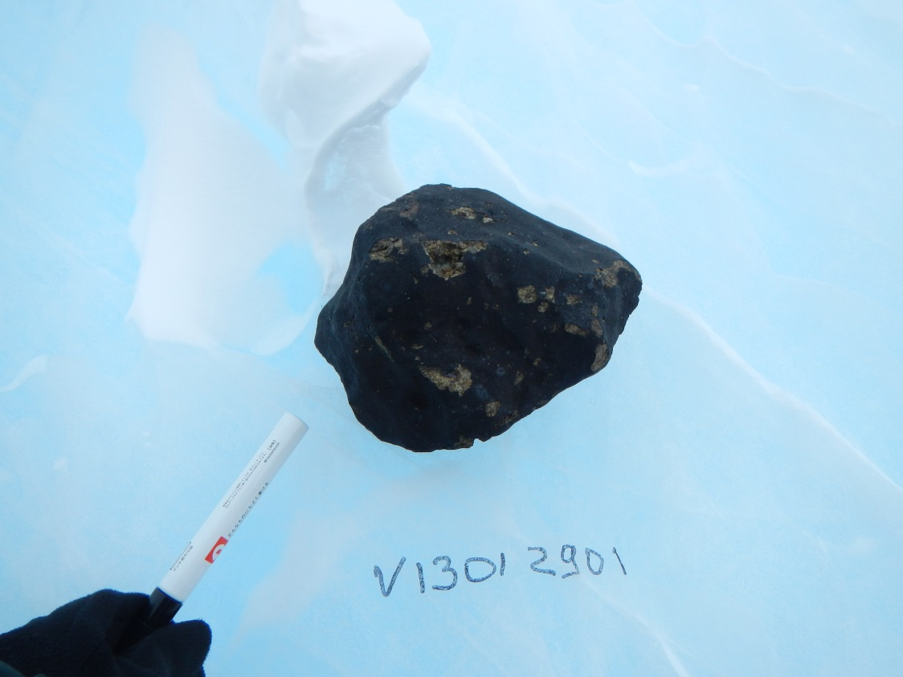
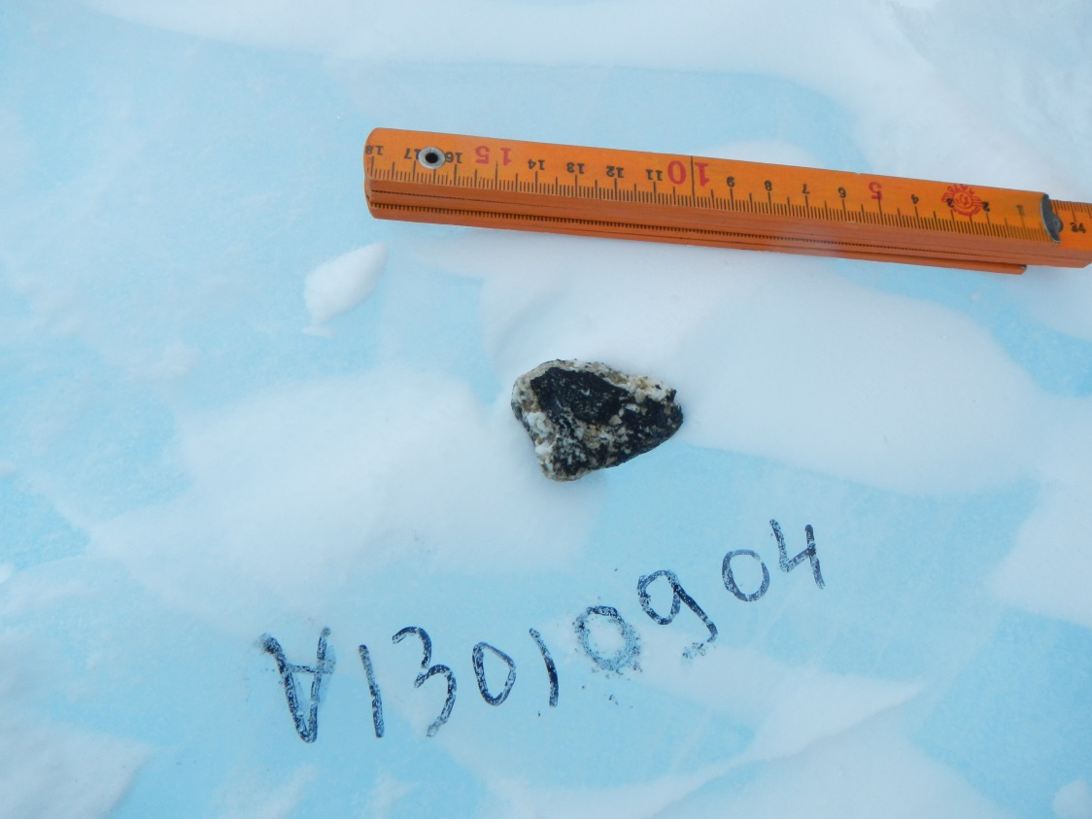
→ ~47000 tons of extraterrestrial material per year (85% as micrometeorites)

Slide 22
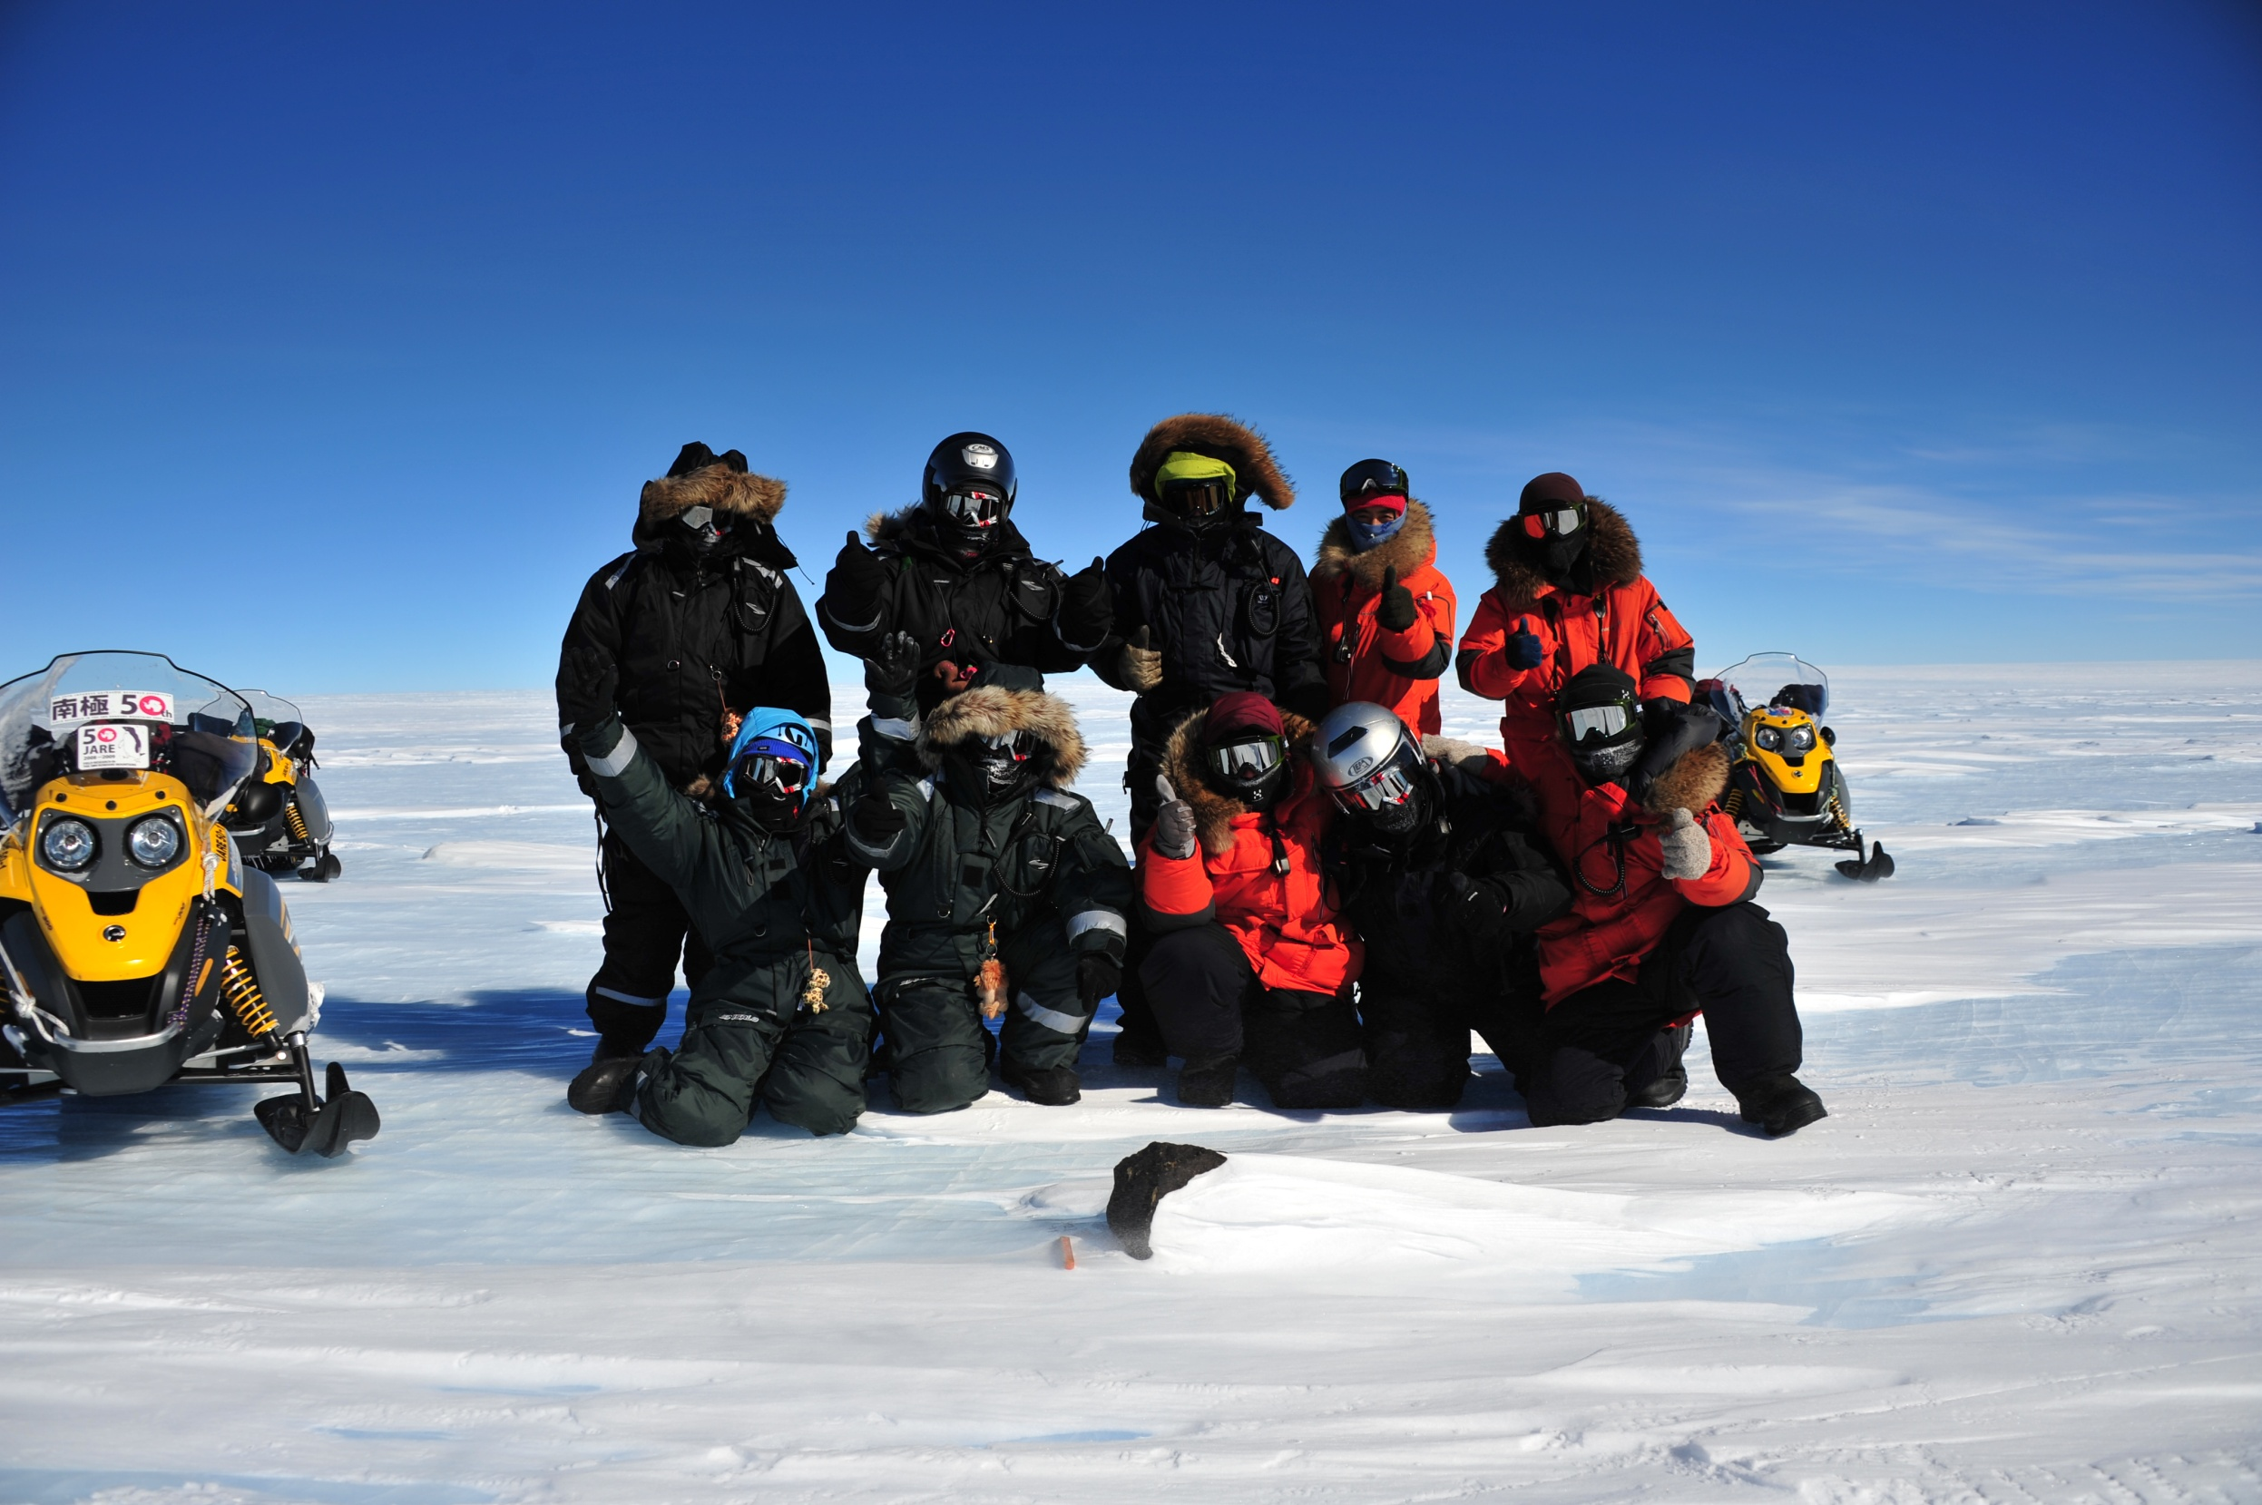
Thanks for your attention!
SWITCH TO SPACE 2 • 2020
→ ~47000 tons of extraterrestrial material per year (85% as micrometeorites)

