Slide 1
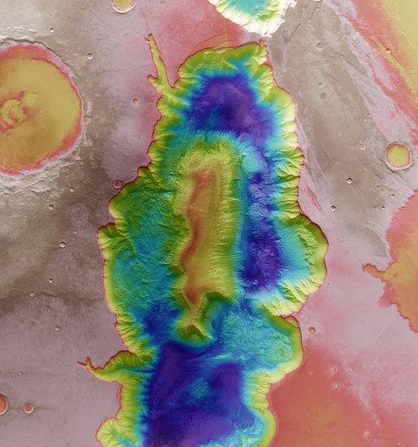

14-10-2020
Public services : suppliers, customers and funders of spatial data and services
#switchtospace
Eric Hallot – ISSeP

Slide 2


Master
my education
Physical Geography @ ULiège
PhD
Geomatic &
Remote Sensing
Physical geography & Hydrography @ ULiège
Hydroecology and Fluvial Geomorphology
Post-Doc
Watershed management @ Canadian Research Center in River Dynamics UMontréal / Québec
SWITCH TO SPACE 2 • 2020

Slide 3
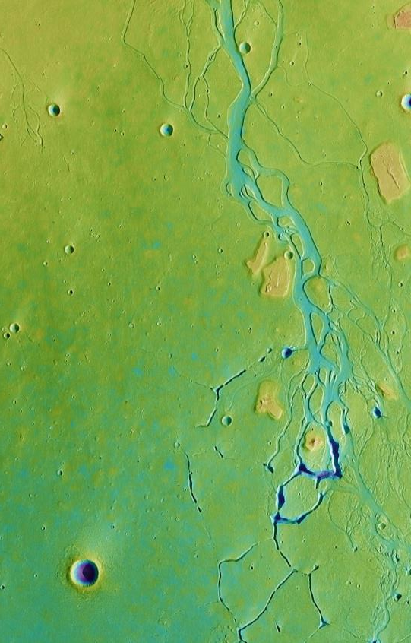
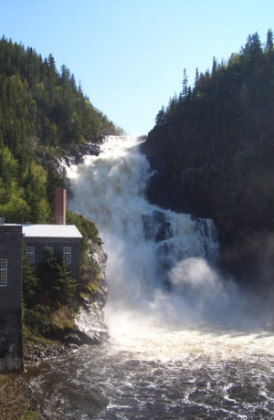
Researcher (2 years)
my career path (1/2)
Geomorphology and Remote Sensing Lab.
@ ULiege
Researcher (7 years)
Hydrology and Fluvial Geomorphology Lab.
@ ULiège
Lecturer (6 years)
Dept. of Physical Geography
@ ULiège
SWITCH TO SPACE 2 • 2020

Slide 4
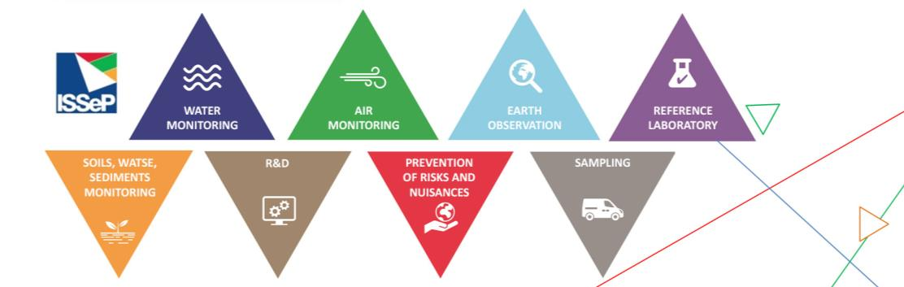
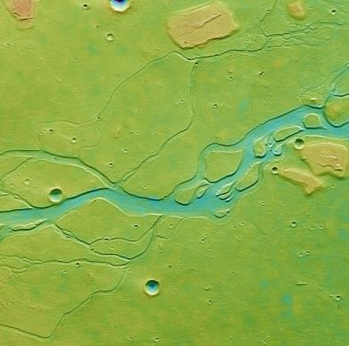
my career
path (2/2)
Scientific Institute of Public Services (since Dec. 2015)
Head of Unit and Scientific Supervision : Remote sensing and Geodata Unit (since 2017)
The Public Insitute of Public Services (www.issep.be) is a public administration unit specializing in environmental monitoring in Wallonia, prevention of risks and nuisances, research and technological development.
The ISSeP employs more than 320 workers with diverse profiles (doctors, engineers, geographers, geologists, bio-engineers, laboratory technicians...). ISSeP provides advice and support to Walloon authorities and private companies in environmental metrology.
SWITCH TO SPACE 2 • 2020

Slide 5
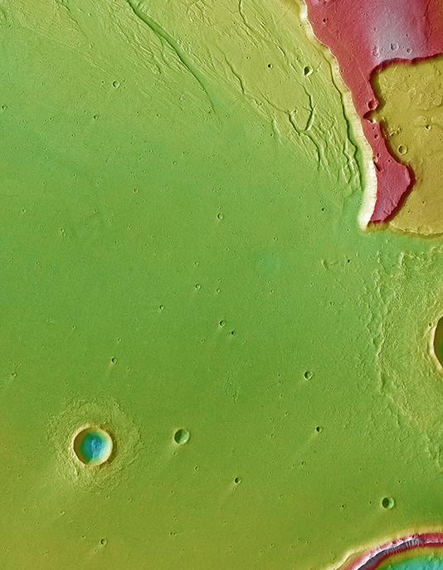
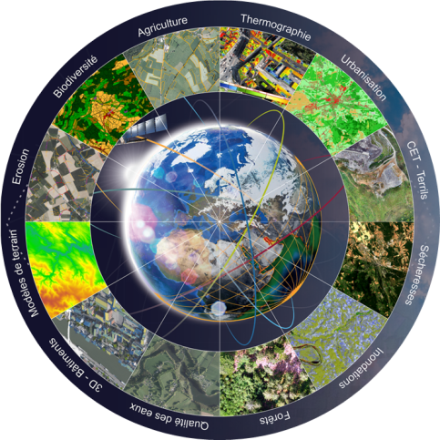
The Remote Sensing and Geodata Unit specializes in the acquisition, processing, analysis and enhancement of Earth observation data and develops decision support tools for more sustainable land management
remote sensing and geodata unit
Data management
Land use / Land Cover
Change detection
Objects/ material detection
Watershed management
Development cooperation
© ISSeP
SWITCH TO SPACE 2 • 2020

Slide 6
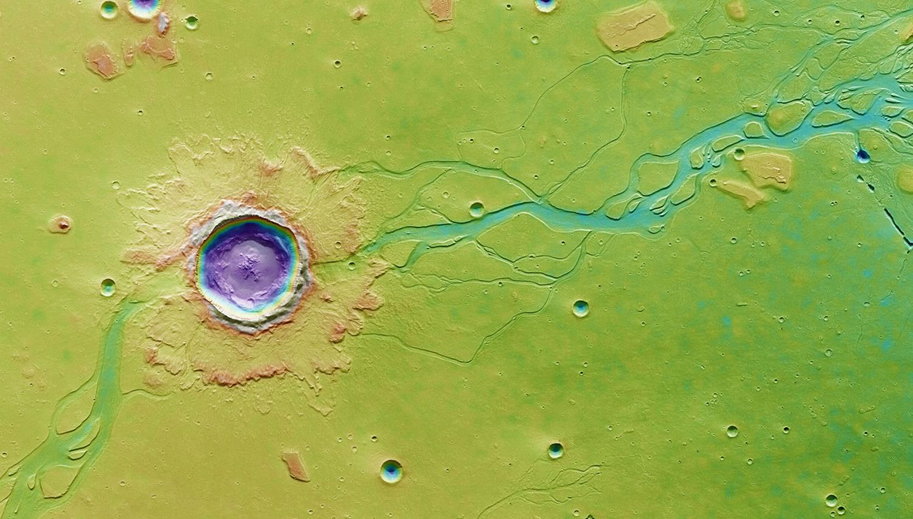
remote sensing and geodata unit
2015
2016
2017
2018
2019
2020
2021
REDD+
SMARTPOP
EO-Regions Sciences
PADI
SAR (partie EO)
BELAIR-SILVA
EO4LULUCF
FPA
WALOUS
HUMSOL
  Geographer / Geomatician
  Bioengineer
  Geologist
  Data scientist
SARSAR
CETEO
CODESUD
SMART AIRPORT v1
V2
CASMATTELE V1
V2
CLADAROC
INTELLO
SWITCH TO SPACE 2 • 2020
CANOPEE

Slide 7
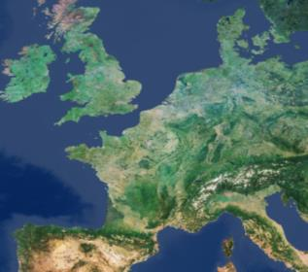






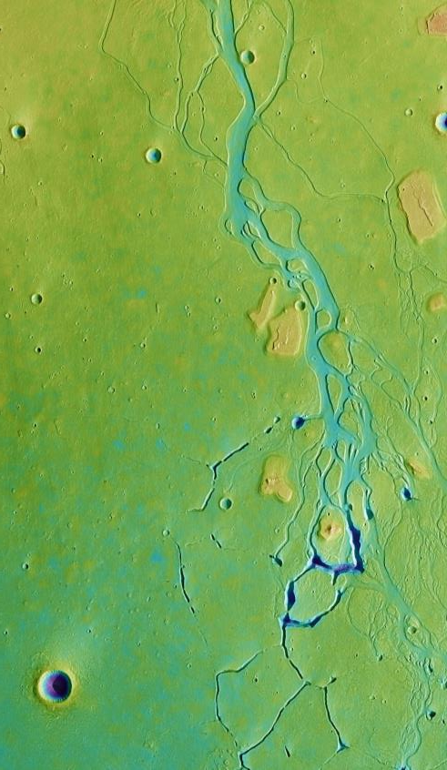
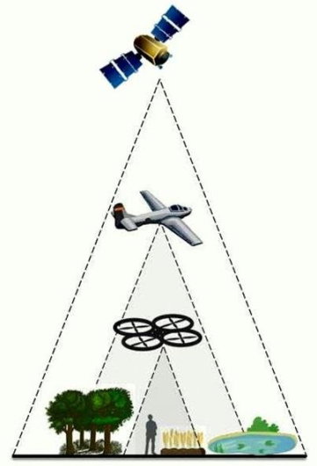
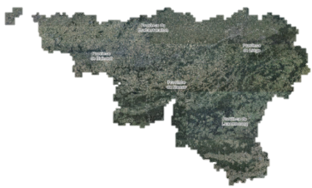


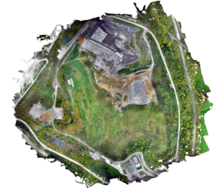
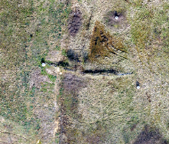


earth observation
data
Nixon D. et al, 2017.

Slide 8
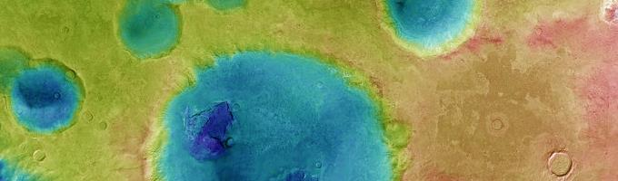
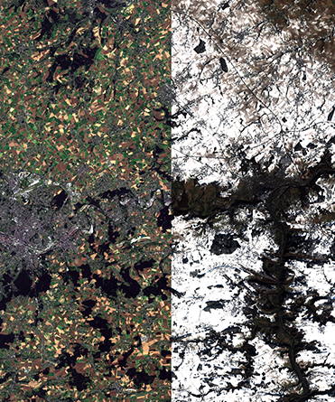
research projects
“A large number of applied research projects are being implemented within the administration and research centres to increase efficiency, productivity and improve decision making”
SWITCH TO SPACE 2 • 2020

Slide 9
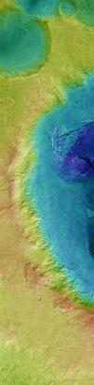
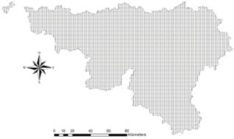
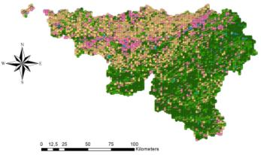

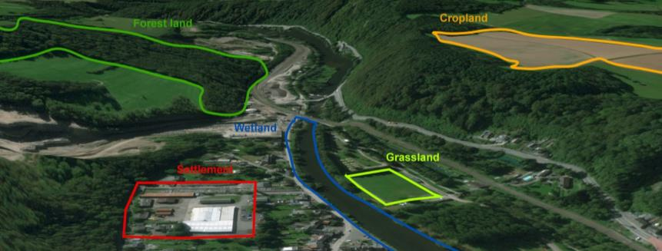

EO4LULUCF
Sentinel-2
Self-financed
Collaboration with AwAC
EO for Climate Reporting - the Land Use, Land Use Change and Forestry Sector (LULUCF)
Classes | # points/classe
- Forest Land | 2782
Cropland | 2282
Grassland | 2002
Wetland | 80
- Settlement | 1293
Total | 8439
SWITCH TO SPACE 2 • 2020

Slide 10
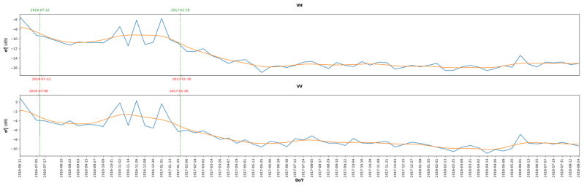
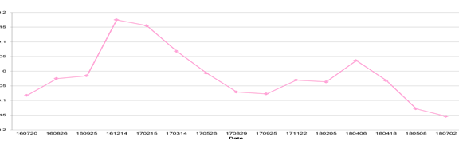
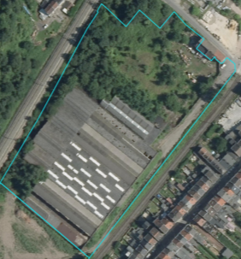
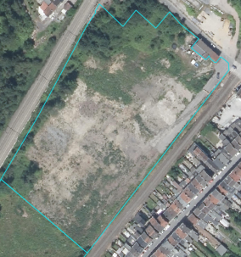
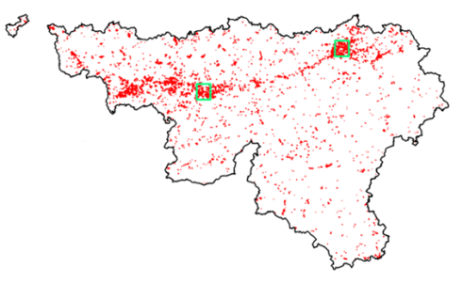


SARSAR
Mean VH and Mean VV
Sentinel-1 / -2 & AOP
Funded by BELSPO
Collaboration with SPW & RMA
Use of remote sensing data (satellite and airborne) to update the inventory of brownfields
NDBI Index
Brownfield inventory
in Wallonia
SWITCH TO SPACE 2 • 2020

Slide 11
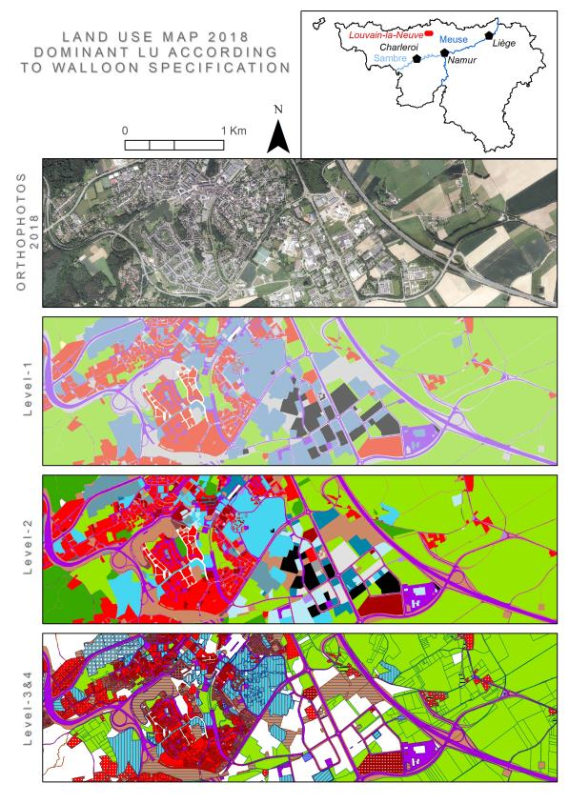
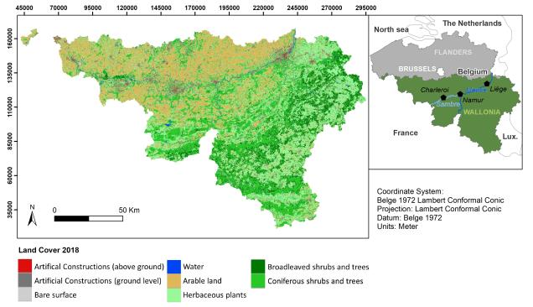


WALOUS
Sentinel -2 & AOP
Funded by SPW
Consortium UCLouvain / ULB / ISSeP
Operational and reproducible methodology for LULC mapping, in compliance with Walloon and European standards
SWITCH TO SPACE 2 • 2020

Slide 12
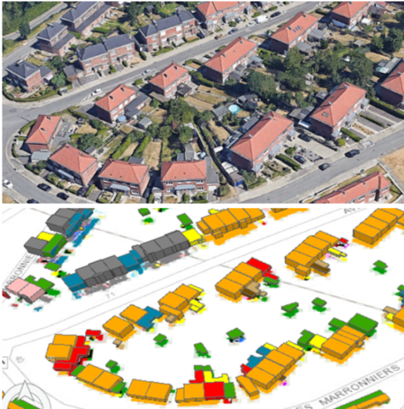
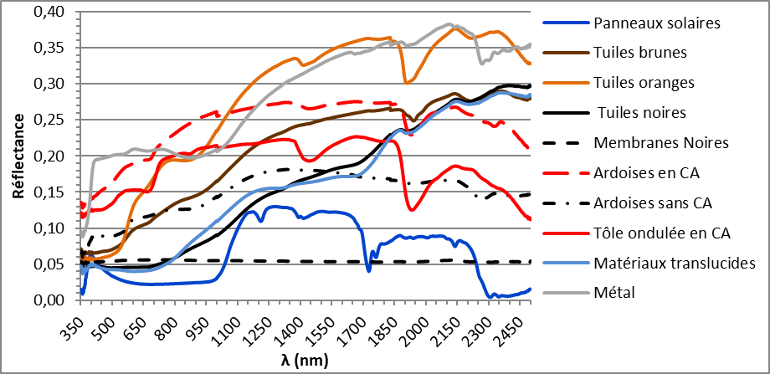

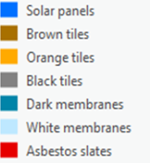
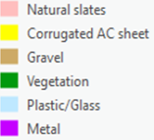

CASMATTELE
AOP ( & WorldView)
Funded by SPW (Plan ENVIeS)
Collaboration with ONERA and CEA (France)
Semi-automatic characterization of roofing materials by remote sensing
SWITCH TO SPACE 2 • 2020
ASD FieldSpec3

Slide 13
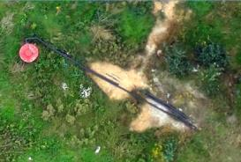
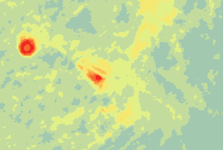
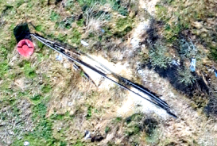
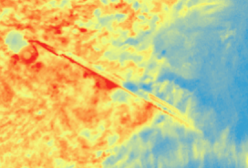
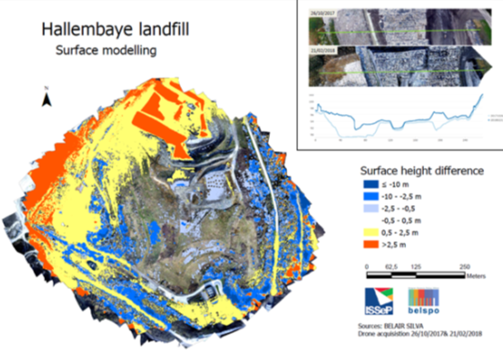
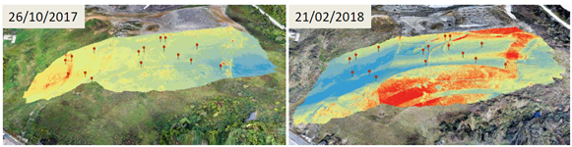
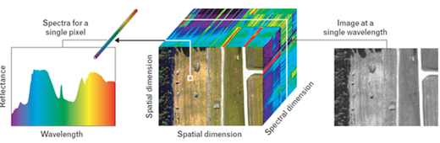

BELAIR / CETEO
DRONE
Funded by BELSPO / ISSeP
Collaboration with VITO
Earth observation-based DSTs for the control and management of Technical Landfill Centers
SWITCH TO SPACE 2 • 2020

Slide 14
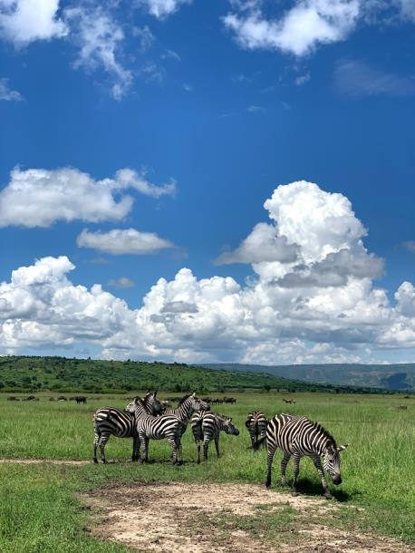
opportunuties
“A policy of wide and open dissemination of a large number of space and earth observation data is a key element for the implementation of future projects and new opportunities”
SWITCH TO SPACE 2 • 2020

Slide 15
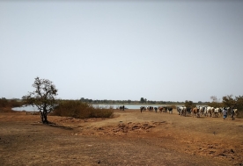
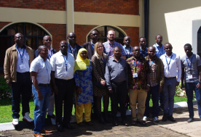
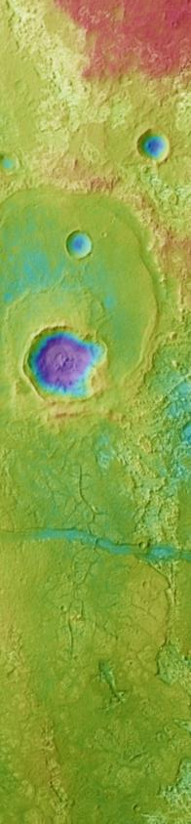
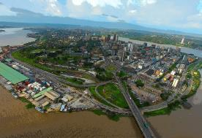
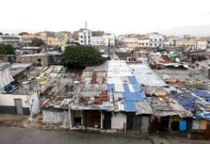
development cooperation
Burkina Faso
Wedbila reservoir, BKF
Remote sensing monitoring of small agricultural water reservoirs
Rwanda
Training in Huye, RWD
Change Detection / Land Cover / Training
Ivory Coast
Abidjan from sky, CIV
Urban Mapping / Air Quality / Training
SWITCH TO SPACE 2 • 2020
Morroco
Slums in Casablanca, MAR
Urban Mapping / Public Health

Slide 16
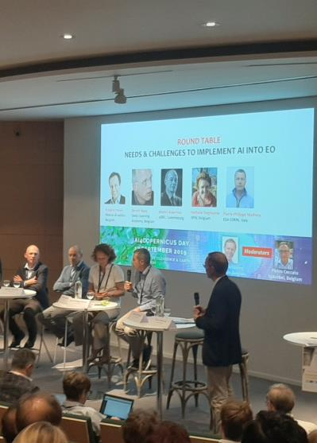
collaborations
“Strong collaborations with private companies also allow an increase in skills, the development of new tools and access to new markets”
SWITCH TO SPACE 2 • 2020

Slide 17


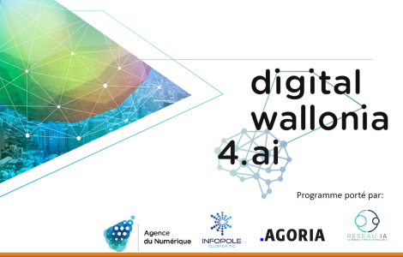




AI vs EO ?
SWITCH TO SPACE 2 • 2020

Slide 18
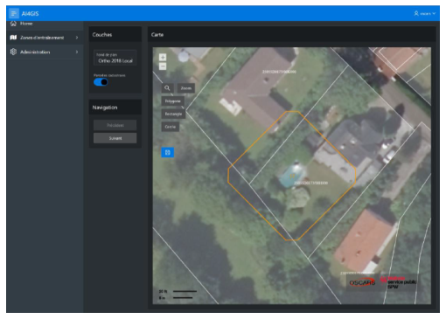
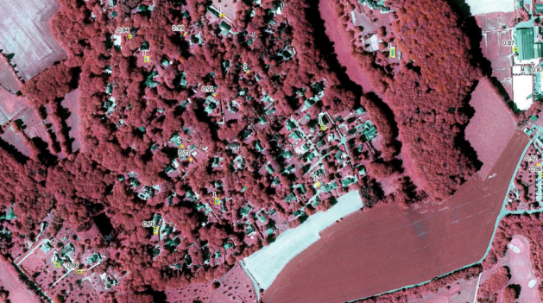
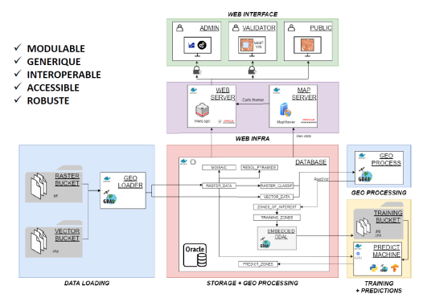


AI4GIS
AI vs EO / GIS
Funded by Digital Wallonia
Consortium with Oscars & Spacebel
Develop an interactive web platform integrating remote sensing, artificial intelligence and other GIS tools.
SWITCH TO SPACE 2 • 2020

Slide 19
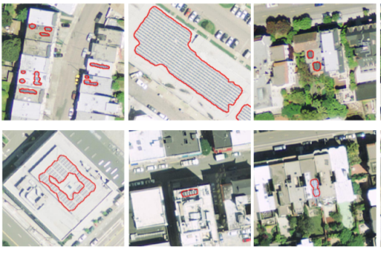






Solar panel
INTELLO
AI vs EO / GIS
Self-financed
Collaboration with EPFL & Oscars
Integrating Artificial Intelligence into Wallon environmental monitoring tools
7 applications to ongoing projects at ISSeP
SWITCH TO SPACE 2 • 2020
Detection of
multiple objects
LC - Building mask
Environmental pressure modeling

Slide 20
In short
Public services:
look for EO skills;
co-finance of data acquisition and projects;
carry out diversified research themes and projects;
collaborate with other research centers, universities and private companies in Belgium and abroad.
Our unit regularly offers internships and jobs like:
the integration of Artificial Intelligence in image classification tools;
the development of UAV solutions;
support for cooperation in Africa;
monitoring of roofs (materials, solar panels…);
detection methods of invasive plants
SWITCH TO SPACE 2 • 2020

Slide 21


thank you for your attention
“Make the right decisions when it comes to environmental policies”
Kivu Lake, RWD
SWITCH TO SPACE 2 • 2020

