Slide 1
Satellite Hacking – How to secure satellite links Nicola De Quattro Head of Engineering and Innovation
12/10/2020

Slide 2
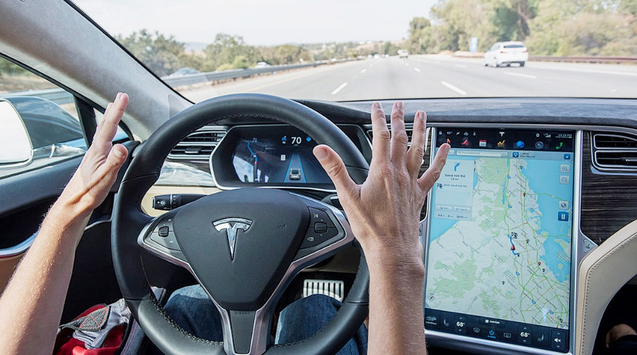
Definition of hacking
Satellite Hacking – How to secure satellite links
“The gaining of unauthorized access to data in a system or computer”
Notes:
Hacking is the action of a single or group of people aiming at entering unauthorized into a system.
What’s this system? It can be our smartphone, our computers, your TV, and nowadays even cars
But why would someone enter into a system?

Slide 3
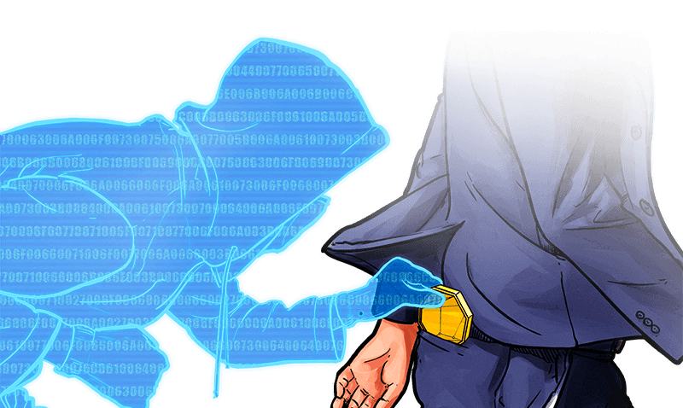
Definition of hacking
Satellite Hacking – How to secure satellite links
“The gaining of unauthorized access to data in a system or computer”
Notes:
There are several reasons: terrorism, stealing money, stealing data… or just having a bit of fun.
In all these cases your devices are accessible through the Internet. Internet security is born to protect these devices from hackers.
But what about satellites?

Slide 4
What is a satellite
Satellite Hacking – How to secure satellite links
System
Serving a specific purpose
Communicate with Earth
Computer on-board
Monitoring of all units
Execution of commands
Ensure autonomy
Protect the on-board computer
Protect the access to the computer
Notes:
A satellite is machine that flies over our heads, so first of all it is a system, and serving a specific purpose. It can carry a camera for taking pictures of the Earth or a transmitter for broadcasting. It uses communication with Earth and embarks a computer. This is used for monitoring the units, executing commands (e.g. configuration, power on) or for some degrees of autonomy. This is the problem.
As we communicate with satellites through antennas, which can receive signals from everywhere, this is a strong vulnerability. Virtually anyone could access the on-board computer of a satellite if he has the right information.
We have to ways to counteract: protecting the computer or protecting the access to the computer.
First of all: why would someone hack a satellite?

Slide 5
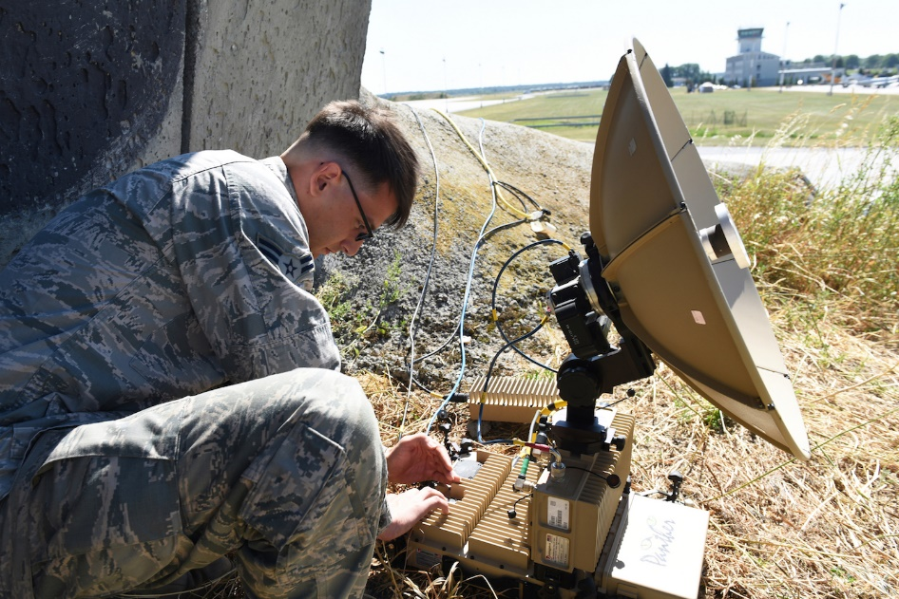
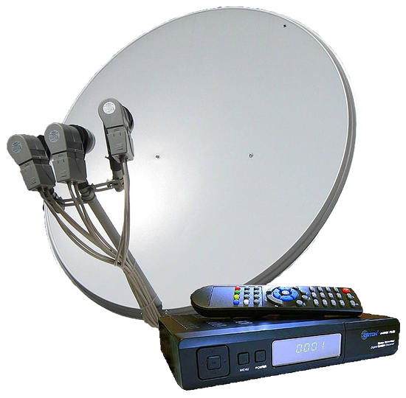
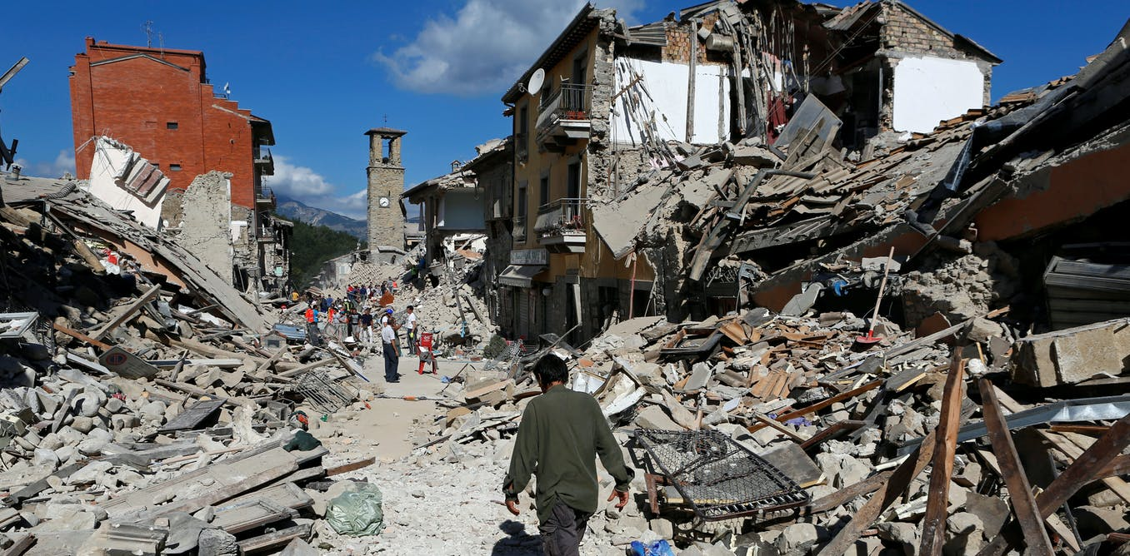
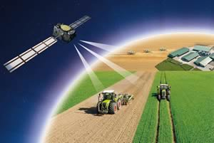
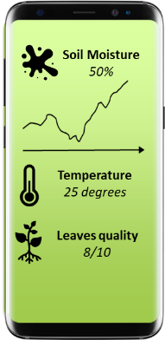
Satellites in our daily life
Satellite Hacking – How to secure satellite links
Notes:
Nowadays satellites are used for many applications, and it’s impossible to count how many of them are dependent on satellites.
We know the most common ones, satellite road navigation and satellite TVs. However, we could live if one of them doesn’t work for few hours.
But let’s think about other applications:
[…]
Availability of satellite services can save lives.
Then, how… ➔

Slide 6
How can we protect the access to a satellite?
Satellite Hacking – How to secure satellite links
Subject
Protect communication between ground station and satellite
What
Confidentiality: against eavesdropping
Authenticity: against fake identities
Resilience: against brute force attack
Different possibilities:
Protect the data which are send and received through the signal
Protect the signal that transport the data
Protect the security mechanisms that allow point 1 and point 2
Они не понимают нас, кроме вас?
我很好，我知道你在说什么
Notes:
What can we do?
It is like protecting the communication between two people talking to each other.

Slide 7
Protect satellite infrastructure data
Satellite Hacking – How to secure satellite links
Two types of data
Telecommand: to manage the satellite
Telemetry: to monitor a satellite
Protect data
Confidentiality ➔ Encryption
Ensure data cannot be understood when intercepted
Authenticity ➔ Authentication
Ensure data sent by external actors are discarded
Limitation:
Very long bitstreams can be intercepted, therefore encryption and authentication algorithms can be broken
Key exchange is vulnerable
No protection against brute-force
Original data
Encrypted data
Original data
010010101001011001
010101010110010101010010
010010101001011001
Original data
Original data +
Authenticity stamp
Original data
010010101001011001
0100101010010110011010010
010010101001011001

Slide 8
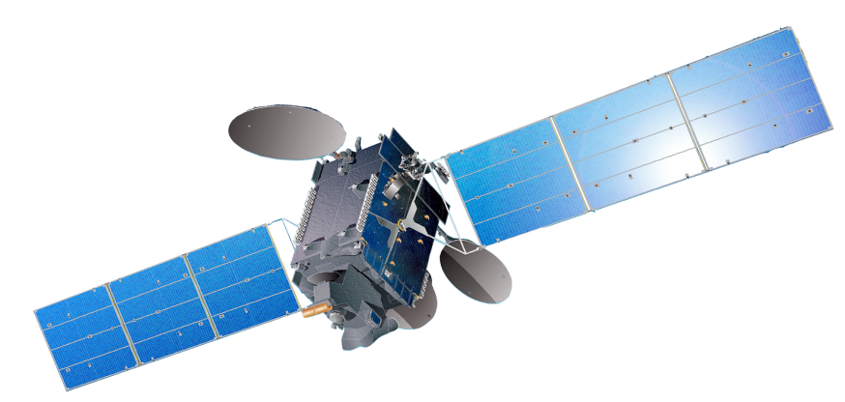
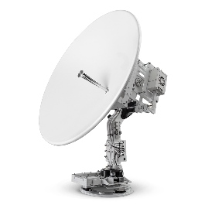
Protect satellite infrastructure signals
Satellite Hacking – How to secure satellite links
Purpose: avoid external actors can receive (understand) or transmit (replicate) the signal
Solution 1:
Unknown or unpredictable signal characteristics ➔ encrypted or (pseudo) random parameters
Signal parameters:
Frequency
Code
…
Certain level of resilience
Limitation
Initial agreement required:
Secret documents
Key exchange
Process is intrinsically vulnerable
Notes:
Protect the signal
A satellite transmits and receive from/to an area which is the satellite footprint. Everyone, from that area (not only the designed antenna), can receive and transmit signals from/to the satellite.

Slide 9
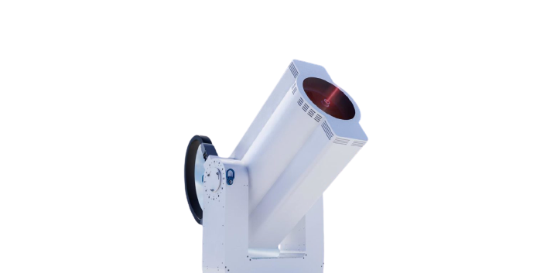
Protect satellite infrastructure signals
Satellite Hacking – How to secure satellite links
Purpose: avoid external actors can receive (understand) or transmit (replicate) the signal
Solution 2:
Avoid that anyone can intercept the signal ➔ laser connection
Connection is point-to-point, collocation is needed
Advantages:
Very high data rate
High level of confidentiality
High level of resilience
Limitation
Availability limited by atmospheric conditions. Diversity is needed

Slide 10
Protect the security mechanism
Satellite Hacking – How to secure satellite links
All the above present have a vulnerability in the security mechanism
Advanced agreement ➔ cannot be trusted
Information exchange ➔ has to be in clear
Information leak will never be detected
Potential solution: Quantum Key Distribution
Based on laser
Key feature: eavesdropping impact quanta status ➔ detectable
Edge of technology today
Classical channel
Quantum channel

Slide 11
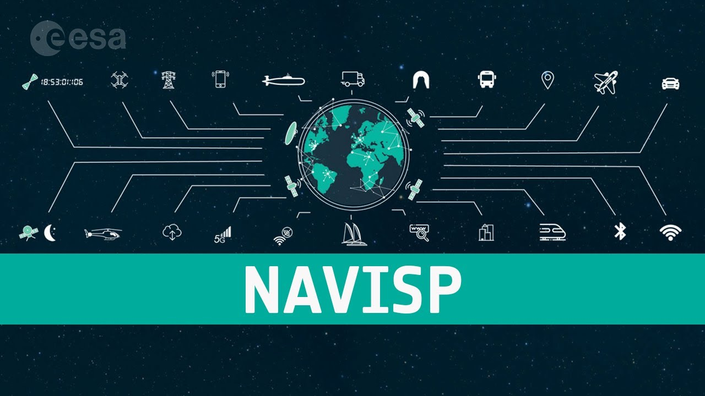
Our activities at Vitrociset Belgium
Satellite Hacking – How to secure satellite links
Design of secure RF systems and attack simulation systems
Development of facilities aimed at testing, validating and qualifying the resilience of systems against electronic attacks
Notes:
At Vitrociset Belgium, among other activities, we work for the design of secure RF systems, like in G2G, or attack simulation systems, as per CyTEF, ESA NAVISP project in collaboration with Royal Military Academy

Slide 12
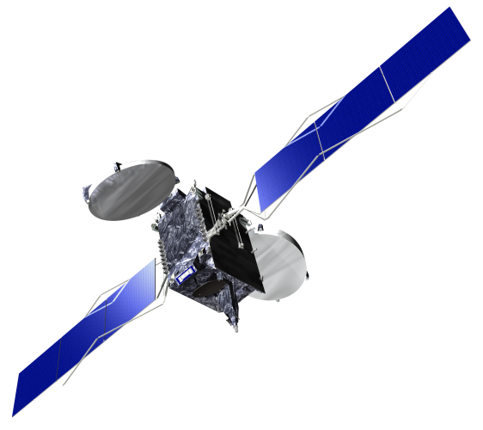
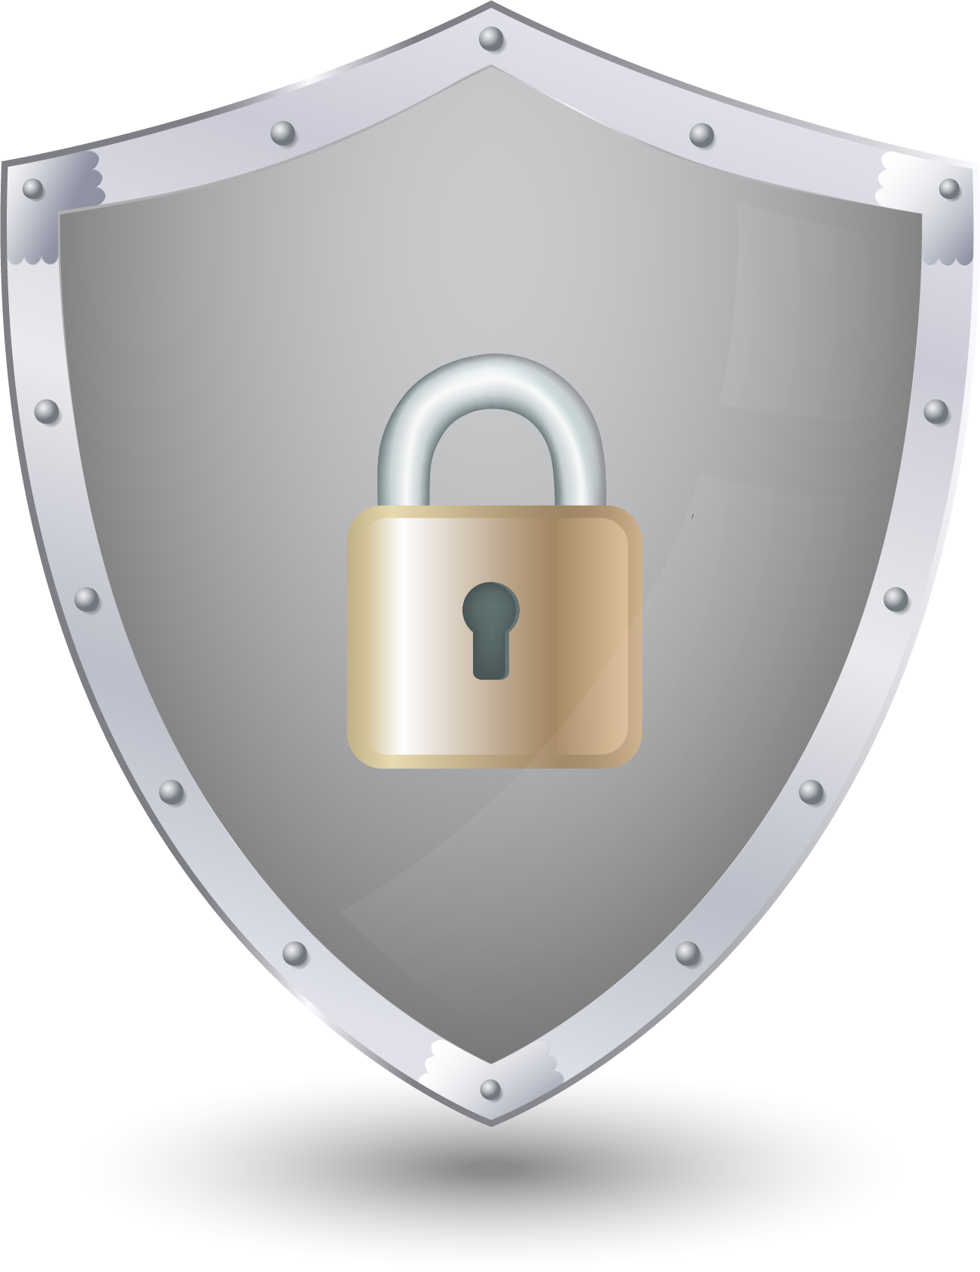
Conclusions
Satellite Hacking – How to secure satellite links
Satellite hacking is becoming every day cheaper.
On the other hand, the world relies every day more on satellites
Solutions exists and are being studied and implemented
Protecting the infrastructure is as important as protecting the service itself

Slide 13
Nicola De Quattro
n.dequattro@vitrocisetbelgium.com

