Slide 1
S2S3 - Space Technologies for the Moon & Mars
The place of Belgian industry in the Moon and Mars gateway
19/10/2022

Slide 2
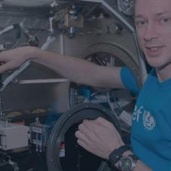
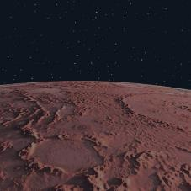
Overview of Lambda-X space activities
SPACE at Lambda-X
Innovation is at the core of our values.
We are the trusted partner in the field of optical systems for the development of pioneering programs.
Microgravity experiments
New Space approach
Earth observation
Space exploration
Olivier Dupont, PhD
CEO, Lambda-X
Notes:
The technical challenges for the realization of compact optics are reviewed for the different stages of the project development, from the design and its trade-offs, to the instrument integration, until the performance verification and the environment qualification. It will be shown how the development and realization of these devices is dictated by the extreme conditions of the space environment and by the strict precautions that apply on man-crafted objects destined to reach celestial bodies. Examples of optics destined for (or that already reached!) Mars, Jupiter and the moon will be presented.

Slide 3
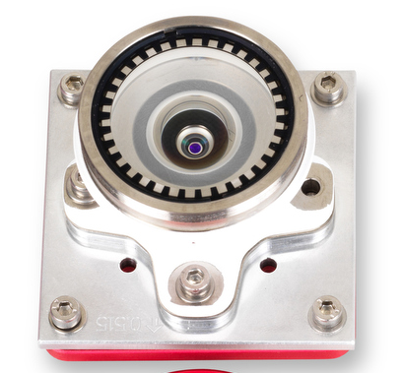
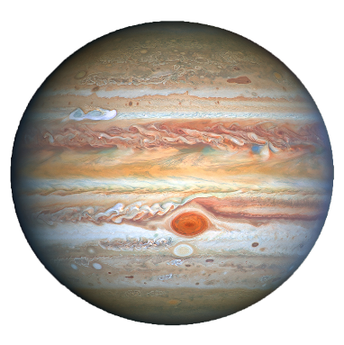
Moon; Mars; Jupiter Lambda-X Space expertise
2031
Here are some of the projects developed by Lambda-X…
2024
2023
MSR
PROSPECT
RASHID
NOVA-C
2016
2024
JUICE
Lunar rovers
UVIS
MMX

