Slide 1
Stela Tkatchova EIC Programme Manager for Space 19/10/2022
European Innovation Council and SME Agency

Slide 2
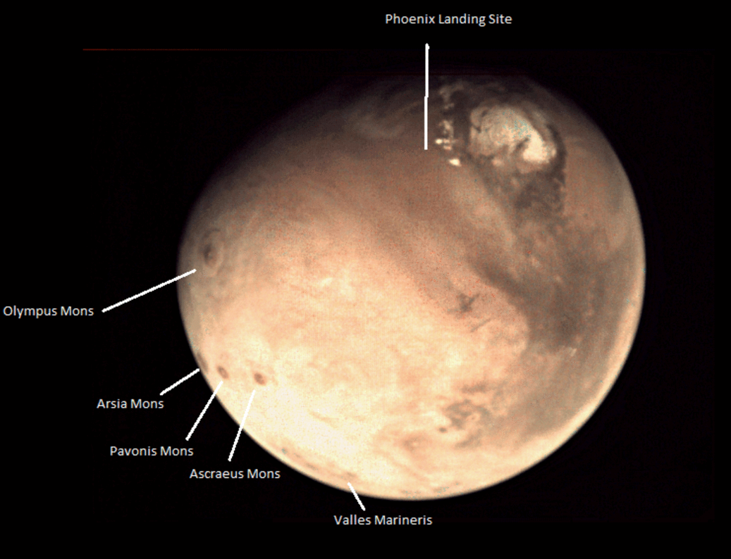
Disruptive Innovation
EIC objective is identify, develop and deploy high risk innovations with a focus on breakthrough market creation and deep tech innovations (Pillar III Innovative Europe)
Funding their disruptive/high-risk ideas and supporting them in the process of disruptive innovation, demonstration and commercialization with transversal EIC Pathfinder, Transition and Accelerator programs
Courtesy: ESA

Slide 3
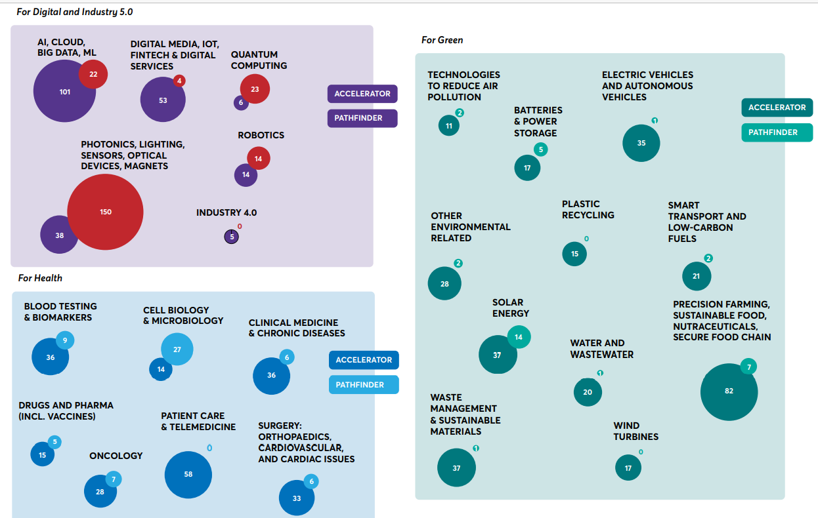
Impacts of the pilot: EIC Pathfinder projects and Accelerator companies in all main fields of breakthrough technology
PATHFINDER

Slide 4
EIC Programs
Pathfinder (TRL1-4)
For consortia
Early stage research on breakthrough technologies
Grants up to €3/4 million
Focus on breakthrough, game-changing, market-creating, deep-tech
Mainly bottom up complemented by targeted funding on strategic technologies/ challenges
Steered by EIC Board of leading innovators (entrepreneurs, investors, researchers, ecosystem)
Business Acceleration Services (coaches/ mentors, corporates, investors, ecosystem)
Pro-active management (roadmaps, reviews, re-orientations, etc) with EIC Programme Managers
Fast track access to Accelerator for results from EIT, EIC Pathfinder,
Transition (TRL 4-6)
For consortia and single entities
Technology maturation from proof of concept to validation
Business & market readiness
Grants up to €2.5 million
Accelerator (TRL 6-9)
For individual SMEs
Development & scale up of deep-tech/ disruptive innovations by startups/ SMEs
Blended finance (grants up to €2.5 million; equity investment up to €15 million or above)

Slide 5
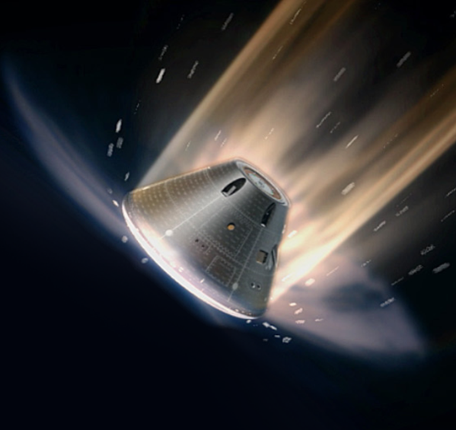
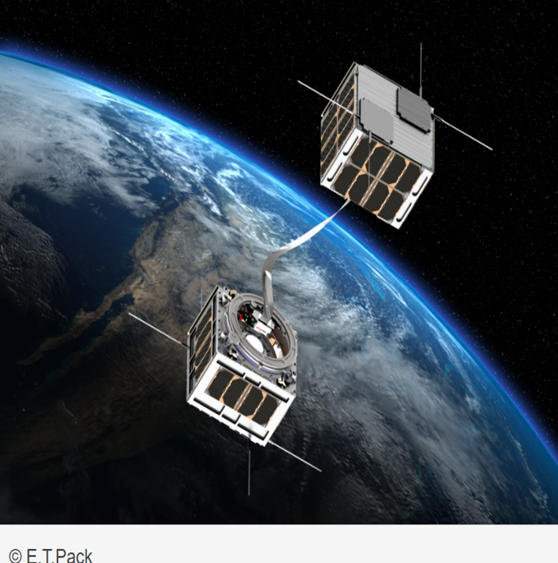
EIC Space Project Examples
EIC Pathfinder (TRL1-TRL4)
Magnetohydrodynamic Enhanced Entry System for Space Transportation (MEESST) research in the use of High Temperature Superconductors. With the objective is to design, build, and test a first proof-of-concept magnetic shielding device for mitigating both thermal loads and radio blackout during space entry.
E. T. PACK - free passive de-orbiting device for space debris removal based on a eletrodynamic tether (e.g. Low Work-function Tether (LWT)). On the 7th June 2022- E.T.PACK project was invited to present at the 65th Session of COPUOS 2022 at United Nations headquarter in Vienna.
Courtesy: MEESST project – EIC Pathfinder
Courtesy: E.T.Pack– EIC Pathfinder

Slide 6
EIC Useful Links
EIC Programs - EIC Funding opportunities (europa.eu)
EIC Work programme 2022 - EIC Work Programme 2022 (europa.eu)
EU Prize for Women Innovators - EU Prize for Women Innovators (europa.eu)

Slide 7
@EUeic
#Eueic
https://eic.ec.europa.eu

