Slide 1
S2S3 - Space Technologies for the Moon & Mars
Technical challenges for compact optics in space missions
19/10/2022

Slide 2

Outline
Introduction - LX activites
The space environment
  Peculiarities of the space environment
  Constraints on the hardware (design, integration & qualifications)
Hands-on examples – LX optics in space missions
Conclusions
Notes:
The technical challenges for the realization of compact optics are reviewed for the different stages of the project development, from the design and its trade-offs, to the instrument integration, until the performance verification and the environment qualification. It will be shown how the development and realization of these devices is dictated by the extreme conditions of the space environment and by the strict precautions that apply on man-crafted objects destined to reach celestial bodies. Examples of optics destined for (or that already reached!) Mars, Jupiter and the moon will be presented.

Slide 3

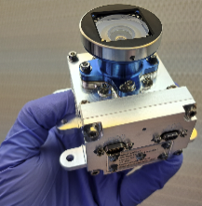
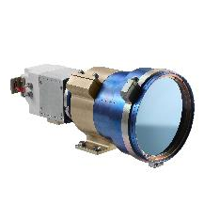

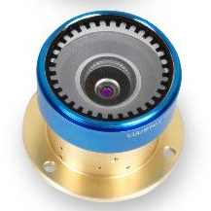
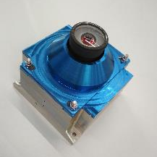
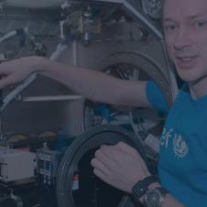

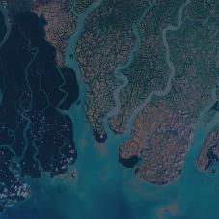
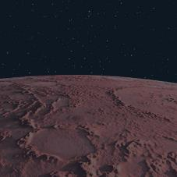
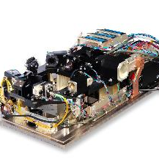
Introduction
Introduction
SPACE at Lambda-X
Micro-gravity experiments
New
Space
Earth
observation
Space
exploration
Notes:
The technical challenges for the realization of compact optics are reviewed for the different stages of the project development, from the design and its trade-offs, to the instrument integration, until the performance verification and the environment qualification. It will be shown how the development and realization of these devices is dictated by the extreme conditions of the space environment and by the strict precautions that apply on man-crafted objects destined to reach celestial bodies. Examples of optics destined for (or that already reached!) Mars, Jupiter and the moon will be presented.

Slide 4

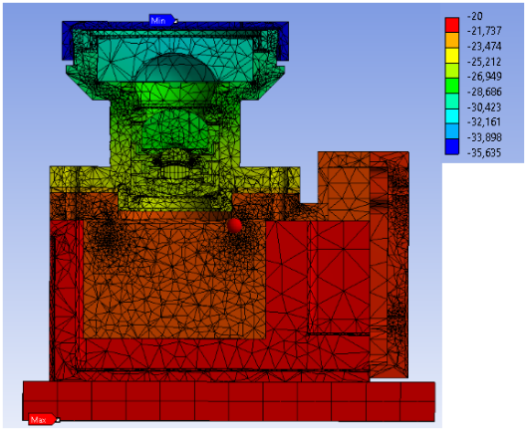
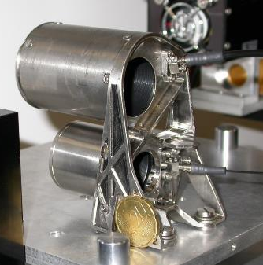
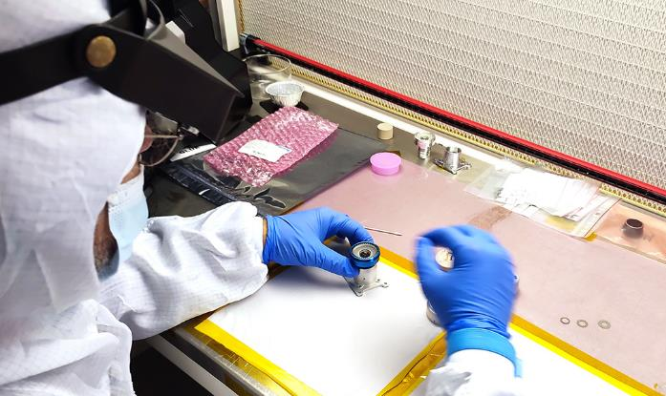
The space environment
Characteristics of the space environment
Space environment can be very harsh…
It starts at ~130km
  Light and small structures
  Vibration resistant (launch)
Temperature (large gradients) (no convection)
  Athermal designs & shielding
  Thermal cycling tests
Vacuum
  Outgass & contamination
  Clear Room integration
Radiation (radiation & particles)
  Damage of materials (electronics, glasses, ..)
  Qualifications
A. Floriduz, & J.D. Devine, 2018 ,18th European Conference on Radiation and Its Effects on Components and Systems (RADECS) IEEE.
Notes:
Light and small structures: size and weight for space instruments are very important factors => the cost on launch increases greatly with the weight, the same for the energy needed once at destination (i.e. for a rover)
There can be no gravity (satellites) or lower gravity (moons)
Vacuum: UHV ! Pressure <10^-9 mbar ; on the moon we have 10^-11 – 10^-12 mbar -> large outgass -> contamination of surfaces, “false positives” in case of detectors, deterioration of the material (organic material loosing their properties when solvent/components evaporate)
Bad news: synergetic effects (the effect of two factors together is much worse than the two separately)

Slide 5
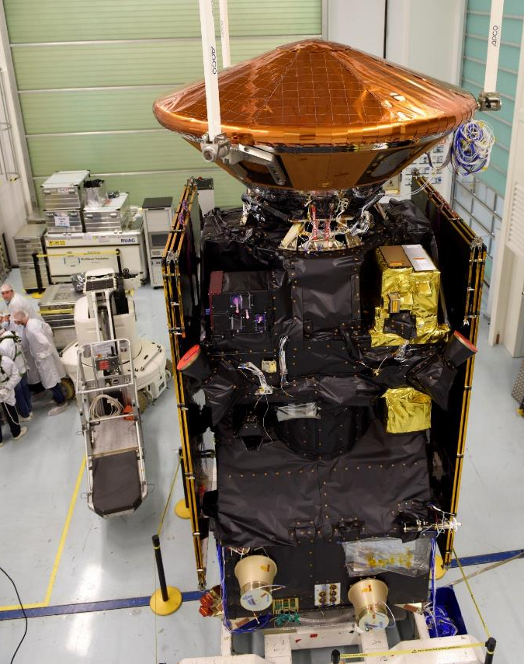
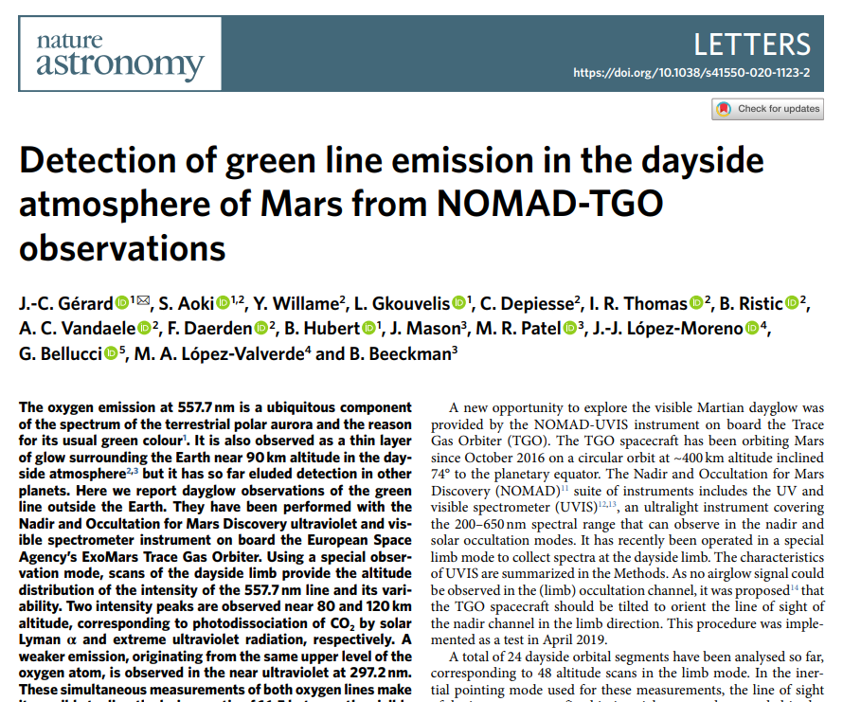
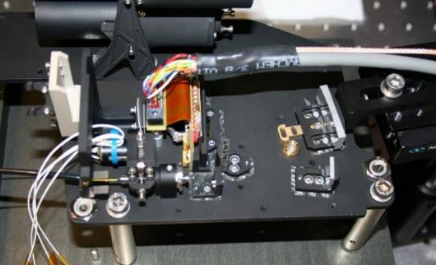
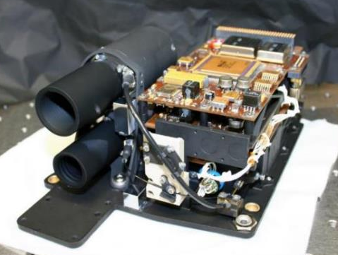
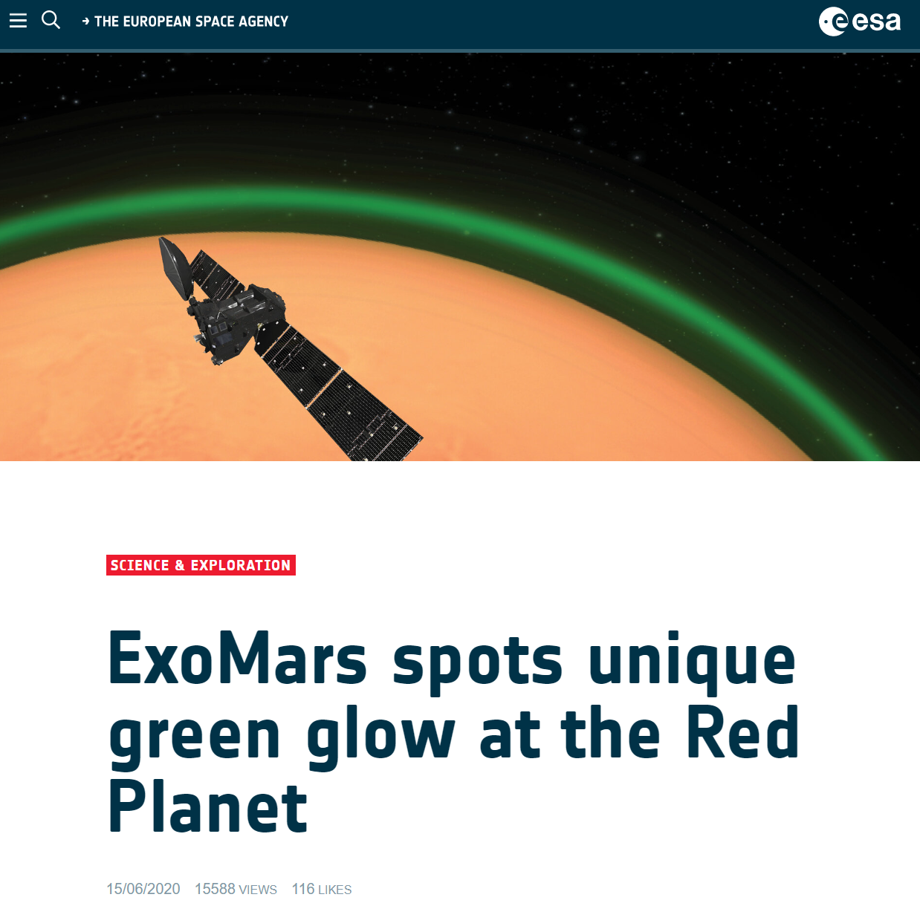

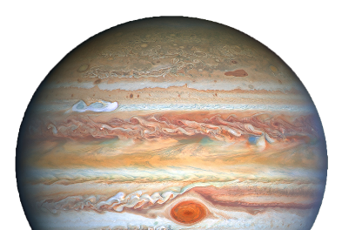
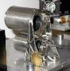






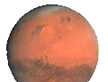
LX intruments – in flight
NOMAD instrument - UVIS
ExoMars Trace Gas Orbiter (ESA-Roscosmos)
Compact UV-VIS spectrometer :
  200-650 nm
  ~1.5 nm resolution
  nadir or limb observations
Launched in 2016
Arrived at final orbit in 2018
©ESA
UVIS

Slide 6
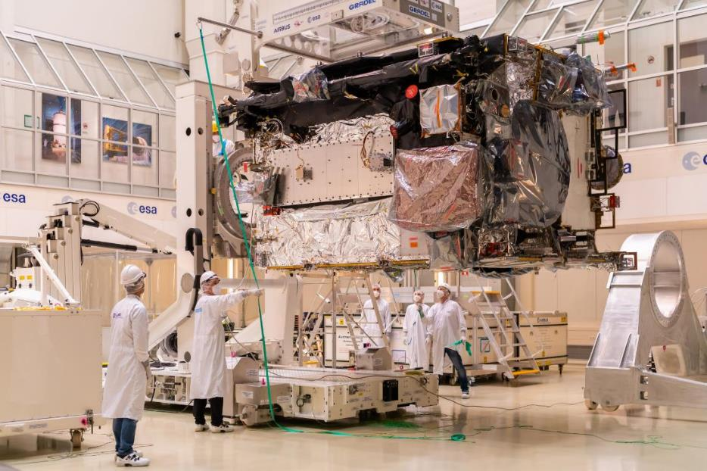
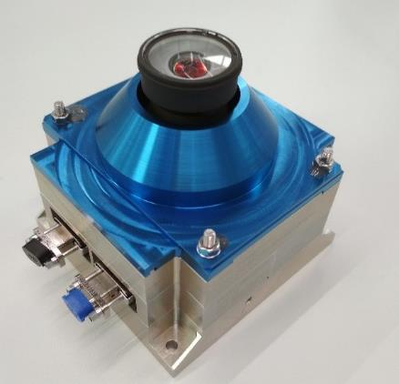
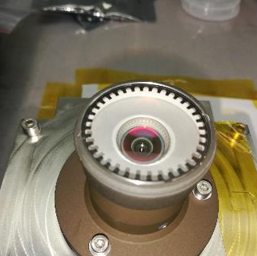

LX intruments – to be launched
JUICE – optics for monitoring camera
JUpiter ICy moons Explorer (ESA)
Specifications:
  FOV: 90°-105°; DoF: 1.2m to inf
  VIS
  4.5 x 5 x 5 cm³
Qualifications:
  Temperature: -40°C to 70°C
  Radiation (40Mrad’s!)
Currently assembled & tested at ESA
Launch: 2023 – ETA: 2031
© MCSE
UVIS
JUICE
Notes:
MCSE: micro cameras and space explorations
2031: arrival at Jupiter, 2034: Ganymede
Objective for one of the monitoring cameras of the JUICE (JUpiter ICy moons Explorer) orbiter (ESA). The camera monitors of the solar array, antenna and spacecraft.
FM delivered in 2021, Launch foreseen for 2023, it will reach the Jupiter systems in 2031, and fly close to Ganymede, Callisto, and Europa.
Very strong radiation specifications (tested at 40 Mrad -> a flat sample with coating was put with a cobalt source for test resistance to gamma rays.
Optical specifications:
FOV : 90° to 105°
DoF : 1.2m to inf
f ~11mm
size: 45mm length, 50mm diameter
VIS
Environment:
Qualification non-operational Temp: -40°C to 70°C
Deep vacuum + long flight -> outgass important (glue, metal coating,..)
radiation : radhard glass + metal shielding

Slide 7
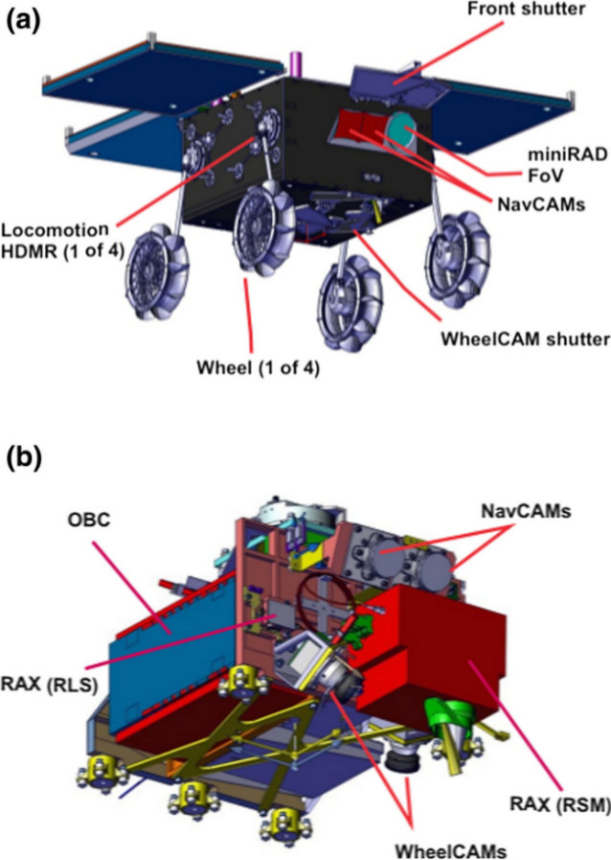
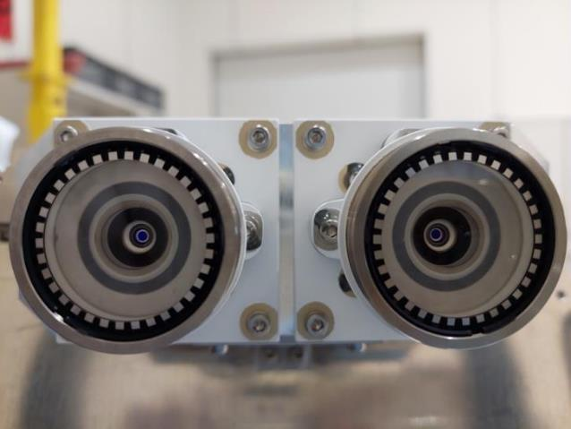
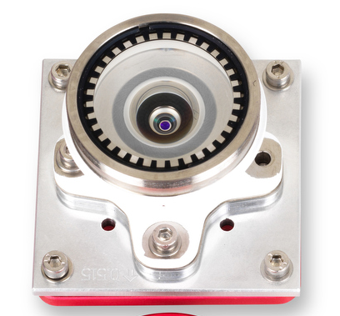
LX intruments – to be launched
MMX – optics for naviagation camera
Martian Moons eXploration (MMX) (JAXA -Japan Aerospace Exploration Agency)
Navigation cameras (stereo)
  FOV: 118°; DoF: 10 cm to inf
  VIS
  5 x 4 x 4 cm³
Qualifications:
  Temperature under vacuum: -45°C to 70°C
  Vibrations – 34G’s random
Currently assembled & tested at CNES
Launch: 2024 – ETA: 2025
© CNES
© CNES
UVIS
MMX
JUICE
Notes:
Camera: 3D plus
Martian Moons eXploration (MMX) - JAXA (Japan Aerospace Exploration Agency (JAXA). NASA, ESA, and CNES participate.
FM delivered in 2021, launch foreseen in 2024, landing in 2025, return to Earth in 2028.
They are going to drill the ground of Phobos, one of the Martian moons, and bring it back to Earth.
Two LX objectives are going to be integrated onto two cameras, which are mounted onto the rover that will land on Phobos. The cameras will be used for the guidance system (NavCams).
https://earth-planets-space.springeropen.com/articles/10.1186/s40623-021-01464-7
Optical specifications:
FOV : 118° diagonal
focal length : 8mm
DoF : 100mm - infinity
size: 50mm length, 40mm diameter
VIS
Environment:
non-operational Temp: -45°C to 70°C
Deep vacuum + long flight -> outgass important (glue, metal coating,..)

Slide 8
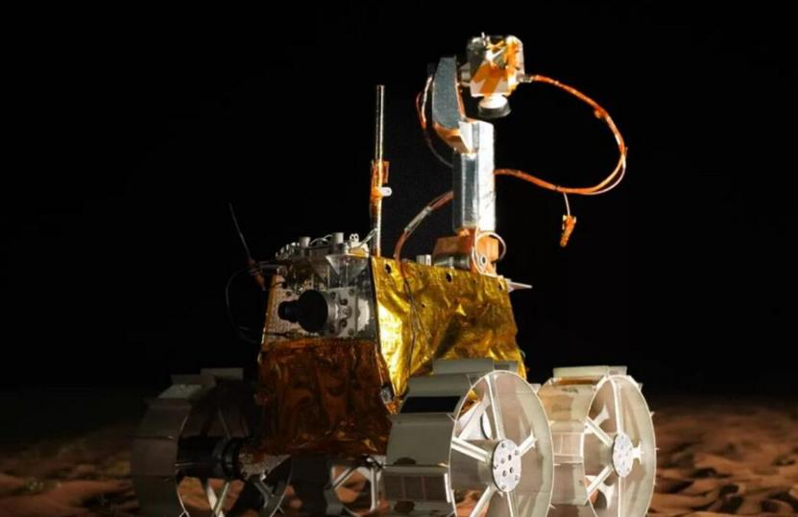
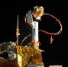
LX intruments – to be launched
Lunar Rovers
Navigation / monitoring cameras for 3 rovers
  Rashid - mohammed bin rashid space centre (MBRSC) - 2022
© MBRSC
Rashid
UVIS
MMX
JUICE
Notes:
Rashid
mohammed bin rashid space centre (MBRSC), United Arab Emirates
Même que MMX (vraiment le même), 2 navigation camera on the rover.
Launch 2022
Intuitive Machines (private commercial company, USA) -> même que MMX (vraiment le même) -
Monitoring camera on the Rover
FM delivered in 2022, launch in 2024
PROSPECT
PROSPECT's drill (ProSEED) will drill beneath the surface in the South Pole region of the Moon and extract samples, expected to contain water ice and other chemicals that can become trapped at the extremely low temperatures expected; typically -150 °C beneath the surface to lower than -200 °C in some areas. (-> https://exploration.esa.int/web/moon/-/59102-about-prospect )
Currently in Phase D (FM) ESA + Leonardo: FM fabrication ongoing
It was in collaboration with Rocosmos, but suspended since this year -> launch date TBD
A camera is on the robotic arm on the lander, the camera looks at the drilling point
Optical specifications:
DoF: 0.3 – 0.6 m
small FOV : 56° horizont/vert
VIS-NIR
Environment:
Qualification non-operational Temp: -110°C to 70°C
Deep vacuum outgass important (glue, metal coating,..)

Slide 9
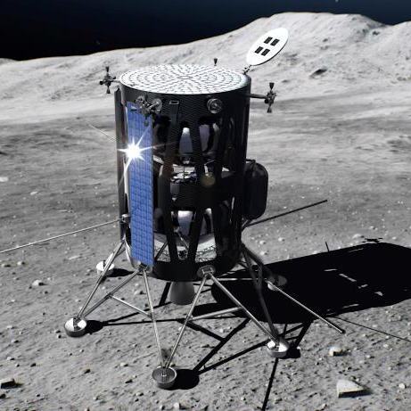
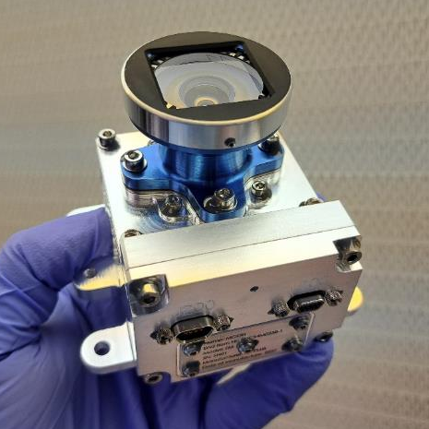
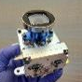
LX intruments – to be launched
Lunar Rovers
Navigation / monitoring cameras for 3 rovers
  Rashid - mohammed bin rashid space centre (MBRSC) - 2022
  Nova-C - Intuitive machines – 2024
© Intuitive Machines
Rashid
Nova-C
UVIS
MMX
JUICE
Notes:
Rashid
mohammed bin rashid space centre (MBRSC), United Arab Emirates
Même que MMX (vraiment le même), 2 navigation camera on the rover.
Launch 2022
Intuitive Machines (private commercial company, USA) -> même que MMX (vraiment le même) -
Monitoring camera on the Rover
FM delivered in 2022, launch in 2024
PROSPECT
PROSPECT's drill (ProSEED) will drill beneath the surface in the South Pole region of the Moon and extract samples, expected to contain water ice and other chemicals that can become trapped at the extremely low temperatures expected; typically -150 °C beneath the surface to lower than -200 °C in some areas. (-> https://exploration.esa.int/web/moon/-/59102-about-prospect )
Currently in Phase D (FM) ESA + Leonardo: FM fabrication ongoing
It was in collaboration with Rocosmos, but suspended since this year -> launch date TBD
A camera is on the robotic arm on the lander, the camera looks at the drilling point
Optical specifications:
DoF: 0.3 – 0.6 m
small FOV : 56° horizont/vert
VIS-NIR
Environment:
Qualification non-operational Temp: -110°C to 70°C
Deep vacuum outgass important (glue, metal coating,..)

Slide 10
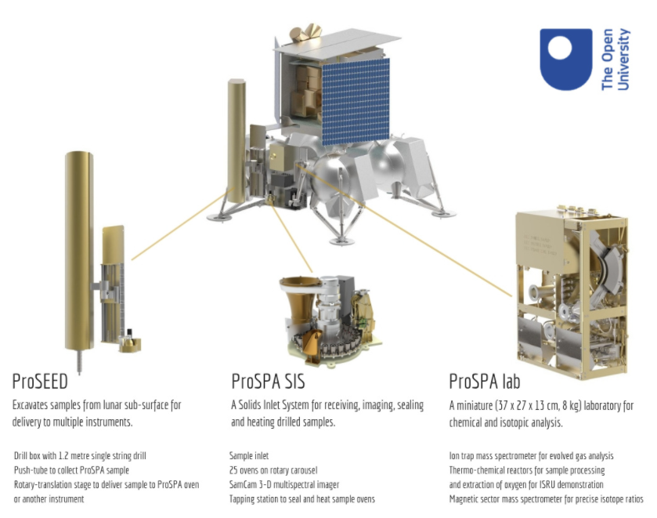
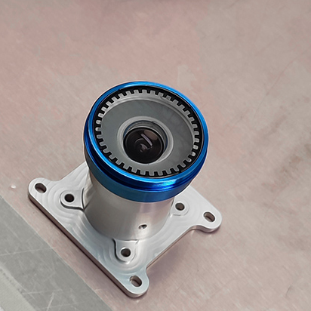

LX intruments – to be launched
Lunar Rovers
Navigation / monitoring cameras for 3 rovers
  Rashid - mohammed bin rashid space centre (MBRSC) – 2022
  Nova-C - Intuitive machines – 2024
  PROSPECT - ESA – 2023 TBC
Rashid
Nova-C
PROSPECT
UVIS
MMX
JUICE
Notes:
Rashid
mohammed bin rashid space centre (MBRSC), United Arab Emirates
Même que MMX (vraiment le même), 2 navigation camera on the rover.
Launch 2022
Intuitive Machines (private commercial company, USA) -> même que MMX (vraiment le même) -
Monitoring camera on the Rover
FM delivered in 2022, launch in 2024
PROSPECT
PROSPECT's drill (ProSEED) will drill beneath the surface in the South Pole region of the Moon and extract samples, expected to contain water ice and other chemicals that can become trapped at the extremely low temperatures expected; typically -150 °C beneath the surface to lower than -200 °C in some areas. (-> https://exploration.esa.int/web/moon/-/59102-about-prospect )
Currently in Phase D (FM) ESA + Leonardo: FM fabrication ongoing
It was in collaboration with Rocosmos, but suspended since this year -> launch date TBD
A camera is on the robotic arm on the lander, the camera looks at the drilling point
Optical specifications:
DoF: 0.3 – 0.6 m
small FOV : 56° horizont/vert
VIS-NIR
Environment:
Qualification non-operational Temp: -110°C to 70°C
Deep vacuum outgass important (glue, metal coating,..)

Slide 11
LX intruments – under assembly
Lunar Rovers
Navigation / monitoring cameras for 3 rovers
  Rashid - mohammed bin rashid space centre (MBRSC) – 2022
  Nova-C - Intuitive machines – 2024
  PROSPECT - ESA – 2023 TBC
Specifications
  Various FoV and DoF depending on the application
  VIS and VIS-NIR (PROSPECT)
Qualifications
  Temperature: -110°C to 70°C
  Radiations (PROSPECT): 300kRad’s
Rashid
Nova-C
PROSPECT
UVIS
MMX
JUICE
Notes:
Rashid
mohammed bin rashid space centre (MBRSC), United Arab Emirates
Même que MMX (vraiment le même), 2 navigation camera on the rover.
Launch 2022
Intuitive Machines (private commercial company, USA) -> même que MMX (vraiment le même) -
Monitoring camera on the Rover
FM delivered in 2022, launch in 2024
PROSPECT
PROSPECT's drill (ProSEED) will drill beneath the surface in the South Pole region of the Moon and extract samples, expected to contain water ice and other chemicals that can become trapped at the extremely low temperatures expected; typically -150 °C beneath the surface to lower than -200 °C in some areas. (-> https://exploration.esa.int/web/moon/-/59102-about-prospect )
Currently in Phase D (FM) ESA + Leonardo: FM fabrication ongoing
It was in collaboration with Rocosmos, but suspended since this year -> launch date TBD
A camera is on the robotic arm on the lander, the camera looks at the drilling point
Optical specifications:
DoF: 0.3 – 0.6 m
small FOV : 56° horizont/vert
VIS-NIR
Environment:
Qualification non-operational Temp: -110°C to 70°C
Deep vacuum outgass important (glue, metal coating,..)

Slide 12
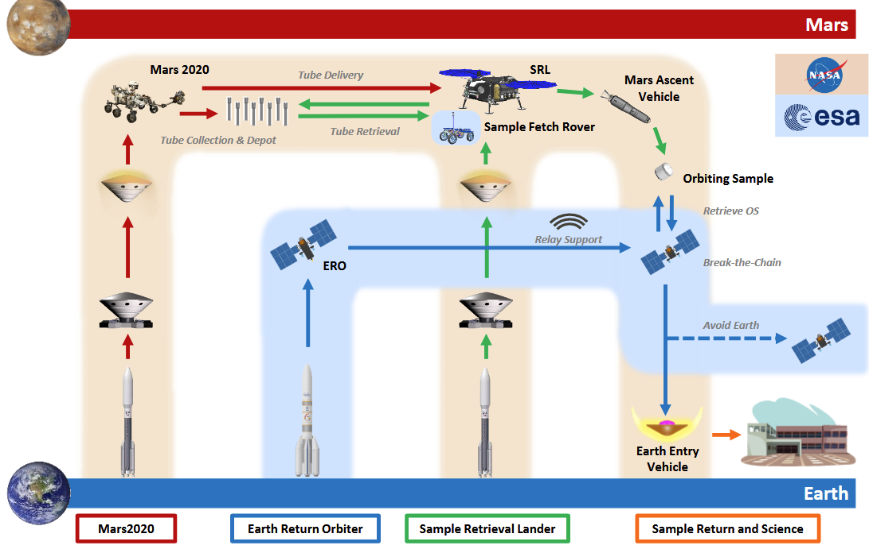


LX intruments – under design
MSR – ERO & STA
Mars Sample Return (ESA-NASA): collect and return samples to Earth by 2031
Rashid
Nova-C
MSR-ERO
MSR-STA
PROSPECT
UVIS
MMX
JUICE

Slide 13
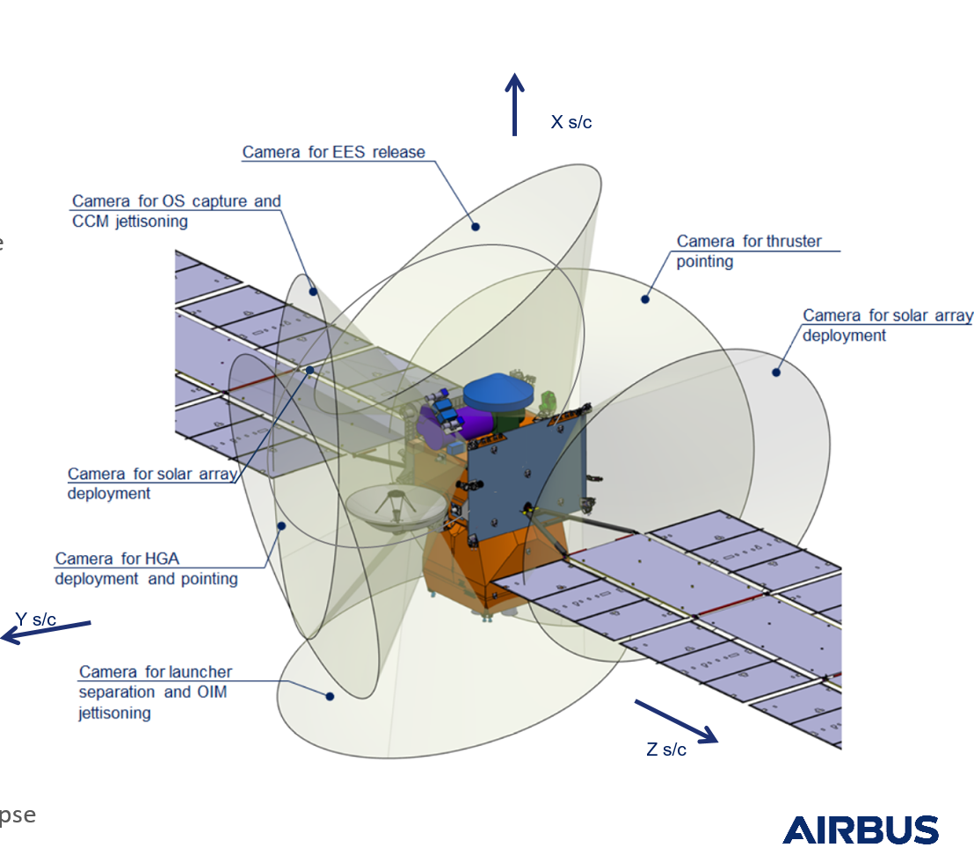
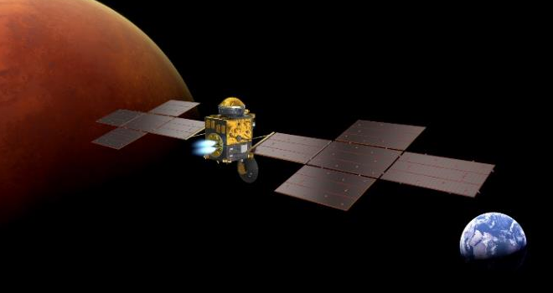
LX intruments – under design
MSR – ERO & STA
Mars Sample Return (ESA-NASA):
Eart Return Orbiter:
  7 monitoring optics
  FOV: 110°; DoF: 1 m to inf
  Temperature: -60°C to 70°C
  Radiations: 1.6 Mrad’s
  Currently Phase C
© ESA
Rashid
Nova-C
MSR-ERO
MSR-STA
PROSPECT
UVIS
MMX
JUICE
Notes:
MSR: Mars Sample Return – ERO: Earth Return Orbiter – ESA
LX builds the optics for 7 monitoring cameras for the Orbiter around Mars
Project started at the end of 2021 – currently EM being built
FOV : 80° to 110° -> mm que MMX
DoF: 1m to inf.
VIS
Environment:
Qualification non-operational Temp: -60°C to 70°C
Deep vacuum + long flight -> outgass important (glue, metal coating,..)
radiation : radhard front glass + metal shielding

Slide 14
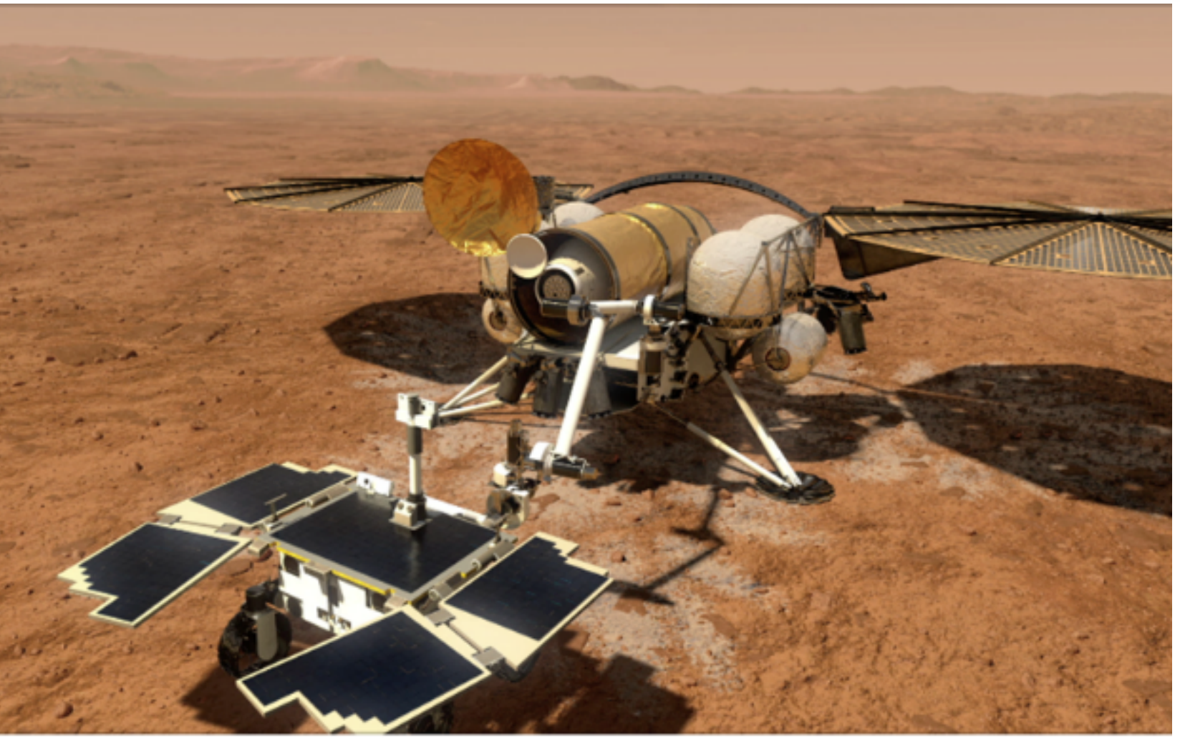
LX intruments – under design
MSR – ERO & STA
Mars Sample Return (ESA-NASA):
Sample Transfer Arm on the Sample Retrieval Lander
  2 navigation optics
  FOV: 60°; DoF: 25 cm to 1 m
  Temperature: -130°C to 80°C
  Radiation mainly during cruise & protected: 272 kRad’s
  Biological contamination→ High temperature bake out required!
  Currently Phase C
© Caltech/JPPL
Rashid
Nova-C
MSR-ERO
MSR-STA
PROSPECT
UVIS
MMX
JUICE
Notes:
MSR: Mars Sample Return – ERO: Earth Return Orbiter – ESA
LX builds the optics for 7 monitoring cameras for the Orbiter around Mars
Project started at the end of 2021 – currently EM being built
FOV : 80° to 110° -> mm que MMX
DoF: 1m to inf.
VIS
Environment:
Qualification non-operational Temp: -60°C to 70°C
Deep vacuum + long flight -> outgass important (glue, metal coating,..)
radiation : radhard front glass + metal shielding

Slide 15
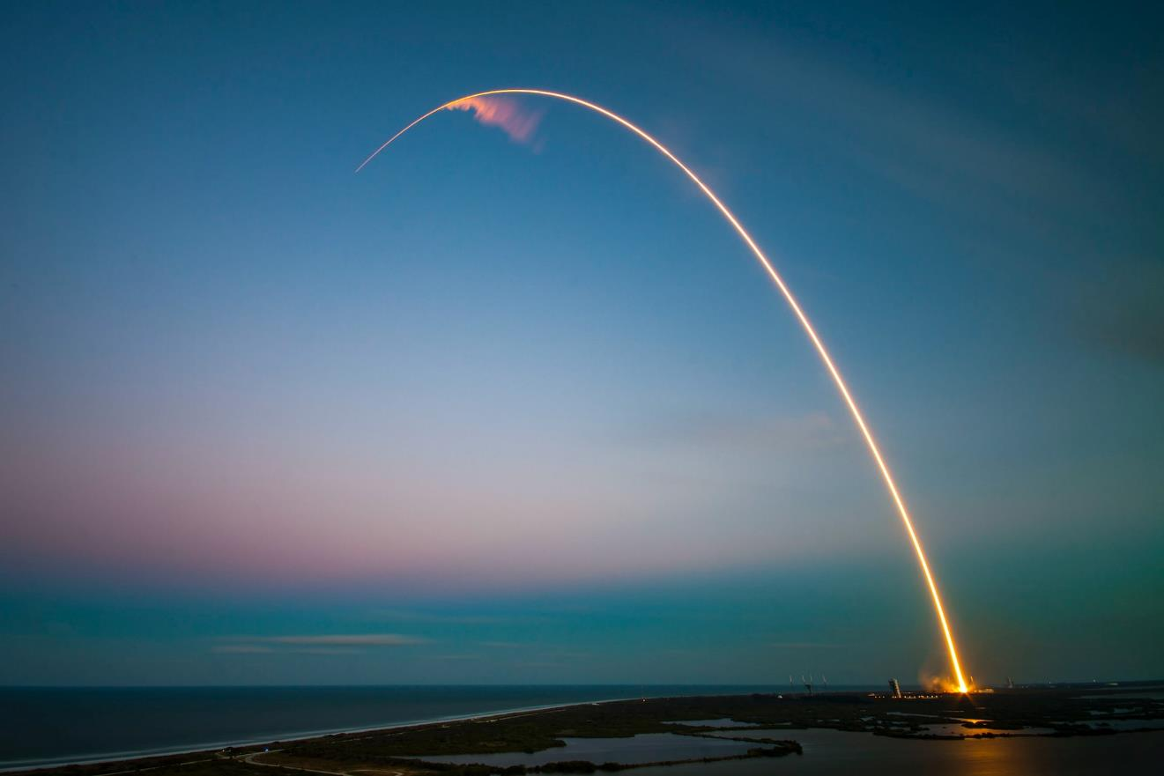
Summary
Summary
LX is an active partner in the field of space discovery.
Space is big and fun, and there is still a lot to do!
https://hightech.lambda-x.com/jobs/

Slide 16
Serena Bolis
System engineer
sbolis@lambda-x.com

