Slide 1


OIP Sensor Systems
Your partner for Space & Security missions

Slide 2
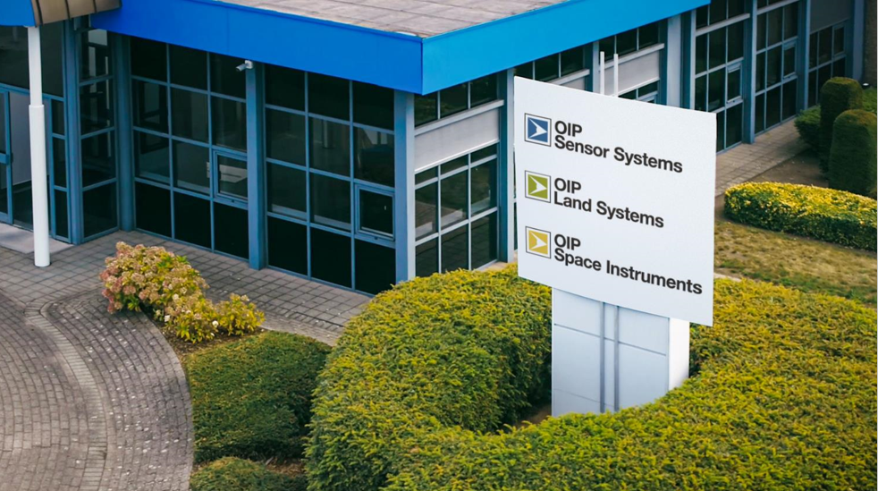
OIP Space Systems
CLIM TEAM
NOMAD
Instrument for Mars atmospheric analysis, searching for traces of life
Switch to Space 3 | 19/10/2022

Slide 3
What is NOMAD?
Spectrometer
A payload of the Exomars 2016 mission
In orbit around mars
Chemical composition of Mars atmosphere
  Methane
  Other trace gases

Slide 4
What is NOMAD?
3 channels:
  SO: infrared spectrometer
  LNO: infrafred spectrometer
  UVIS: UV & visual spectrometer
OIP activities
  Industrial lead: project management and system engineering
  SO & LNO: optical and mechanical design
  Overall assembly and testing

Slide 5
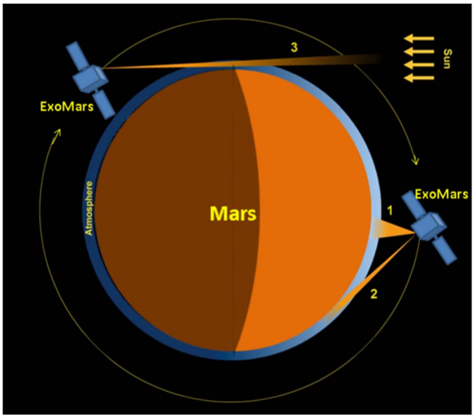
Working principle
Nadir
Limb
Occultation
© IASB-BIRA

Slide 6
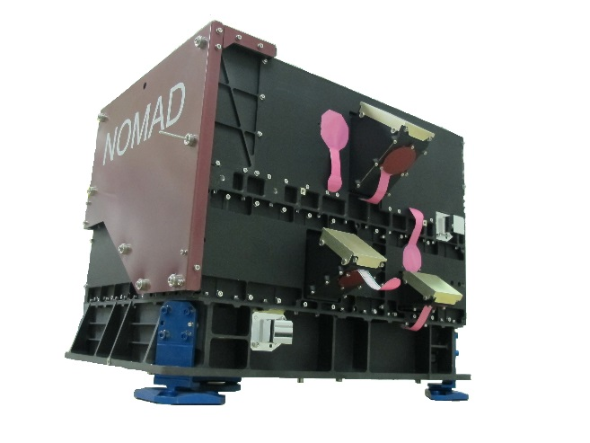
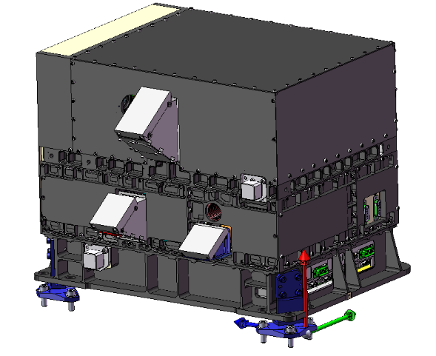
NOMAD

Slide 7
Timeline
5 years from idea to finished instrument
  2010-2013: design phase
  2013-2015: build, test & delivery
March 2016: launch
October 2016: arrival at Mars and orbit insertion
2018 up to today: science mission

Slide 8
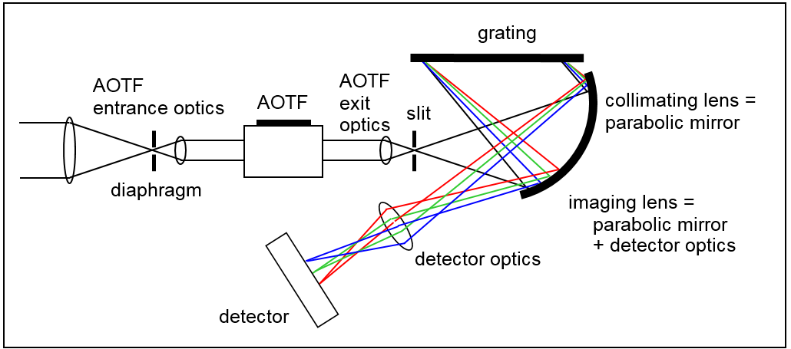
Schematic optical design

Slide 9
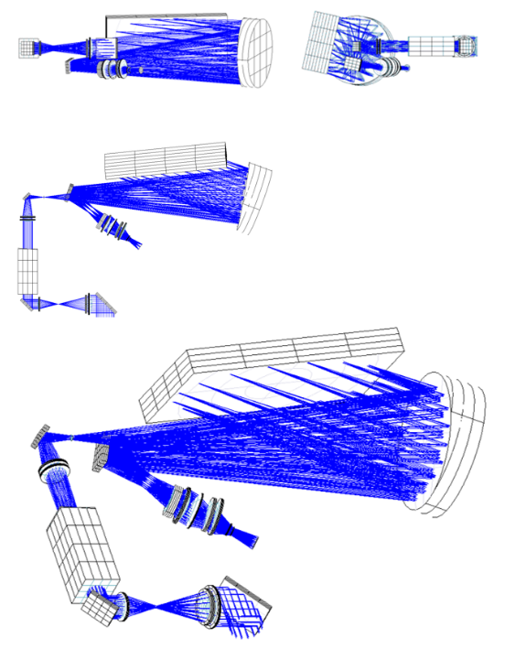
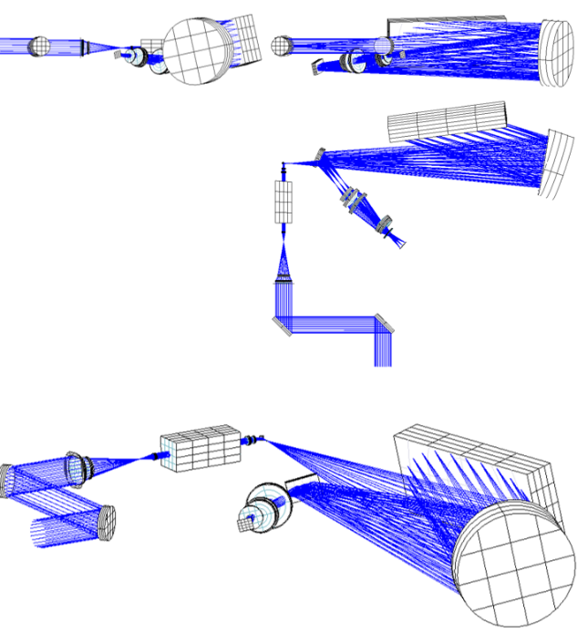
Detailed optical design

Slide 10
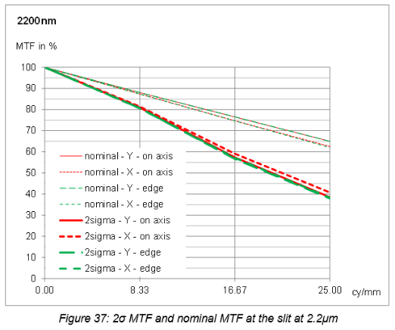
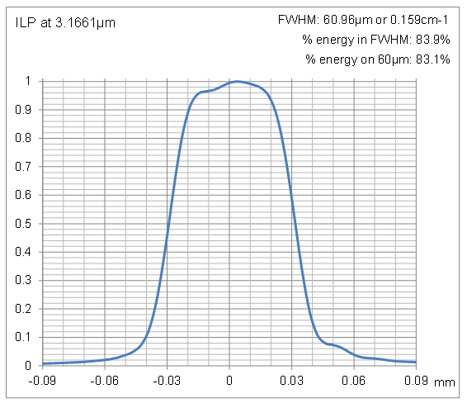
Detailed optical design
Analyses: feasibility, performance, tolerances, thermal,...

Slide 11
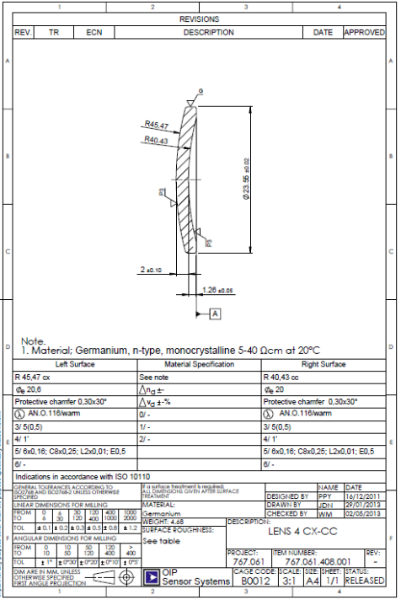
Detailed optical design
Output:
Optical drawings
Design report

Slide 12
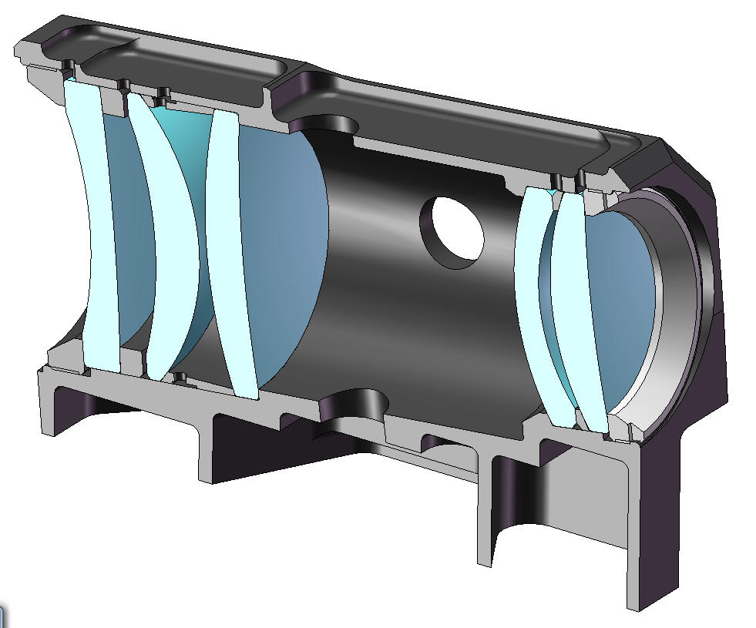
Mechanical design – lens holders

Slide 13
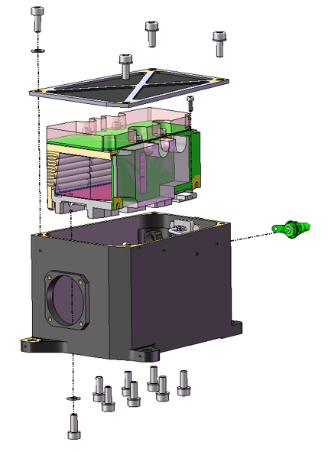
Mechanical design – AOTF box

Slide 14
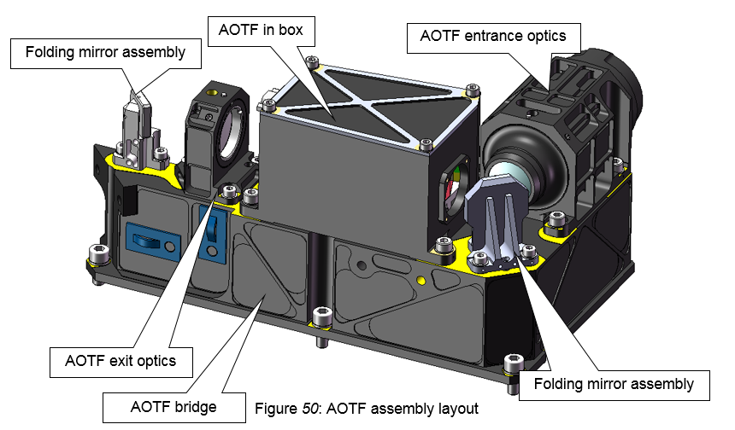
Mechanical design – input optics

Slide 15
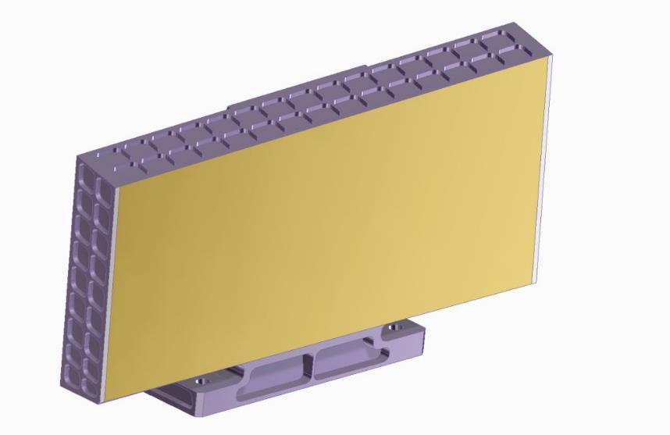
Mechanical design – monolithic grating

Slide 16
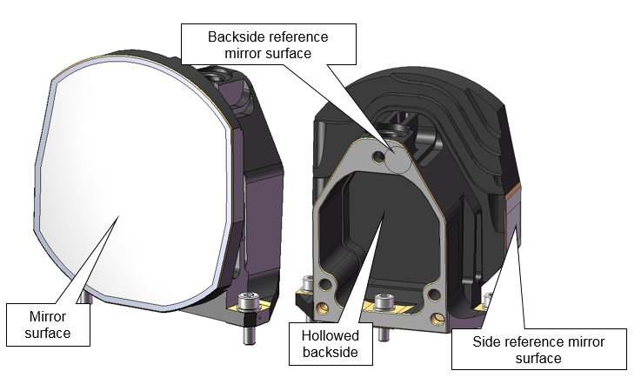
Mechanical design – monolithic mirror

Slide 17
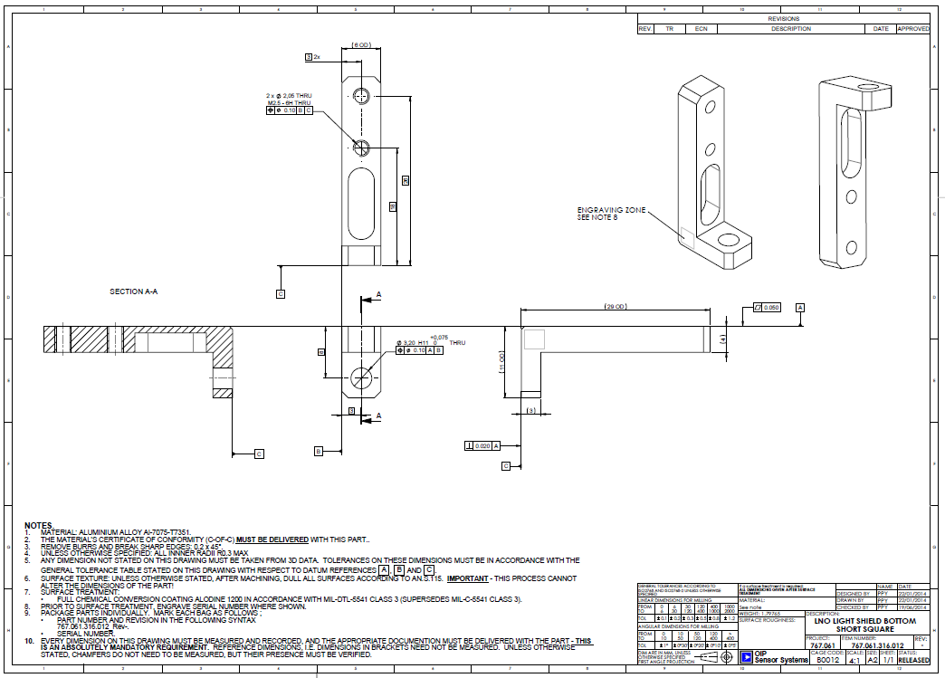
Mechanical design – part drawings

Slide 18
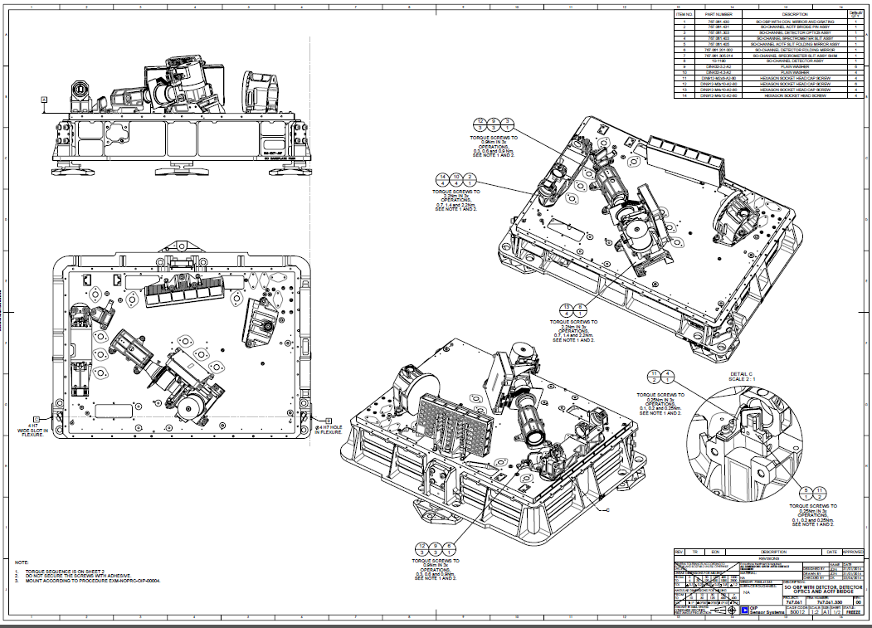
Mechanical design – assembly drawings

Slide 19
General work
Lots of documents
Design is approved in design reviews
Partners
  UVIS channel
  Electronic design & manufacturing
  Radiation analysis
  Structural & thermal analyses

Slide 20
General work
Project management
  Planning
  Reporting
  Financial
System engineering
  Technical coordination
  ~2000 requirements to manage
  Verification of all requirements: design / analyses / tests
Product Assurance
  Verification of workmanship, procedures, materials
  Inspections
  Cleanliness

Slide 21
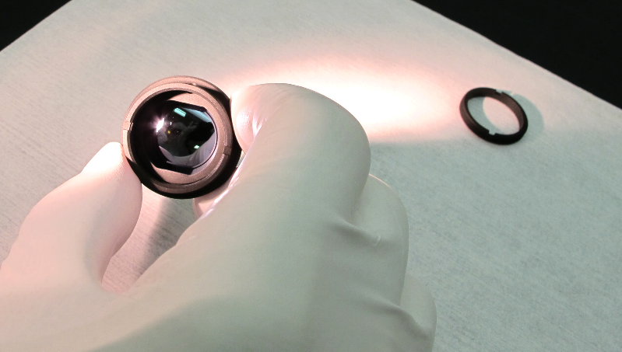
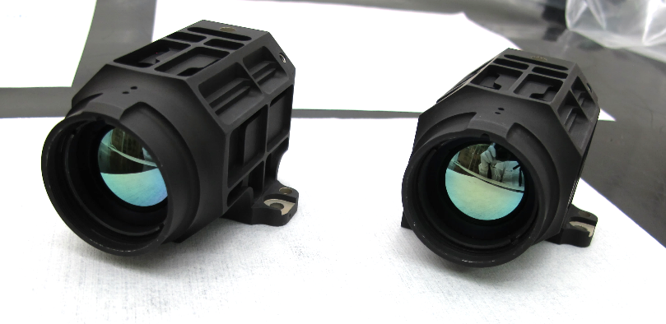
Assembly & integration: lens modules

Slide 22
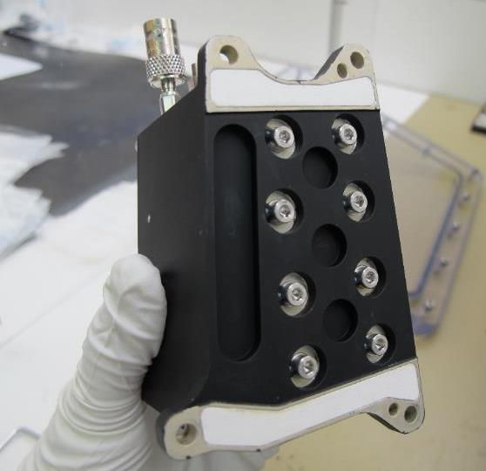
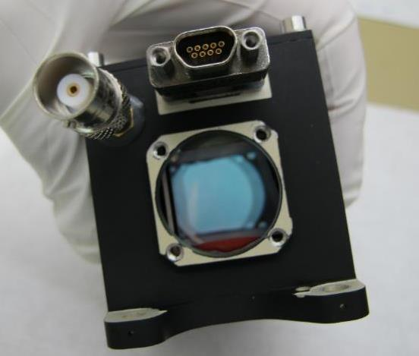
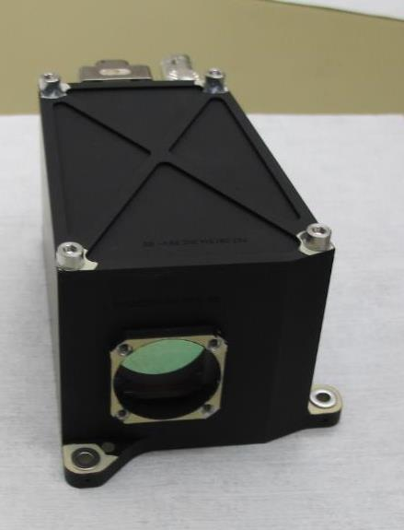
Assembly & integration: AOTF module

Slide 23
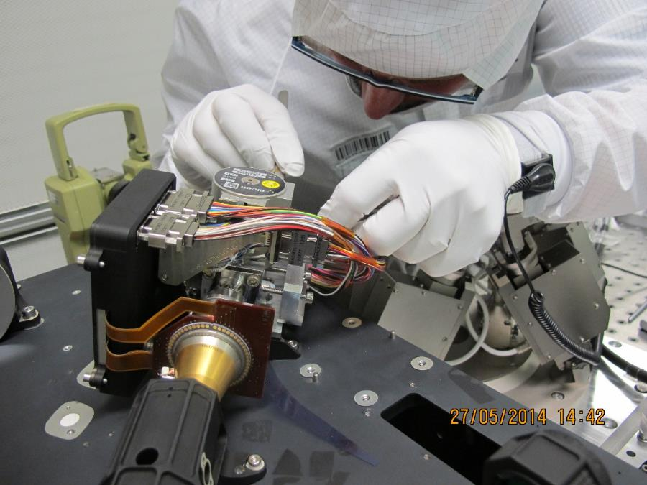
Assembly & integration – detector assembly

Slide 24
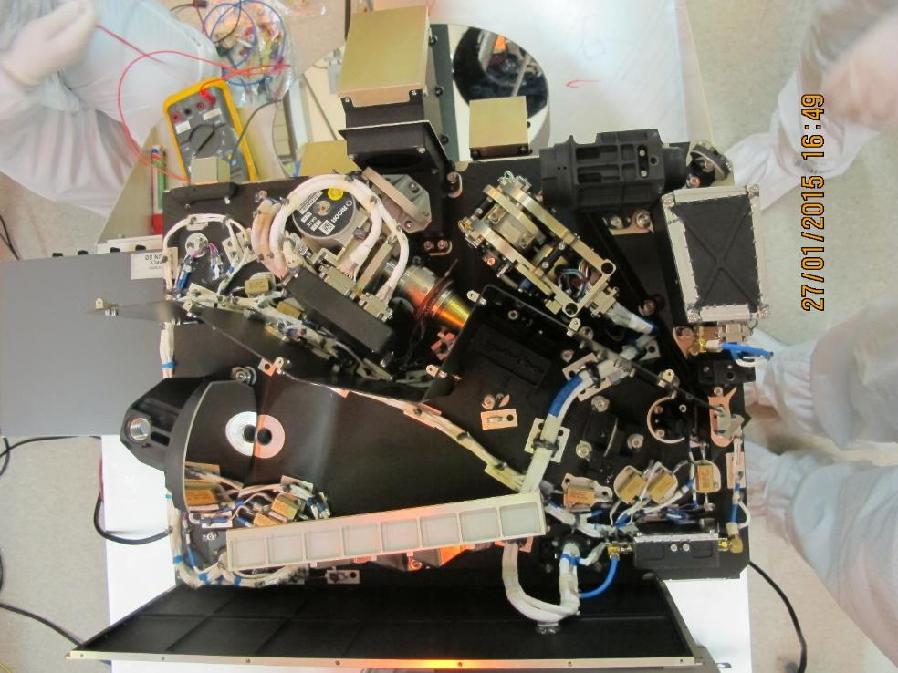
Assembly & integration: overall assembly

Slide 25
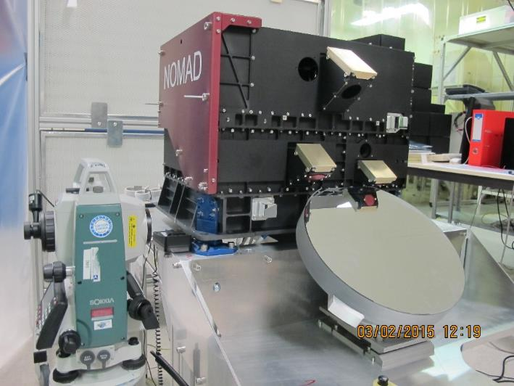
Assembly and alignment finished

Slide 26
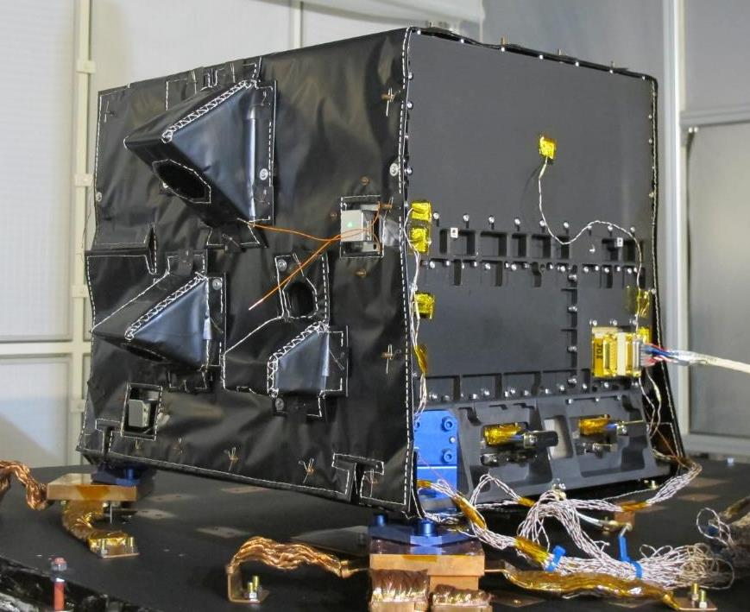
Multi-layer insulation

Slide 27
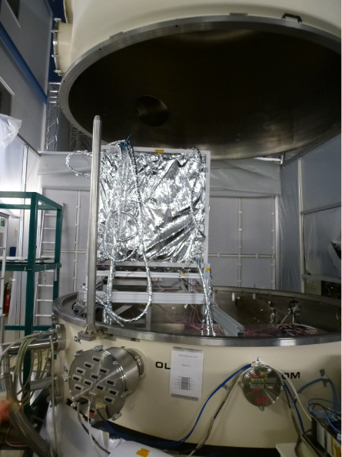
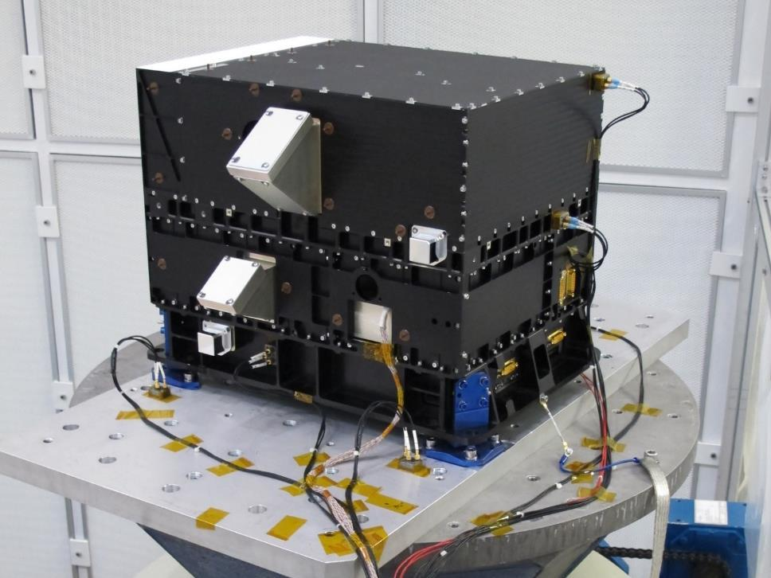
Tests
Tests at system level
  Thermal vacuum tests
    Thermal cycling
    Thermal balance
    Scientific calibration
  Vibration test
  Shock test
  Electromagnetic compatiblity tests
For each test:
  Test procedure
  Test report
© CSL

Slide 28
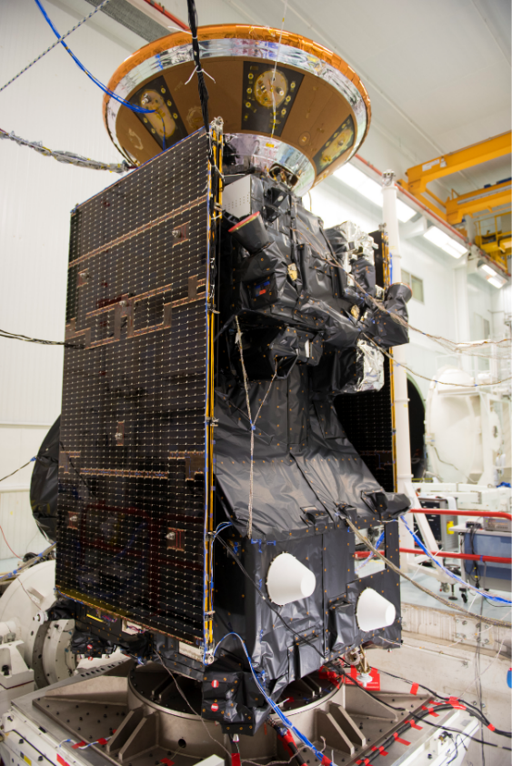
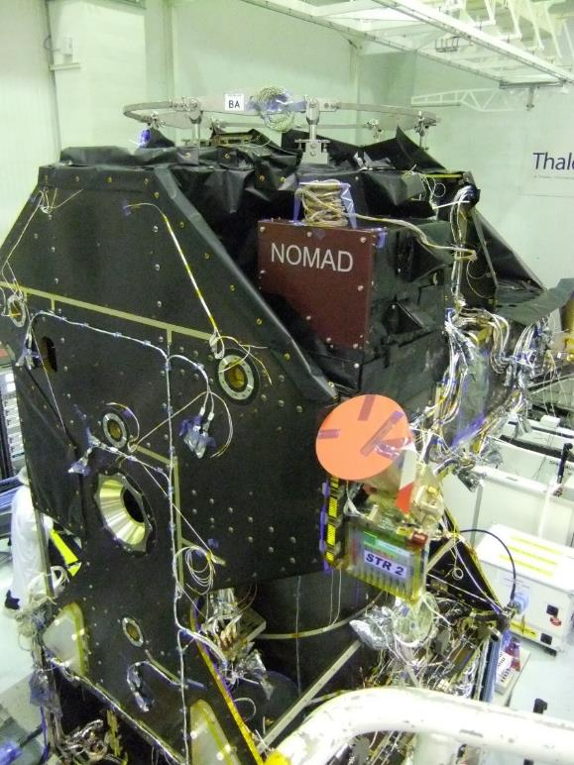
Integration in spacecraft

Slide 29

And today?
Boring can be good!
Monthly operations reports:
Scientific papers published, more in preparation
...
...
...

Slide 30

Thank you for your attention
For more information:
Stefan Lesschaeve | stefan.lesschaeve@oip.be
OIP Sensor Systems | Westerring 21 | B-9700 Oudenaarde

