Slide 1
Telespazio Belgium
Federico Rossi – President & CEO
Switch to Space 3
Bruxelles 19/10/2022

Slide 2
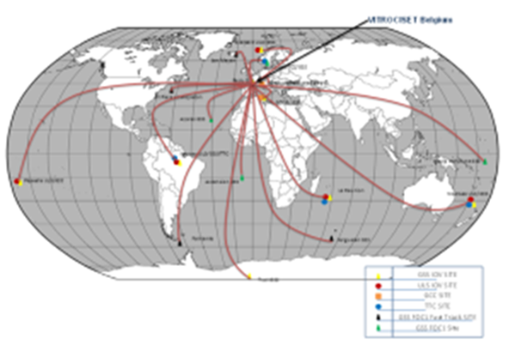
We are Telespazio
33%
Joint Venture between Leonardo and Thales
European leader and a major world actor in Satellite Space Service and Solutions
Wealth of Experience of the Highest Level, for 60+ years of business practice
67%
~600M €
+3K
2021 REVENUES
EMPLOYEES
+60
15
13
YEARS OF
EXPERIENCE
COUNTRIES
OF PRESENCE
COMPANIES WORLDWIDE
We are Telespazio Belgium
Young (39 years average), dynamic and rapidly growing Belgian company with roots on the territory
4 decades of expertise to provide efficient and innovative solutions
~55M €
+175
2021 REVENUES
EMPLOYEES
+40
+24
38
YEARS OF
EXPERIENCE
NATIONALITIES
% of women in the company
federico.rossi@telespazio.com - Switch to Space 3 – Bruxelles 16/10/2022

Slide 3
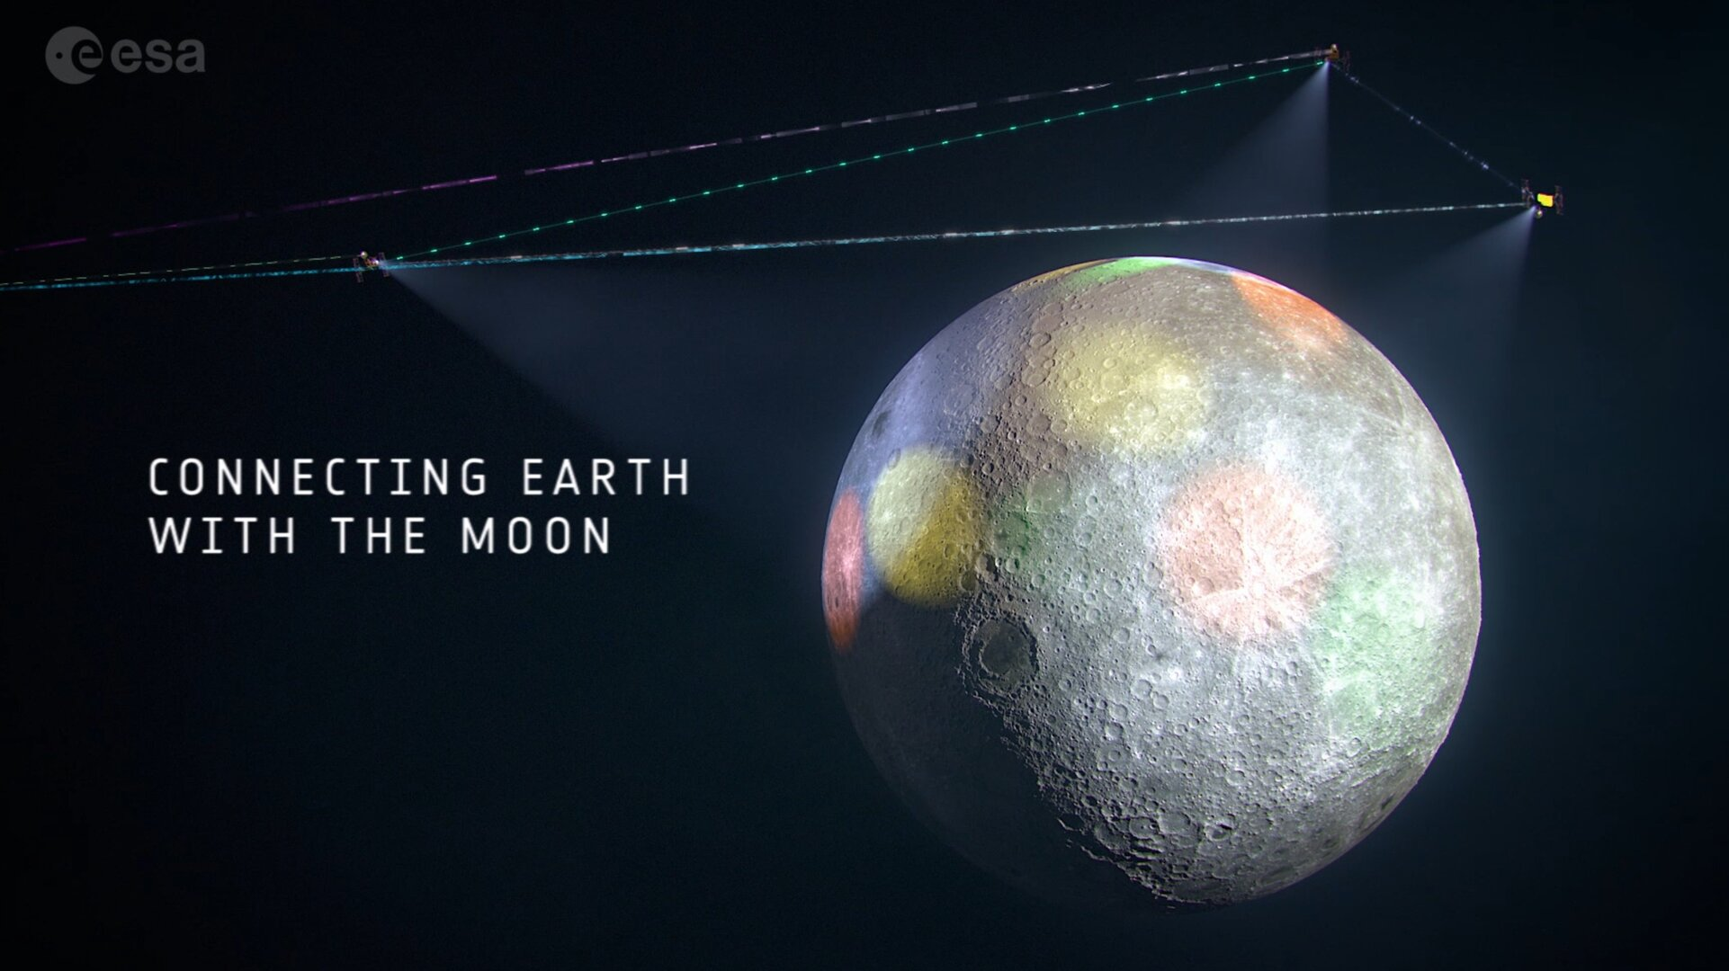
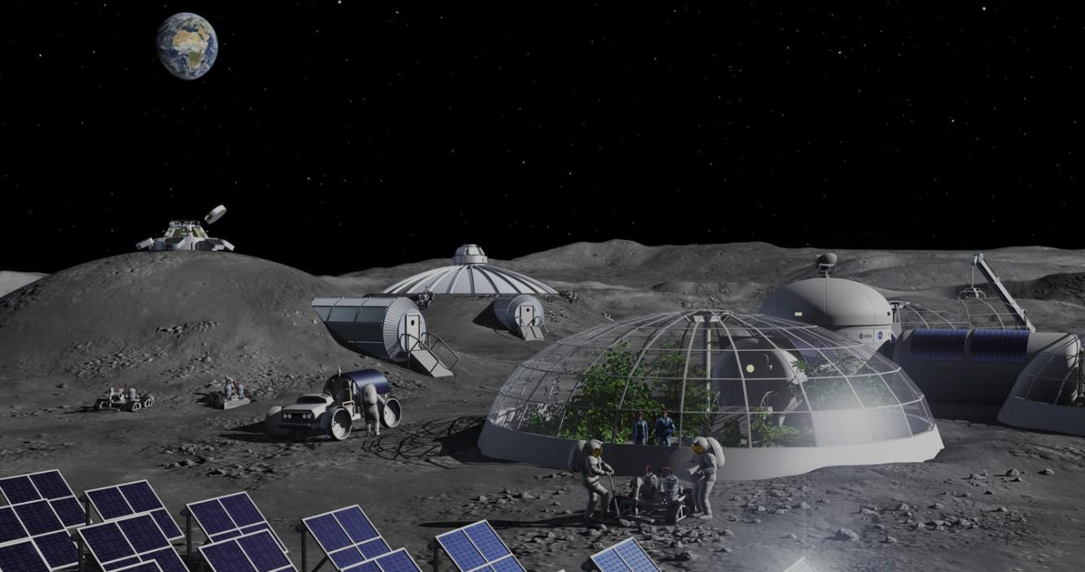
Telespazio in Space Exploration
Enabling habitats on the Moon and Mars
Communicate and Navigate on the Moon
Telespazio as Prime Contractor in the Lunar Communication and Navigation Service (LCNS) project
Commercial provider for orbiting and surface users
Participating in technology developments
Integrated Logistics Support
Moon mapping
Cultivate food on the Moon and Mars
ReBUS (In-Situ Resource Bio-Utilization for supporting life in Space): Telespazio part of a consortium of Universities and research institutes
Managing experiments in microgravity on the International Space Station (ISS)
federico.rossi@telespazio.com - Switch to Space 3 – Bruxelles 16/10/2022

Slide 4
federico.rossi@telespazio.com - Switch to Space 3 – Bruxelles 16/10/2022

