Slide 1
Switch To Space
Topic 3: Out of this world technologies
To Jupiter and Back Again
The Challenges of Communication at a
distance of 900 Million kilometers
(07/10/2020 – Mattias Genbrugge)

Slide 2
Today?
Today we will talk about a ESA Mission to Jupiter: JUICE
- an overview of its key scientific objectives,
- a description of the complex JUICE orbital trajectory,
- the spacecraft lay-out,
- the Communication Subsystem and its technical challenges
Sources of scientific background: ESA / NASA

Slide 3
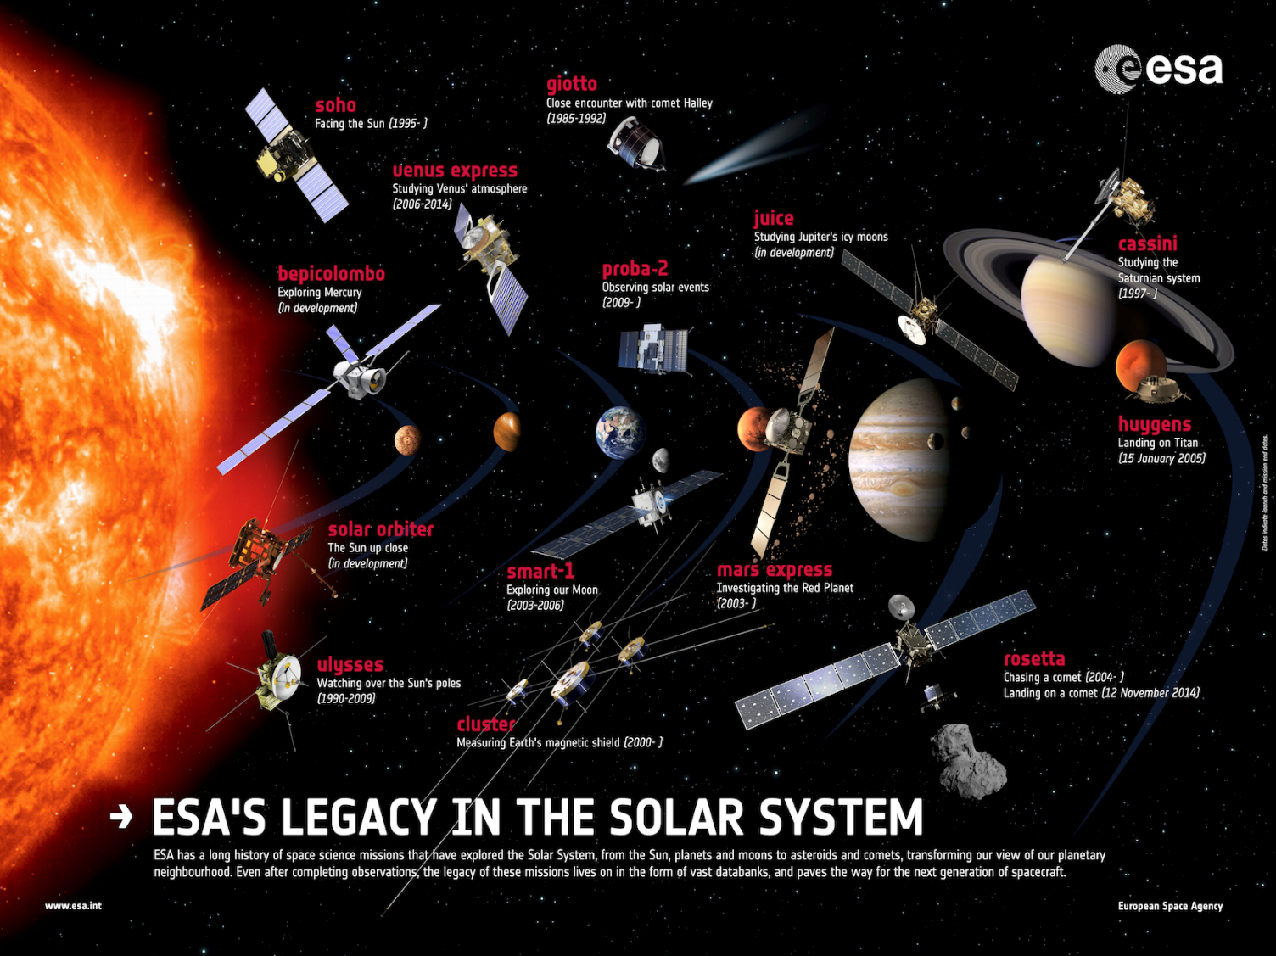
Space Missions : JUICE

Slide 4
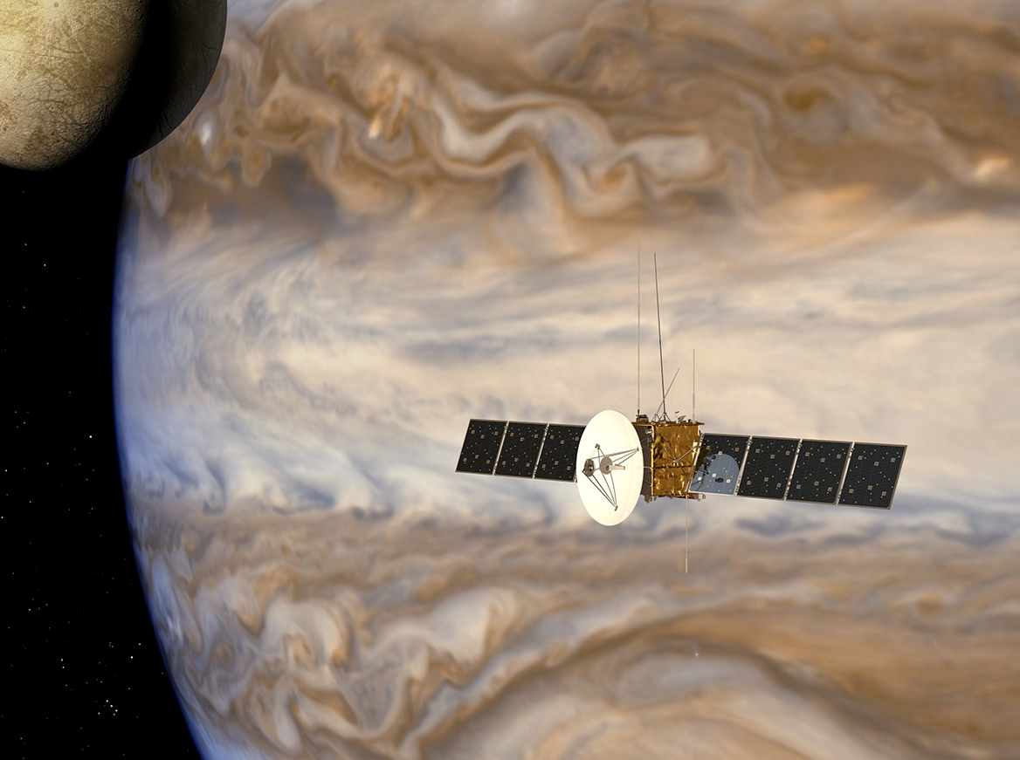
(2) Space Missions : JUiCE

Slide 5
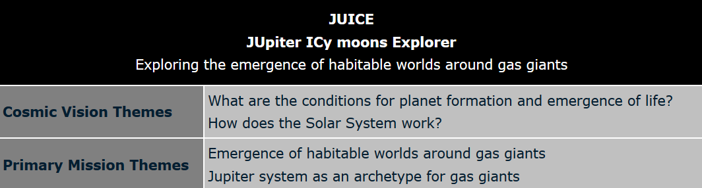
JUICE - Jupiter Icy Moon Explorer
JUICE is the first large-class mission in ESA's Cosmic Vision 2015-2025 program:
Planned for launch in 2022 and arrival at Jupiter in 2030, it will spend at least three years making detailed observations of the giant gaseous planet Jupiter and three of its largest moons, Ganymede, Callisto and Europa.
Antwerp Space is part of the JUICE consortium as we provide the Communication Subsystem (COMS) of the JUICE Spacecraft.

Slide 6
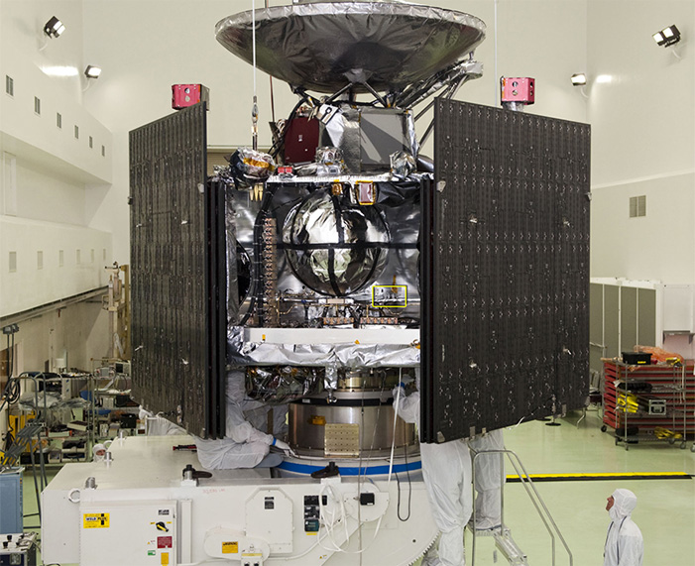
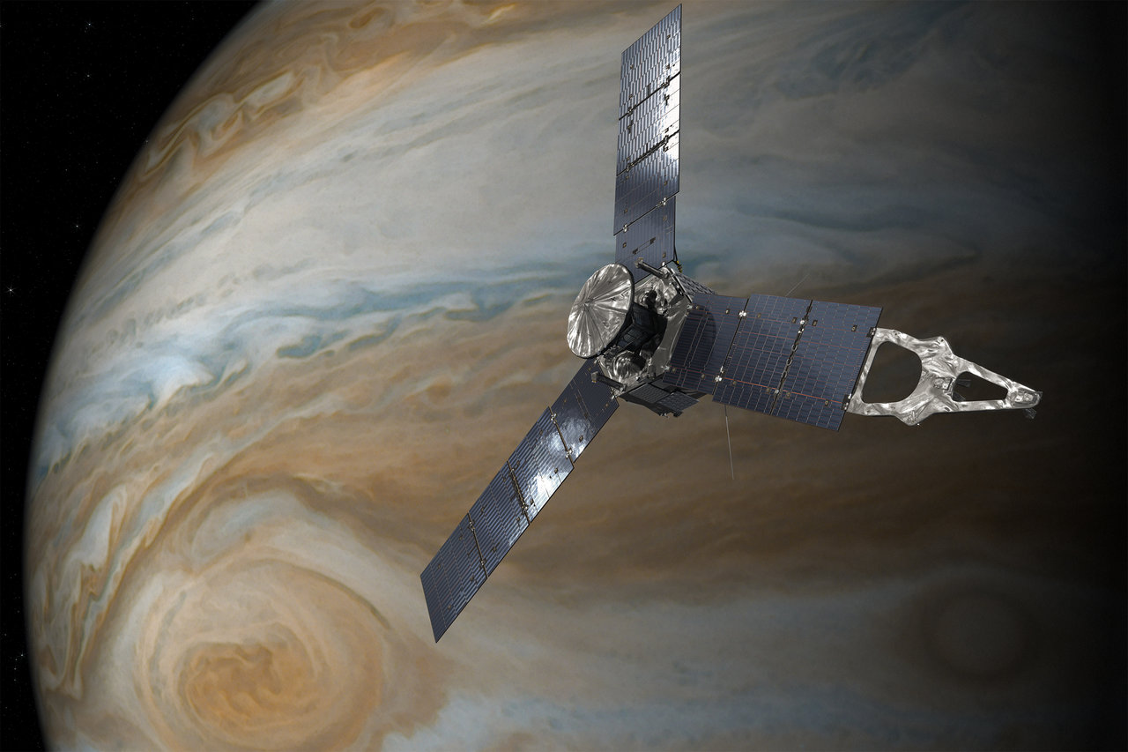
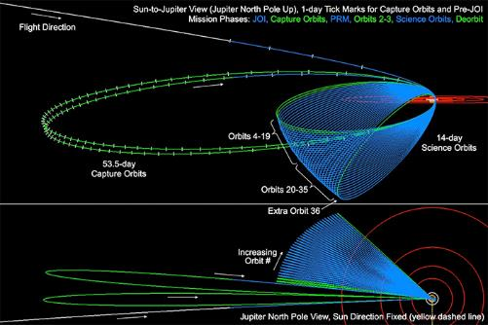
JUNO?
NASA mission: launched in 2011, currently in orbit around Jupiter
JUNO: a spinning, solar-powered spacecraft in a highly elliptical polar orbit

Slide 7
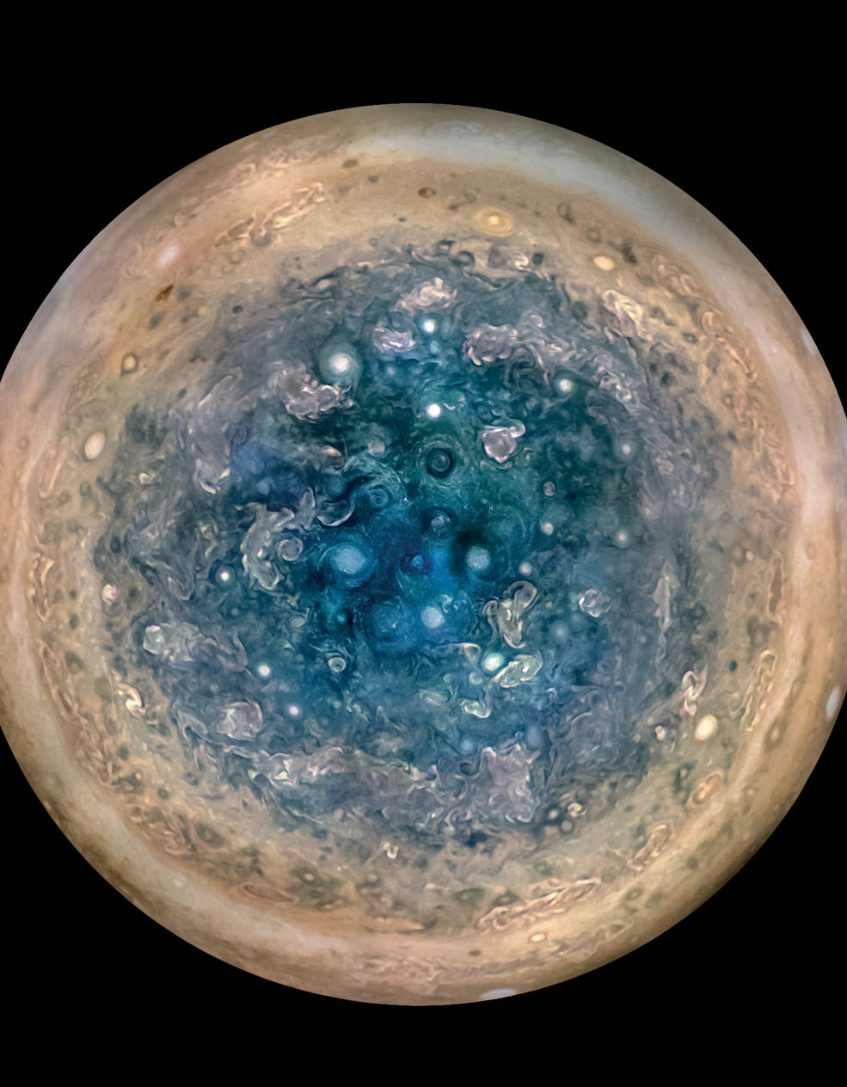
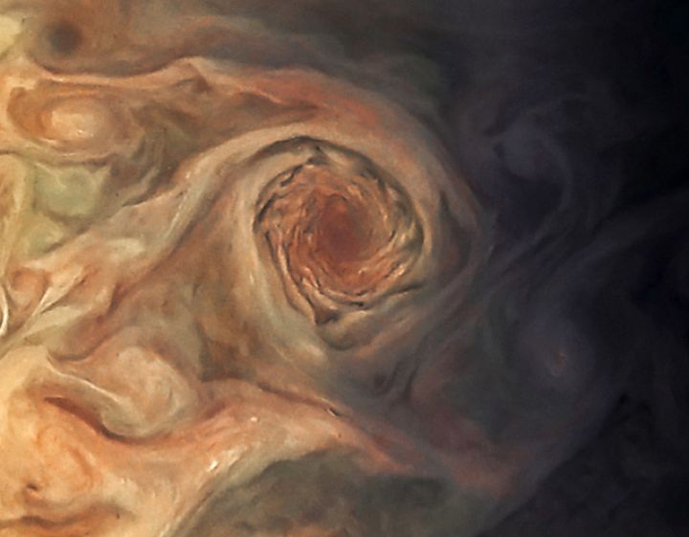
JUNO – First Images (NASA)

Slide 8
Jupiter – Factoids (NASA.gov)
Jupiter is a giant ball of gas 11 times wider than Earth, 300 times more massive than our planet and five times farther from the sun. The giant world takes 12 years to orbit the sun, but rotates so fast that its day is only 10 hours long.
As the most massive world in our solar system, orbited by four large moons -- Io, Europa, Ganymede and Callisto -- and 60 smaller ones (as far as we know), Jupiter forms its own solar system in miniature. Jupiter resembles a star in composition, and if it had been about 80 times more massive, it would have become a star rather than a planet.
The composition of Jupiter is similar to that of the sun — mostly hydrogen and helium. Its composition and great size imply that it was the first planet to form, incorporating most of the leftover gas not incorporated into the sun.

Slide 9
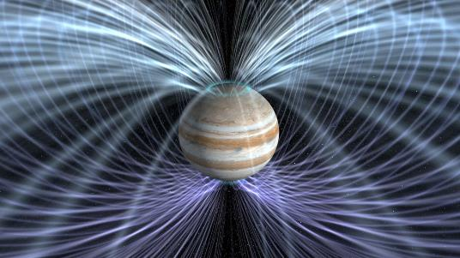
Jupiter – Factoids (NASA.gov)
Deep in the atmosphere, the pressure and temperature increase, compressing the hydrogen gas into a liquid. At depths of about 1/3rd of the way down, the hydrogen becomes a liquid that conducts electricity like a metal. Jupiter's powerful magnetic field could be generated by electrical currents in this giant, swirling ocean of liquid metallic hydrogen, driven by Jupiter's fast rotation.
At the planet's center, the temperature is several times hotter than the surface of the sun, and the pressure is tens of millions of times the air pressure on Earth.

Slide 10
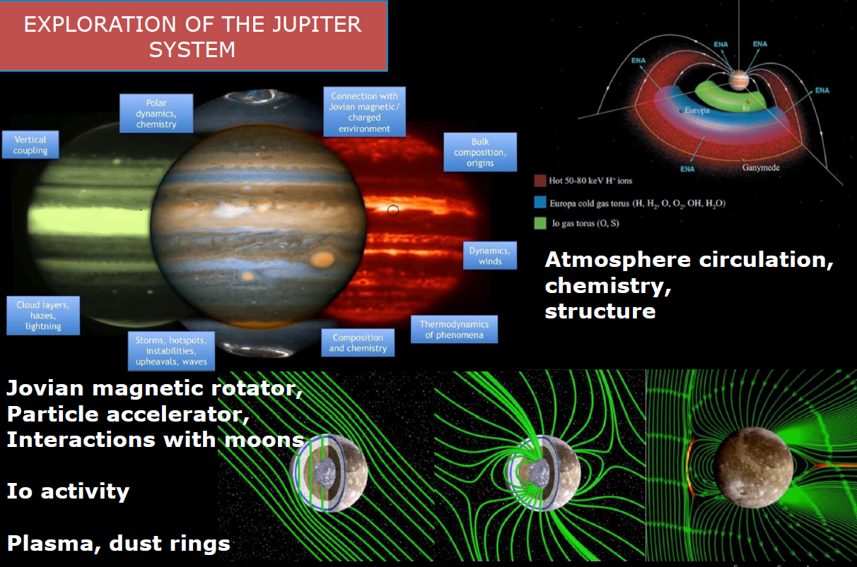
JUICE Science Mission (courtesy of ESA)

Slide 11
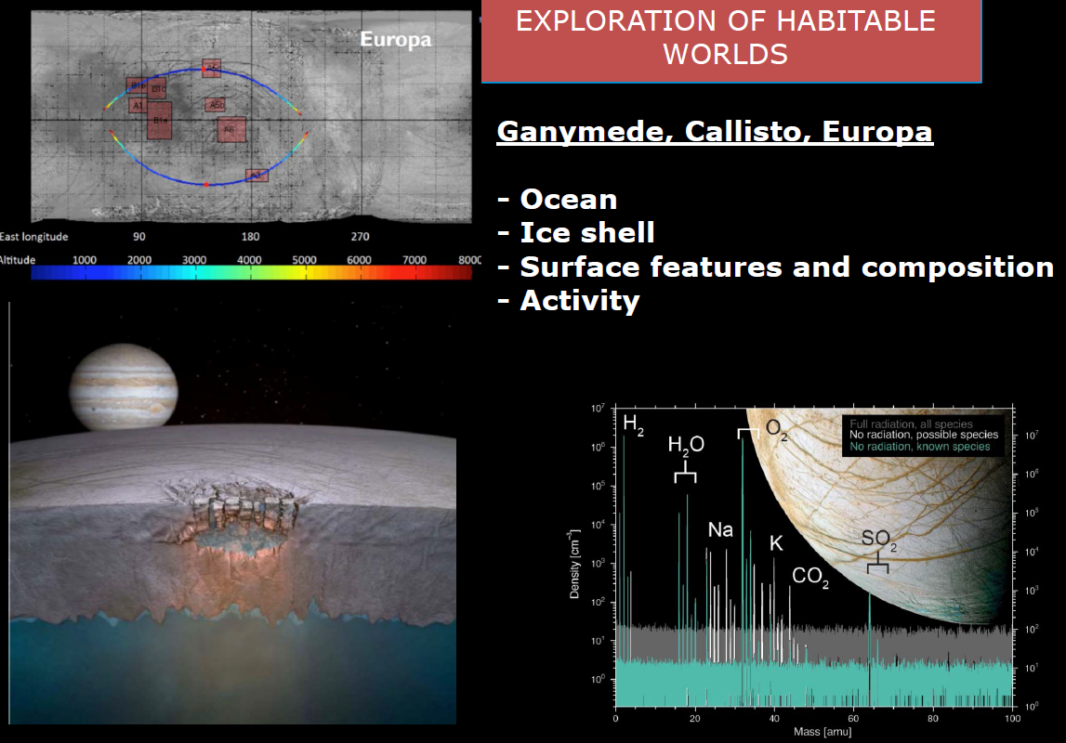
JUICE Science Mission (courtesy of ESA)

Slide 12
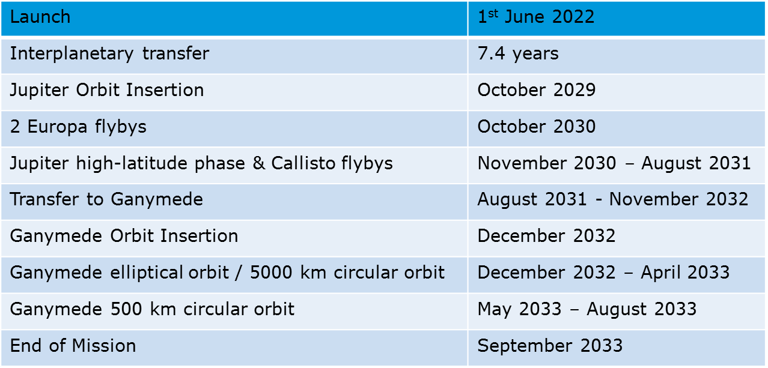
JUICE Mission Overview

Slide 13
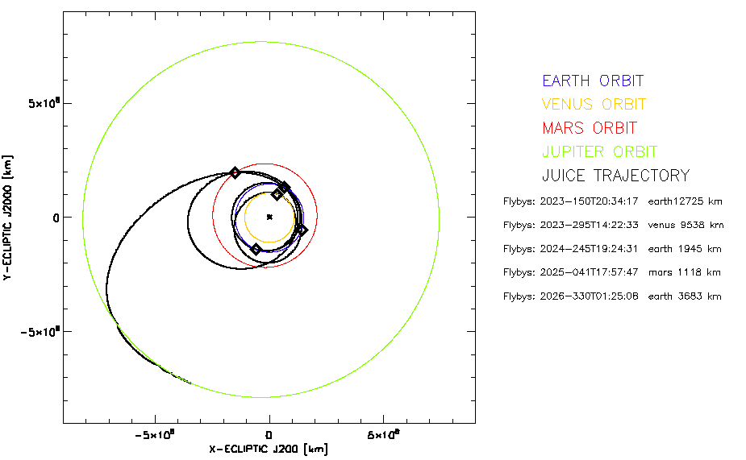
JUICE Trajectory (courtesy of ESA)
Trajectory JUICE Movie

Slide 14
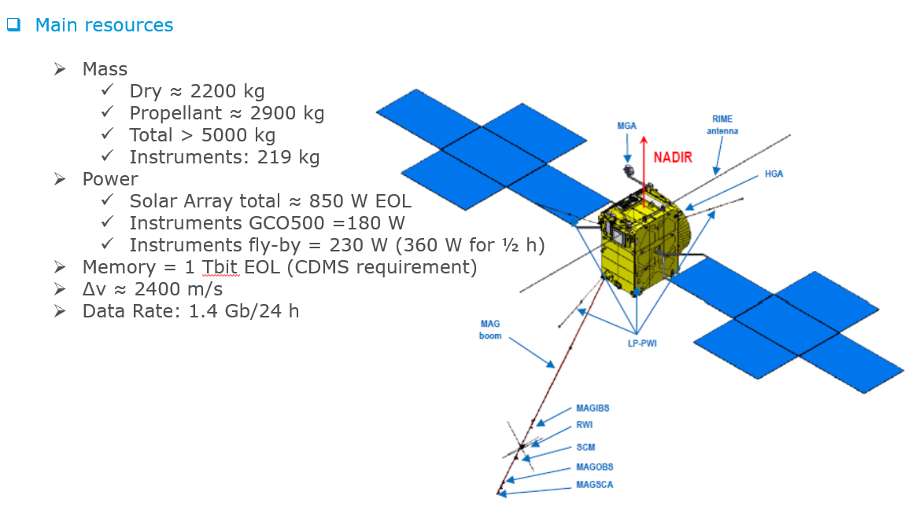
JUICE Spacecraft (courtesy of Airbus)

Slide 15
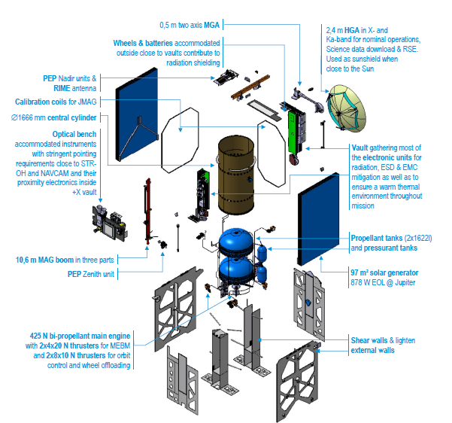
JUICE Spacecraft (courtesy of Airbus)

Slide 16
JUICE Communication Subsystem
The COMS subsystem provides the JUICE spacecraft with
  Telecommand at X-band (7.18 GHz), up to 4 kbps
  Telemetry at X-band (8.43 GHz), up to 714 ksps
  Telemetry at Ka-band (32.06 GHz), up to 1.4 Msps
  Ranging
(a simple home data link is easily > 100Mbps)

Slide 17
JUICE COMS Architecture
COMS Units
  Deep-Space Transponder (DST)
  Travelling-Wave Tube Amplifier (TWTA)
  RF Distribution Assembly (RFDA)
Single-Point Failure Tolerant
Operational Lifetime
  8 years on ground
  13.5 years in orbit

Slide 18
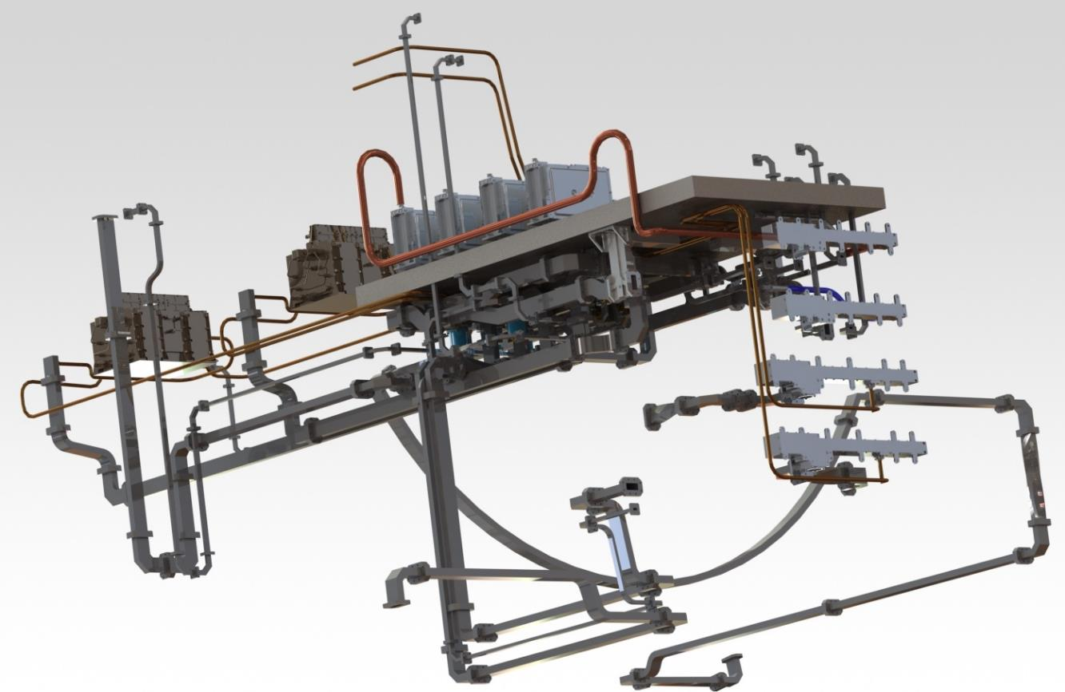
JUICE COMS - Communication Subsystem

Slide 19
COMS RFDA
Set of passive components
  X-band section
  Ka-band section
Assembled on a panel (1025 x 471 mm²)
Includes
  Hybrid coupler
  High power isolator (HPI)
  Diplexer / Triplexer
  RF switch
  Waveguide
  Coaxial cable
  Waveguide-to-Coax transition

Slide 20
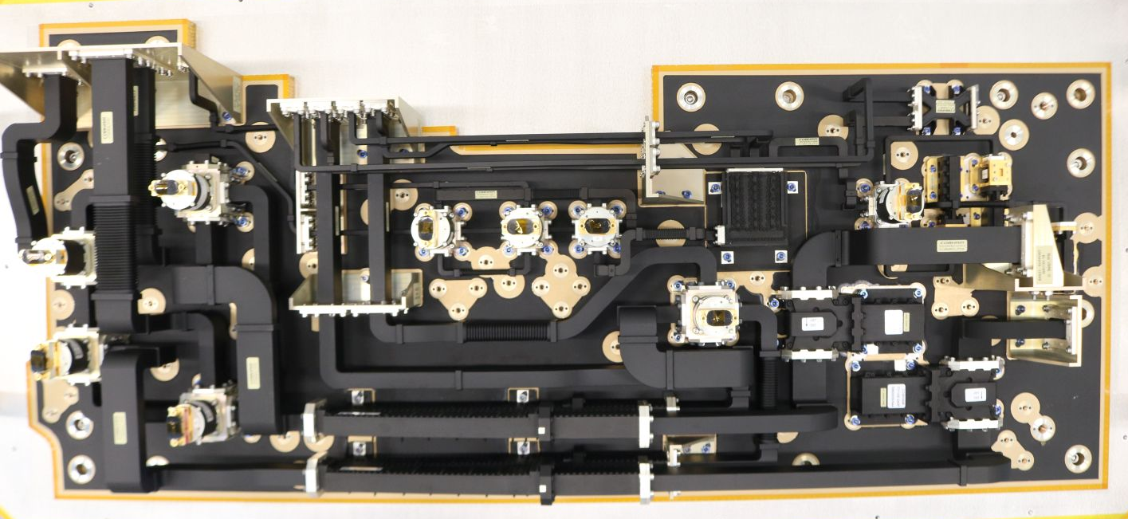
COMS RFDA

Slide 21

COMS Fact Sheet
Mass ~ 35 kg
Equipment
  34 units / components
  19 m coaxial cable
  30 m waveguide
  10 m HV cable
Power Consumption < 215 W
Heat Dissipation < 167 W
Reliability
  X-band transmit chain > 99.44 %
  X-band receive chain > 98.96 %
  Ka-band transmit chain > 99.54 %

Slide 22
JUICE Environmental Constraints
EMC constraints related to highly sensitive instrument
  Low radiated/Conducted emissions
  Accurate magnetic characterization
Thermal constraints related to the mission and to the system architecture
    Low cold operating temperature: -30 ° for qualification
Stringent generic mechanical requirements: Need for some delta-qualification regarding sine vibration, random vibration and even shock
Extremely severe radiation environment
Extreme distance: 900 Million km → 50 minutes for the signal to travel (one-way)

Slide 23
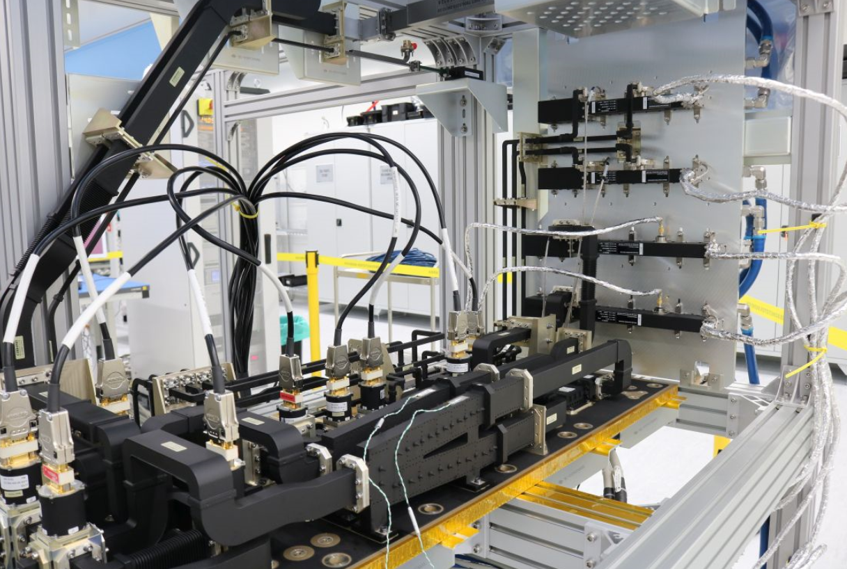
Integration: it is easy in the lab…

Slide 24
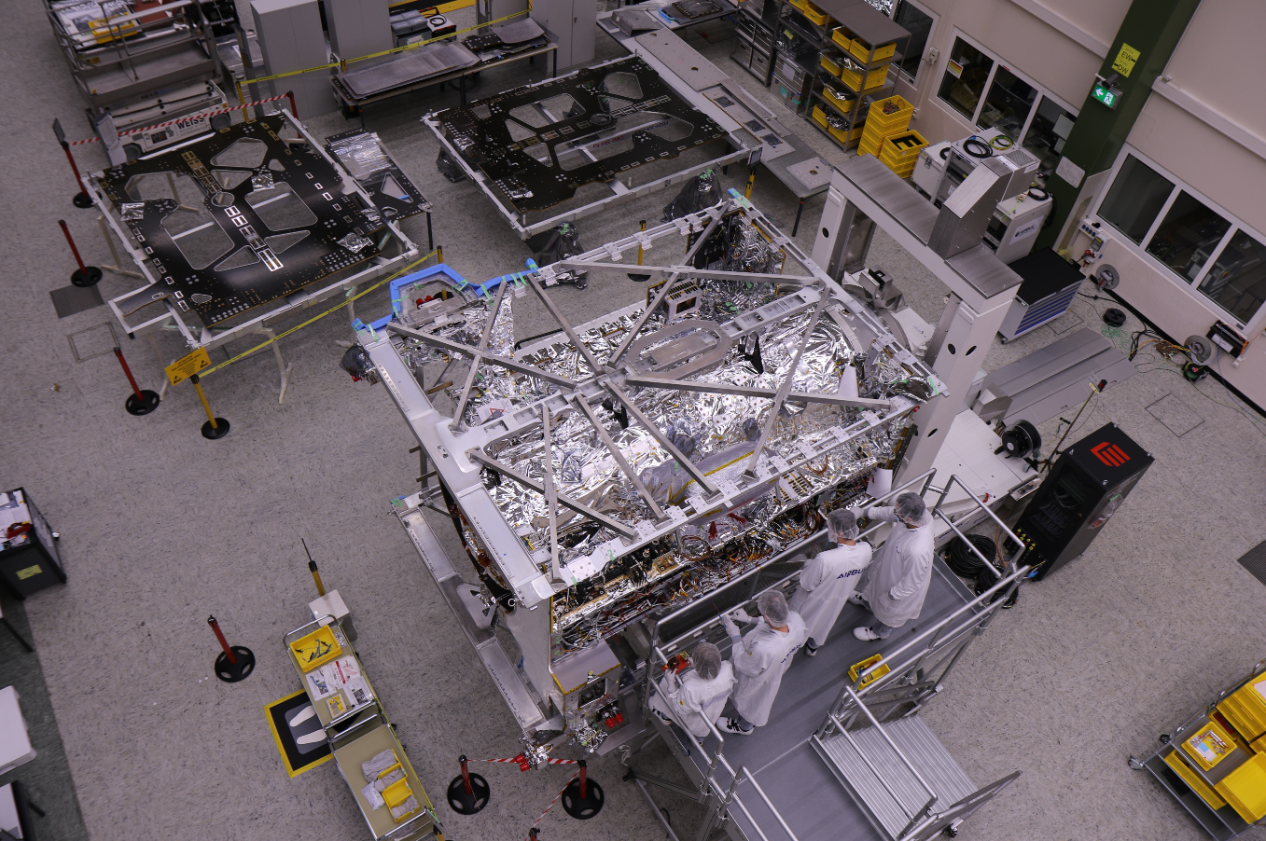
But difficult on the Spacecraft!

Slide 25
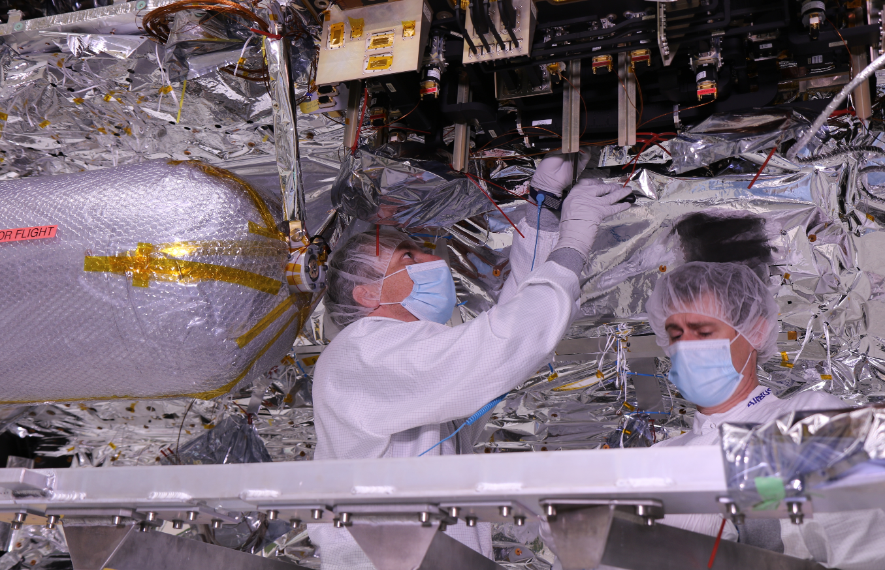
…or IN the Spacecraft.

Slide 26
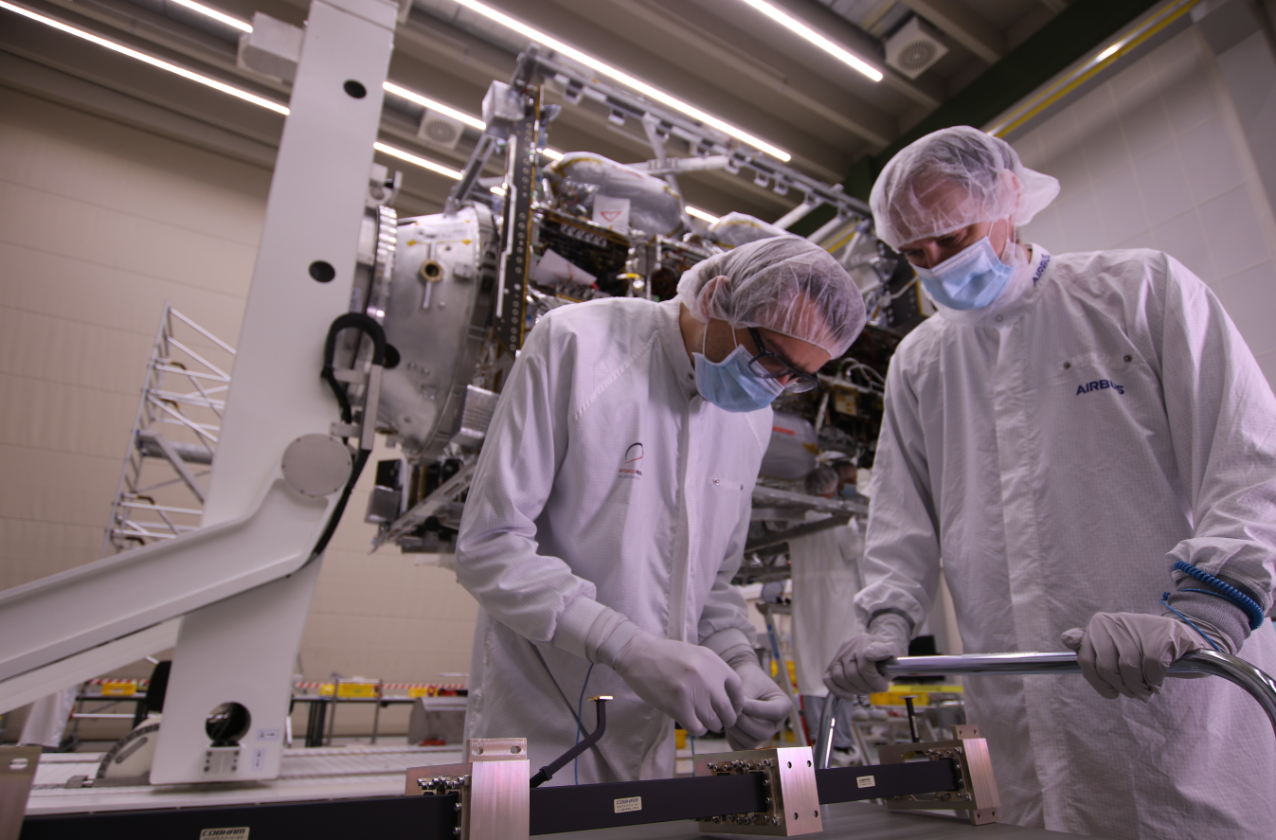
But the view is always amazing…

Slide 27

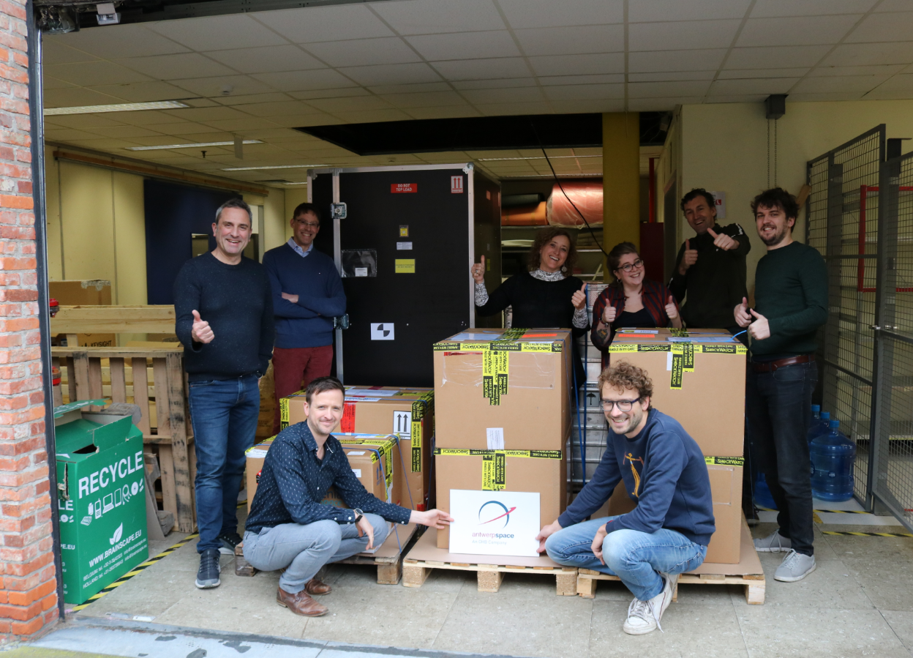
QUESTIONS?

