Slide 1
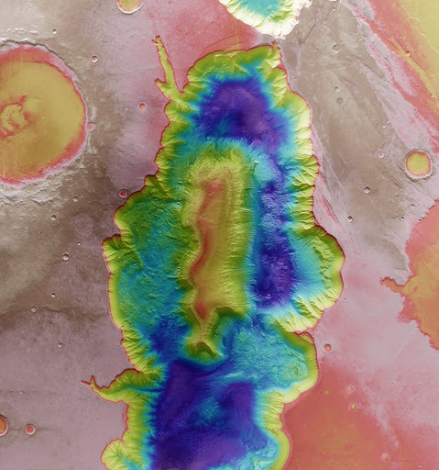
13/10/2020
Become the next space entrepreneur with ESA Space Solutions Belgium
-Nicolas Helssen
#switchtospace

Slide 2
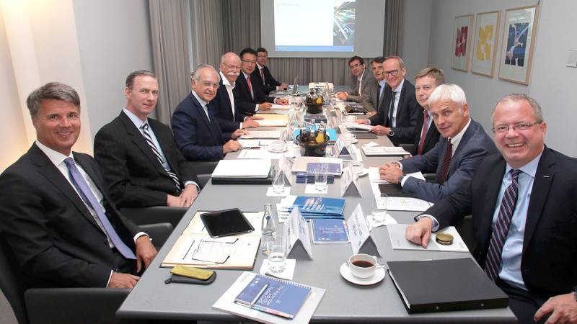
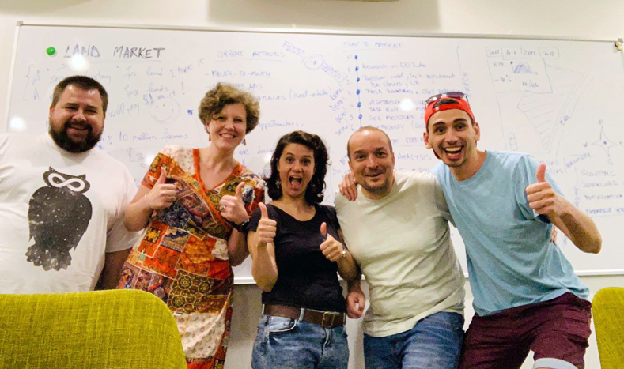
What is ESA Space Solutions Belgium?
We are an agile and specialized incubation and business network focusing on space technologies.
We target innovative industries and entrepreneurs and try to offer the most suitable funding support tool that fits their needs.
SWITCH TO SPACE 2 • 2020

Slide 3
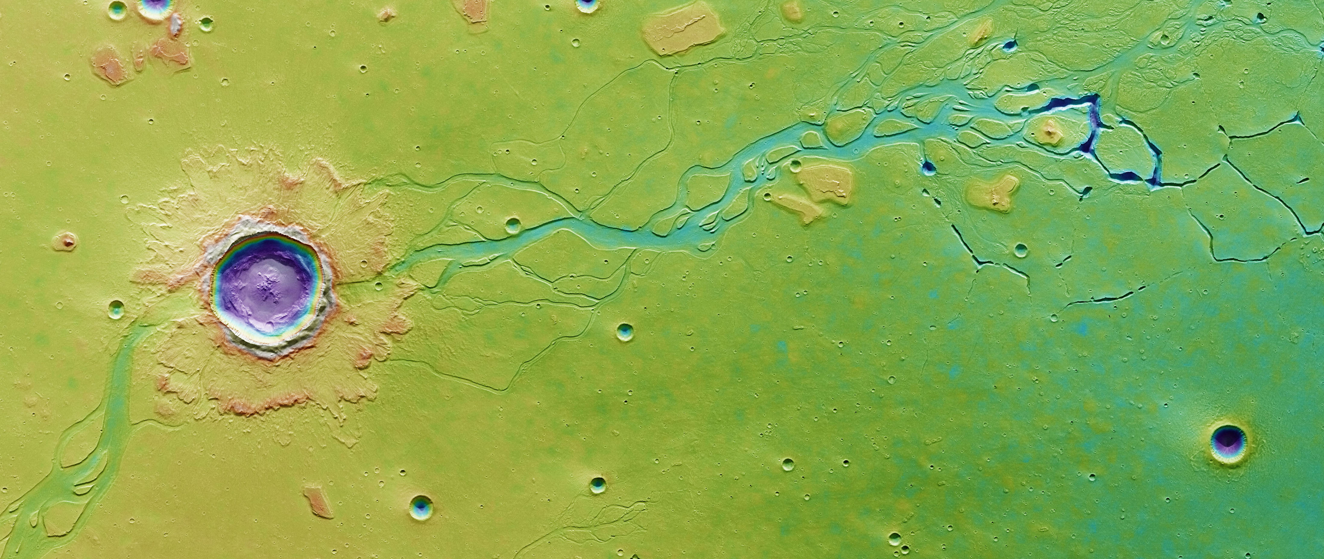
What is right for me?
SWITCH TO SPACE 2 • 2020

Slide 4
What could your journey to becoming a space entrepreneur look like?
SWITCH TO SPACE 2 • 2020

Slide 5
Coaching & Mentoringe
e
Up to 50 hours of mentoring is available for each successful applicant, over a 6-month period
100 mentors available for over 500 applicants across Europe
Offers free trainings and webinars for early-stage entrepreneurs
In the process of creating a European-wide public space database
SWITCH TO SPACE 2 • 2020

Slide 6
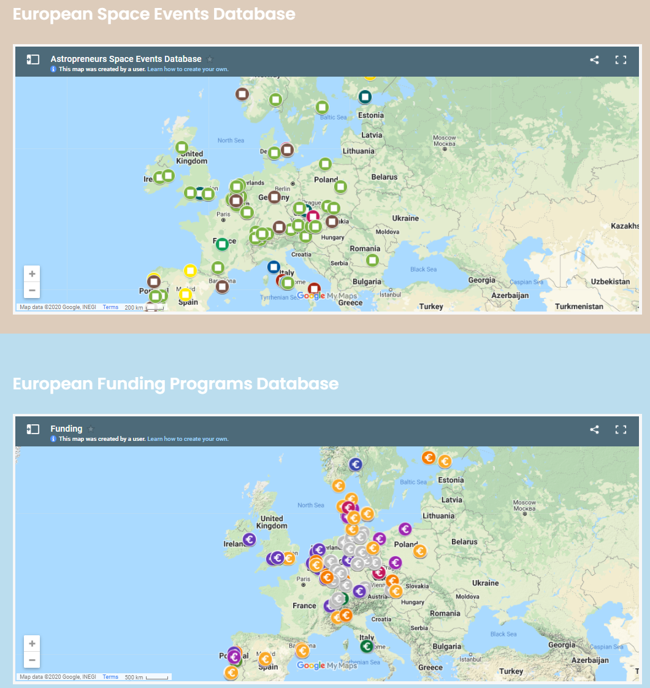
Coaching & Mentoringe
e
SWITCH TO SPACE 2 • 2020

Slide 7
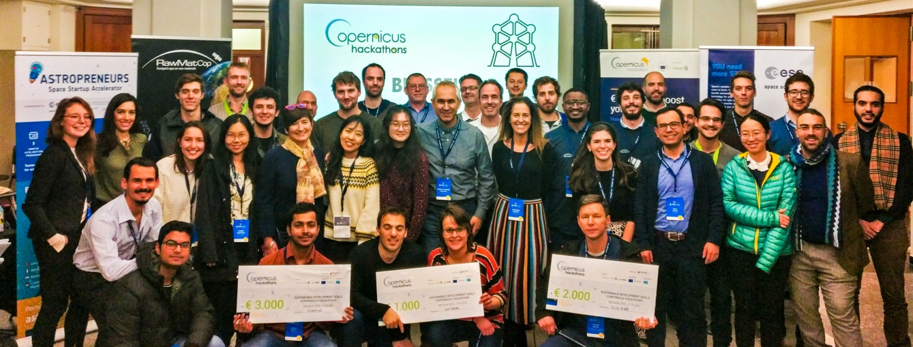
Explore ideas at hackathons
Join as a team of students
Tackle interesting challenges
Get to know the space ecosystem
Receive mentoring from experts
Win cash prizes
Get introduced to follow-on programmes.
SWITCH TO SPACE 2 • 2020

Slide 8
Get incubated at ESA BIC Belgiume
Your idea must be based on space-related technology, expertise and/or application and target the non-space market
Your company must not be older than five years or you are going to start a new company
Receive €50.000 and up to 80 hours of technical and business support
SWITCH TO SPACE 2 • 2020

Slide 9
Get incubated at ESA BIC Belgiume
SWITCH TO SPACE 2 • 2020

Slide 10
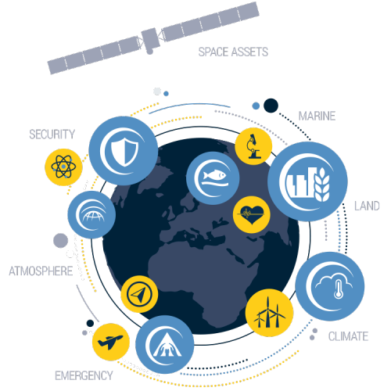
Boost your incubation even further
Apply if your team is already incubated somewhere
Submit a video en then perform a live pitch in front of a panel of international experts
Get an extra €50.000 on top of your current incubation support
Gain visibility and credibility.
SWITCH TO SPACE 2 • 2020

Slide 11
Sprint your way to succes!
Join a bootcamp to brainstorm on your Galileo-IoT solution
Take part in a 3-month mentoring sprint with 9 other teams
Get access to 80 hours of technical, business and design support
Win €20.000 prize money after pitching to investors
New application round early 2021.
SWITCH TO SPACE 2 • 2020

Slide 12
Kick-start your Business
e
Once you have you completed an ESA BIC or other boost initiative, join the Kick-Start programme at ESA Business Applications
Get up to €60.000 to further investigate your idea in a Feasibility Study
Do a follow-on Demonstration Project for up to €500.000 to bring your idea to an operational phase.
SWITCH TO SPACE 2 • 2020

Slide 13
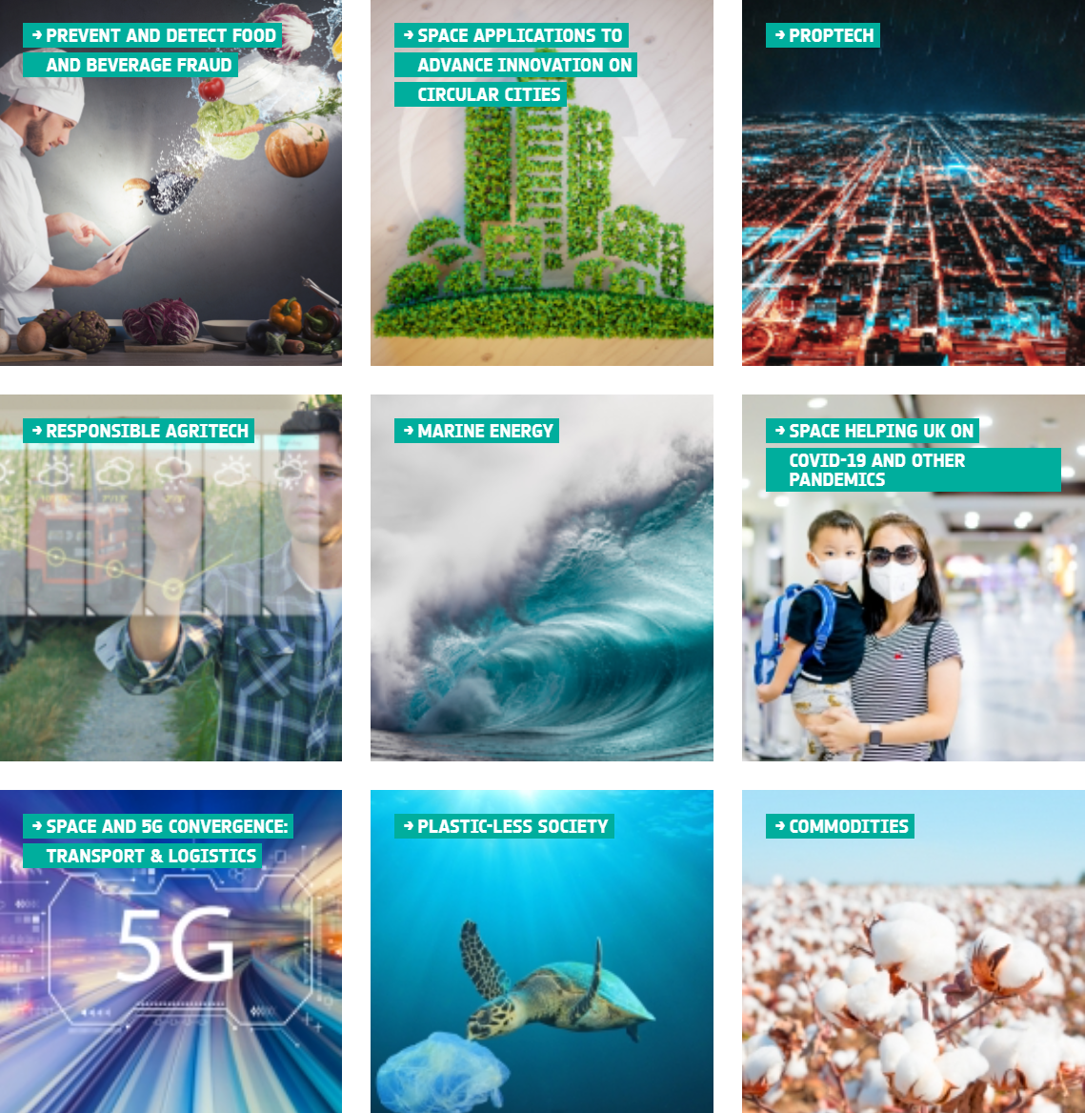
Kick-start your Business
e
New themes and competitions are added on a continuous basis
SWITCH TO SPACE 2 • 2020

Slide 14
All of this goes to show...
... that anybody can become a space entrepreneur!
SWITCH TO SPACE 2 • 2020

Slide 15
How To Get In Touch
SpaceSolutions.be
Nicolas.Helssen@belspo.be
+32 487 355 345
SWITCH TO SPACE 2 • 2020

Slide 16
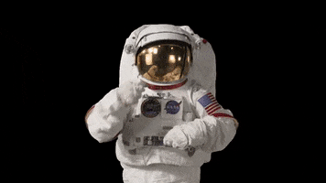
Thanks!
SWITCH TO SPACE 2 • 2020

