Slide 1
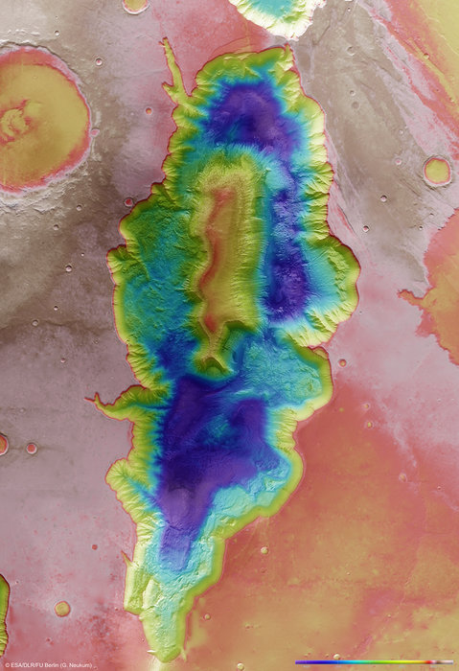
Bird’s eye view on sustainable development
#switchtospace
Paul COUNET
Head of Strategy, Communication and
International Relations, EUMETSAT

Slide 2
A very trendy mission statement ...
SWITCH TO SPACE 2 • 2020

Slide 3
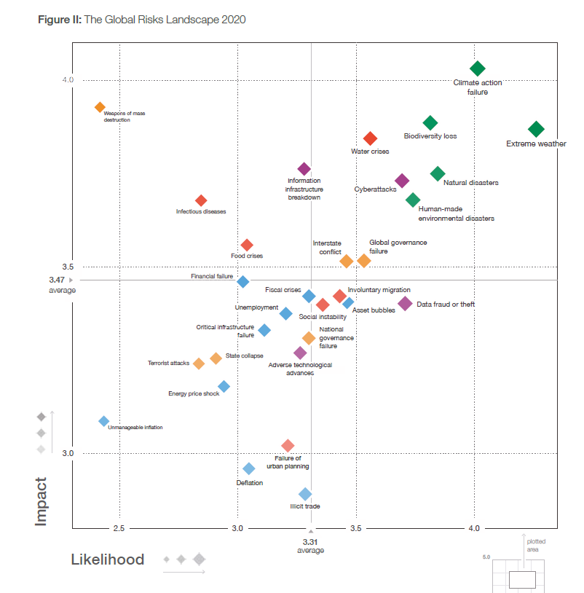
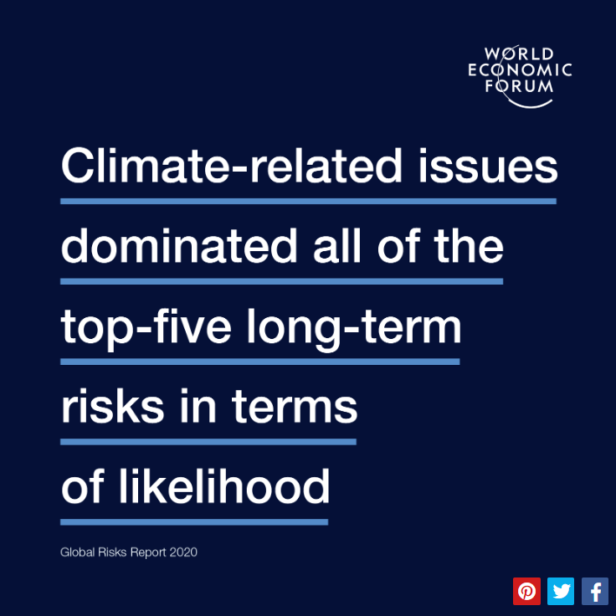
Among 30 global risks, climate change and extreme weather events are ranked as the top 1 and 2 in terms of likelihood and 1 and 3 in terms of impact on economies.
SWITCH TO SPACE 2 • 2020
Source : Global Economic Forum, Global Risks Report, 2020

Slide 4
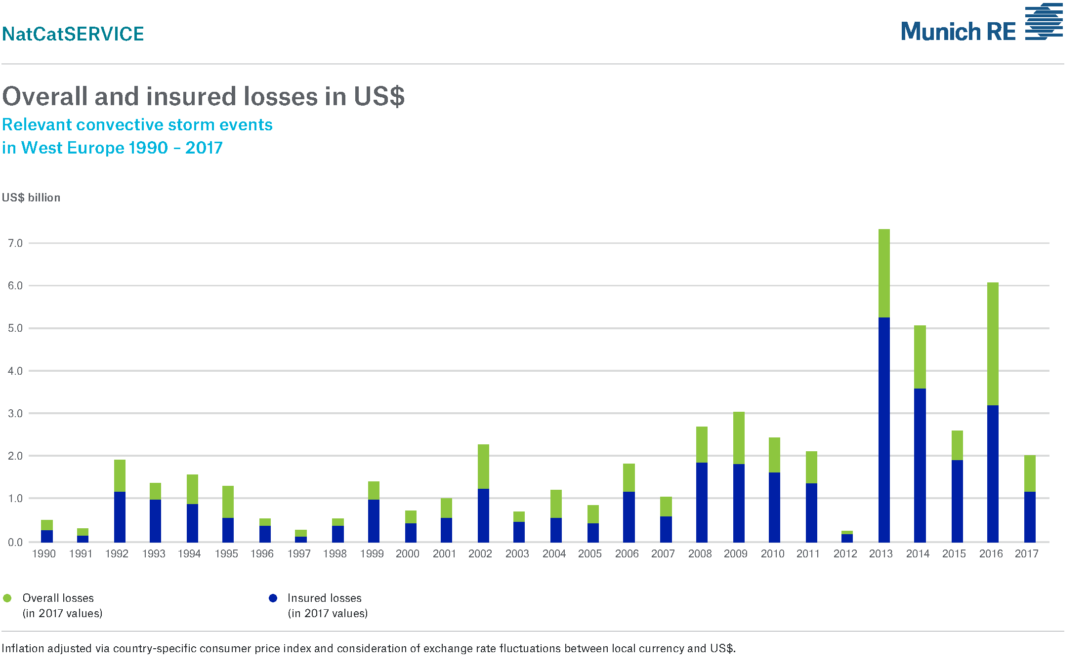
Over the period 2007-2017, the losses from convective storms in Western Europe amounted to around €35 billion (Munich Re, 2019)
Significant increase over the last 5 years
SWITCH TO SPACE 2 • 2020

Slide 5
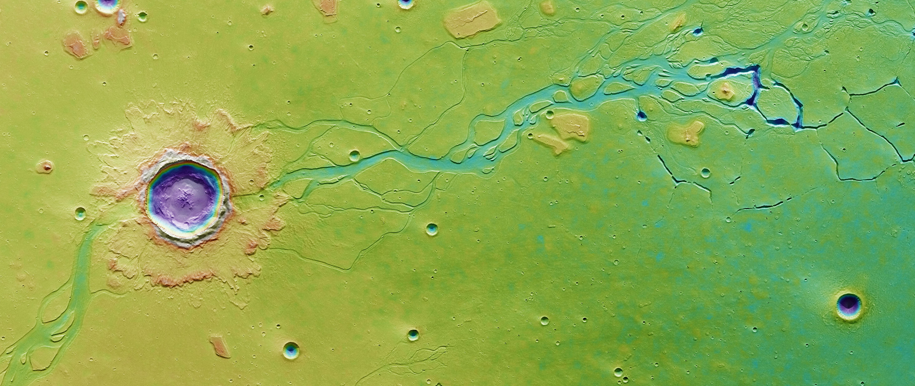
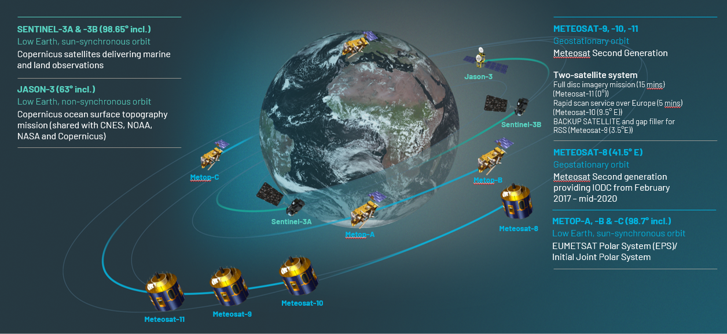
EUMETSAT operates 10 satellites, incl. for Copernicus
SWITCH TO SPACE 2 • 2020

Slide 6
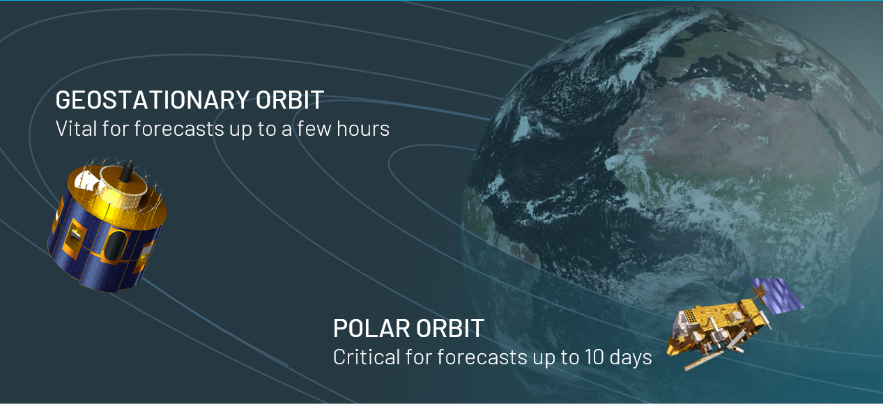
The need for two types of meteorological satellites
SWITCH TO SPACE 2 • 2020

Slide 7
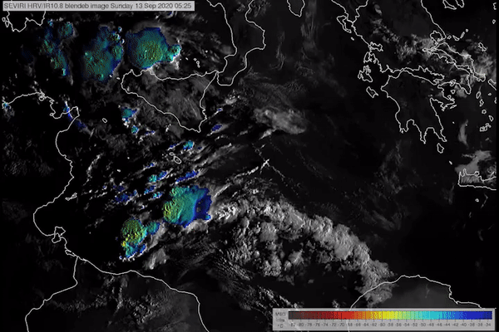
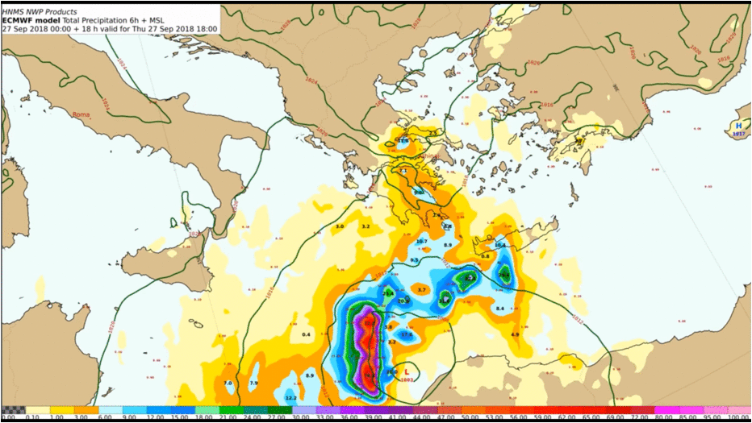
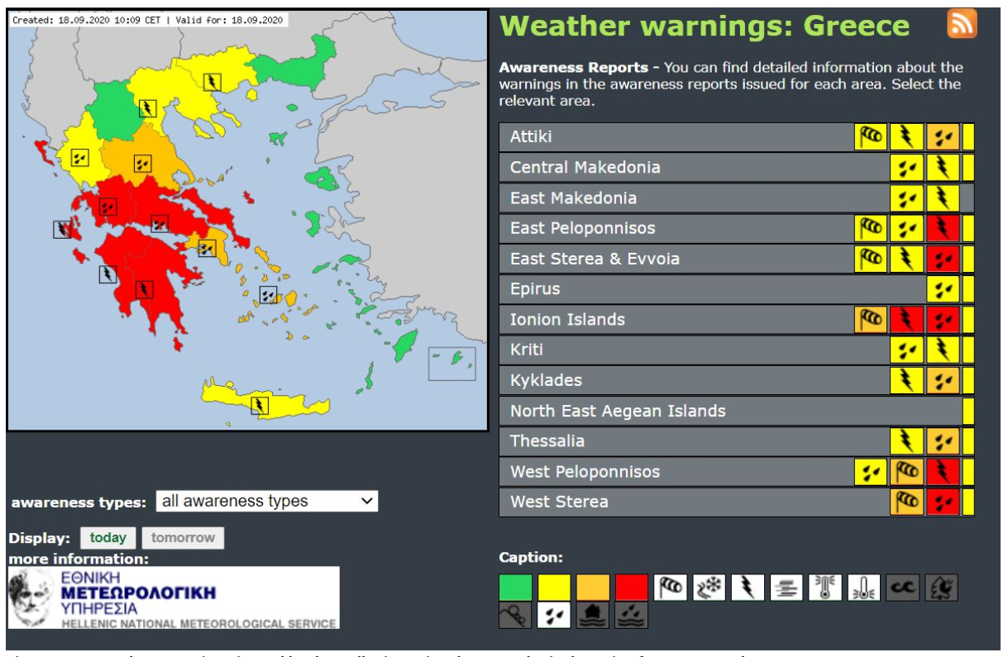
Medicane Ianos, 14-20 September 2020
From Observations to Alerts
Real Time Observations
Forecasts T-48H
Alerts T-48 H
SWITCH TO SPACE 2 • 2020

Slide 8
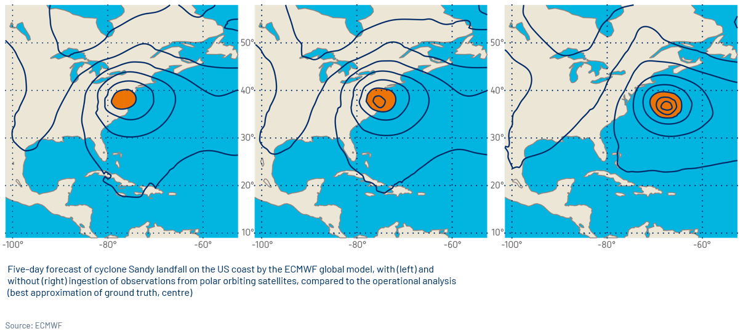
Contribution of Metop satellites to NWP
SWITCH TO SPACE 2 • 2020

Slide 9
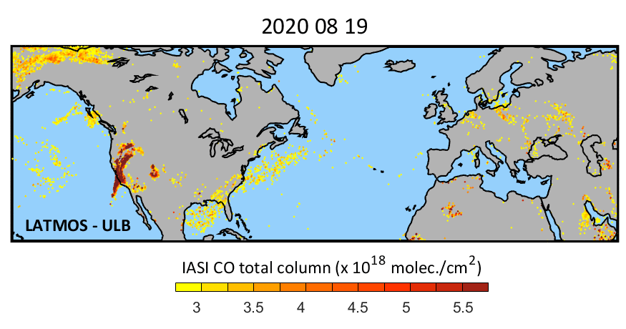
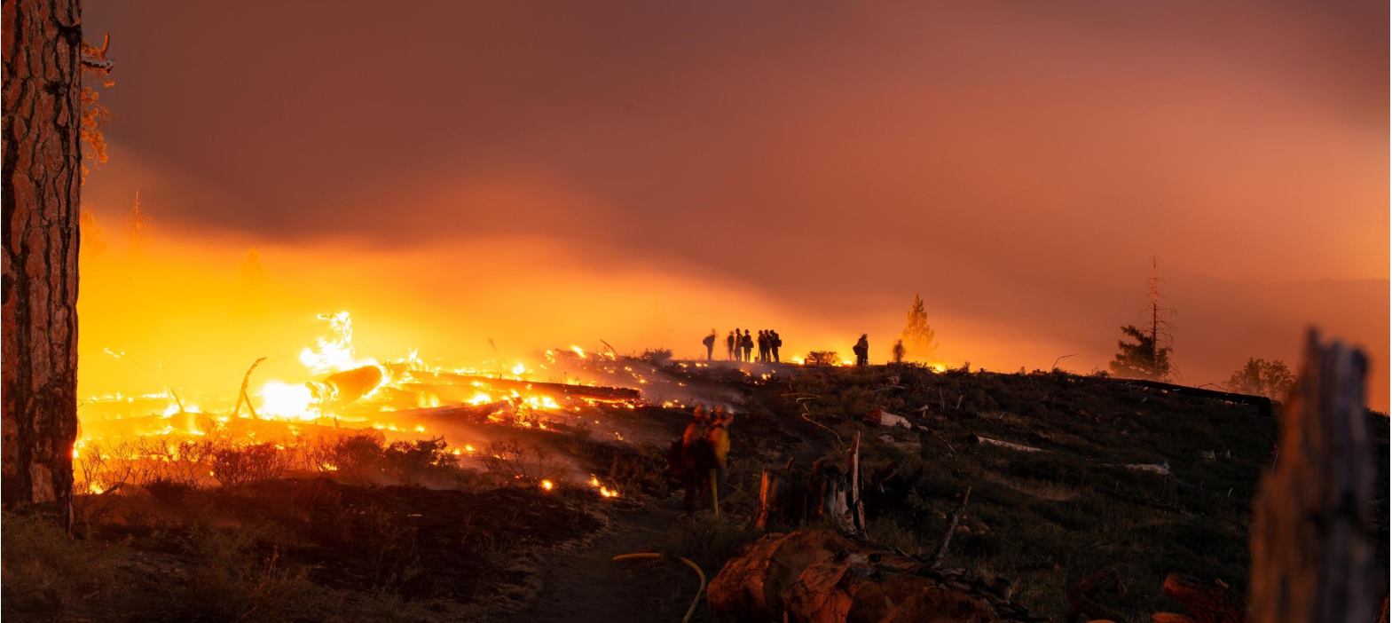
Californian fires seen by Metop / IASI
SWITCH TO SPACE 2 • 2020

Slide 10
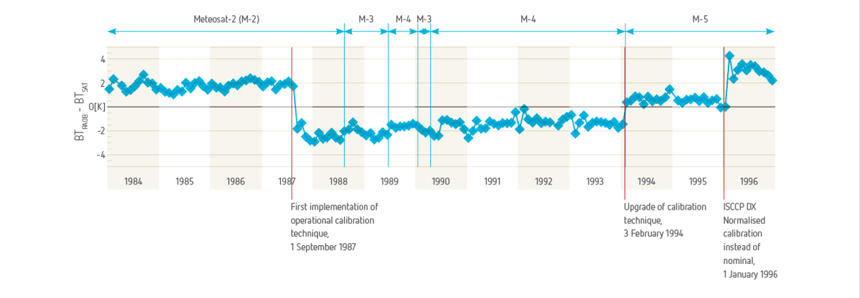
Contribution to Climate Monitoring
SWITCH TO SPACE 2 • 2020

Slide 11
Contribution to Climate Monitoring
SWITCH TO SPACE 2 • 2020

Slide 12
Contribution to Climate Monitoring
SWITCH TO SPACE 2 • 2020

Slide 13
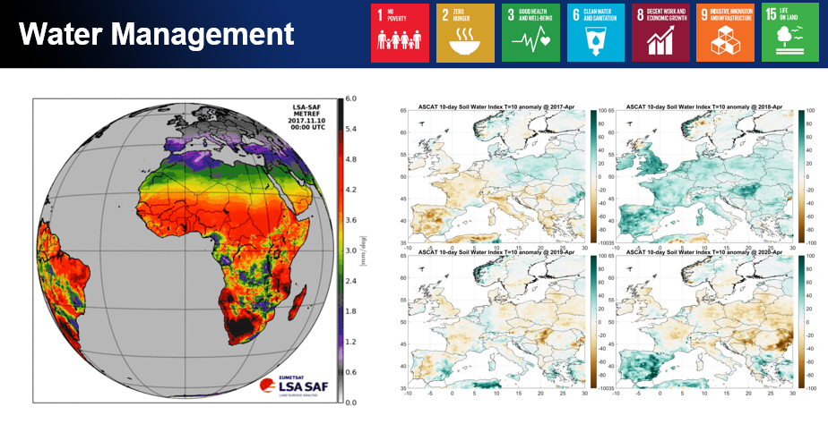
Contribution to Climate Monitoring
SWITCH TO SPACE 2 • 2020

Slide 14
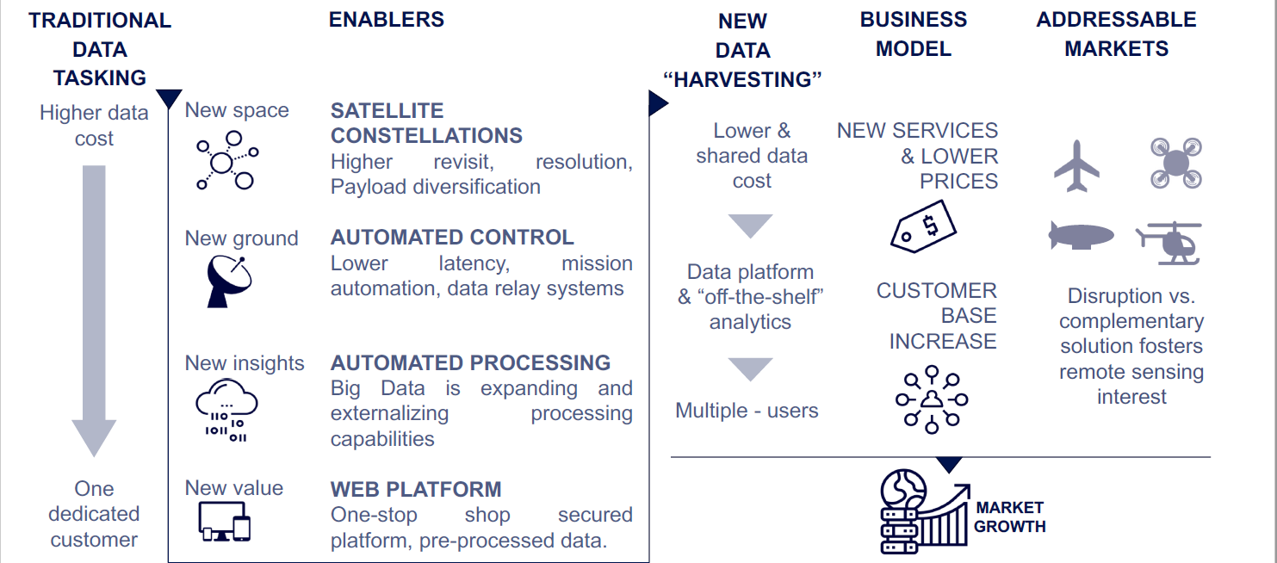
Source : Euroconsult, 2020
Why joining the space community now ?
Challenges and Opportunities of New Space
New models for developing and operating satellite systems
Integration of Big Data for handling vast amount of information
New Business models
SWITCH TO SPACE 2 • 2020

Slide 15
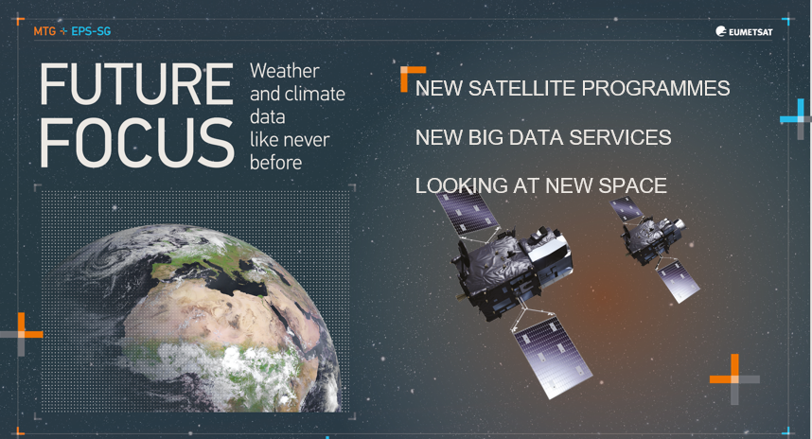
@EUMETSAT, we will face the challenges of the 21st century
Your text, your text, your text
Your text, your text, your text
SWITCH TO SPACE 2 • 2020

Slide 16
In EUMETSAT, we need :
Scientists
Space engineers
IT and Big Data specialists
AI specialists
But also
Lawyers
Contract Officers
Finance specialists
HR managers
…
e
SWITCH TO SPACE 2 • 2020

Slide 17
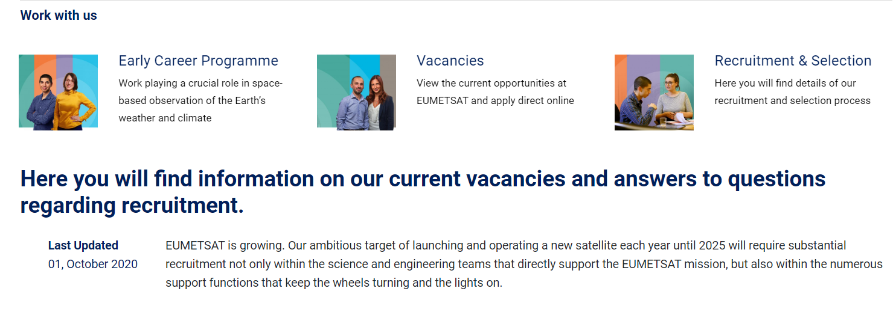
https://www4.eumetsat.int/work-us/careers-eumetsat
SWITCH TO SPACE 2 • 2020

Slide 18
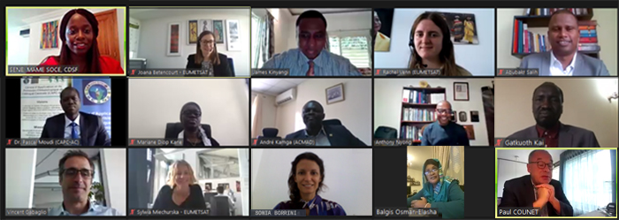
A recent example of an intern work at EUMETSAT
SWITCH TO SPACE 2 • 2020

Slide 19
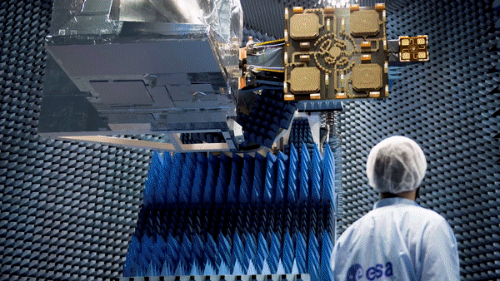
A 1 minute bio ?
Be curious
Grab opportunities
Watch us on November 10,
Launch of Copernicus Sentinel-6 satellite
SWITCH TO SPACE 2 • 2020

Slide 20
Follow us, discover us, know us better…
@paulcounet
www.facebook.com/eumetsat/
You Tube EUMETSAT
flickr.com/photos/eumetsat/
@eumetsatmedia
linkedin.com/company/eumetsat
+49 171 973 54 43
SWITCH TO SPACE 2 • 2020

