Slide 1
New Space Economy
Prof. W. Peeters
S2S2
October 2020

Slide 2
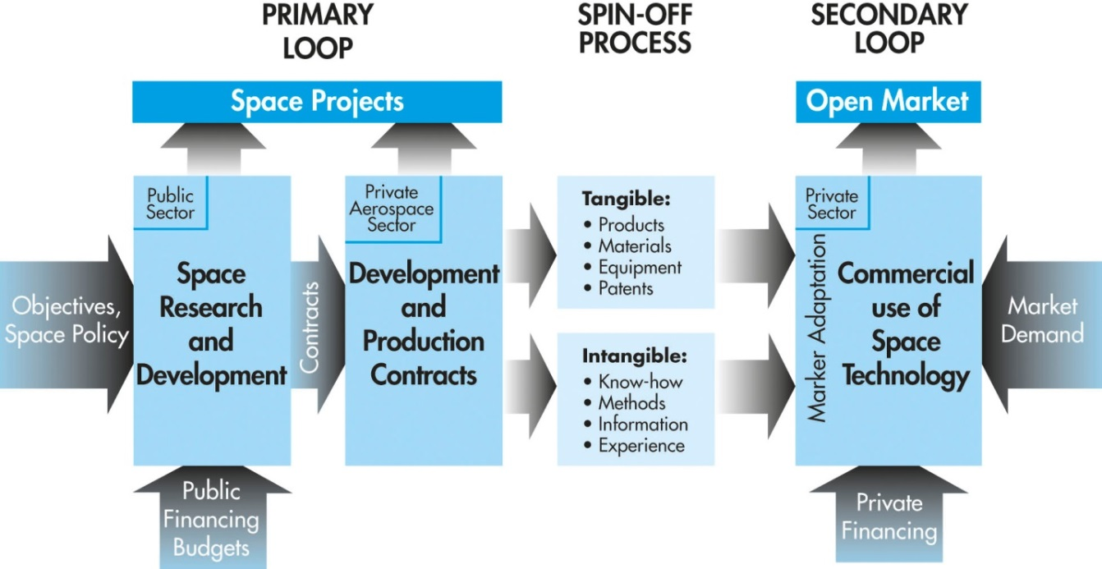
The three phases of space business
New Space Effect
New Markets
New Space Companies
Equity funding
1.GOVERNMENTAL SPACE 2. COMMERCIAL SPACE 3. NEW SPACE

Slide 3
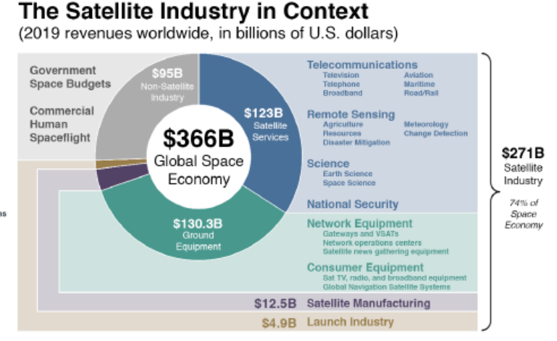
At present : ¾ Commercial and NewSpace
(SIA/Bryce, 2020)

Slide 4
Novel Approaches: New Space
NEW APPROACH: thinking space business out of the box
NEW SPACE
TRADITIONAL SPACE
Low-cost Model
High-cost, High-quality
Software Driven
Hardware Driven
VS.
Application Oriented
Techno Push
Standardization
Customization
Higher Tech. and Business Risks
Risk adverse

Slide 5
New Space : Applications
1. Priority 1 : Use/combine existing space data (low CAPEX)
CAPEX : Capital Expenditure
Combine space data (Navigation, Earth Observation, telecom signals) via algorithms for specific applications
Some Examples
Advice real estate developers (using AI)
Agricultural applications
Advice on energy consumption of households
Tracking of cars / emergency devices for hikers
Routing optimization for fleet of trucks
Tracking containers
Detection of illegal waste dumping

Slide 6
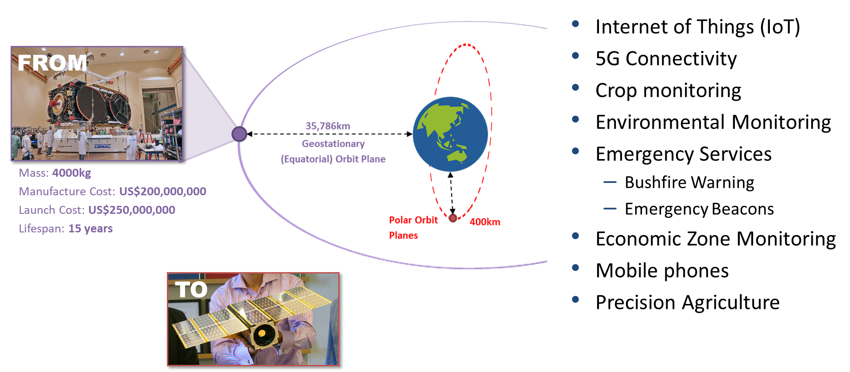
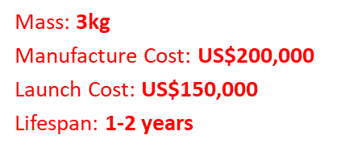
New Space : from GEO to LEO
2. For new services: Constellations of Smallsats

Slide 7
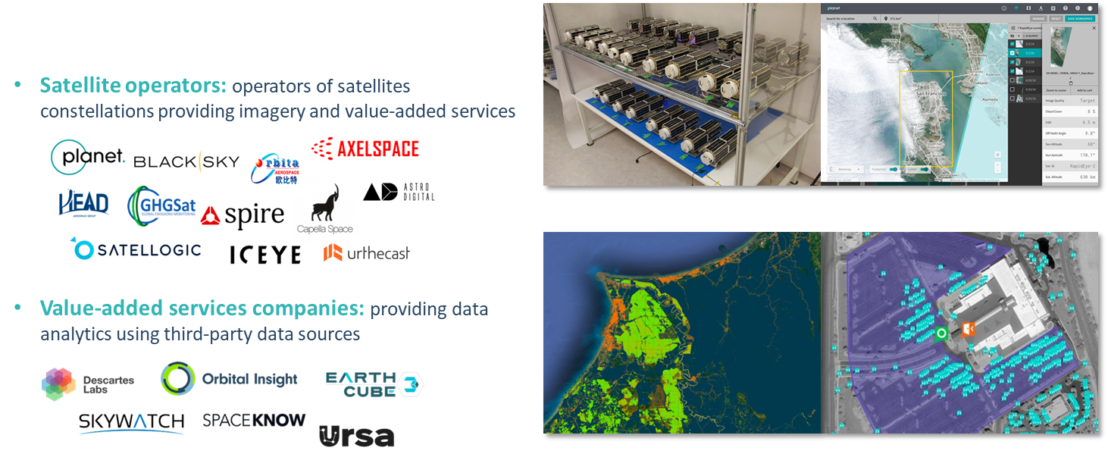
Example of New Space Companies (1)
Earth observation

Slide 8



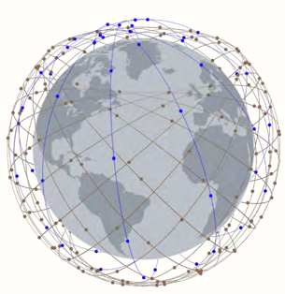


Example of New Space Companies (2)
Satellite operators of narrowband constellations (information): Internet of Thing, AIS (vessel tracking), etc.
Satellite operators of broadband constellations: rural connectivity, mobility, enterprise, cell backhaul, etc.
Image credit: exactEarth
Ground communications: terminal manufacturers, communication service providers
Image credit: Telesat

Slide 9
Example of New Space Companies (3)
Image Credit:
SpaceX
Launch/Access to space
Launch vehicles: re-usable launch vehicles, 3D printed rockets, dedicated smallsat vehicles,…
Stratospheric balloons
Launch brokers and space tugs
Image Credit:
Spaceflight
Industries

Slide 10





Example of New Space Companies (4)
Space Exploration
Orbital infrastructure: microgravity research,
3D printing, space stations/modules…
Crew/Cargo transportation:
Lunar landers, robotics, ISRU:
Images Credit: NASA/SpaceX
Image Credit: NASA
Image Credit: Astrobotic

Slide 11
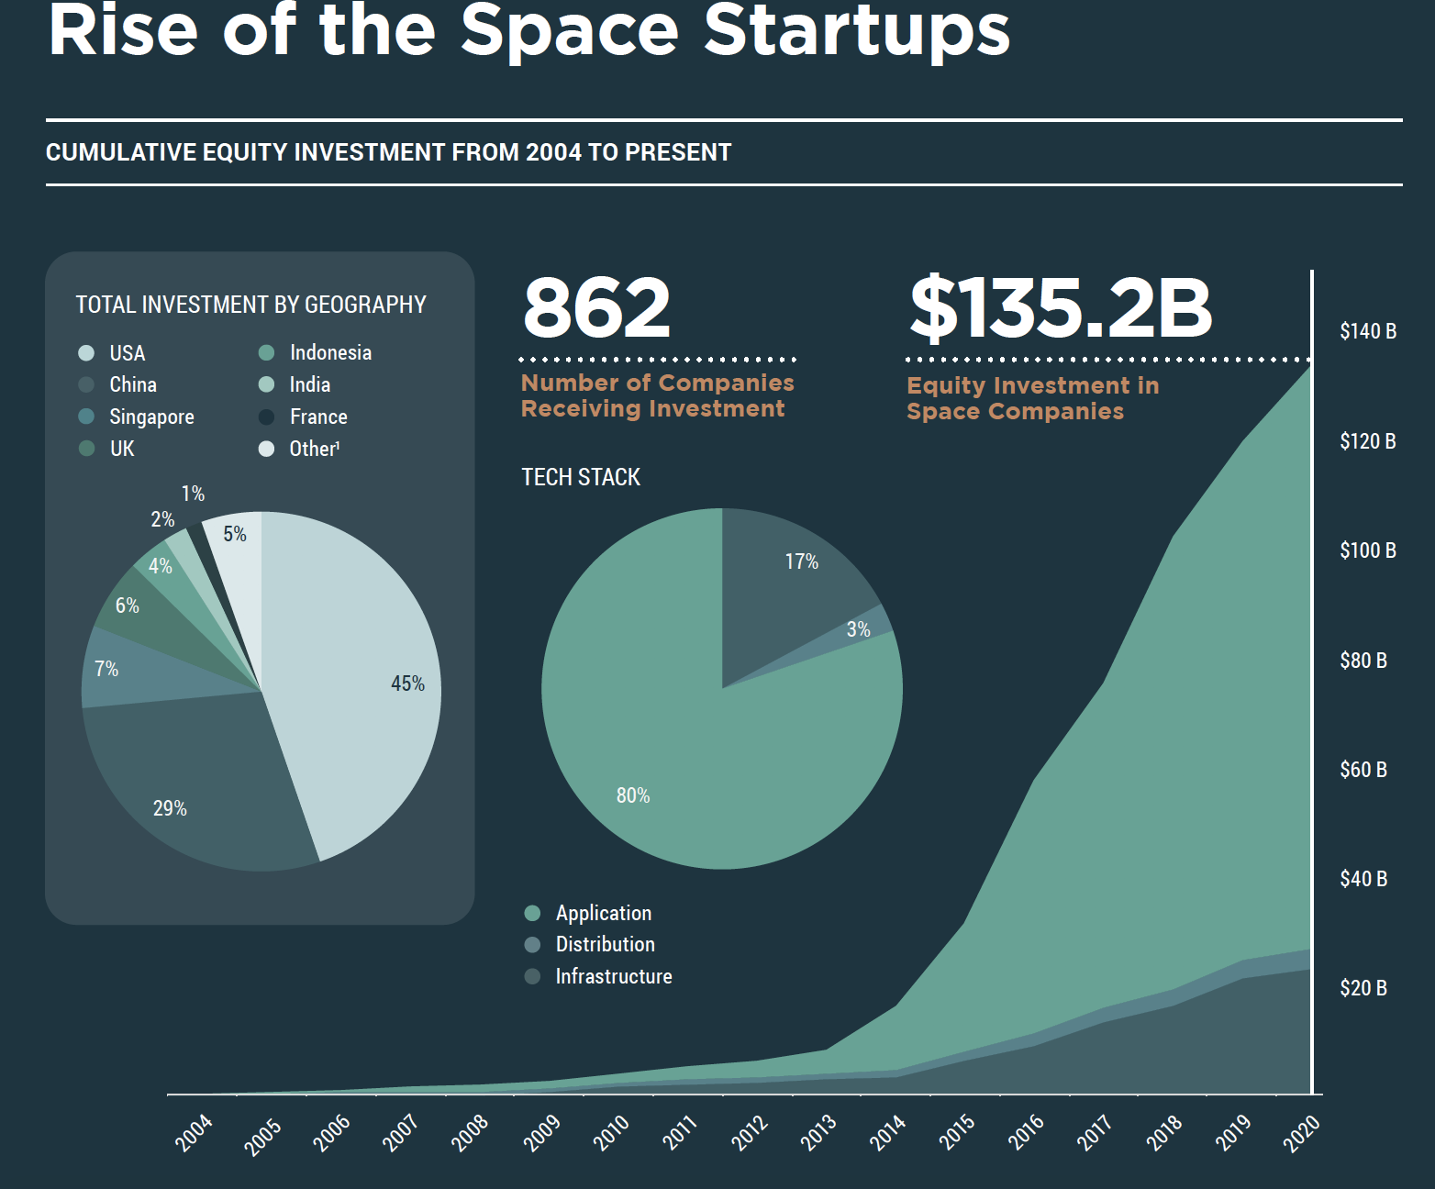
New Space Economy : Financing
Source: Space Capital, 2020

Slide 12
Equity Funding : Sources
Investor | Motivation | Criteria | Amounts (*)
Founders, friends, family (FFF) | Vision Return | Confidence | 50K – 100K
Private, Business Angels, | Idealism Return | Opportunity | 100K – 1 Million
Financial, Venture capitalists, Private Equity | Return | Return On Investment Product Management | VC 2-75 Million PE 100M – 1Billion
(*) : Source: Bryce 2019

Slide 13

New Space Company Creation
Incubators (e.g. ESA-BIC)
Based upon a business plan to be submitted to and approved by a jury
Start-ups are accommodated for max. 2 years
Early financing is provided (appr. 50,000 -200,000 USD)

Slide 14
New Space Business Plan
10/20/30 rule (10slides/20minutes/font30)
TITLE : company name, address, email
OPPORTUNITY : Problem that you will solve
VALUE PROPOSITION : What is your solution?
UNDERLYING MAGIC : Which technology will be used?
MARKET : which market and market share?
GO-TO-MARKET : How will you capture that market?
COMPETITION : Present and future competitors?
TEAM : Key players, education and experience
FINANCIALS : 5 year projection of income/expenses
FUNDING : your funding ask and your offer (% shares)

Slide 15
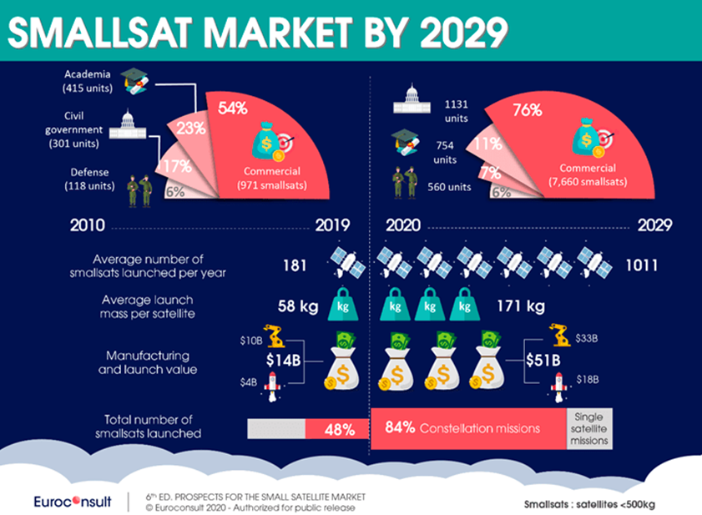
New Space Economy : Outlook

Slide 16
References
Web sites (e.g.www.space.com, www.eurospace.org, www.spacefoundation.org…)
Specialized reports (e.g. Bryce, NSR, Euroconsult)
SIA, State of the Satellite Industry, June 2020
Space Foundation, The Space Report 2019
Bryce Space and Technology, 2020. Start-up Report 2020 (Bryce website https://brycetech.com/reports)
Morgan Stanley : Space: Investment Implications of the Final Frontier (Nov. 2017)
Peeters, W., Towards a definition of New Space? New Space Vol 6(3) (2018), pp. 187-190.

