Slide 1
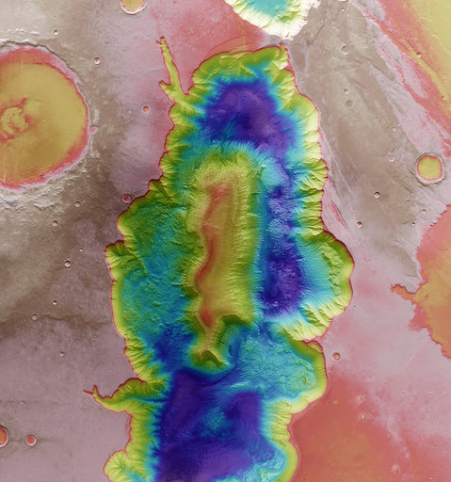
October 7th 2020
State-of-the-art instruments to understand our Universe and protect our Planet
#switchtospace

Slide 2
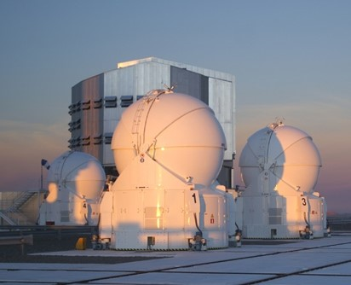
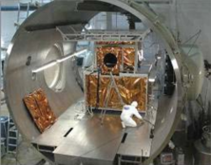


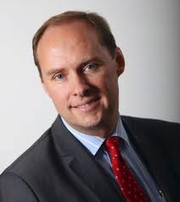
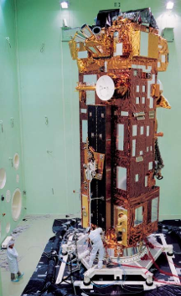
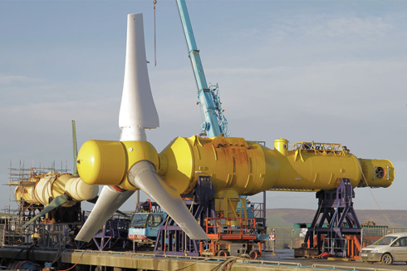
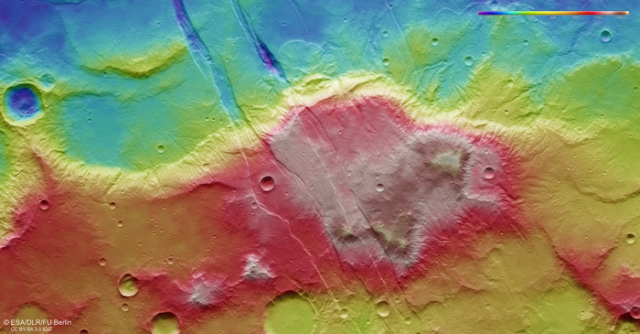
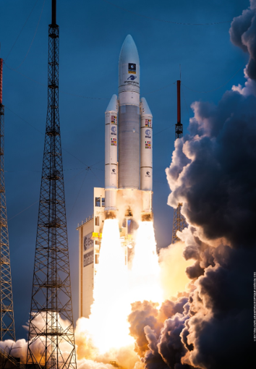

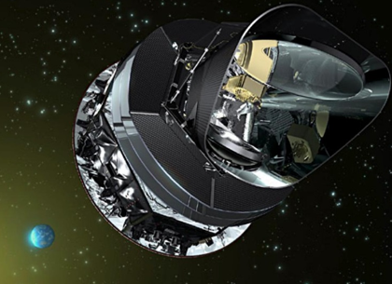
AMOS
(B)
Centre
Spatial
de Liège
(B)
Masters in
Aerospace Engineering
Ph. Gilson
Alstom Renewables (F)
European Space Agency
(NL)
Air
Liquide
(F)
Masters in
Business Administration
Guyana
Space Center (F)

Slide 3
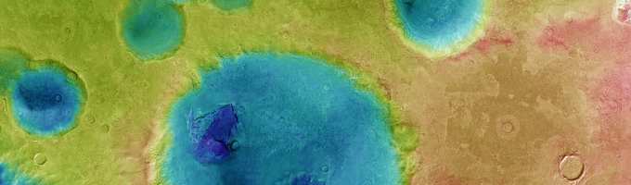
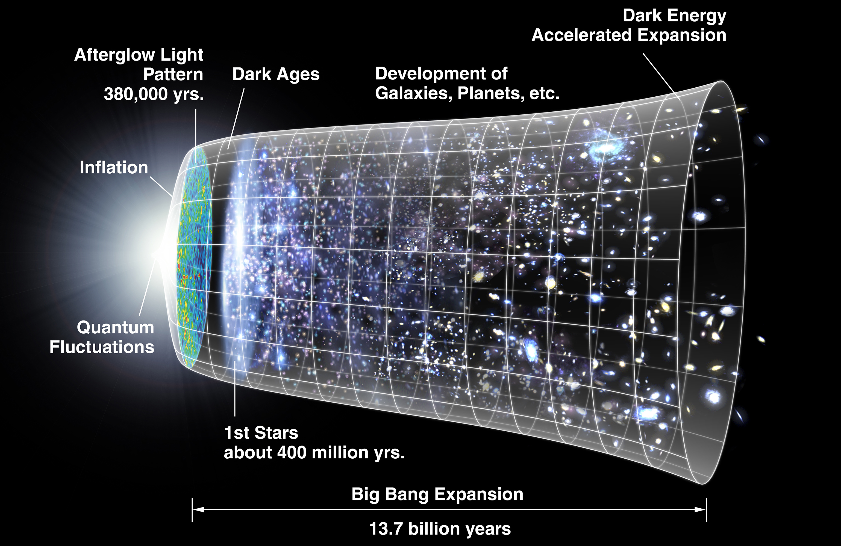
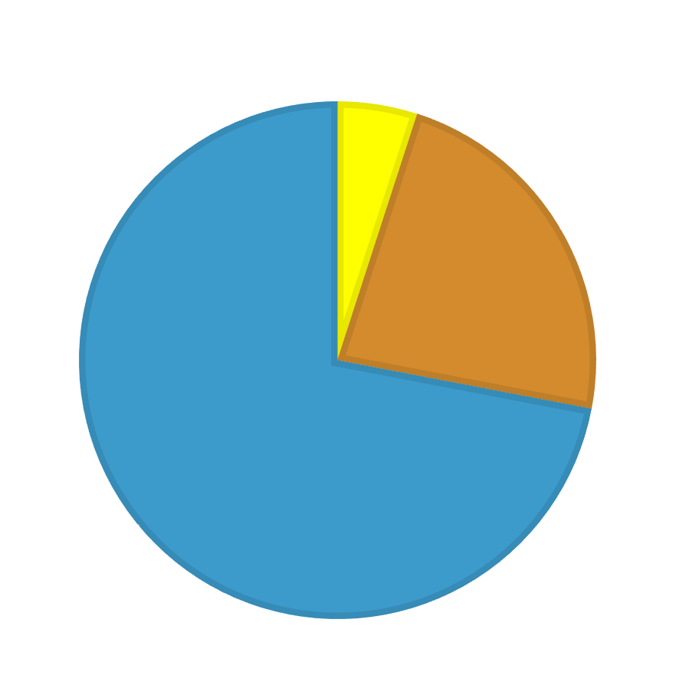
Astronomy
Understanding our Universe
Ordinary Matter
Dark
Matter
Dark
Energy

Slide 4
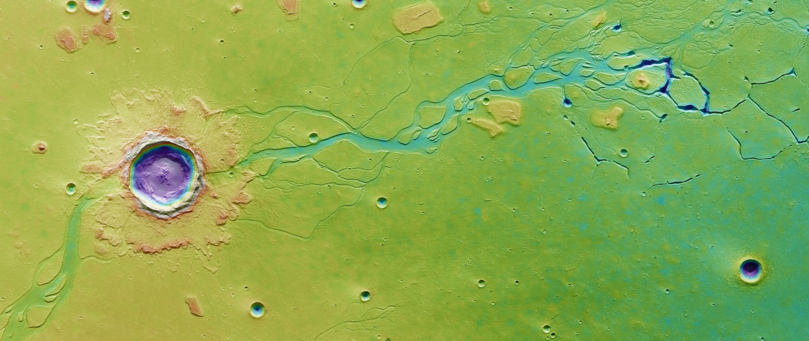
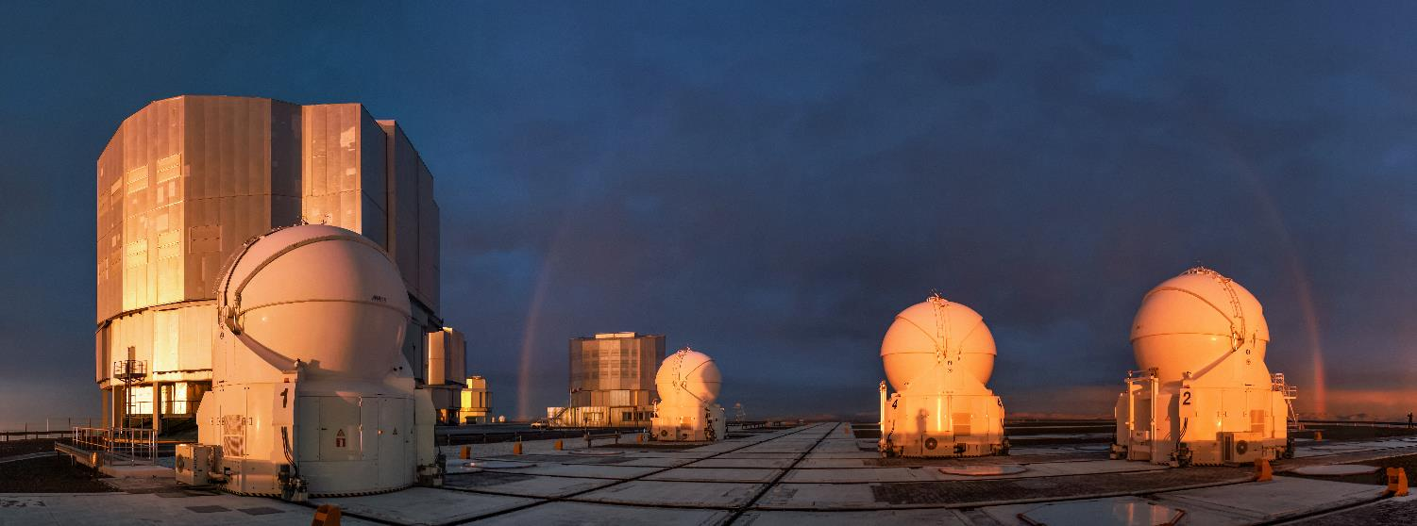
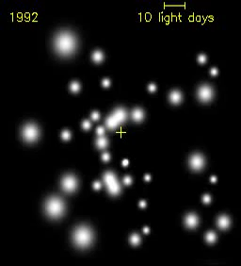
Astronomy
Ground Based Telescopes
VLT interferometer
Sagittarius A*
SWITCH TO SPACE 2 • 2020

Slide 5
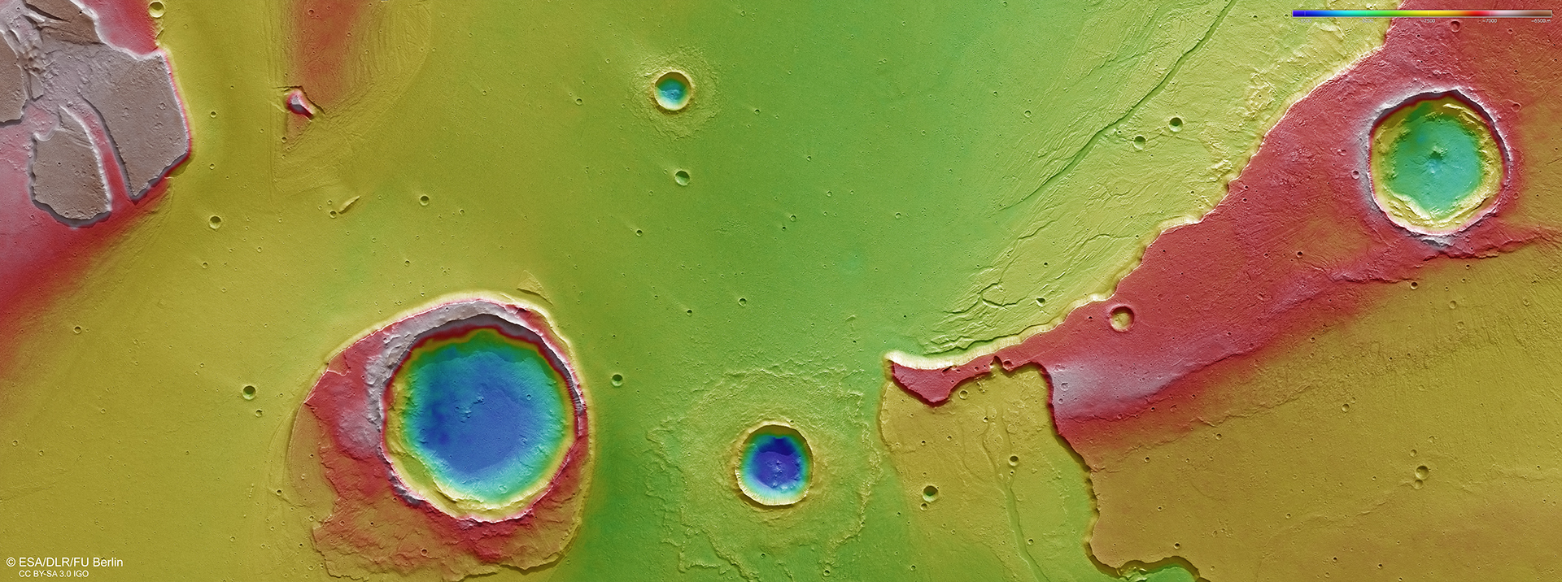
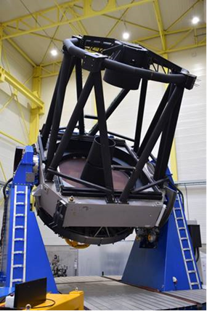
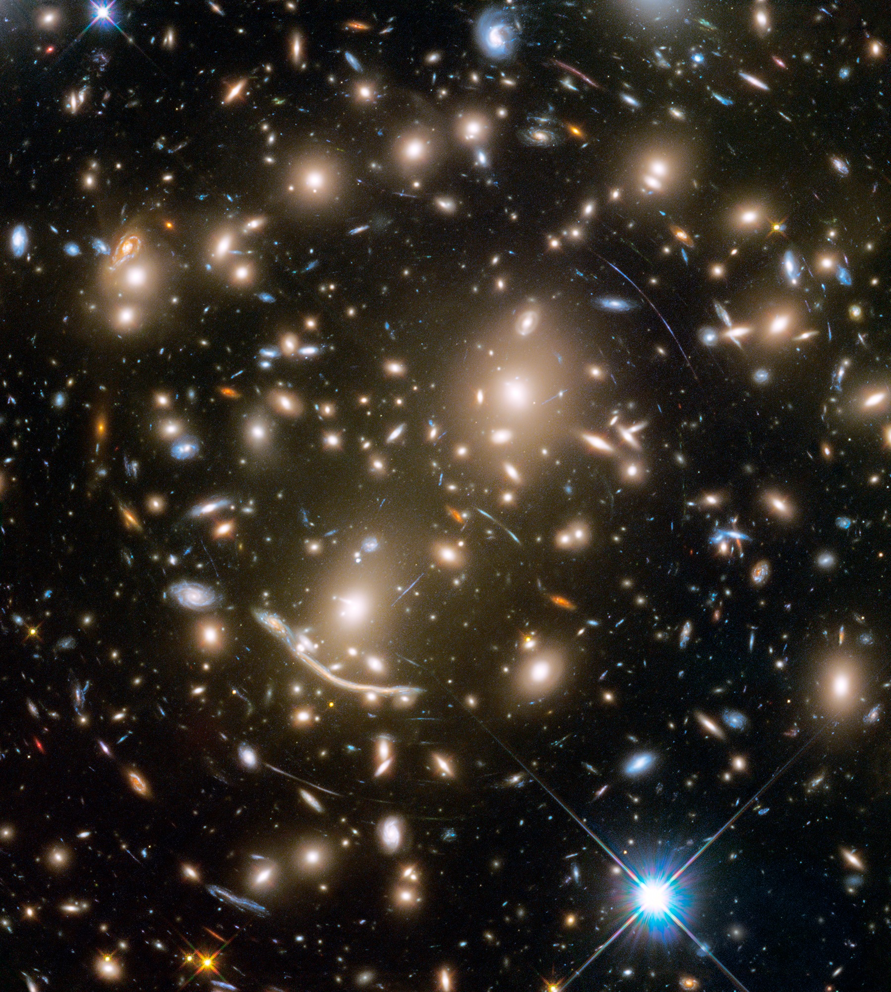
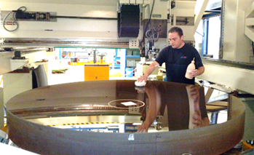
Mount Abu Telescope
India
2,5 m diameter
active optics
Astronomy
Ground Based
Telescopes
Place to your image
SWITCH TO SPACE 2 • 2020

Slide 6
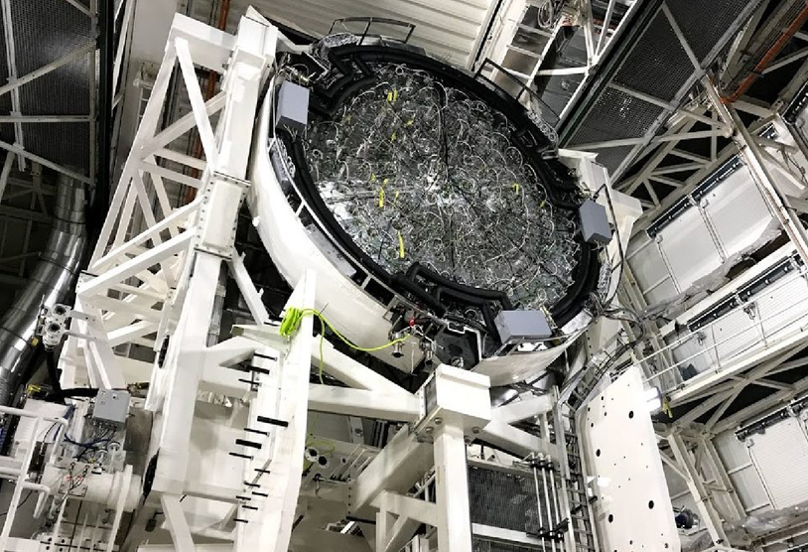
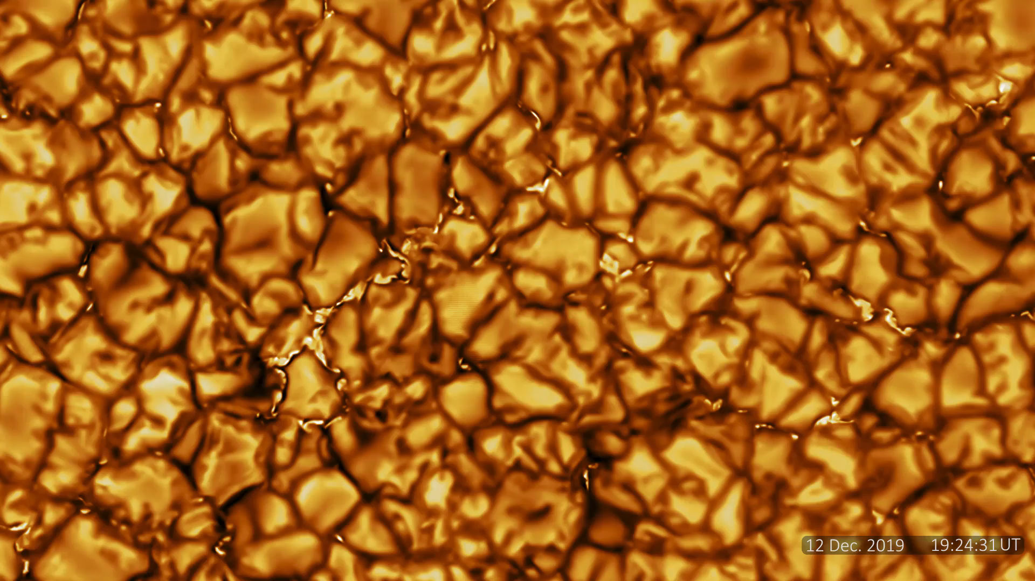
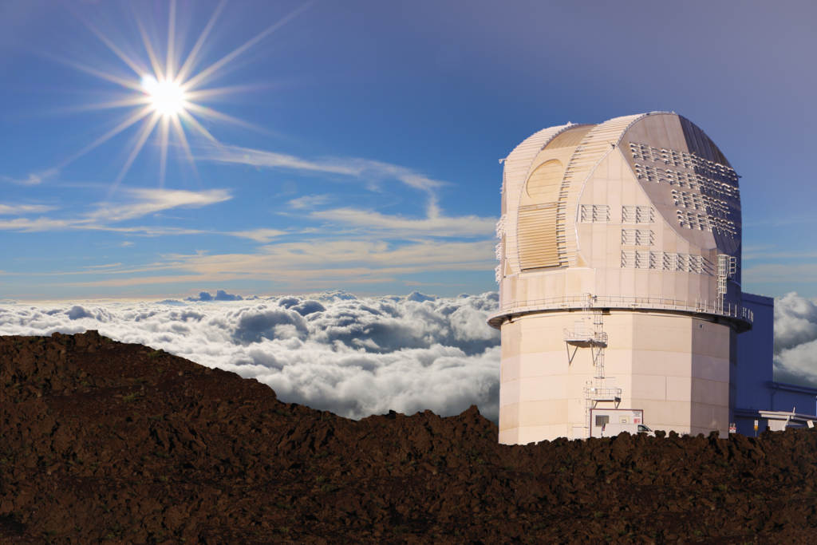
D. K. Inoue Solar Telescope
4 m diameter
active optics
Astronomy
Ground Based
Telescopes
SWITCH TO SPACE 2020
DKIST (Hawaii)

Slide 7
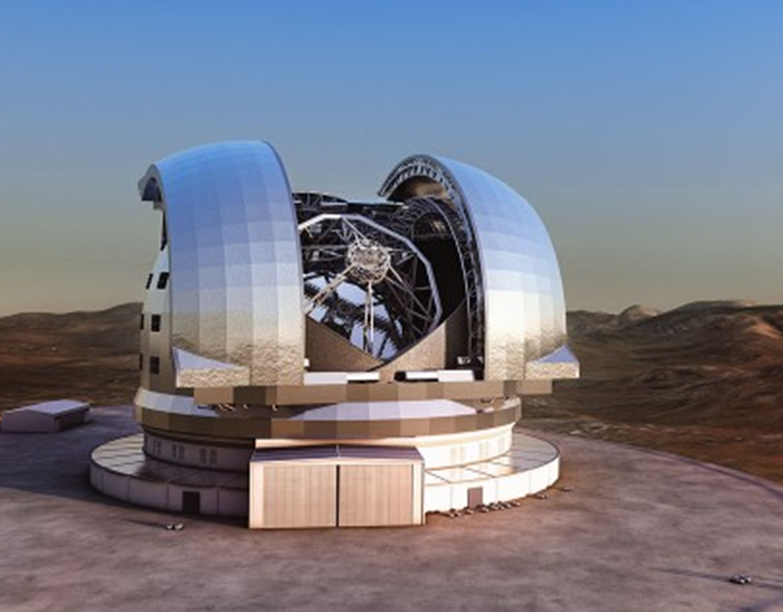
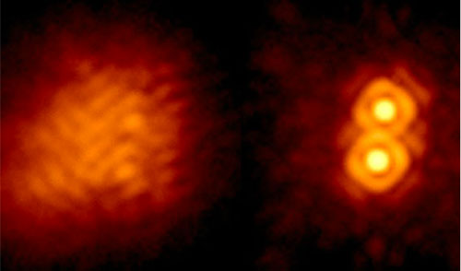
European Extremely Large Telescope
39 m diameter segmented primary mirror
Astronomy
Ground Based
Telescopes
Adaptive Optics
EELT (Chile)
SWITCH TO SPACE 2 • 2020

Slide 8
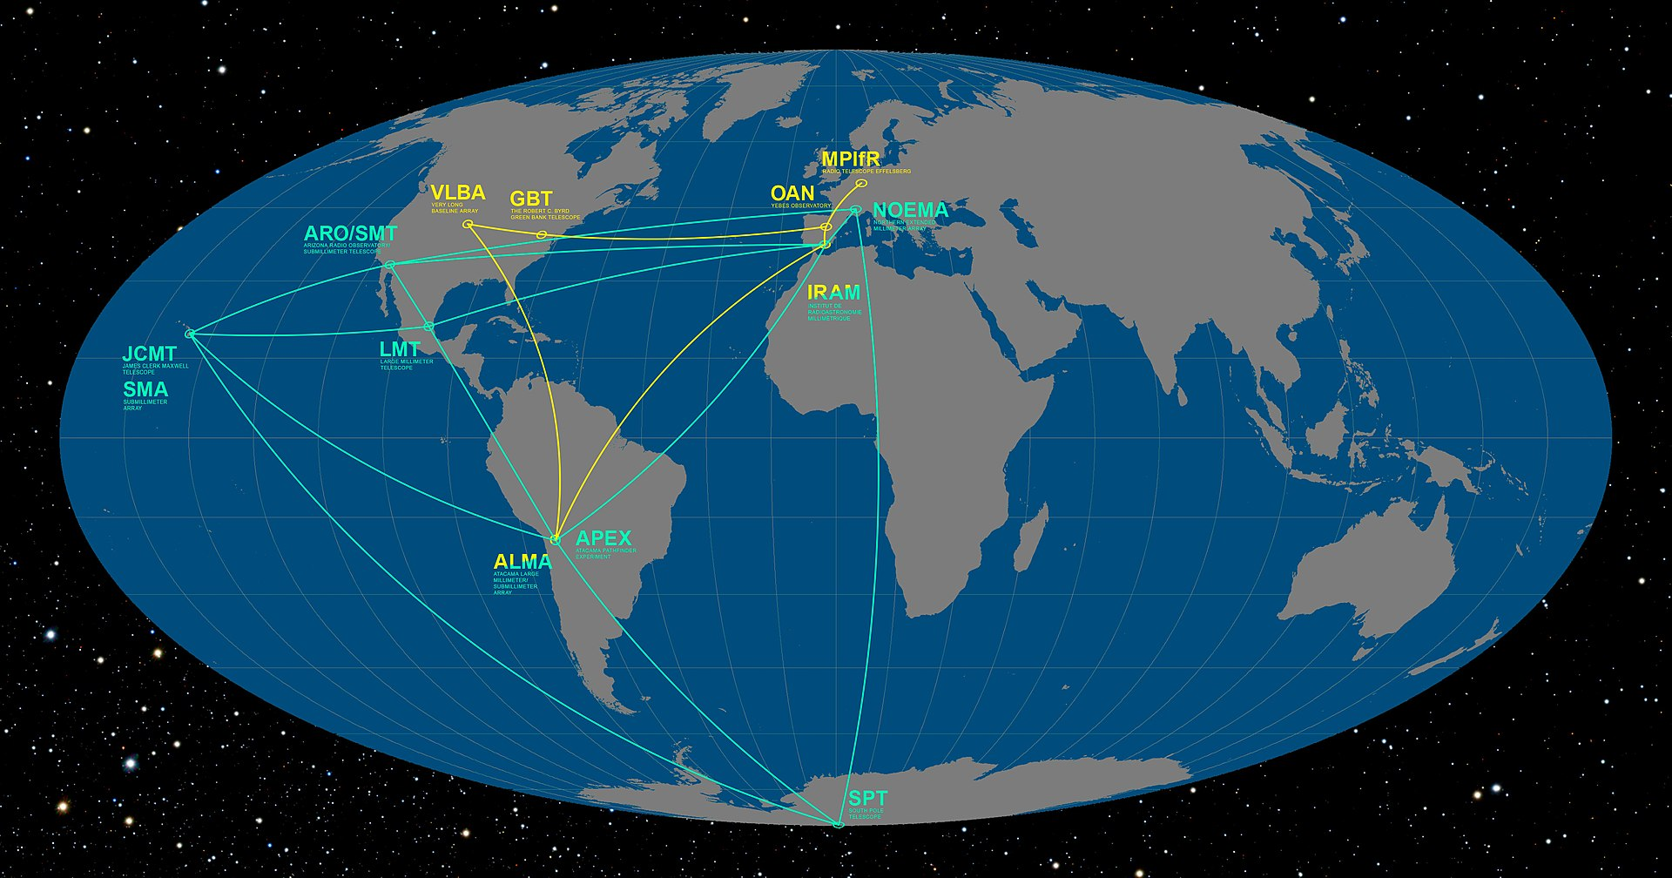
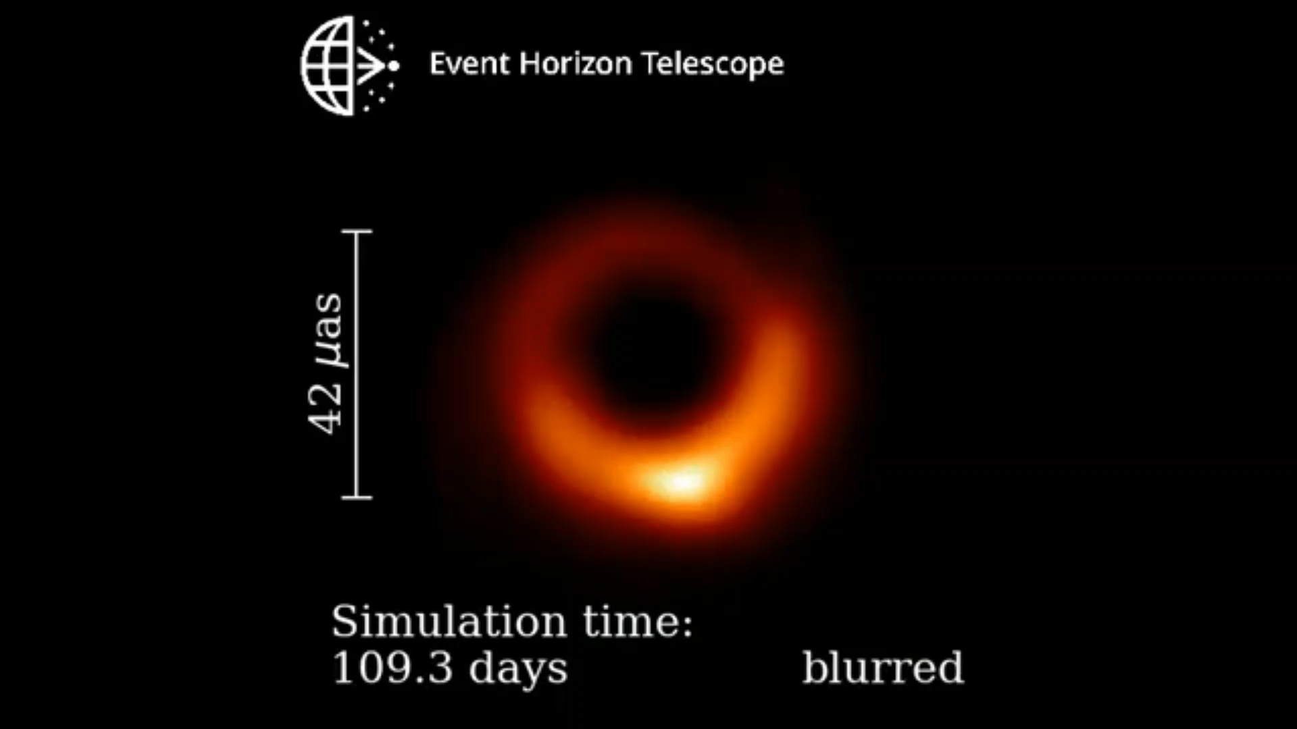
Astronomy
Event Horizon Telescope
Very Wide Base Interferometer
of Radio-Telescopes
Ground Based
Telescopes
M87*
EHT
SWITCH TO SPACE 2 • 2020

Slide 9
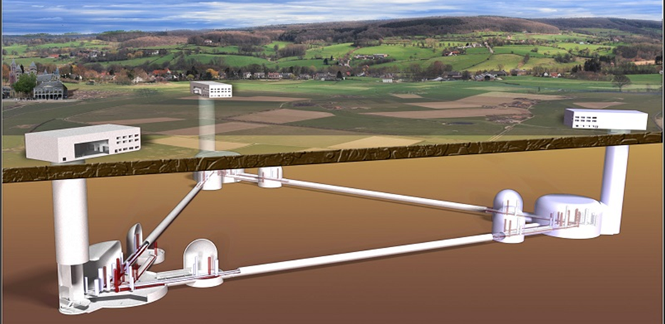
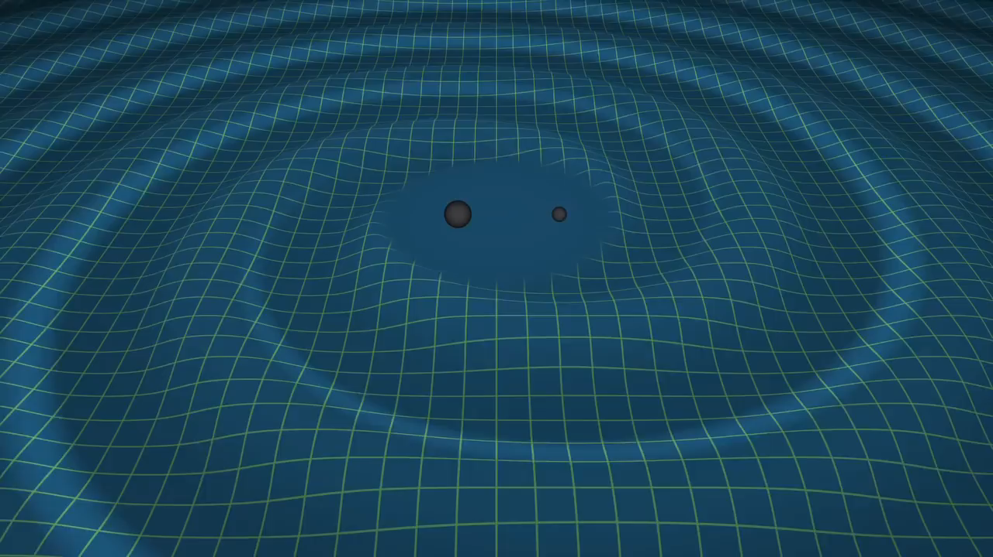
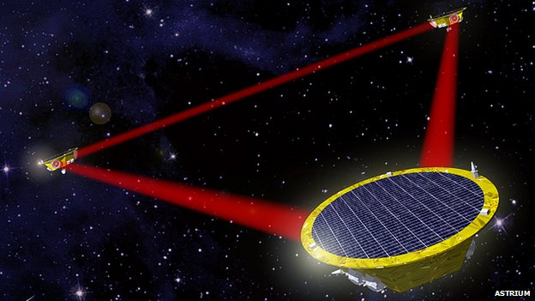
EINSTEIN TELESCOPE
Astronomy
Gravitational Waves
Telescopes
(10 km)
LISA
(5 million km)
SWITCH TO SPACE 2 • 2020

Slide 10
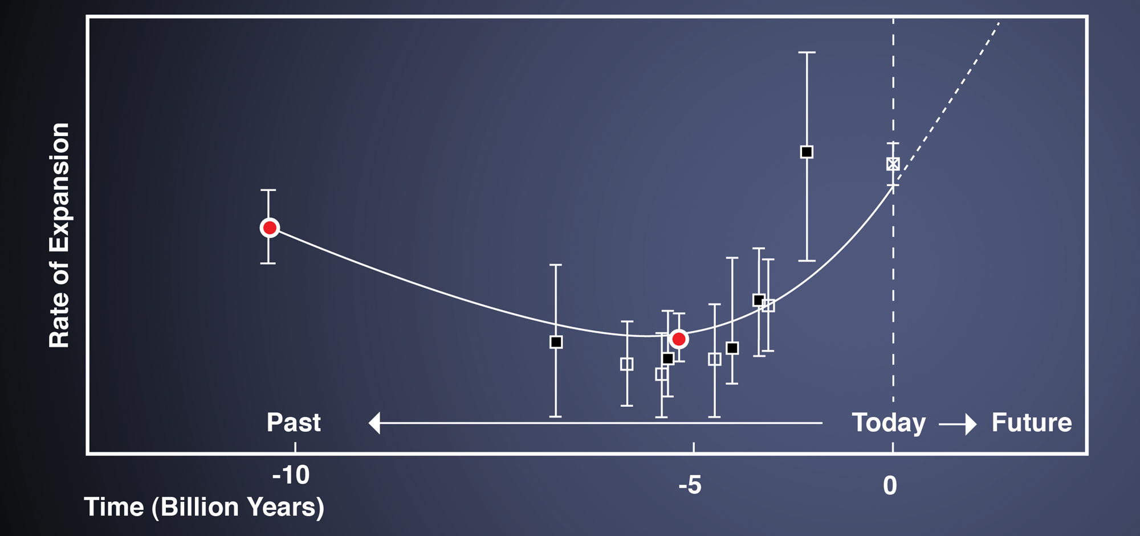
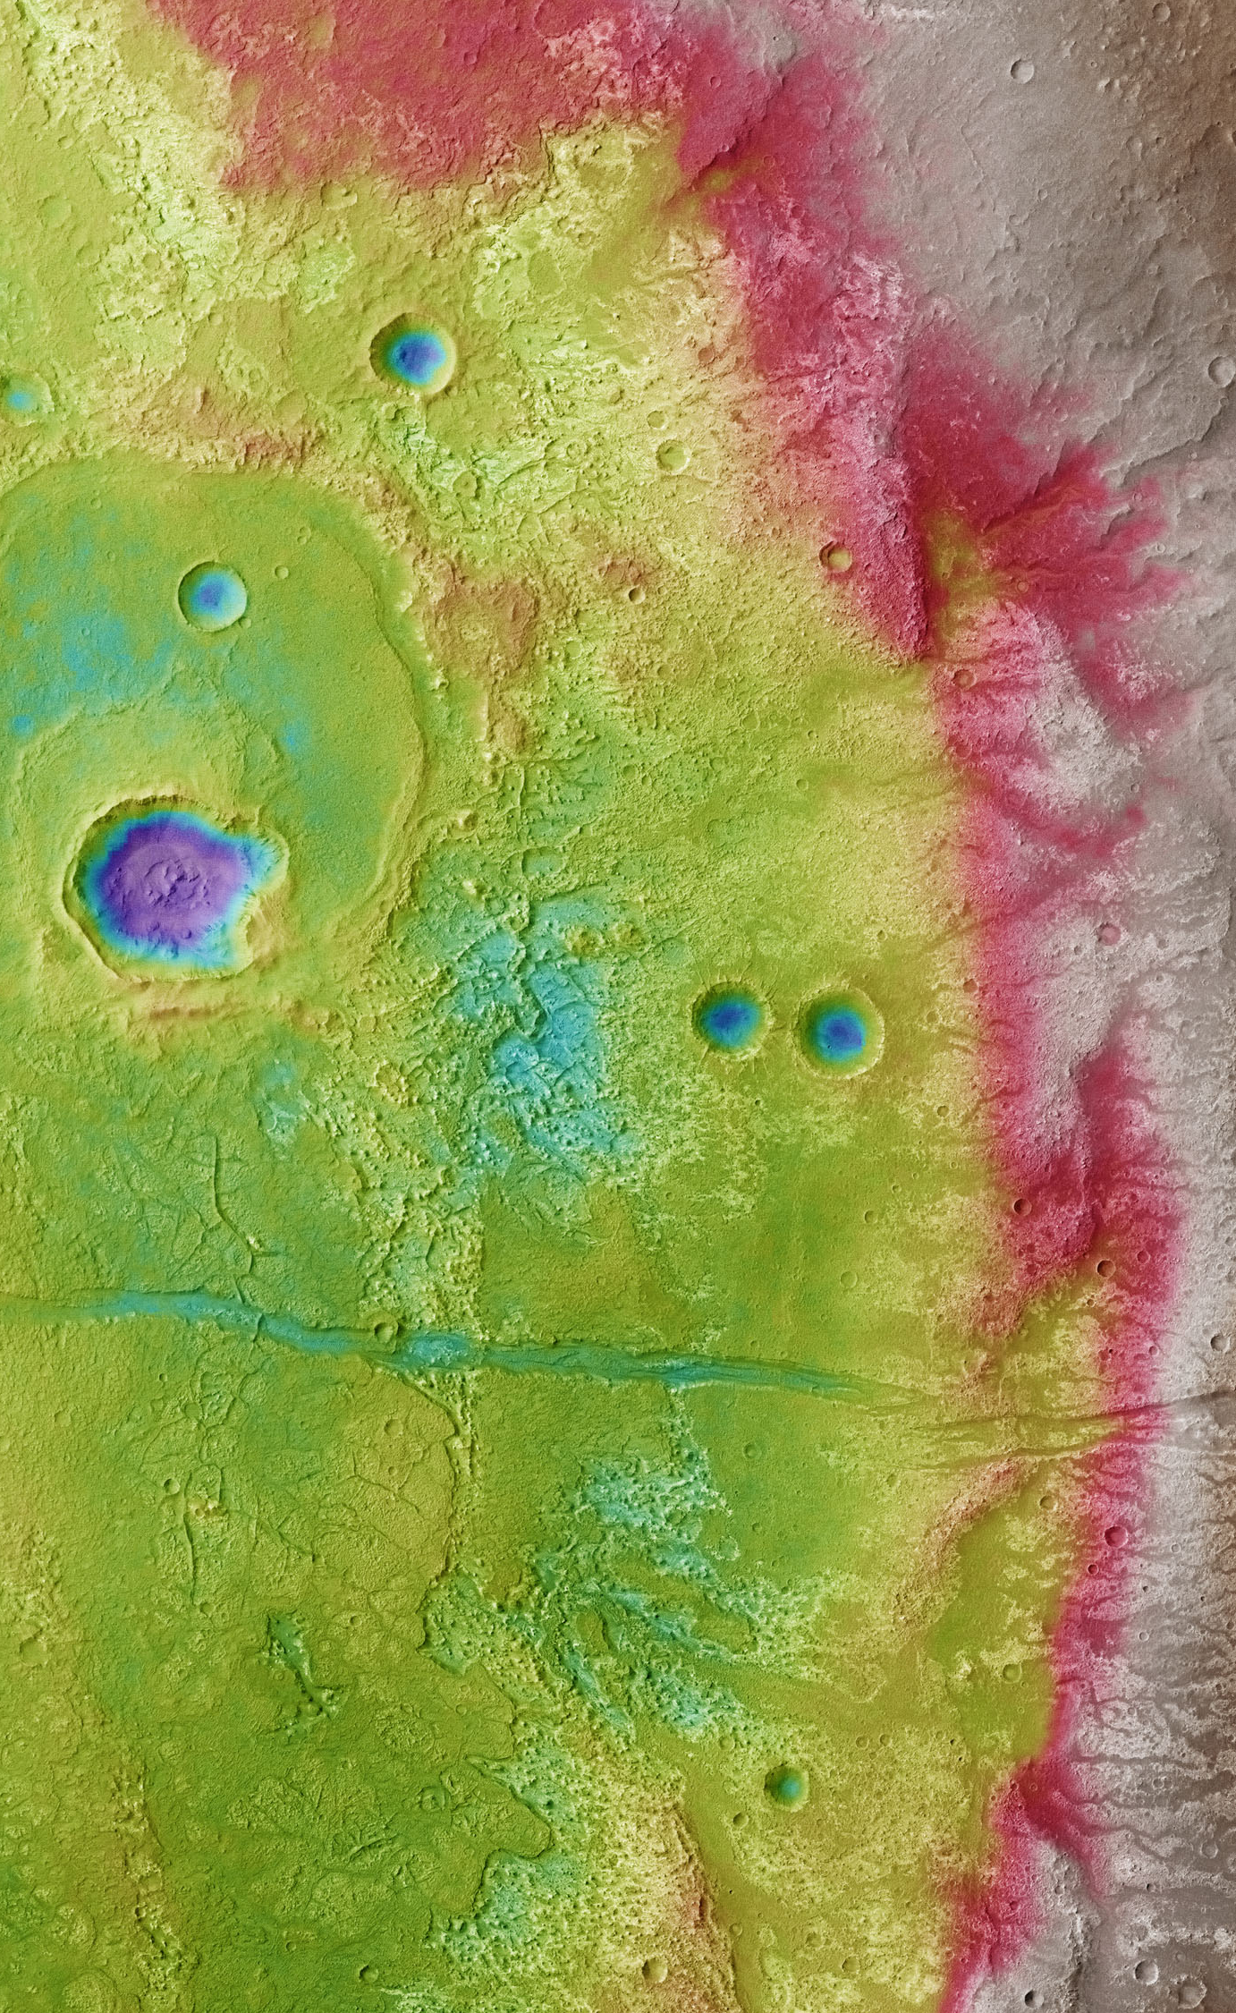
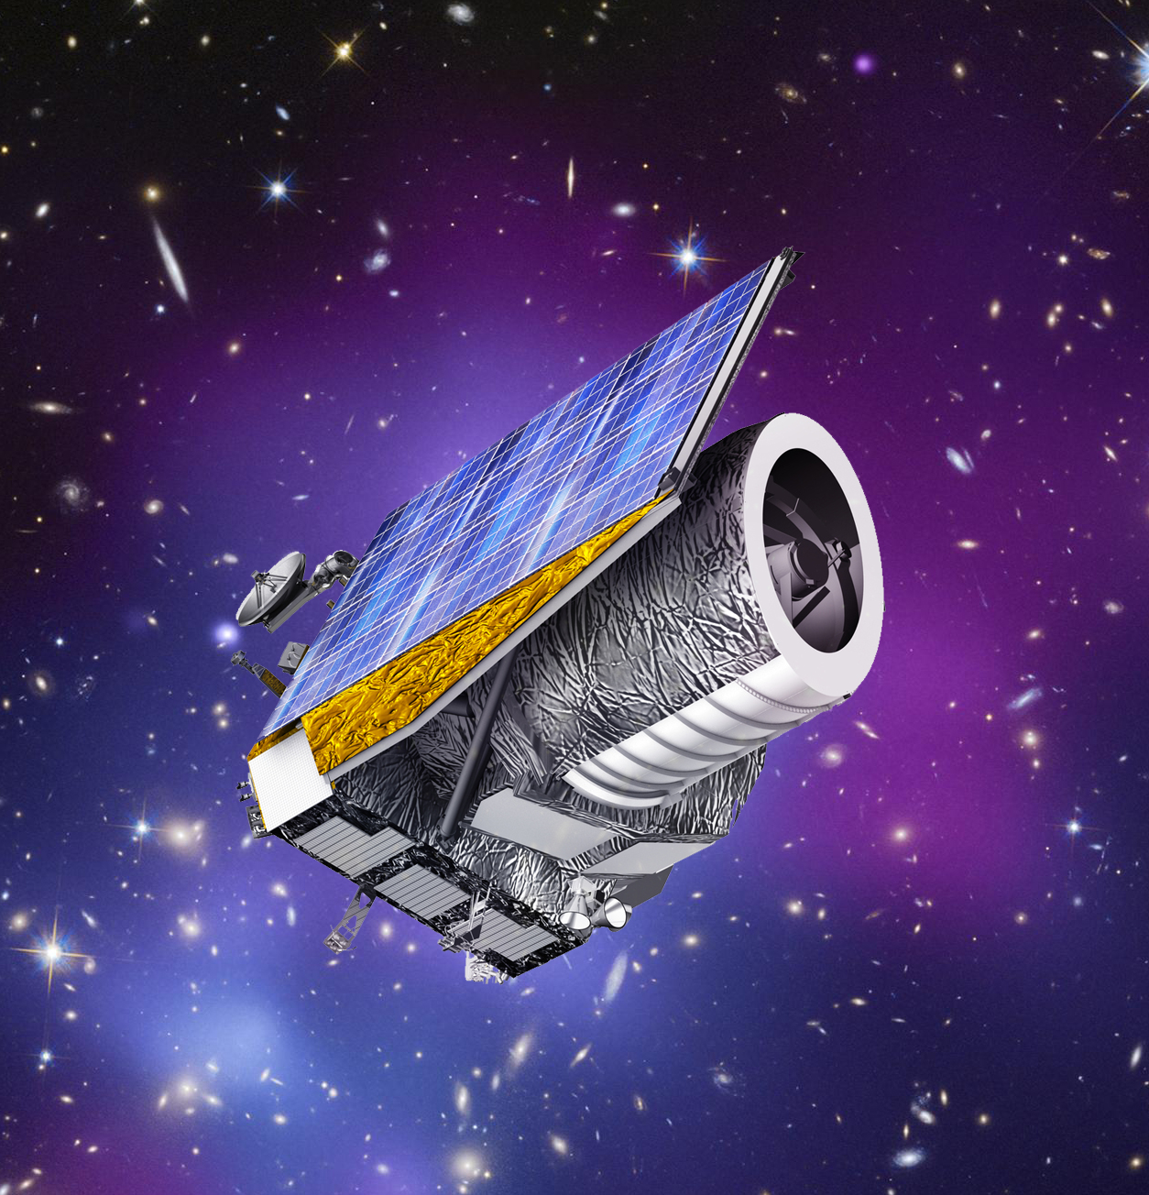
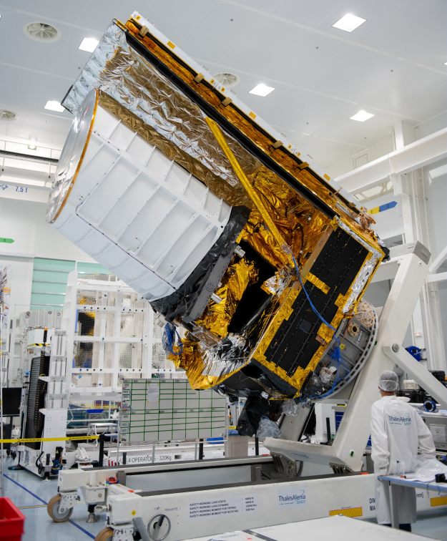
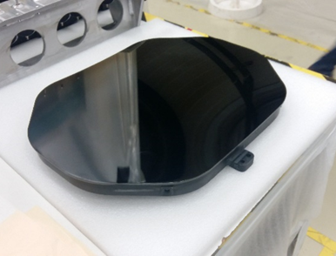
Astronomy
Space Telescopese
EUCLID
SWITCH TO SPACE 2 • 2020

Slide 11
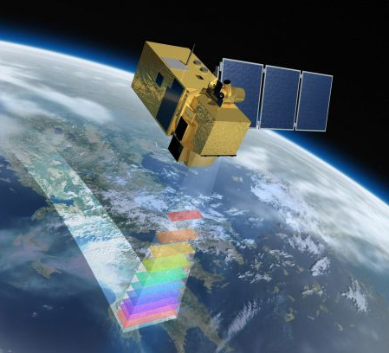
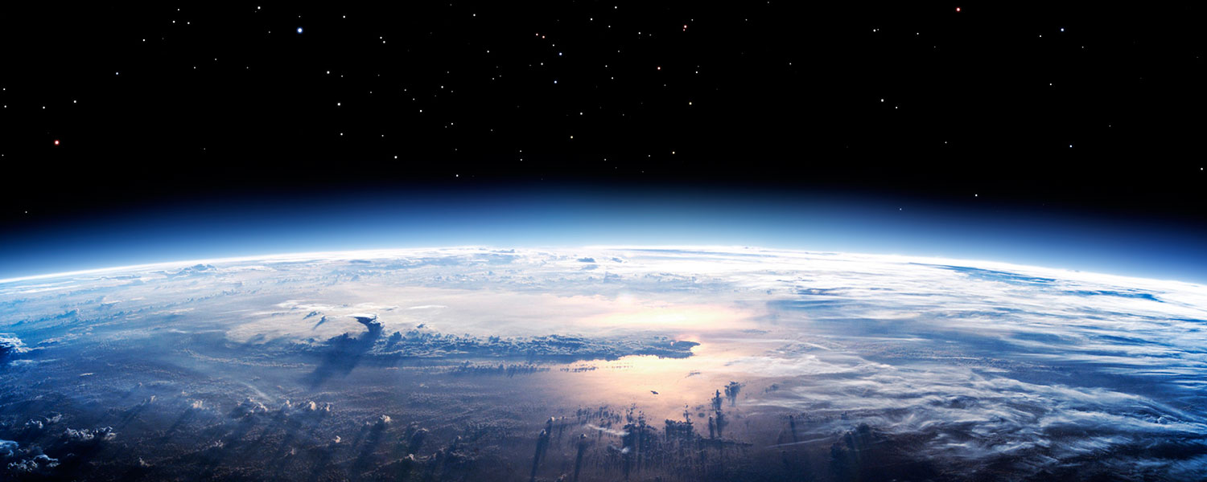
Earth Observation from Space
Place to your
image
SWITCH TO SPACE 2 • 2020

Slide 12
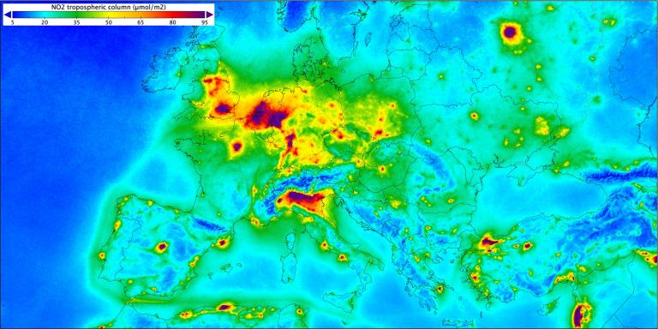
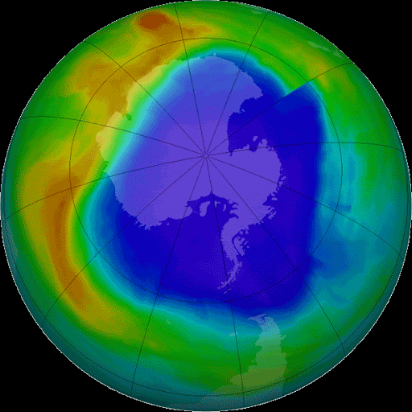
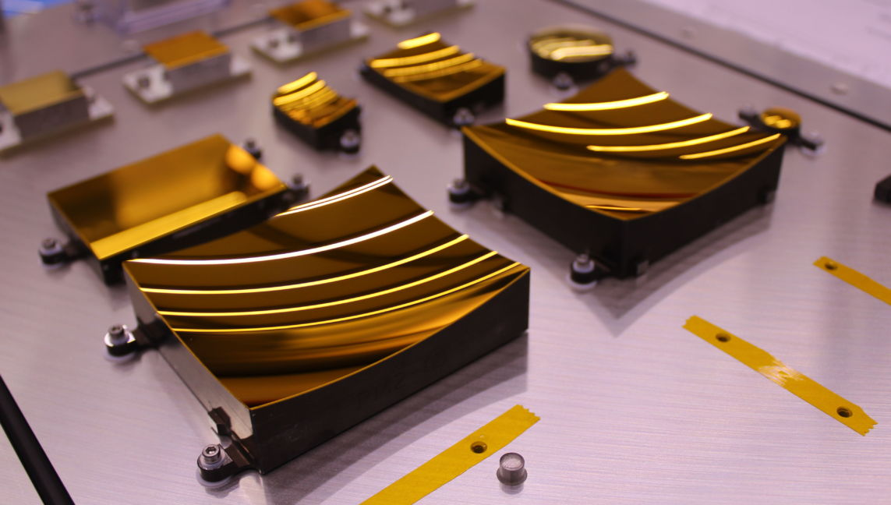
Earth Observation
Monitoring our atmosphere
Air pollution Monitoring
Sentinel 5P - TROPOMI
Ozone Monitoring
ALTIUS
SWITCH TO SPACE 2 • 2020

Slide 13
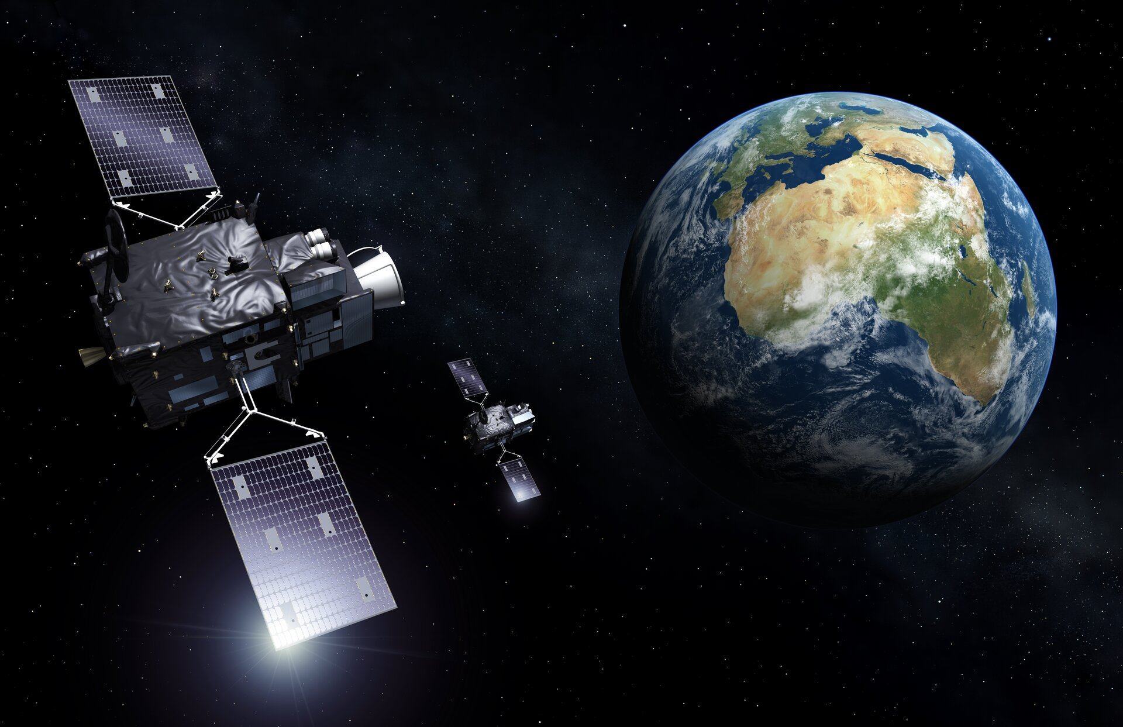
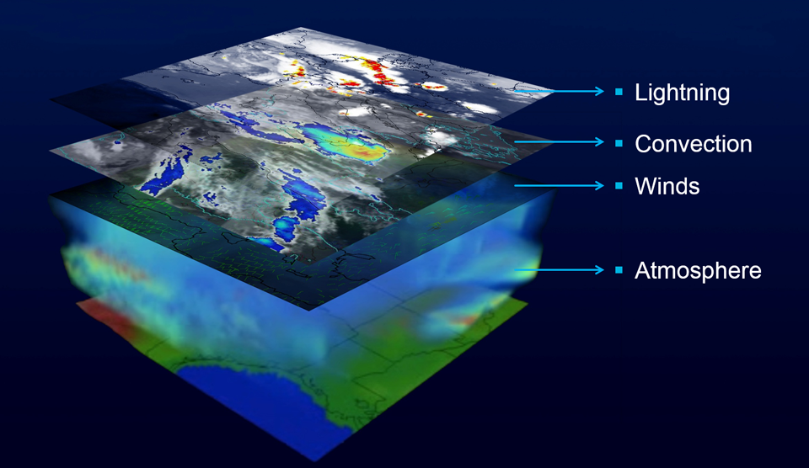
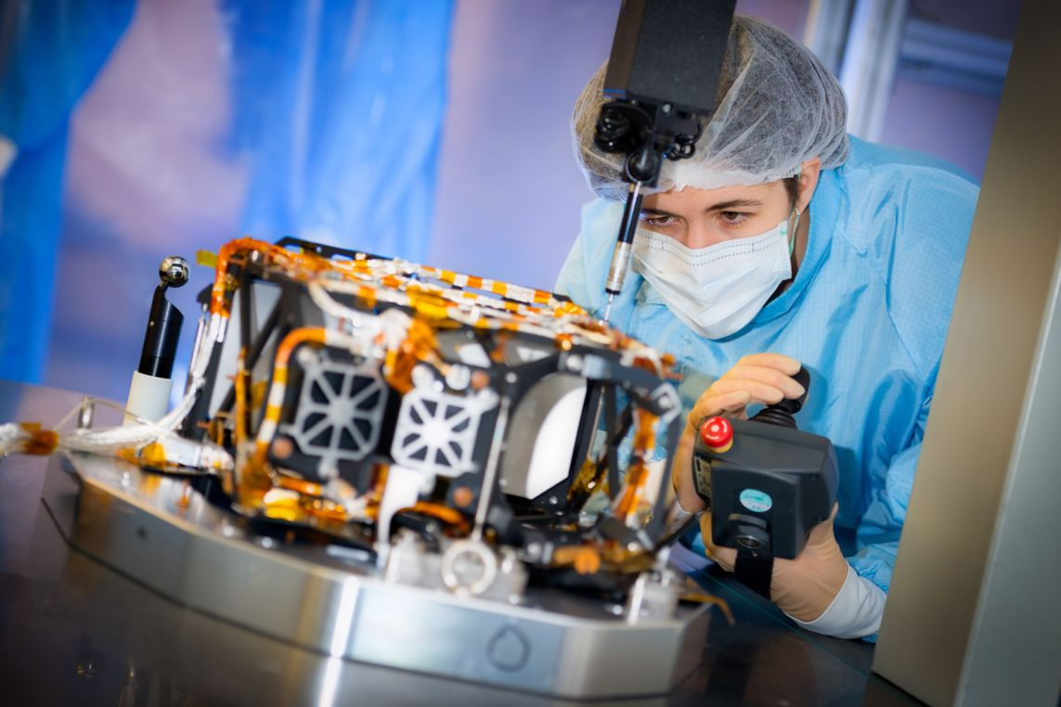
Earth Observation
Wheather forecasting
Temperature
Humidity
Meteosat
Third Generation
SWITCH TO SPACE 2 • 2020

Slide 14
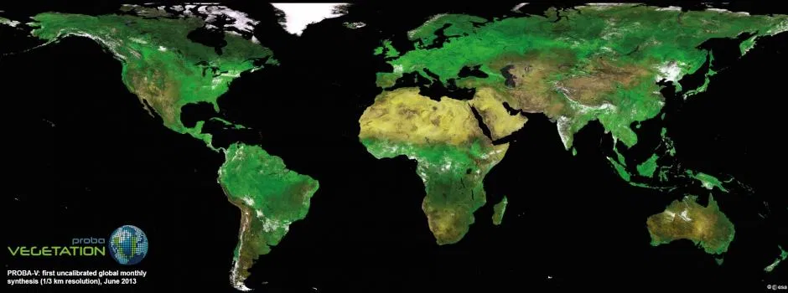
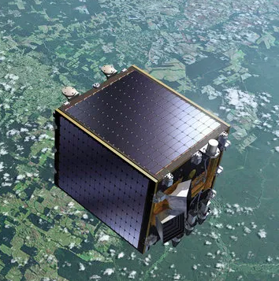
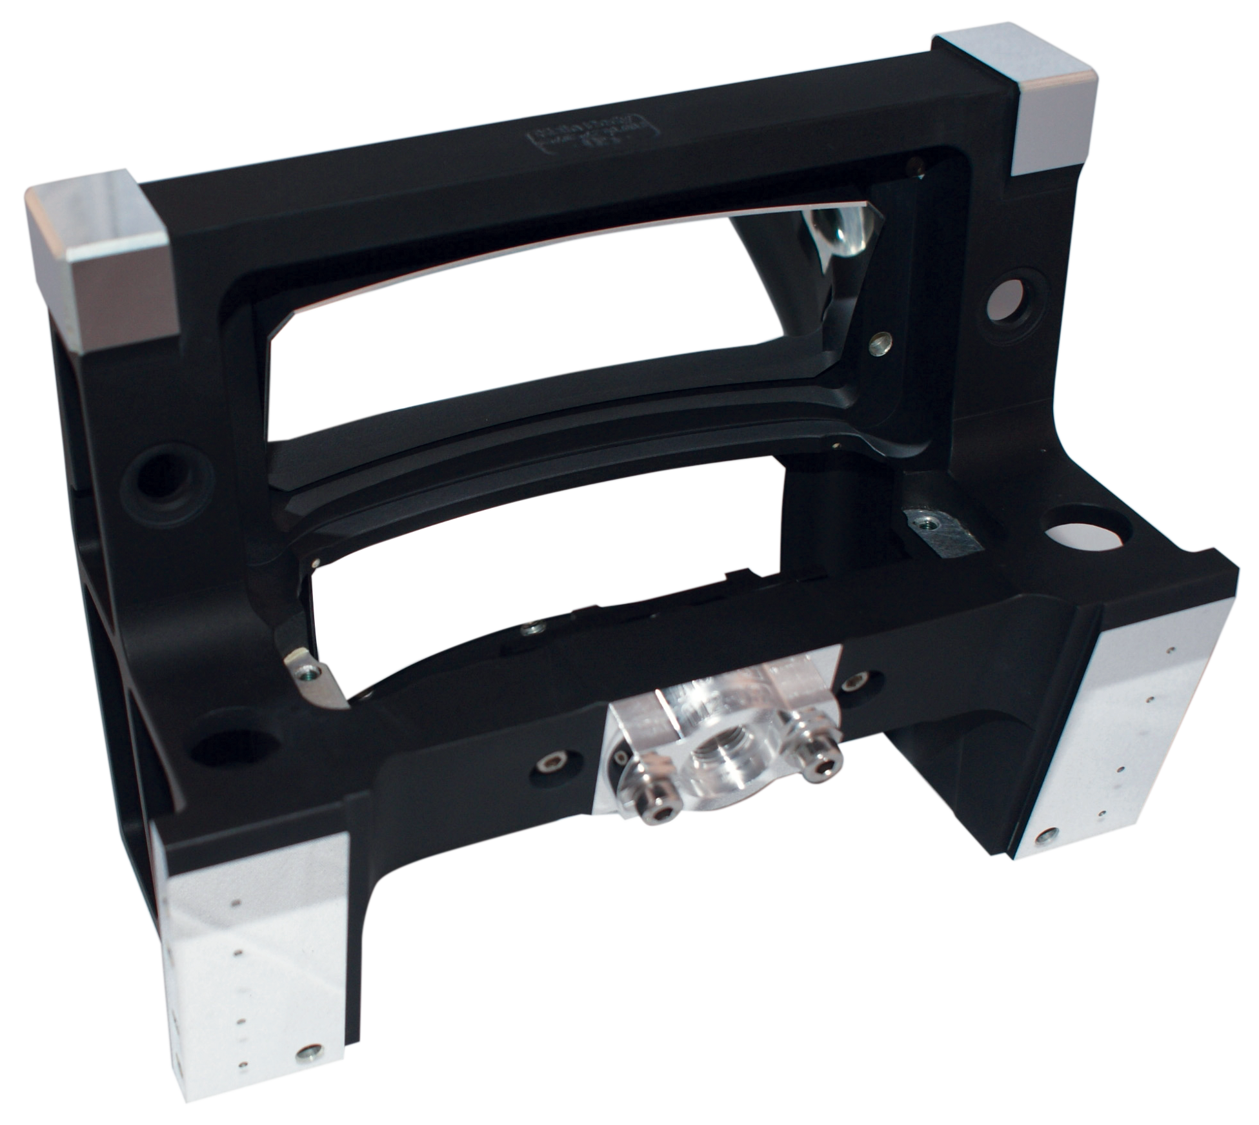
Earth Observation
Monitoring our Environment
PROBA-V
3 TMAs
Global Vegetation Monitoring
(Ground resolution = 100 m)

Slide 15
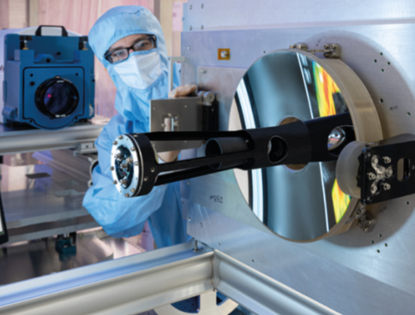
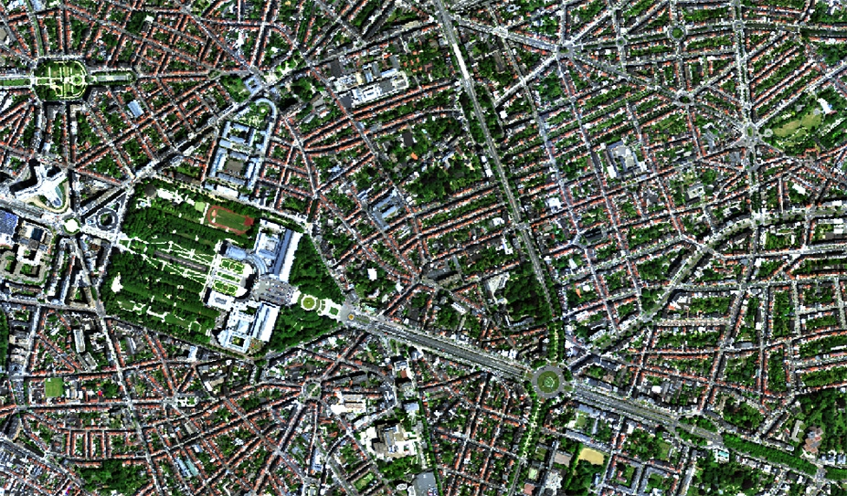
Earth Observation
Monitoring our Environment
Brussels Urban Trees Health Check
MicroMHiDe (Resolution < 1 m)

Slide 16
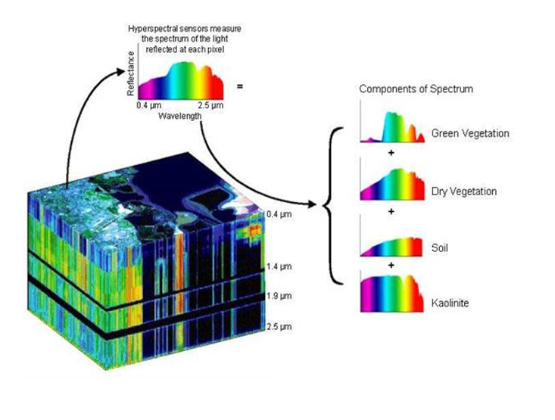
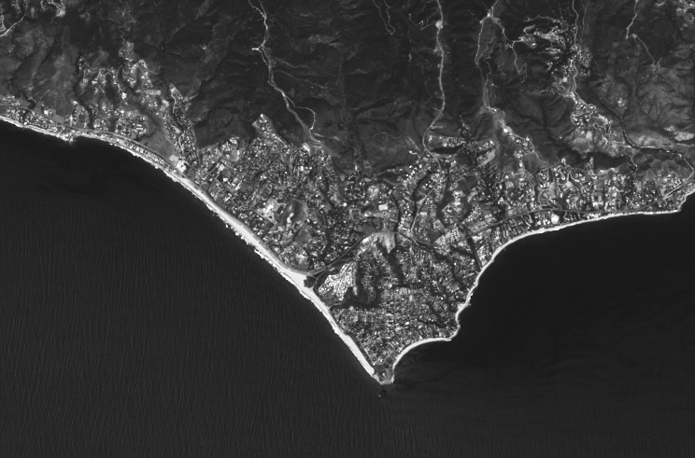
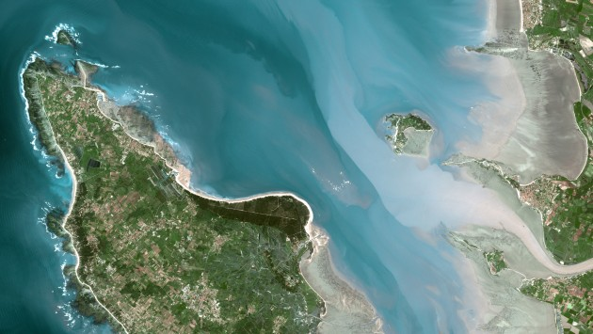

Earth Observation
Monitoring our Environment
Panchromatic
(Grey scale)
Multispectral
(R / G / B )
Superspectral
(13 colors)
Hyperspectral
(> 200 colors)
Improving
Spectral
Resolution !
Landsat
SPOT
Sentinel 2

Slide 17





Earth Observation
Monitoring our Environment
CHIME
Copernicus Hyperspectral Imaging Mission for the Environment
Precision agriculture
Forestry
Water quality
Geology
ELOIS

Slide 18








Would you like to join us
in Liège ?
We are
hiring !
System
Engineer
Optical
Engineers
Electro-mechanical Engineer
SWITCH TO SPACE 2 • 2020
Thermal
Engineer
Technology Development Engineer
Precision
Machining
Engineer
And more to come … !
www.amos.be/job

