Slide 1
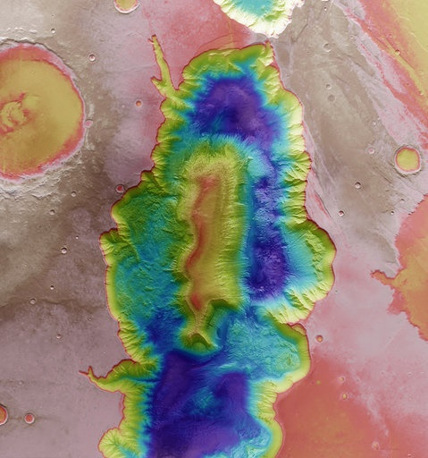
The ins and outs of the design, development and verification of electro-optical payloads
System integration from A(nalysis) to Z(ero-G)
#switchtospace
Notes:
Despite title insinuation, will not be going through the entire alphabet today

Slide 2
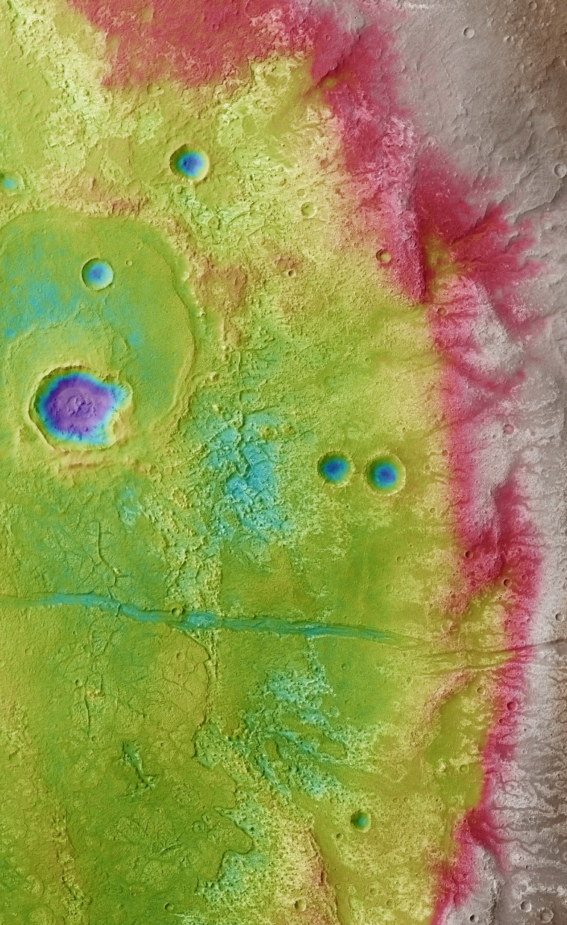
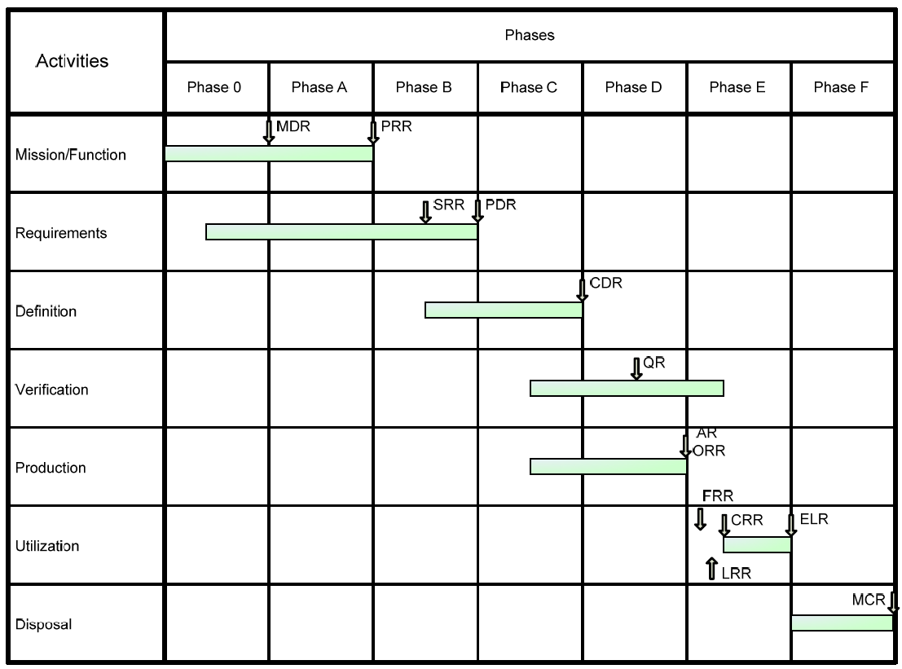
Phases of space project life cycle
Phase 0 ‐ Mission analysis/needs identification
Phase A ‐ Feasibility
Phase B ‐ Preliminary Definition
Phase C ‐ Detailed Definition
Phase D ‐ Qualification and Production
Phase E ‐ Utilization
Phase F - Disposal
From ECSS-M-ST-10C
SWITCH TO SPACE 2 • 2020
2
Notes:
Talk focuses on those phases with direct involvement from industry.

Slide 3
Phase A
Anything’s possible… with sufficient budgets
Elaborate possible concepts and system architectures
Assess technical and programmatic feasibility
Identify critical technologies and propose pre‐development activities
Concluded by Preliminary Requirements Review
SWITCH TO SPACE 2 • 2020
3

Slide 4
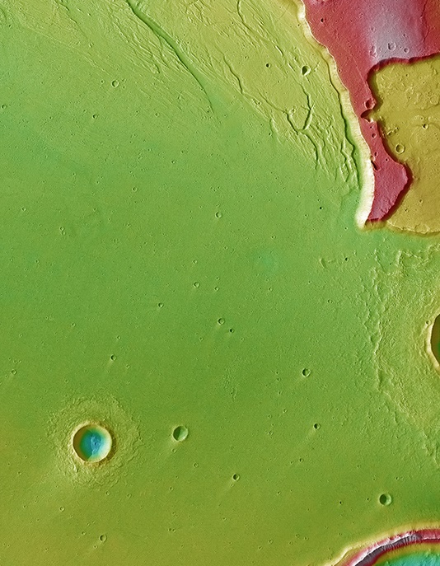
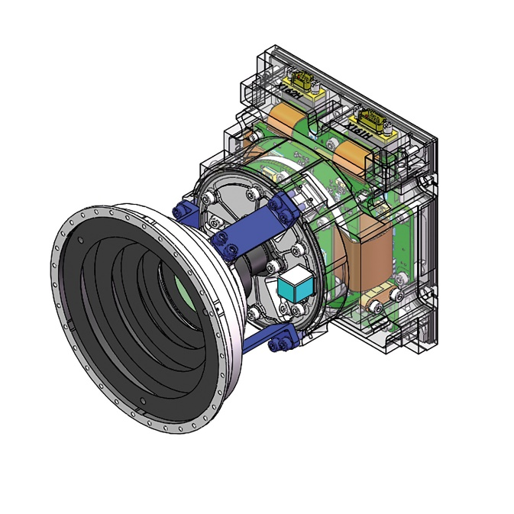
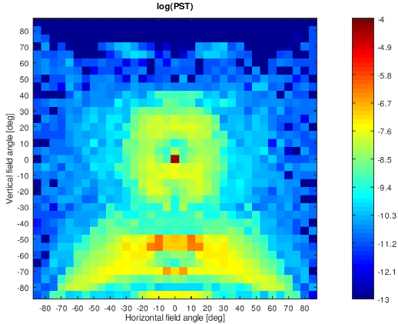
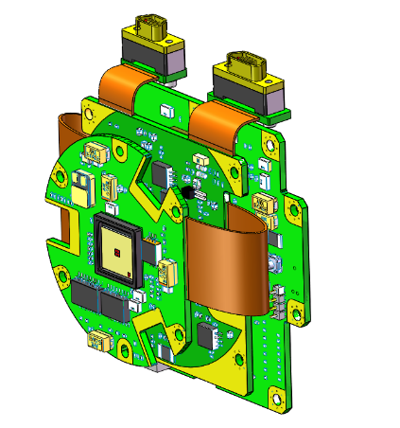
Flow-down of requirements → System Requirements Review
Establish preliminary design definition for selected system concept and retained technical solution(s)
Conduct “trade‐off” studies and related analyses
Determine the verification program including model philosophy
Elaborate programmatic baseline (schedule, cost at completion, organization breakdown, …)
Concluded by Preliminary Design Review
Phase B To the drawing board!
SWITCH TO SPACE 2 • 2020
4
Notes:
Point Source Transmittance as resulting from ray tracing straylight analysis

Slide 5
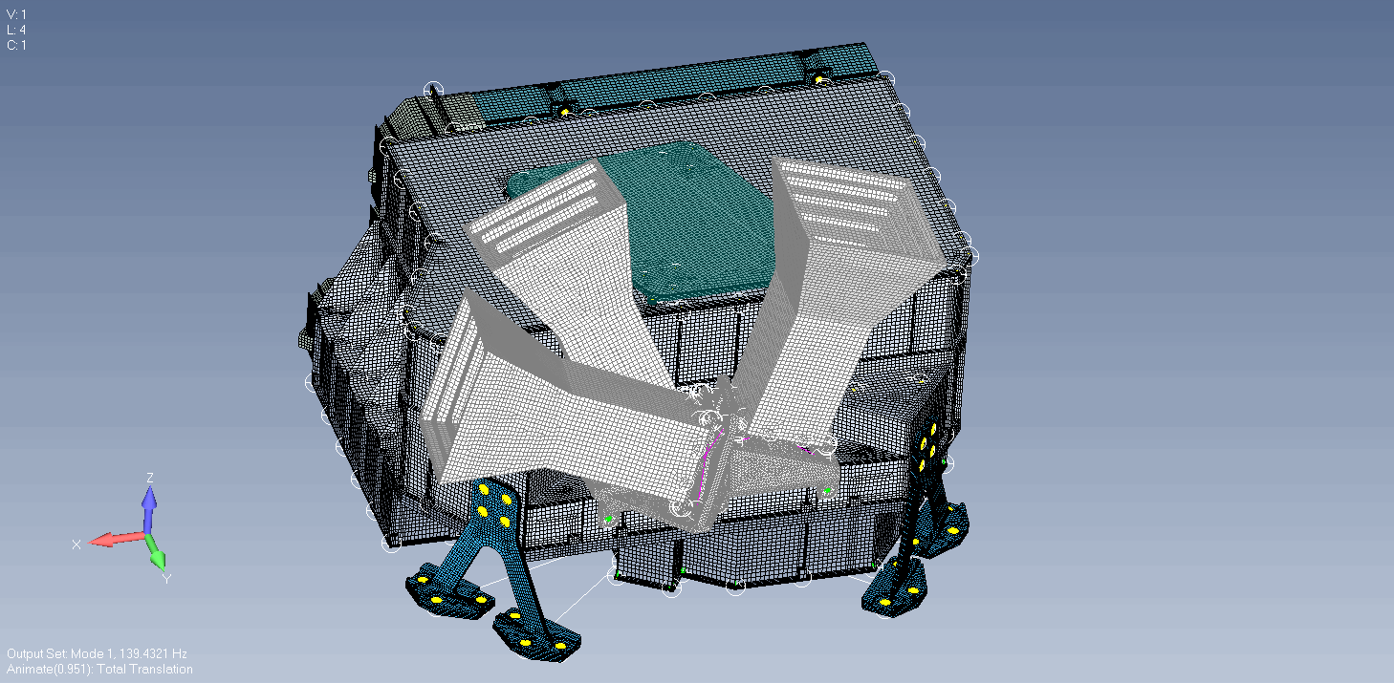
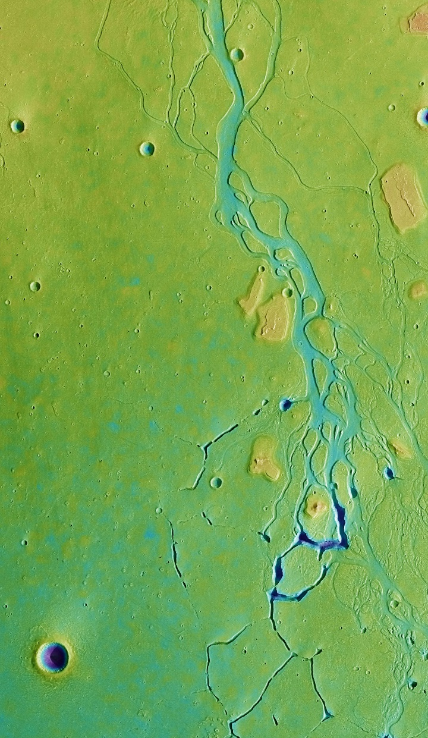
Phase C The Devil’s in the details
Completion of detailed design definition and related analyses at all levels in the supplier chain
Pre‐qualification of selected critical elements and components
Production and development testing of engineering models
Concluded by Critical Design Review
SWITCH TO SPACE 2 • 2020
5
Notes:
Instrument Finite Element Model consisting of some 1.5 million nodes

Slide 6
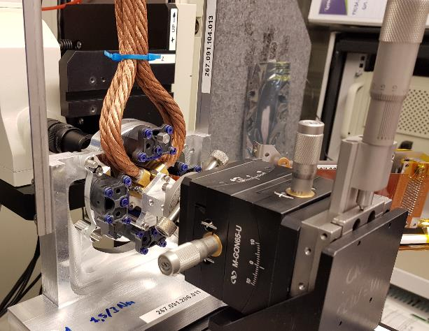
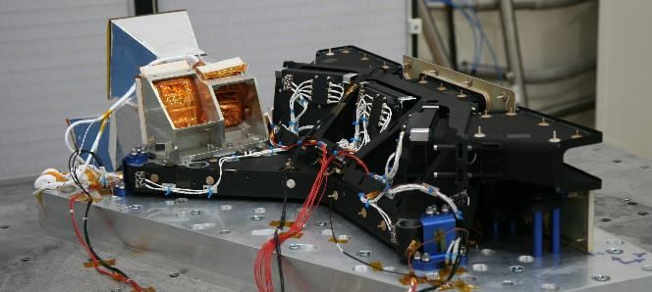
Phase D It’s all coming together now
Complete qualification testing and associated verification activities → Qualification Review
Complete Manufacturing, Assembly, Integration and Testing (MAIT) of flight hardware/software
Concluded by Acceptance Review
SWITCH TO SPACE 2 • 2020
6
Notes:
Favorite phase tells a lot about the personality of someone.

Slide 7
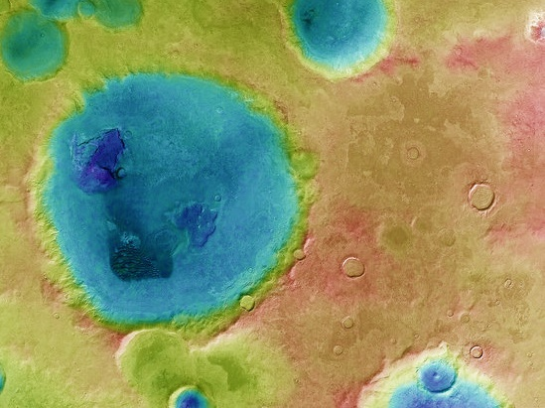
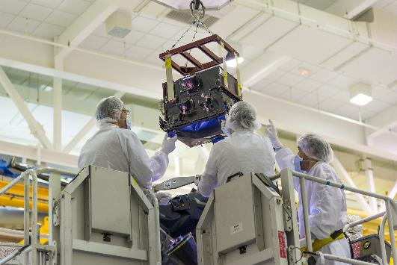
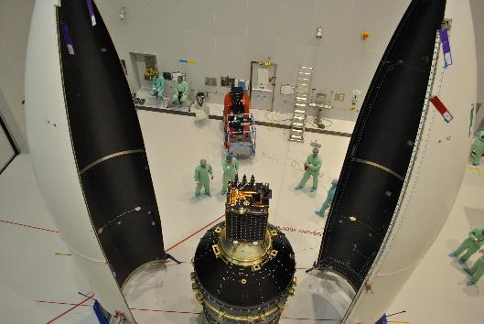
Phase E1
The bittersweet goodbye
Perform all activities in order to prepare the launch (Flight Readiness Review)
Conduct all launch and early orbital operations
Perform on‐orbit verification (including commissioning) activities
Concluded by Commissioning Results Review
SWITCH TO SPACE 2 • 2020
7
Notes:
NOMAD Instrument being built into the ExoMars spacecraft. Proba-V satellite integrated on the VEGA launcher adapter prior to closing of the fairing

Slide 8
Let’s talk!
jobs@oip.be
www.oip.be
SWITCH TO SPACE 2 • 2020
8
Notes:
11 open vacancies currently Always open to spontaneous applications

