Slide 1
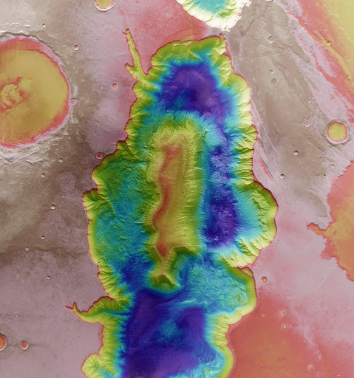
7/10/2020
Getting Humans back to the Moon
About Building Satellites and Critical Systems to Return to the Moon
#switchtospace
Stijn Ilsen

Slide 2
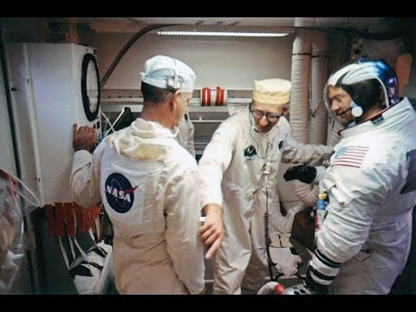
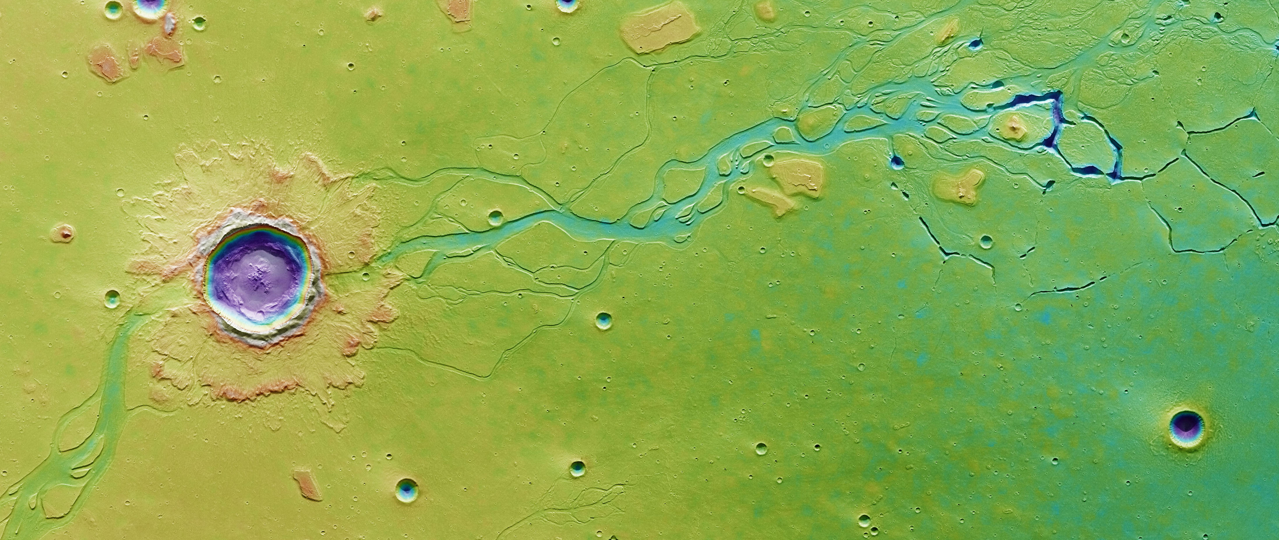
Günter Wendt
SWITCH TO SPACE 2 • 2020
Notes:
Nooit astronaut worden
Wel deel uitmaken van een grootse missie
De missies naar de maan inspireerden mateloos
Vooral de figuur van Gunter Wendt, de pad leader, degene die de astronauten in het capsule vastzette, ze een goede reis wenstte en dan de deur sloot

Slide 3
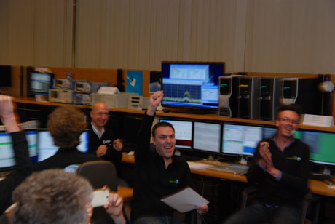
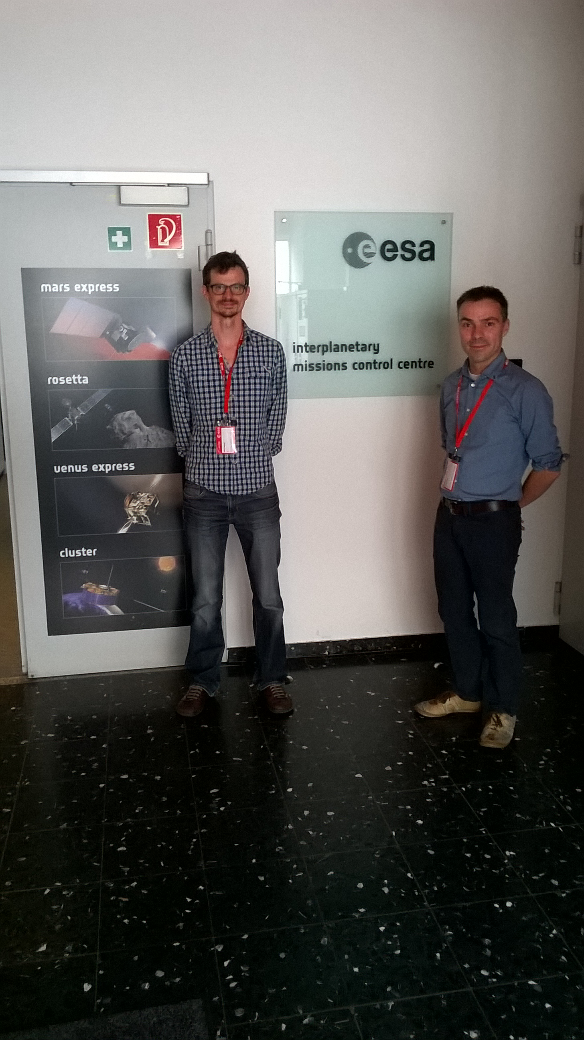
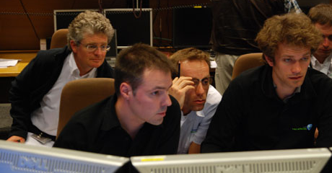
HOUSTON
REDU & ESOC
SWITCH TO SPACE 2 • 2020

Slide 4
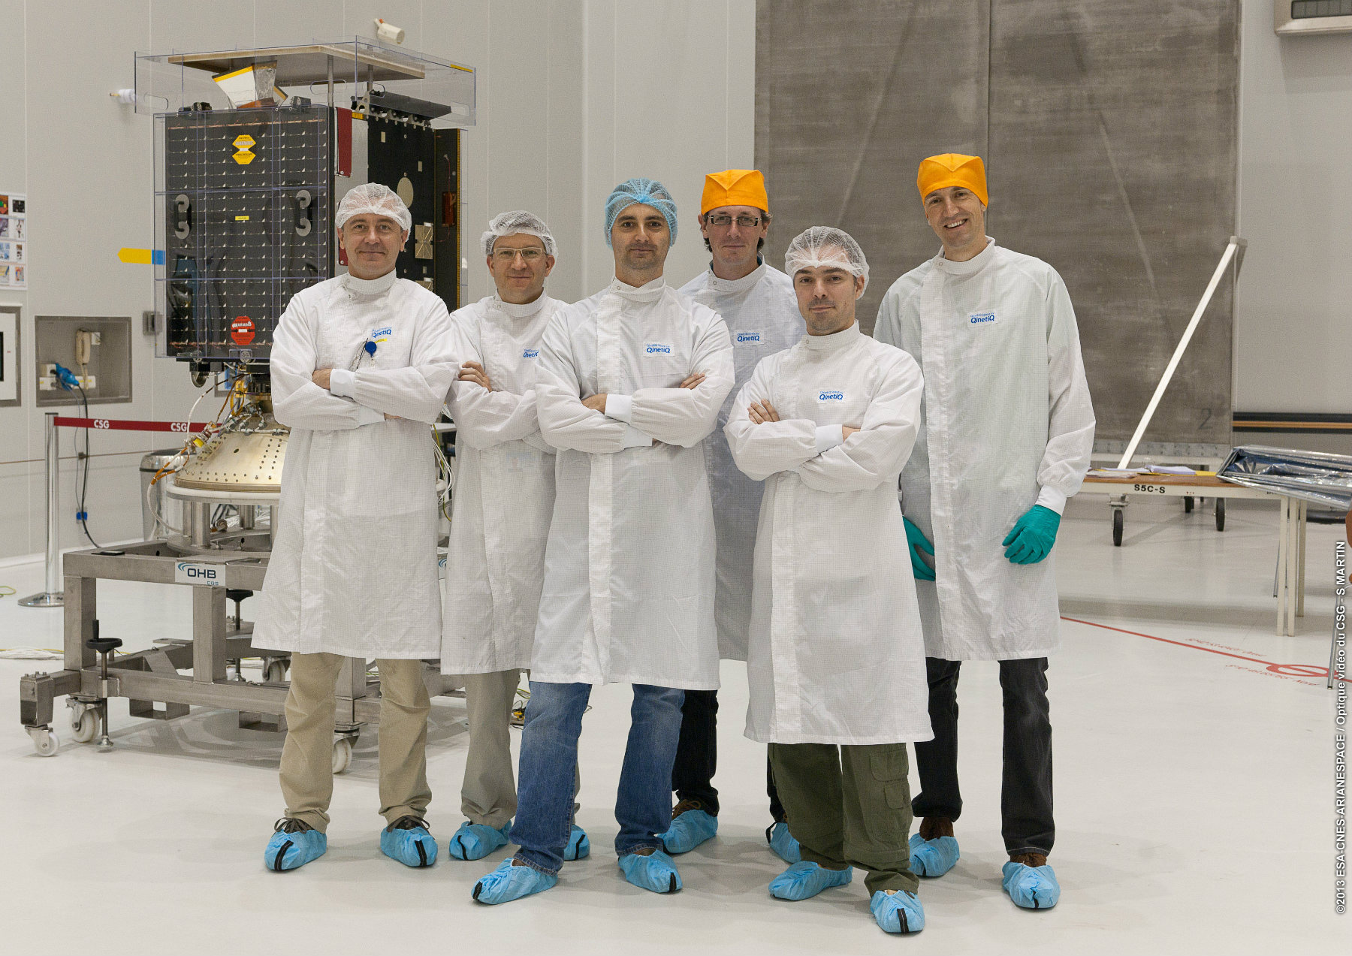
KENNEDY SPACE CENTER
CENTRE SPATIAL DE GUYANA
SWITCH TO SPACE 2 • 2020

Slide 5
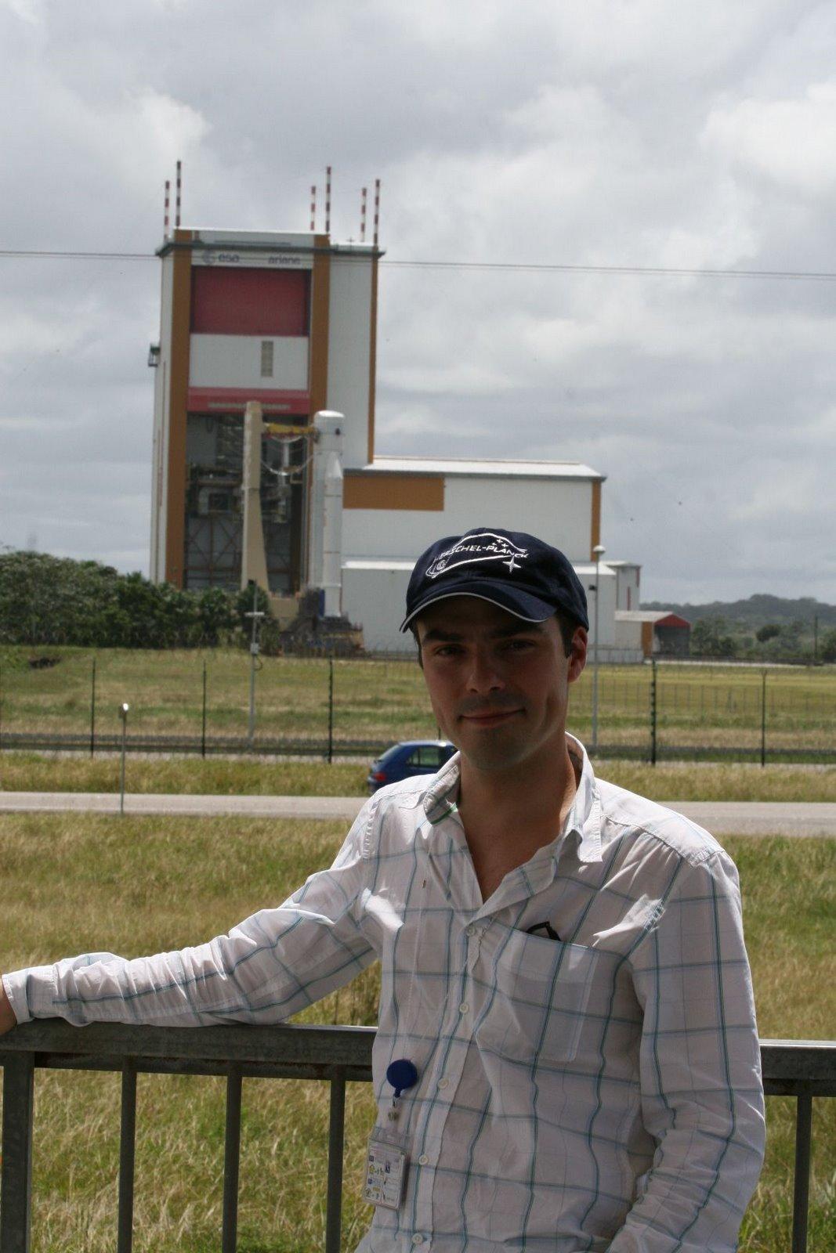
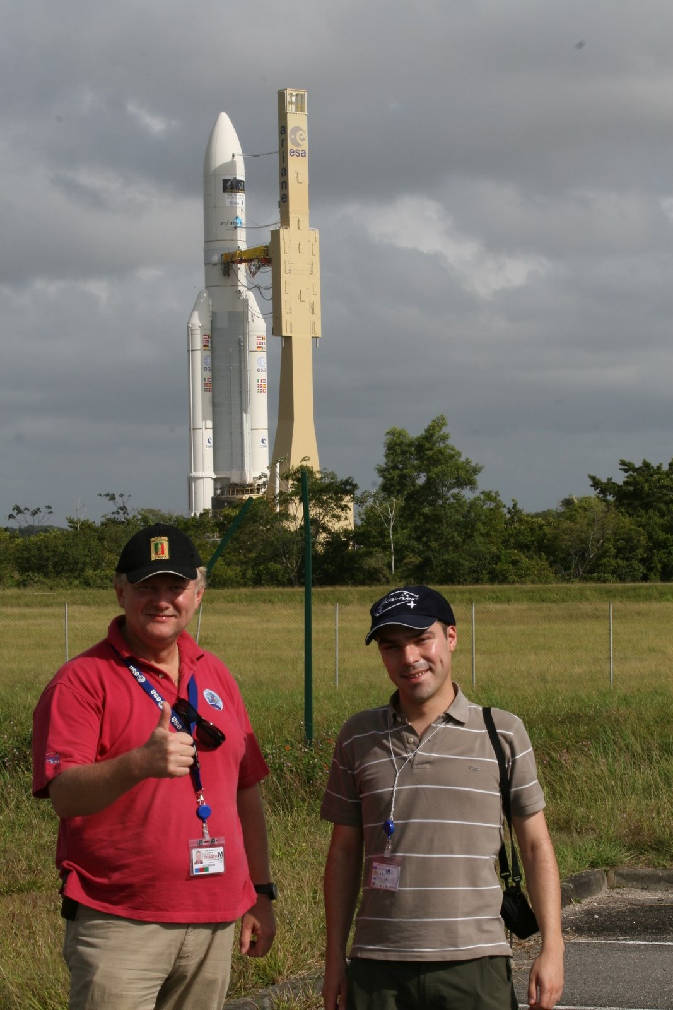
SATURN V
ARIANE 5
SWITCH TO SPACE 2 • 2020
Notes:
Allemaal mogelijk als Belgische ruimtevaart-ingenieur

Slide 6
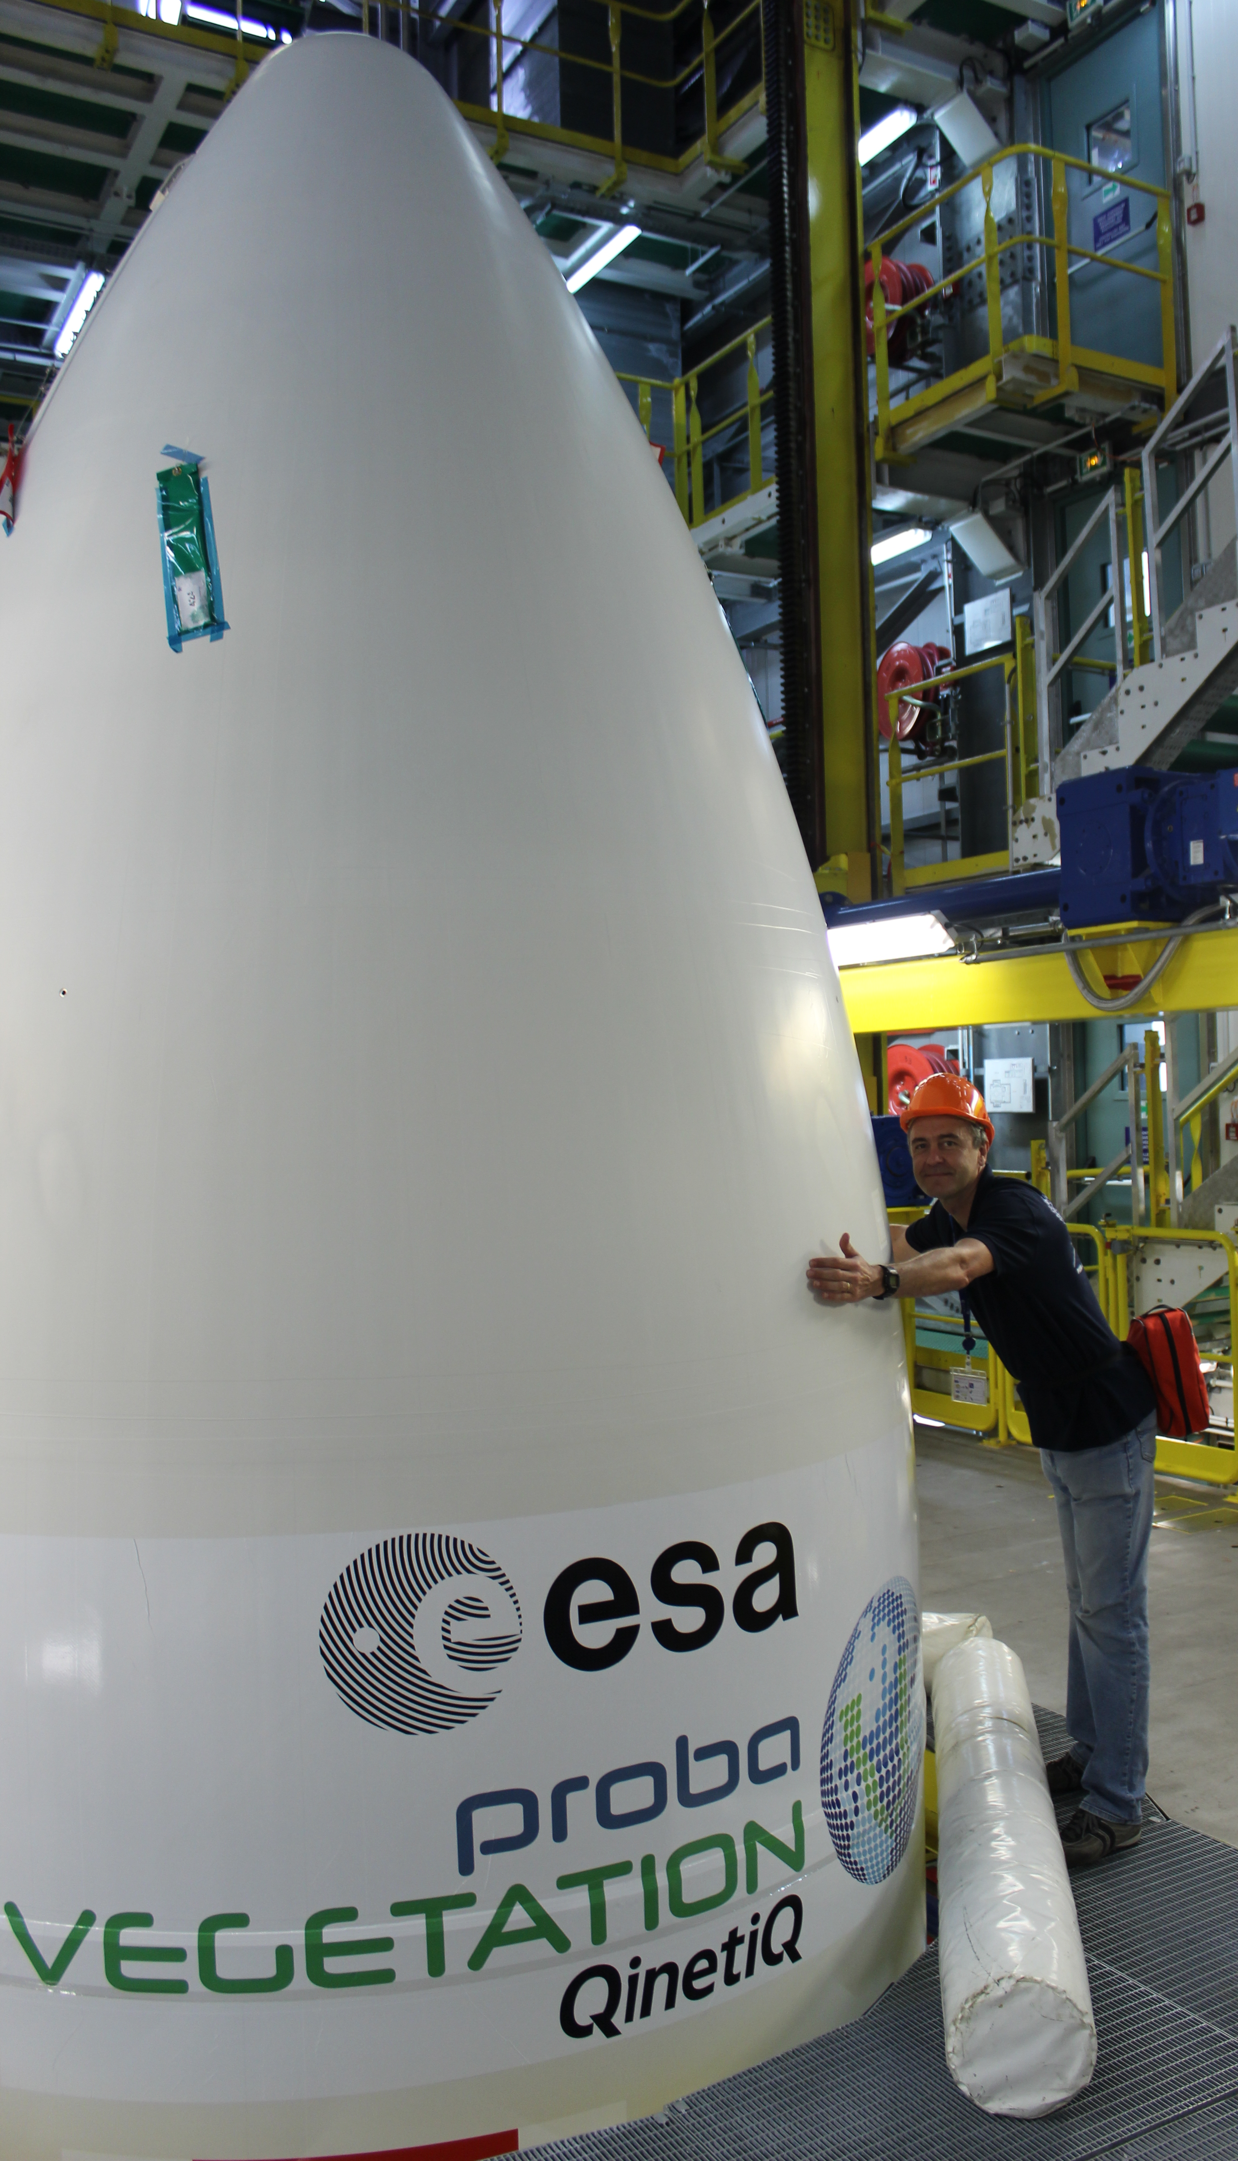
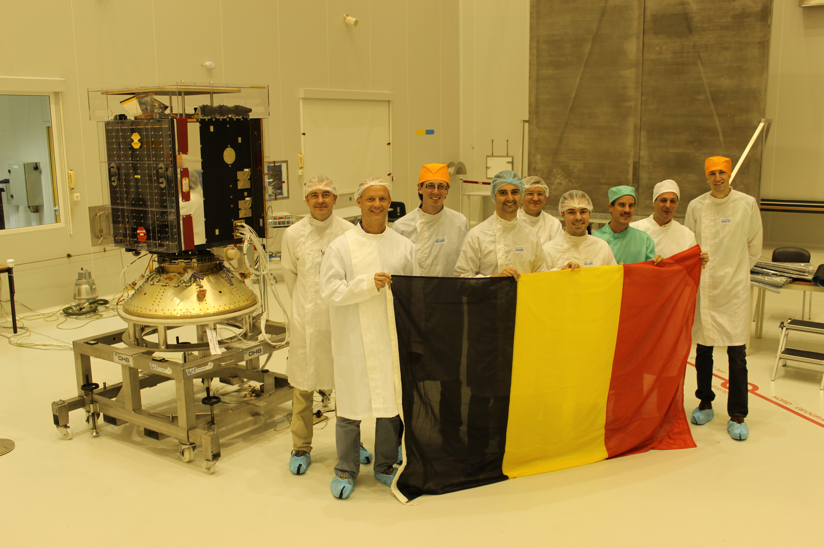
Working on a dream
Foto met Belgische vlag in Kourou
SWITCH TO SPACE 2 • 2020
Notes:
Allemaal mogelijk als Belgische ruimtevaart-ingenieur

Slide 7
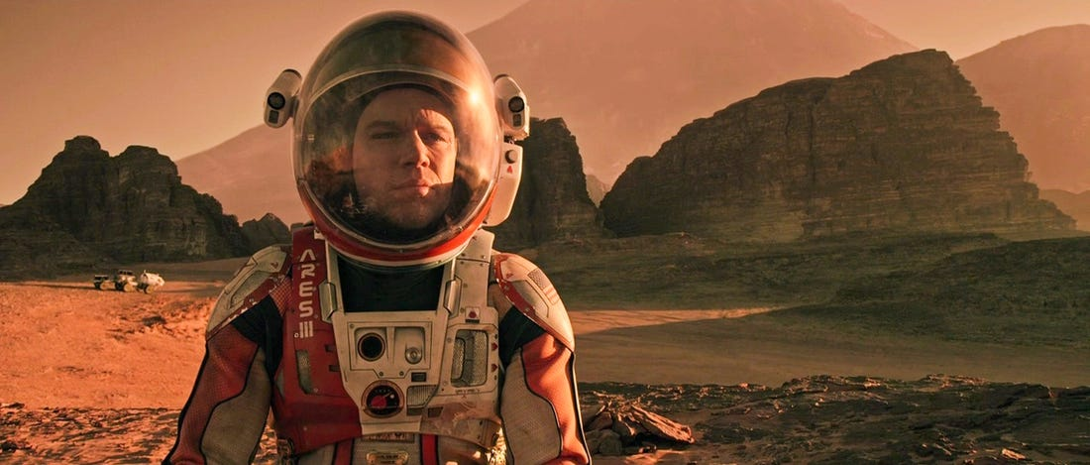
I need water
I need to get back home
I need to exercise
I need food
I need pictures from home
SWITCH TO SPACE 2 • 2020
Notes:
Allemaal mogelijk als Belgische ruimtevaart-ingenieur

Slide 8
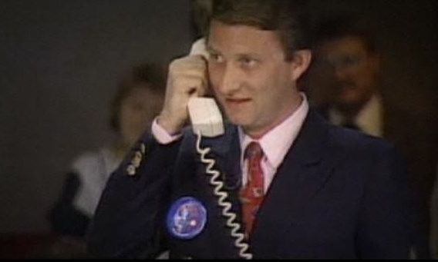
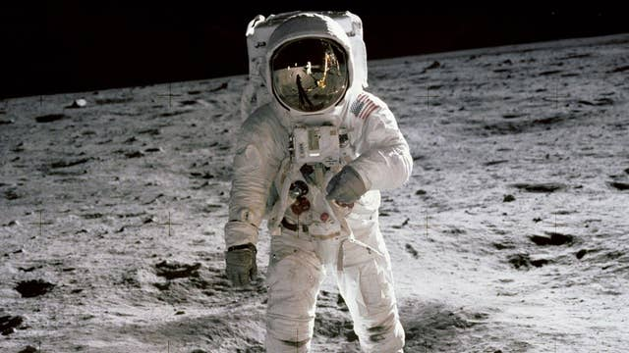
I need water
4500 liter per year!
Do not worry! QinetiQ Space has a water treatment allowing recycling of my … euh … you know
How much water do you need?
So much? That costs 1600 Million Euro per year, just to launch it and get it onto the Moon!
SWITCH TO SPACE 2 • 2020

Slide 9
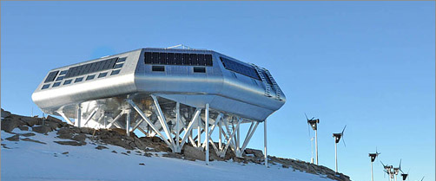
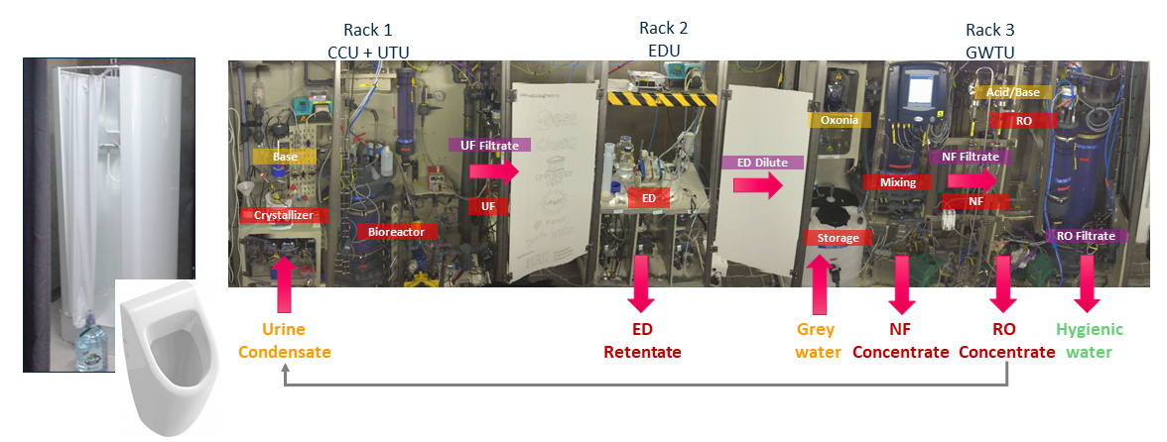
I need water
Your text, your text, your text
Your text, your text, your text
Place to your
image
SWITCH TO SPACE 2 • 2020

Slide 10
I need exercise
Your text, your text, your text
Your text, your text, your text
Place to your
image
SWITCH TO SPACE 2 • 2020

Slide 11
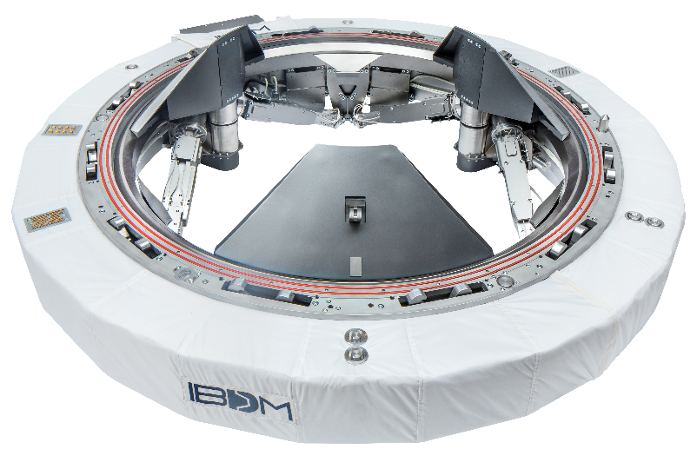
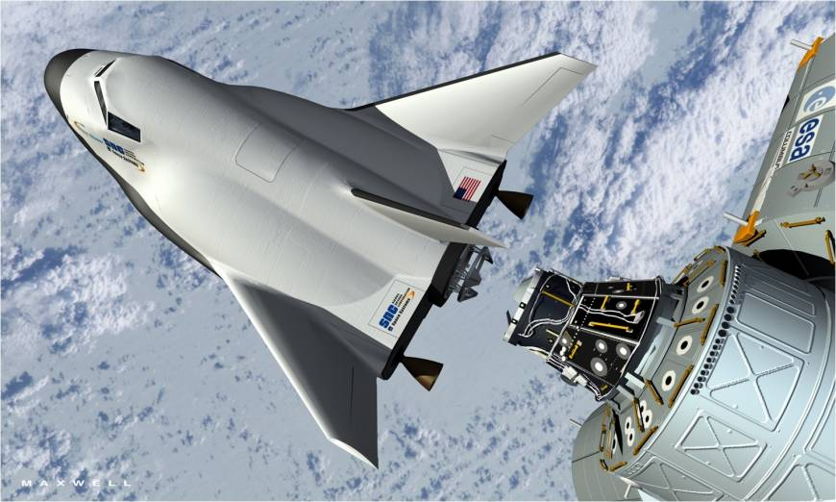
I need to get back home
Your text, your text, your text
Your text, your text, your text
Place to your
image
SWITCH TO SPACE 2 • 2020
One docking ring to rule them all

Slide 12
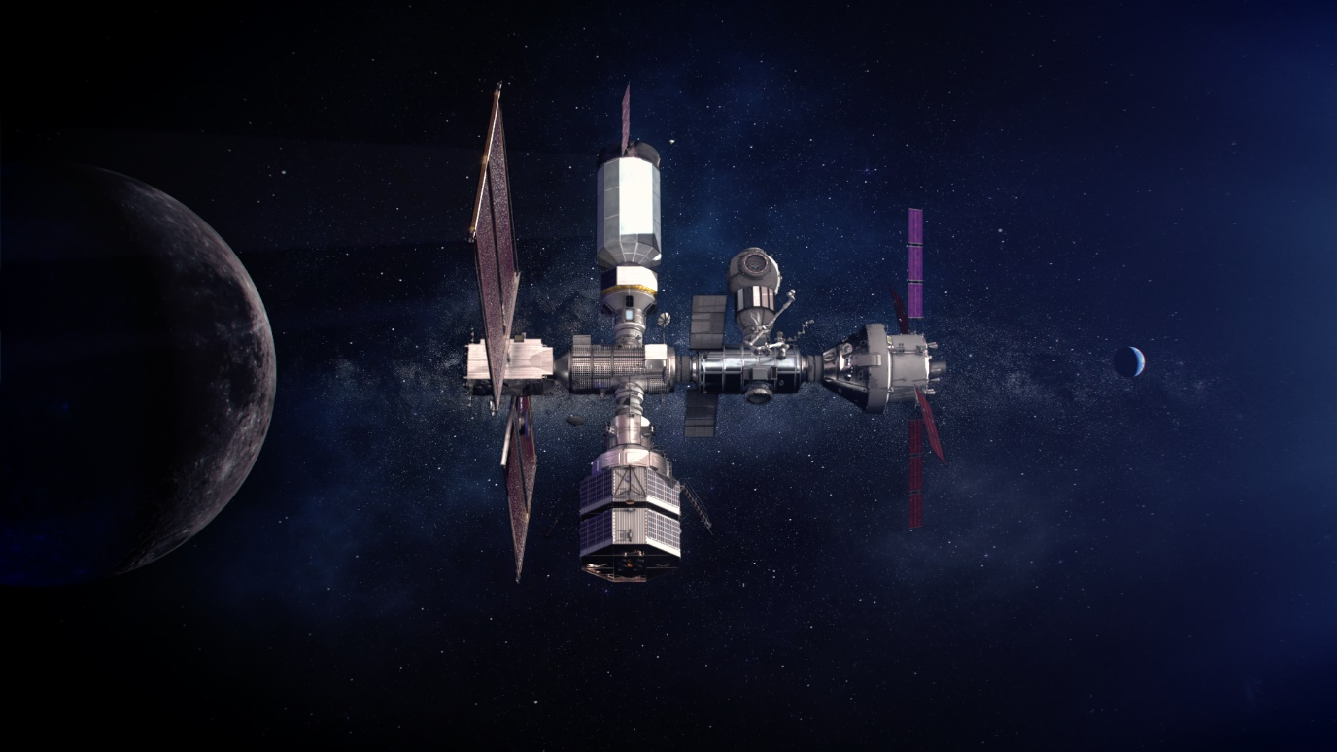
I need to get back home
Your text, your text, your text
Your text, your text, your text
Place to your
image
Gateway around the Moon
SWITCH TO SPACE 2 • 2020

Slide 13
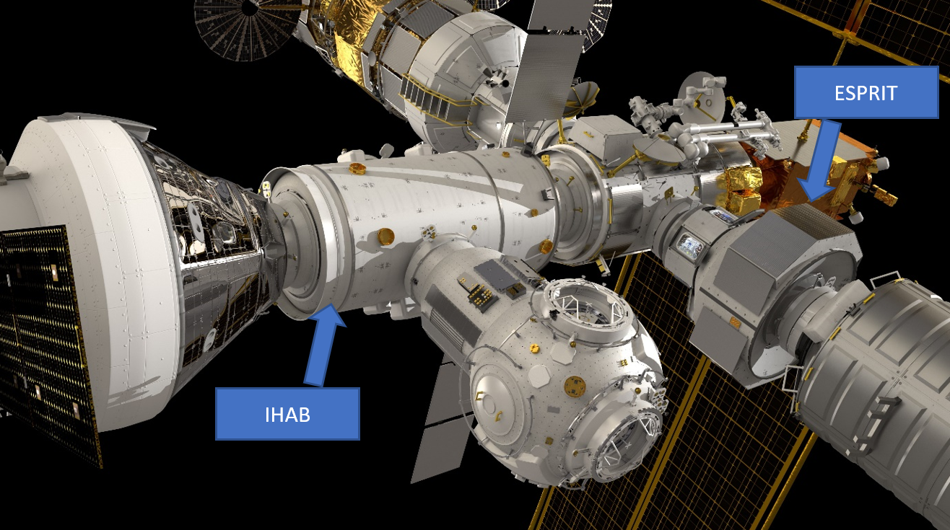
I need to get back home
Your text, your text, your text
Your text, your text, your text
IBDM on at least the 2 European modules
SWITCH TO SPACE 2 • 2020

Slide 14
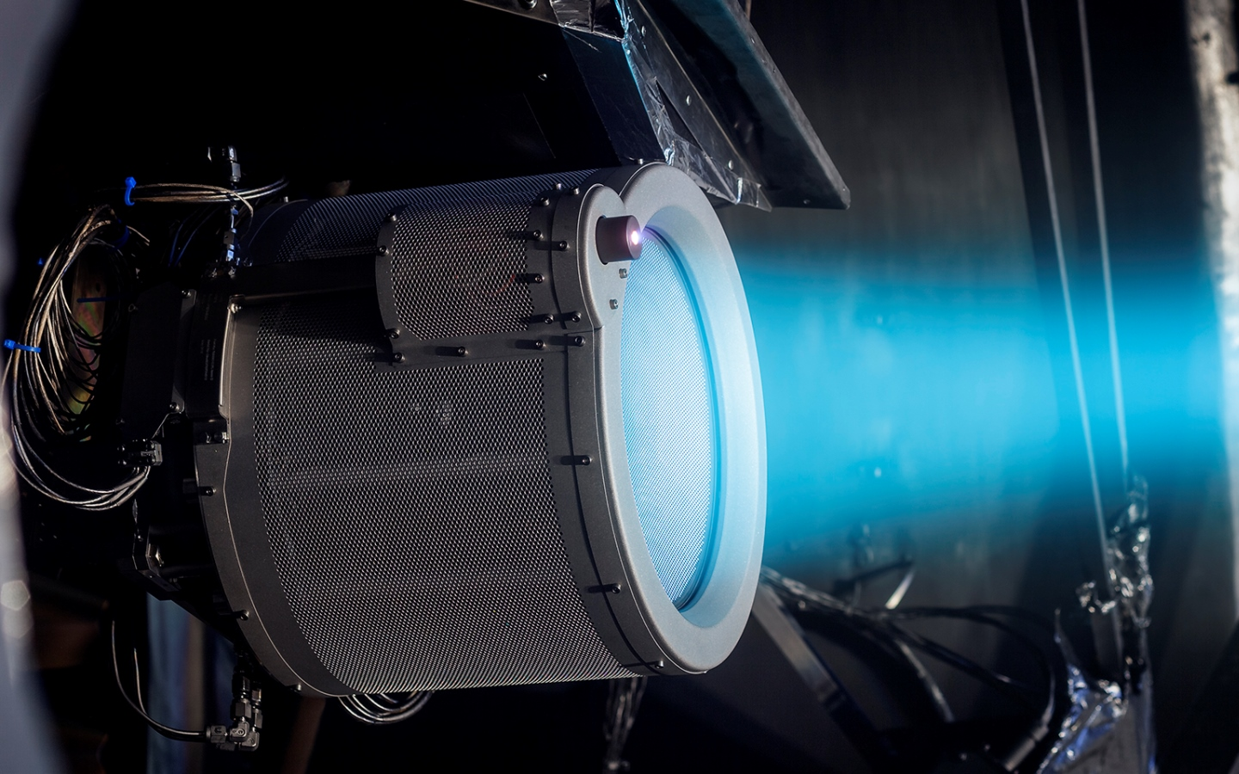
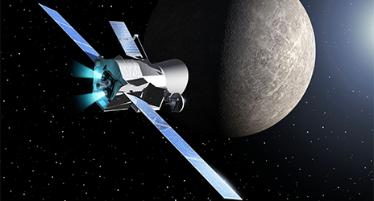
I need to get back home
Your text, your text, your text
Your text, your text, your text
Ion thrusters
On road to Mercury
SWITCH TO SPACE 2 • 2020

Slide 15
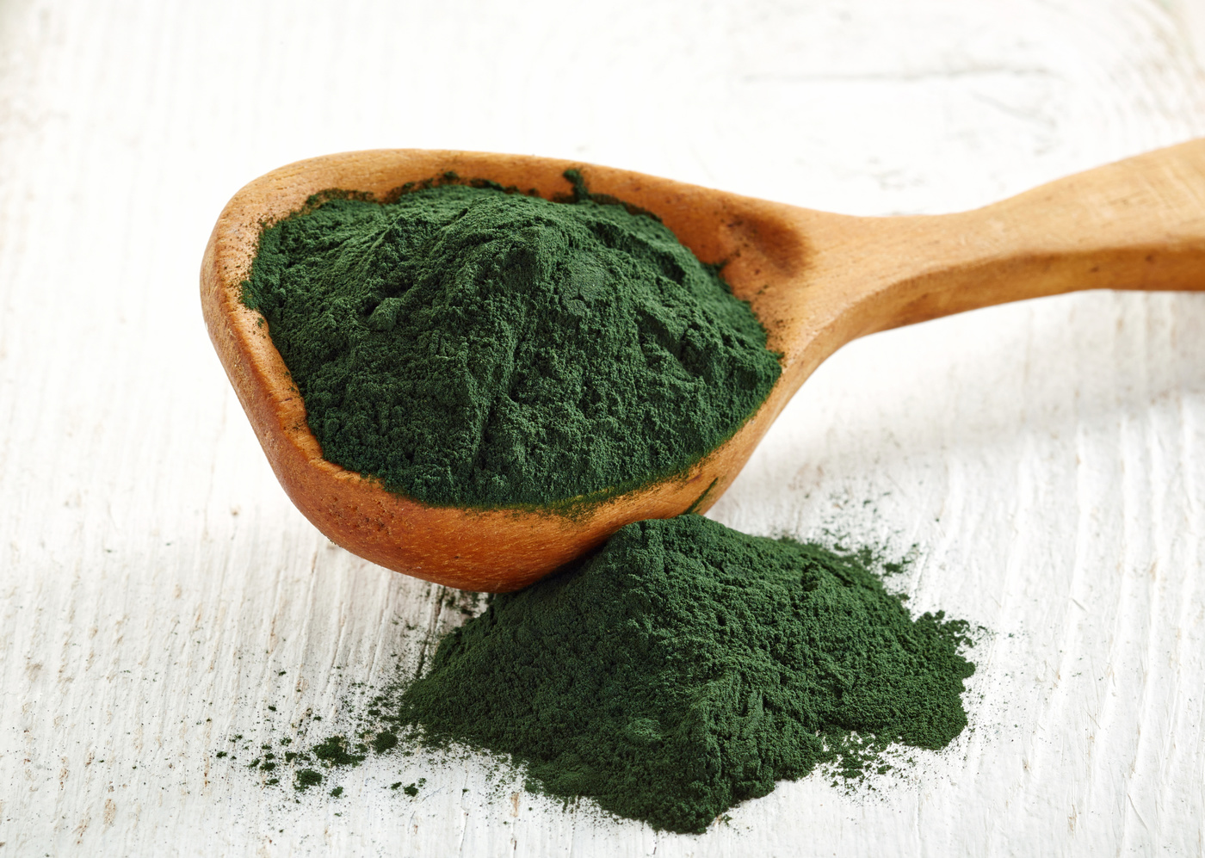
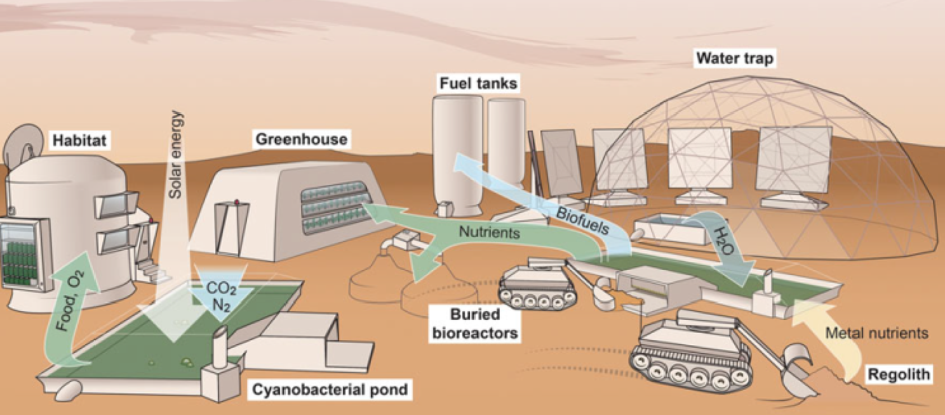
I need food
Your text, your text, your text
Your text, your text, your text
Spirulina
SWITCH TO SPACE 2 • 2020

Slide 16
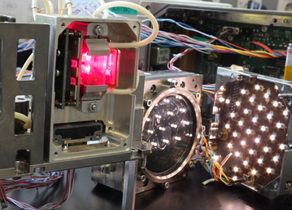
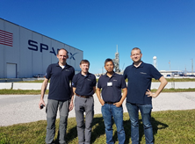
I need food
Your text, your text, your text
Your text, your text, your text
SWITCH TO SPACE 2 • 2020

Slide 17
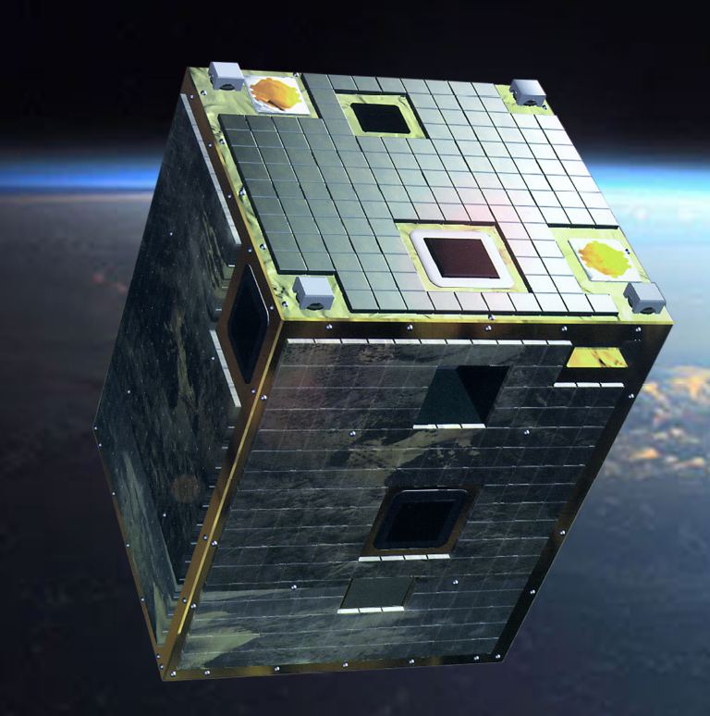
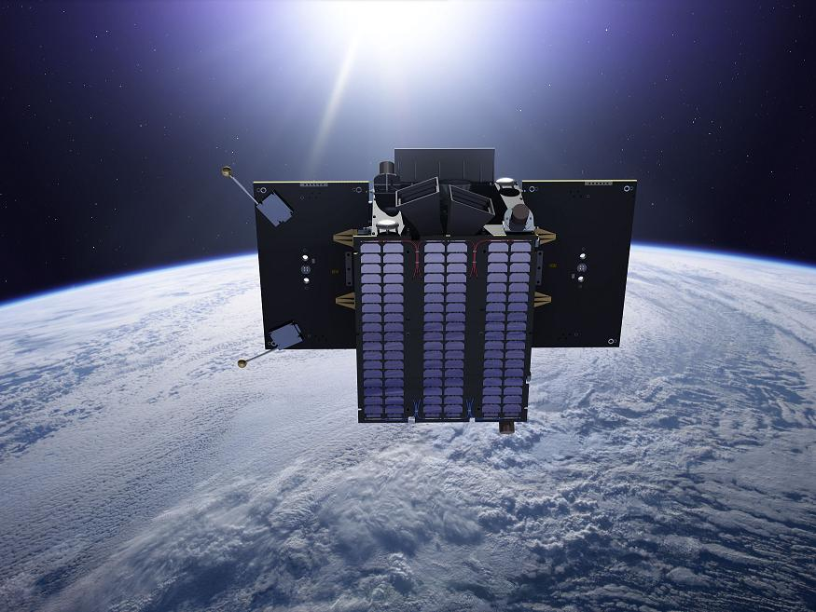
I need pictures from home
PROBA satellites
2001
2009
2013
SWITCH TO SPACE 2 • 2020

Slide 18
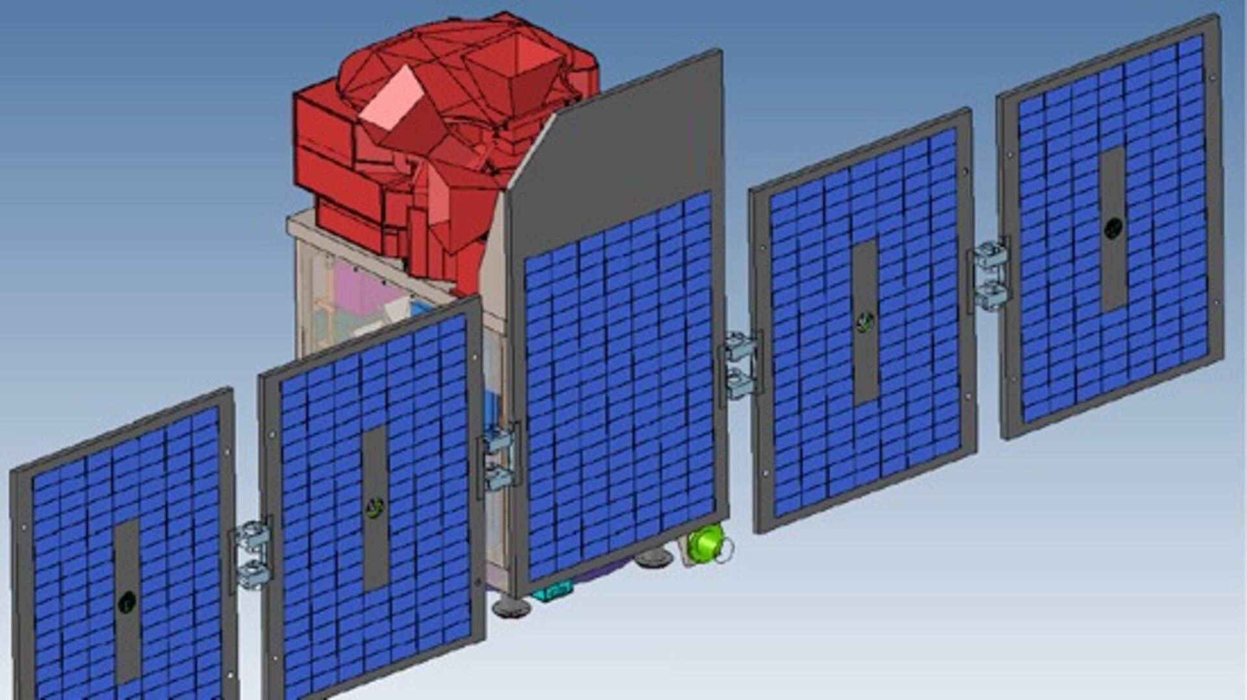
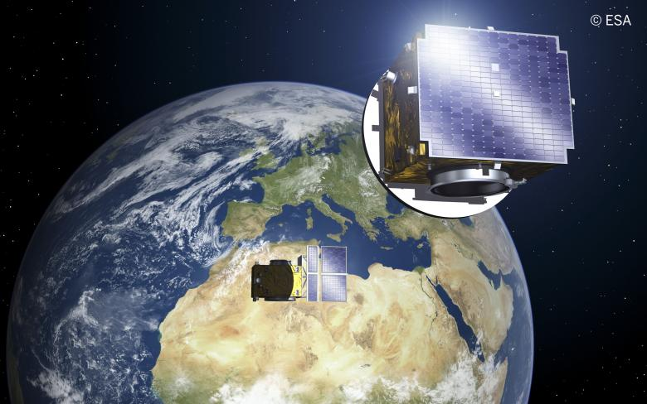
I need pictures from home
Upcoming satellites
HERA
ALTIUS
PROBA-3
SWITCH TO SPACE 2 • 2020

Slide 19
Be a rocket!
Follow
Your
Dream
qinetiqspace.talentfinder.be
Satellite Electronics Engineer
Lead System Engineer
Optical Engineer
Project Managers
Test Engineer
Thermal and Structural Engineer
SWITCH TO SPACE 2 • 2020

