Slide 1
WRC 2019: New Radiofrequencies Management for Short Duration Missions
#switchtospace, 5/10/2020
Michaël Vandroogenbroek
BIPT

Slide 2
Outline
BIPT
Frequency coordination
ITU/Coordination
Short duration missions
WRC-19
Belgian Institute for Postal services and Telecommunications

Slide 3
BIPT
Belgian Institute for Postal services and Telecommunications

Slide 4
^{What is BIPT?}
BIPT = Belgian Institute for Postal Services and Telecommunications
BIPT is the national regulatory body responsible for:
the electronic communications market
the postal market
the electromagnetic spectrum of radio frequencies

Slide 5
Frequency coordination
Belgian Institute for Postal services and Telecommunications

Slide 6
^{Frequency coordination}
Goal of frequency coordination: interference-free operation
Example of application | Distance of coordination | International coordination?
WiFi | Up to 200 meters | Not required
4G base station | Up to 20 kilometers | With neighbouring countries
DTT transmitter | Up to 150 kilometers
Non-GSO satellite | All the World | With all countries

Slide 7
ITU/Coordination
Belgian Institute for Postal services and Telecommunications

Slide 8
International Telecommunication Union (ITU)
ITU is the UN specialized agency for ICTs (193 Member States)
Role of the ITU :
Allocation of global radio spectrum and satellite orbits
Development of technical standards
Improvement of access to ICTs to underserved communities worldwide

Slide 9
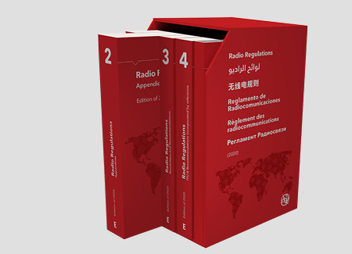
ITU Radio Regulations (RR)
Intergovernmental treaty governing the use of spectrum/orbit resources
Define the rights and obligations of Member States in respect of the use of these resources
Updated every 4 years by World Radiocommunication Conferences (WRC)
Last WRC in 2019 (WRC-19)

Slide 10
Coordination and notification procedures for satellites
2 coordination approaches in the RR
Satellite networks not subject to the full coordination procedure | Satellite networks subject to the full coordination procedure
Advanced Publication Information (publication of the general description of the planned satellite network) No examination Notification Recording in Master Register (Bringing into use) | Coordination (publication of the detailed description of the planned satellite network) Examination Obligatory negotiation Notification Recording in Master Register (Bringing into use)

Slide 11
Short duration missions
Belgian Institute for Postal services and Telecommunications

Slide 12
^{Satellite applications}
Fixed Earth stations Mobile Earth stations Satellite broadcasting Satellite navigation systems Aeronautical satcoms Meteorological satcoms Earth exploration-satellite | Space operations Space research Amateur-satellite Military satellite systems

Slide 13
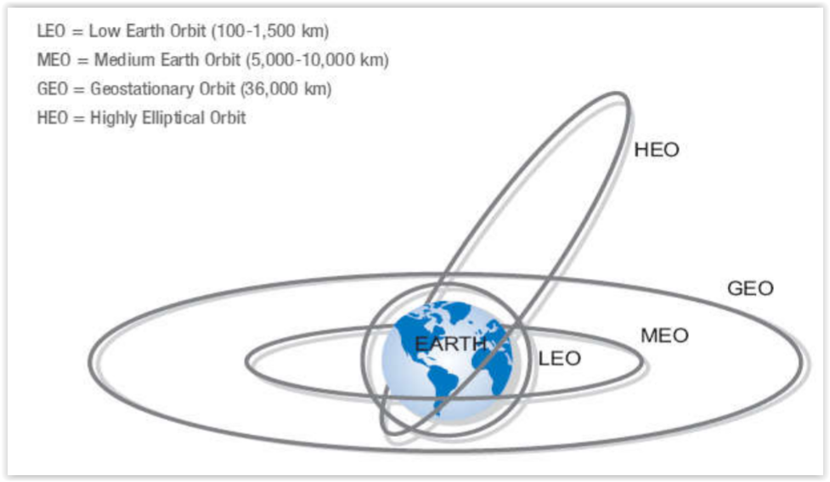
^{Satellite orbits}
Source: http://www.journalcra.com/sites/default/files/issue-pdf/24387.pdf

Slide 14
^{Short duration missions}
Issue: growing spectrum needs for telemetry, tracking and command for satellites with short duration missions (Cubesat)
Short duration: < 3 years
Short duration missions are typically composed of small non-GSO satellites
Wide variety of applications, but one common need which is Telemetry, Tracking and Command (TT&C)
Non-GSO satellites were subject to the coordination procedure for most of the frequencies below 1 GHz
Need of regulatory procedures which take account of the short development cycle, short lifetimes and typical missions of short duration missions

Slide 15
WRC-19
Belgian Institute for Postal services and Telecommunications

Slide 16
Modifications adopted by WRC-19
Identification of the bands 137-138 MHz (space-to-earth) and 148-149.9 MHz (earth-to-space) for short duration missions
Away from amateur allocations
Simplified regulatory regime for non GSO satellite systems with short duration missions:
no full coordination procedure for the band 148-149.9 MHz
no full coordination procedure for the band 137-138 MHz if the PFD threshold is not exceeded
No Change for all other bands than 137-138 MHz and 148-149.9 MHz
Criteria:
the maximum period of operation and validity of frequency assignments shall not exceed three years from the date of bringing into use of the frequency assignments
the total number of satellites shall not exceed 10 satellites

Slide 17
Thank You For Your Attention
Michaël Vandroogenbroek
E-mail: michael.vandroogenbroek@bipt.be

